Slide 1
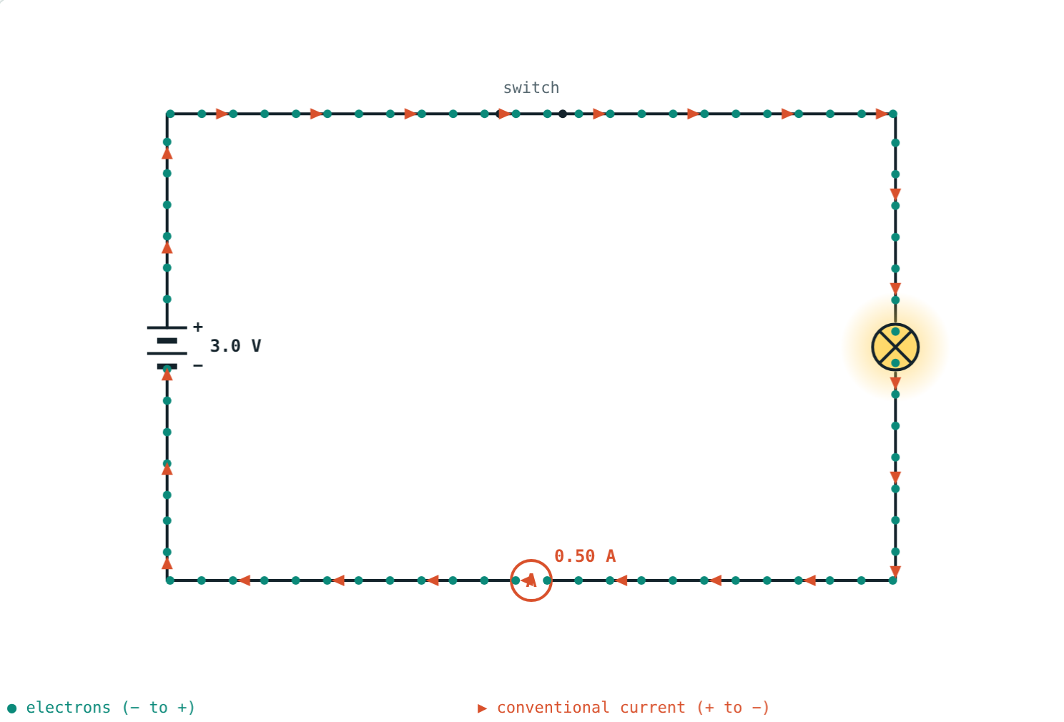
Current and Potential Difference
STD 9 SCIENCE · CH. 3 CURRENT ELECTRICITY
Lesson 1 · Visual Science & Maths
Notes:
Goal: students can define potential difference (V = W/Q) and current (I = Q/t), use volts, amperes and coulombs, and tell electron flow from conventional current.

Slide 2
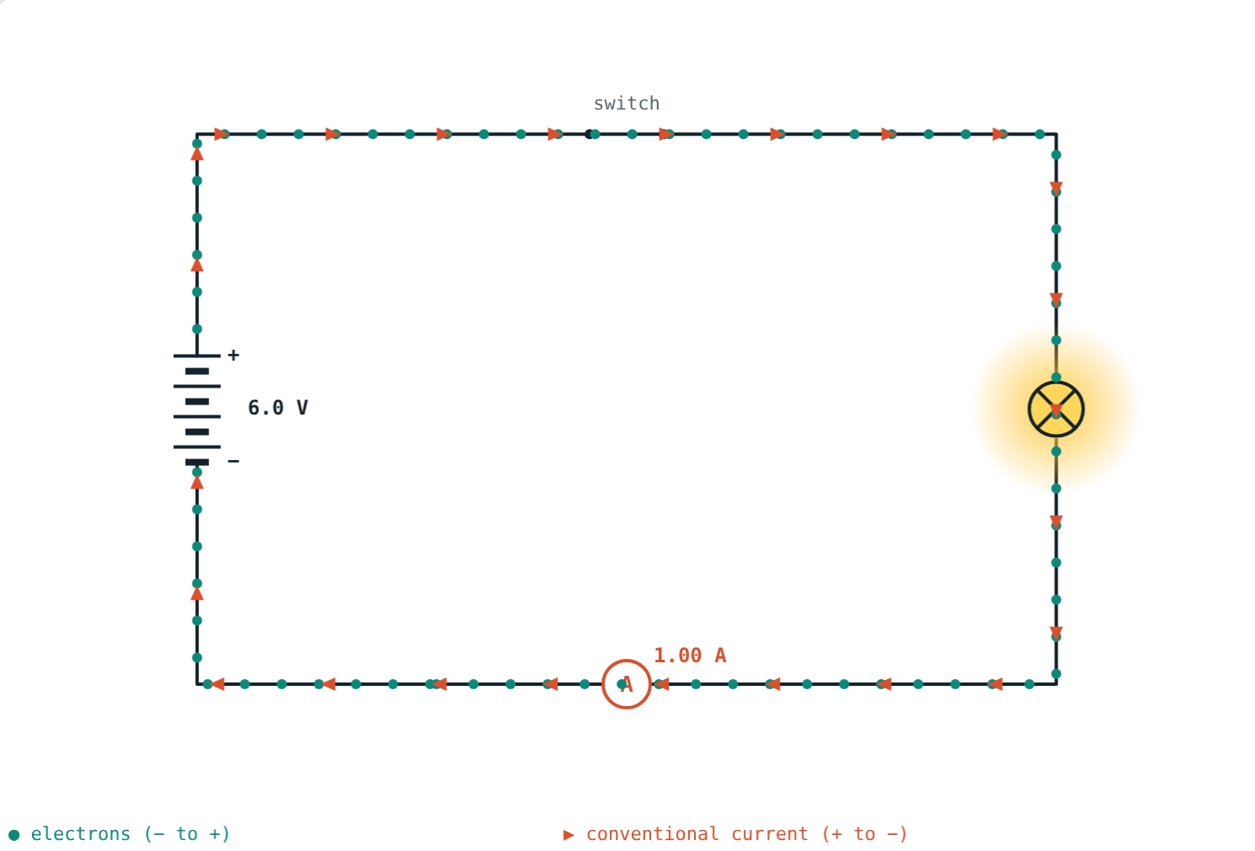
What makes a bulb light?
Flick a switch and the bulb lights at once, yet electrons only drift slowly through the wire.
What pushes them, and how do we measure their flow?
Teal dots: electrons. Coral arrows: conventional current
Notes:
The whole wire is already full of free electrons; the cell pushes them all at once, like water in a full pipe.

Slide 3
Electric charge
e = 1.6 × 10⁻¹⁹ C
Electrons carry negative charge
Unit of charge: coulomb (C)
1 C = charge of about 6.25 × 10¹⁸ electrons
Metals have free electrons that can move
Free electrons drifting round the circuit
Notes:
Free electrons are the outermost electrons of metal atoms, only weakly held.

Slide 4
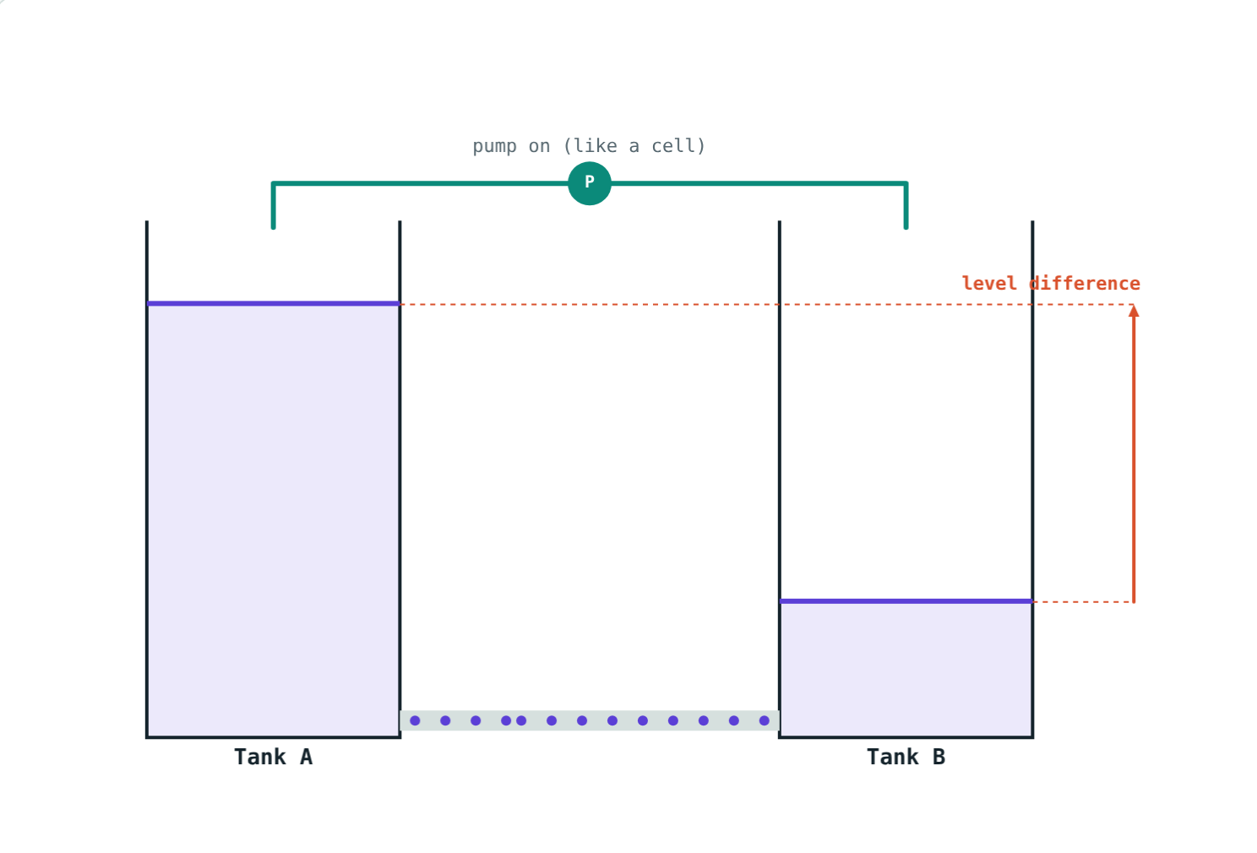
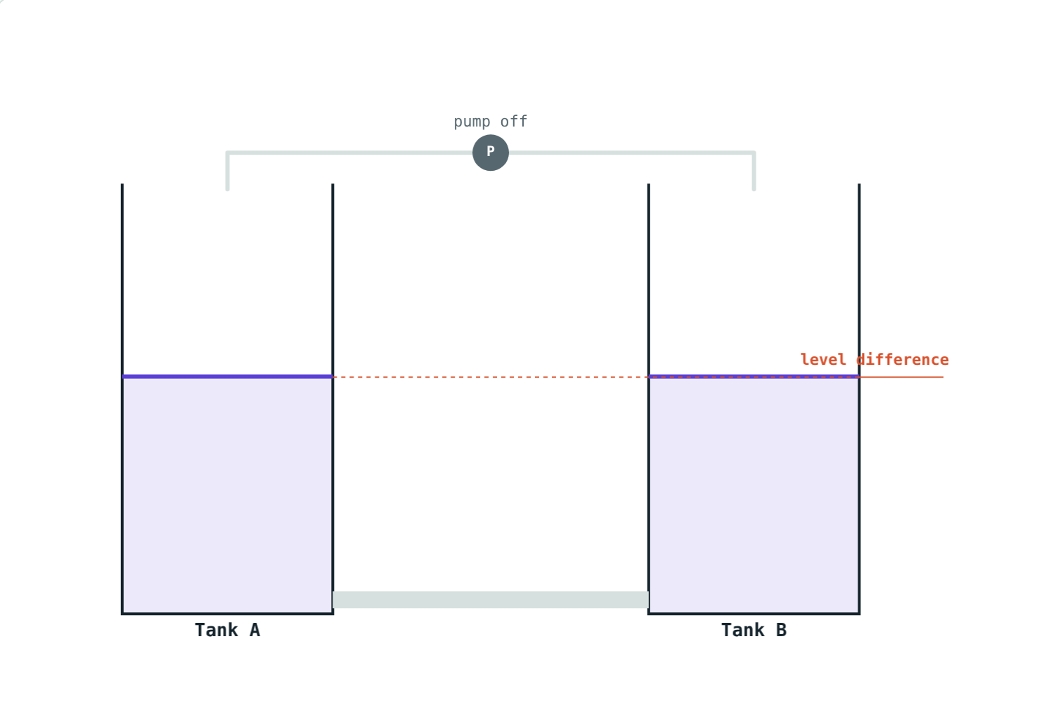
Potential difference: the water analogy
A level difference keeps water flowing, like a cell keeps current flowing.
Equal levels: no flow. No potential difference: no current.
Notes:
This mirrors the textbook activity with two bottles joined by a tube.

Slide 5
Potential difference
V = W ÷ Q
Work done to carry unit positive charge between two points
Unit: volt (V) = 1 J/C
1 mV = 10⁻³ V, 1 kV = 10³ V
A cell keeps a potential difference between its terminals
Four cells: 6 V
Notes:
Measure it with a voltmeter joined in parallel.

Slide 6
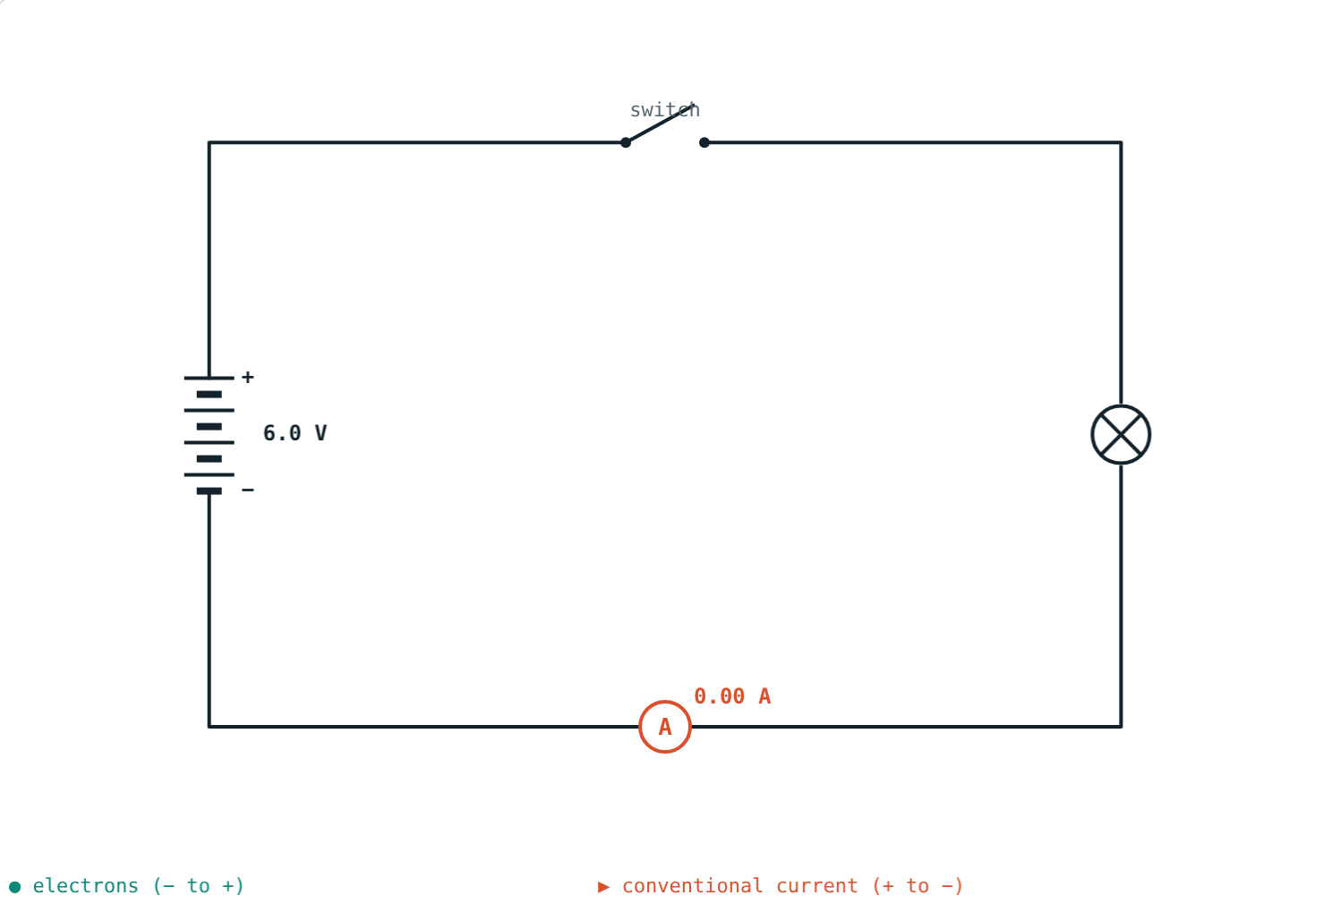
Electric current
I = Q ÷ t
Charge passing per unit time
Unit: ampere (A) = 1 C/s
1 mA = 10⁻³ A, 1 µA = 10⁻⁶ A
Measured with an ammeter joined in series
Switch open: no complete path, no current
Notes:
A current needs both a potential difference and a complete circuit.

Slide 7
Which way does current flow?
− → +
+ → −
Why?
Electrons
Conventional current
History
Drift from the negative terminal, round the circuit, to the positive terminal.
Taken from positive to negative, opposite to the electrons.
The convention was fixed before electrons were discovered.
Notes:
Circuit diagrams and rules always use conventional current.

Slide 8
Worked examples
Charge from current
Potential difference
0.3 A flows through a torch bulb for 10 minutes. Find the charge.
12 J of work moves 4 C between two points. Find the potential difference.
t = 600 s
Q = 0.3 × 600 = 180 C
V = 12 ÷ 4 = 3 V
Notes:
Always convert minutes to seconds first.

Slide 9
Worked example: counting electrons
How many electrons make up 1 C? How many pass each second when the current is 2 A?
1 ÷ (1.6 × 10⁻¹⁹) = 6.25 × 10¹⁸
2 × 6.25 × 10¹⁸ = 1.25 × 10¹⁹ per second
1 A: 6.25 × 10¹⁸ electrons pass every second
Notes:
Huge numbers of electrons move, each carrying a tiny charge.

Slide 10

Common mistakes
Minutes in I = Q/t
Current vs potential difference
Use seconds.
Volts push; amperes flow.
Electrons go + to −
Ammeter across a bulb
Electrons go − to +.
Ammeter in series, voltmeter in parallel.
Notes:
Meter connection errors are common in practical exams.

Slide 11
Quick check
1
60 C passes through a wire in 2 minutes. Find the current.
2
Write 1 volt in terms of joules and coulombs.
3
Which way does conventional current flow outside a cell?
4
How is a voltmeter connected to measure the potential difference across a bulb?
Notes:
Answers: 1) 0.5 A. 2) 1 V = 1 J/C. 3) From + to −. 4) In parallel, across the bulb.

Slide 12
Count the charge yourself
Open the Current and Potential Difference lesson on the Visual Science & Maths website. Add cells, open the switch, and try the water analogy.
Next lesson: Resistance and Ohm's law
Notes:
Homework idea: read the voltage printed on five batteries or chargers at home.

