Slide 1
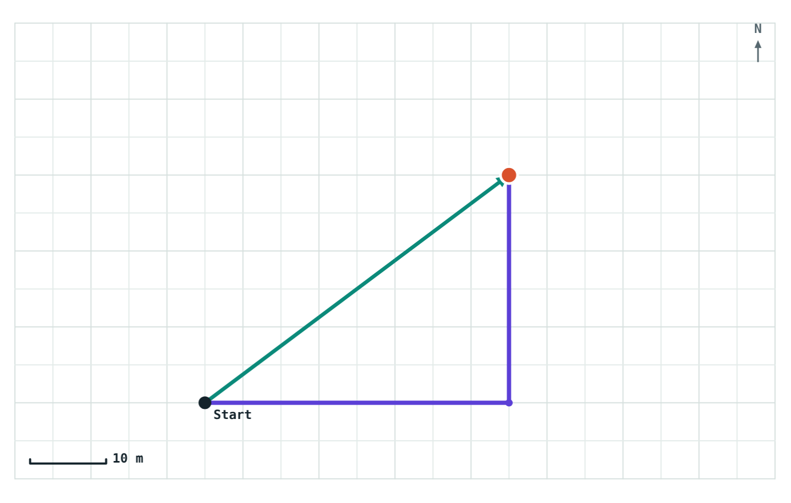
Distance and Displacement
STD 9 SCIENCE · CH. 1 LAWS OF MOTION
Lesson 1 · Visual Science & Maths
Notes:
Lesson 1 of Chapter 1. Goal: students can tell distance from displacement, calculate both for simple routes, and give displacement with a direction.

Slide 2
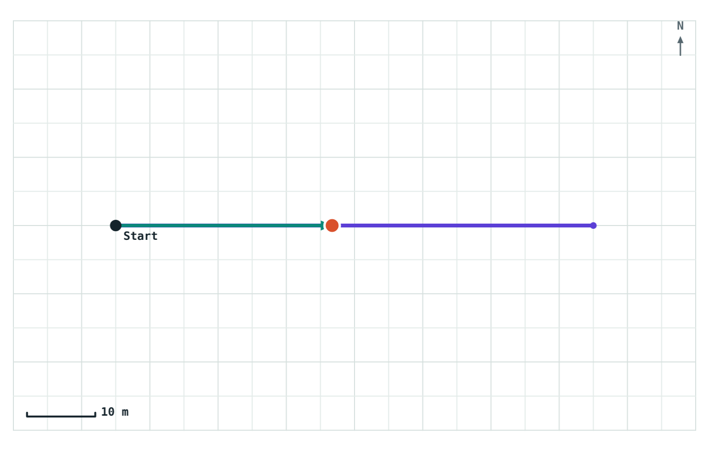
How far did you really go?
Walk 70 m east along a road, then turn around and head back. Part of the way home, two different numbers describe your trip:
108 m
walked along the road
32 m
east of where you started
Violet: path walked. Teal arrow: start to walker.
Notes:
Ask: how far did this person go? Let students argue. Some will say 108 m, some 32 m. Both are right; they are answering different questions. Today we name the two quantities.

Slide 3


Motion depends on the reference point
An object is in motion when its position changes with respect to its surroundings. We judge this against a fixed point called the reference point.
A passenger sits still in a moving bus.
Compared with the seat in front
Compared with a tree outside
AT REST
IN MOTION
Notes:
The same passenger is both at rest and in motion. There is no contradiction once we say what we are comparing with. Ask for another example: a person on an escalator, a sleeping passenger on a plane.

Slide 4
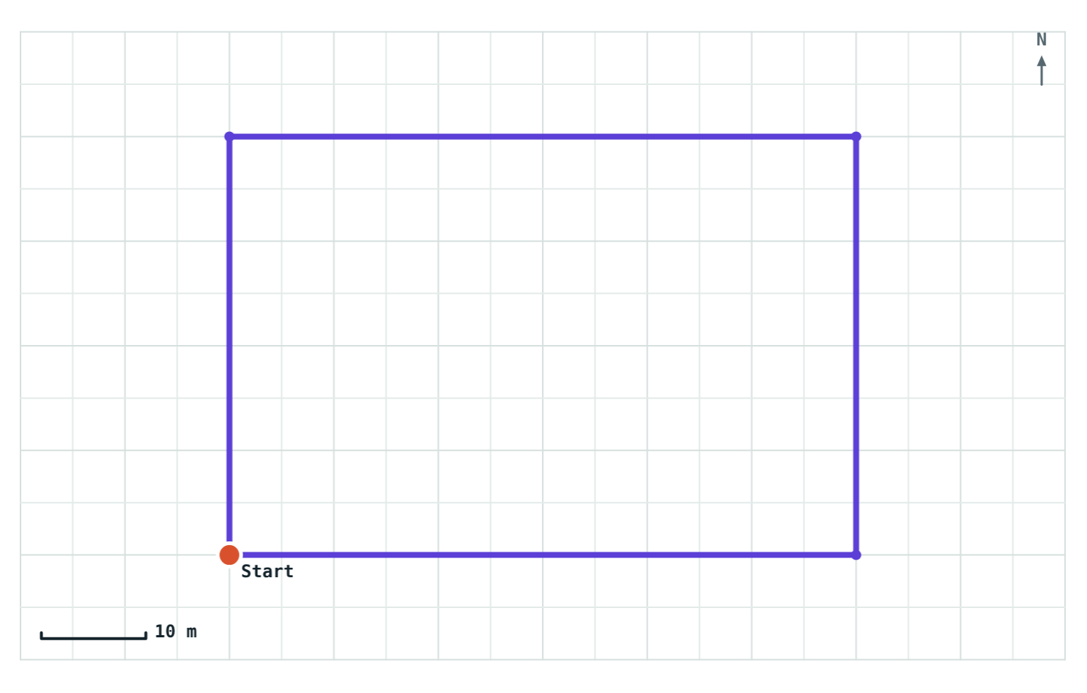
Distance: the length of the path
The total length of the path actually travelled
Has size only, no direction: a scalar
Every step adds to it, so it never decreases
Measured in metres (m)
One lap of a 60 m × 40 m park: distance = 200 m
Notes:
Point out the violet line: that is the distance. 60 + 40 + 60 + 40 = 200 m. Ask: where did the walker finish? Back at the start. Keep that in mind for the next slide.

Slide 5
Displacement: start to finish
The minimum distance between the starting and finishing points, in a straight line
Has size and direction: a vector
Ignores the route taken in between
Can be zero, even after a long walk
Measured in metres (m)
40 m east, then 30 m north: displacement 50 m, 37° north of east
Notes:
The teal arrow is the displacement. It goes straight from Start to the walker, cutting the corner. Ask: in the park lap from the previous slide, what was the displacement? Zero, because the walker ended at the start.

Slide 6
Distance or displacement?
 | Distance | Displacement
Meaning | Length of the actual path | Straight line from start to finish
Direction | Not included (scalar) | Included (vector)
Zero while moving? | No | Yes, after a round trip
Depends on the route? | Yes | No, only on start and end
Unit | metre (m) | metre (m)
Notes:
Use this as a summary students can copy. Cover one column and ask them to fill it in.

Slide 7
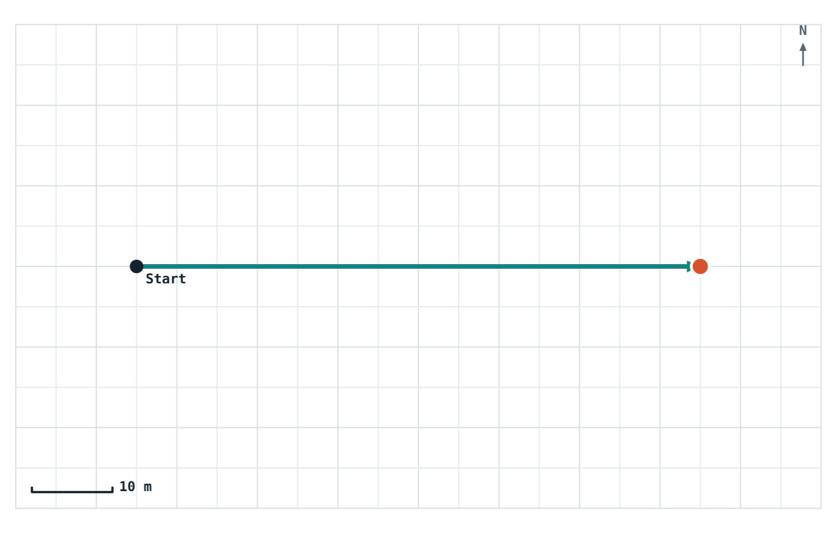
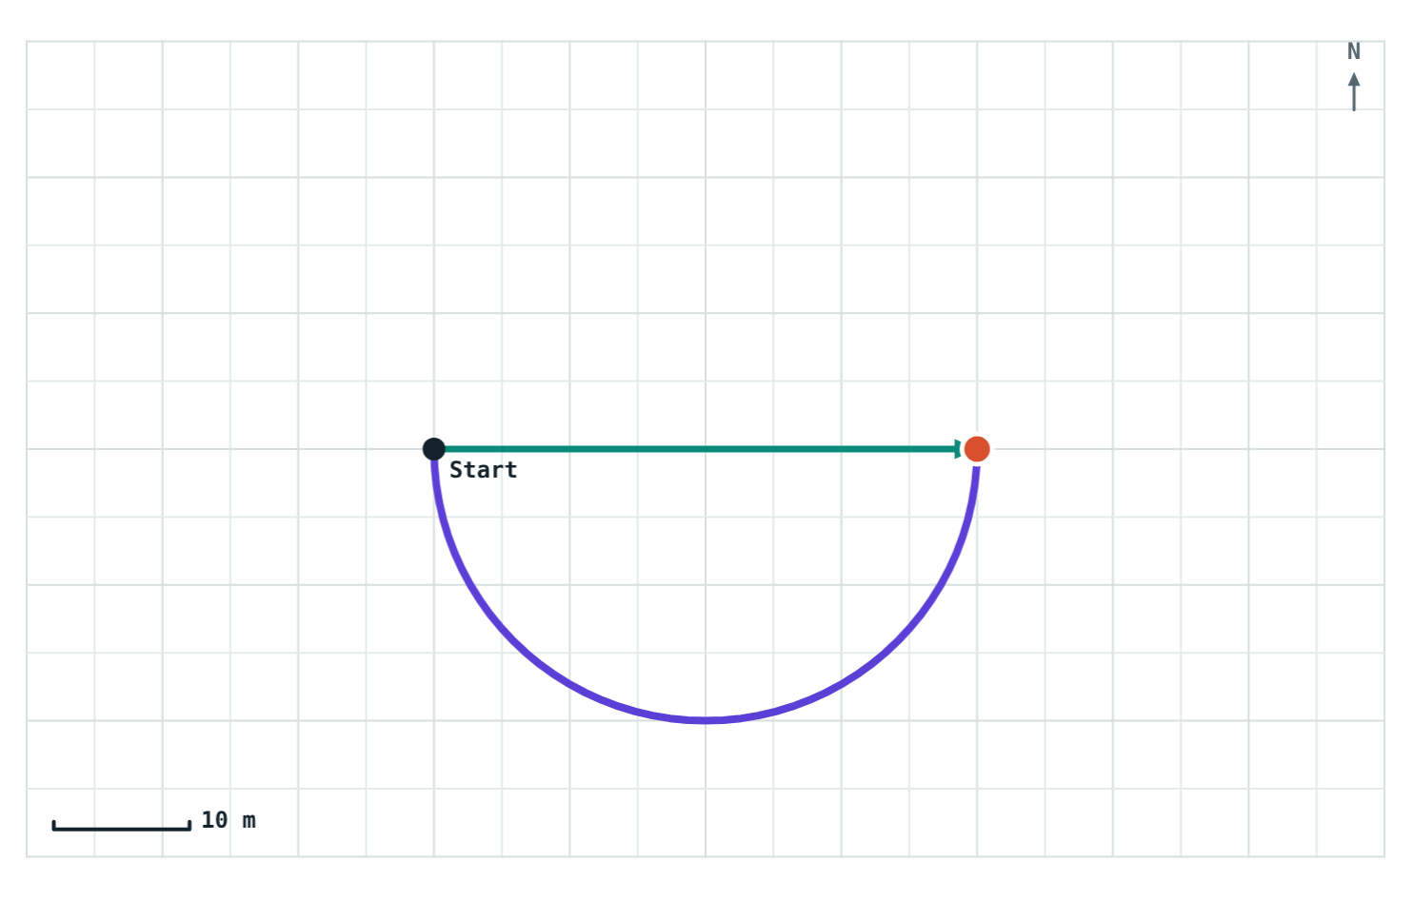
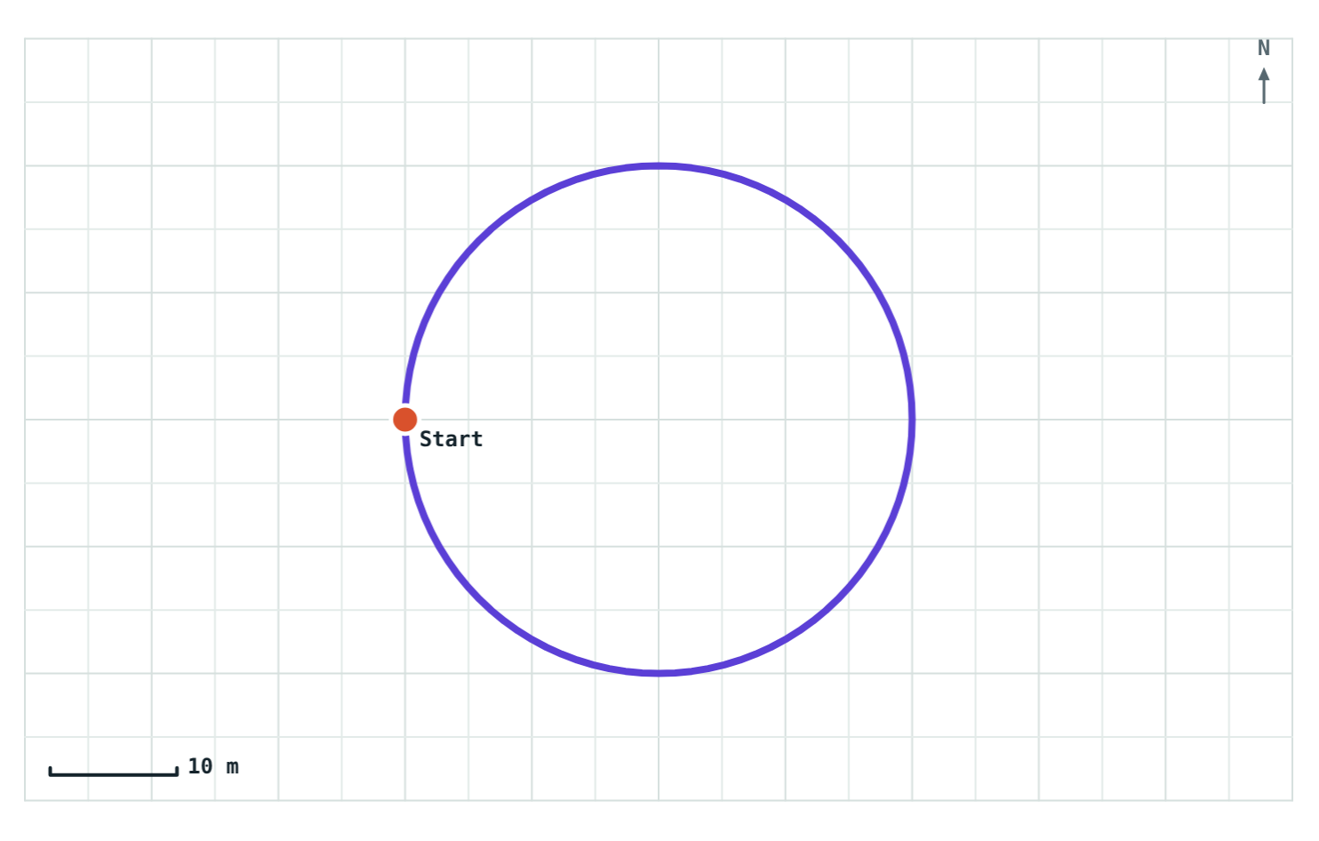
Displacement is never more than distance
Straight walk
Half lap, radius 20 m
Full lap
Distance 70 m
Displacement 70 m
Distance 62.8 m
Displacement 40 m
Distance 125.6 m
Displacement 0 m
Equal: no turns, no turning back
Displacement is the diameter
Back at the start
Notes:
A straight line is the shortest path between two points, so displacement can equal distance but never exceed it. They are equal only for a straight walk in one direction.

Slide 8
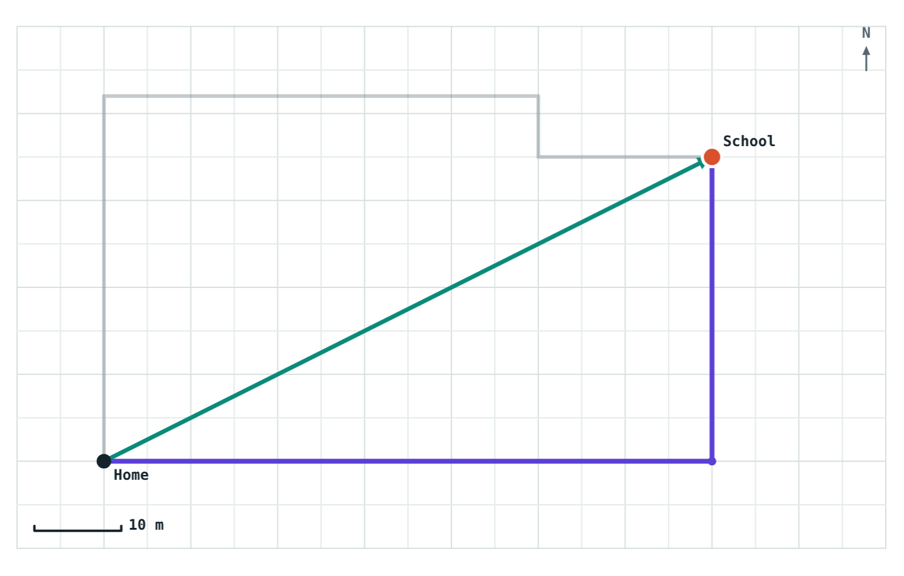
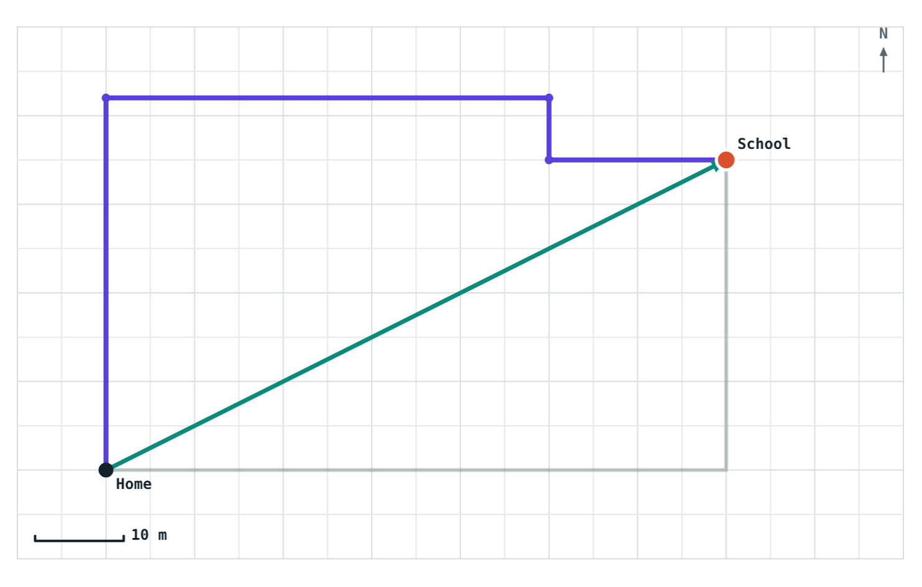
Two routes, one displacement
Route A Distance 105 m Displacement 78.3 m
Route B Distance 119 m Displacement 78.3 m
Same home, same school: the displacement is identical (78.3 m, 27° north of east) however you get there.
Notes:
This mirrors the textbook activity with two students taking different routes to school. Distance depends on the route; displacement depends only on where you start and finish. The faded line in each picture is the other route.

Slide 9
Worked example: going to the shop
Riya walks 40 m east and then 30 m north to reach a shop. Find the distance she walked and her displacement.
Distance
40 + 30 = 70 m
Displacement
√(40² + 30²) = √2500 = 50 m
Direction
tan θ = 30 / 40, so θ ≈ 37° north of east
Answer: 70 m; 50 m, 37° north of east
Notes:
The two legs make a right angle, so displacement comes from Pythagoras: a 3-4-5 triangle scaled by 10. Insist on the direction in the final answer.

Slide 10
Worked example: round the track
An athlete runs around a circular track of radius 50 m. Circumference = 2πr = 2 × 3.14 × 50 = 314 m.
After half a lap
157 m distance 100 m displacement
Directly across: displacement = diameter = 2r
After a full lap
314 m distance 0 m displacement
Back at the start
The same idea in the simulation, on a 20 m track
Notes:
Ask students to predict the displacement after a quarter lap: two radii at right angles, √(50² + 50²) ≈ 70.7 m.

Slide 11

Common mistakes
Leaving out the direction
Adding the legs
Zero means no motion
“50 m” is incomplete. Write “50 m, 37° north of east”.
40 m east + 30 m north is not 70 m of displacement. Draw the straight line.
A full lap is plenty of motion. Only the start and end points coincide.
Notes:
These three account for most lost marks on this topic.

Slide 12
Quick check
1
A car drives 5 km east, then 5 km west. Distance and displacement?
2
Which is a vector: distance, displacement or time?
3
Can displacement ever be larger than distance?
4
Is a student sitting in a moving train at rest or in motion?
Notes:
Answers: 1) Distance 10 km, displacement 0. 2) Displacement. 3) Never; a straight line is the shortest path. 4) Both: at rest compared with the train, in motion compared with the platform.

Slide 13
Walk your own routes
Open the Distance and Displacement lesson on the Visual Science & Maths website. Tap the map to draw any route and watch both numbers change.
Next lesson: Speed and velocity
Notes:
Homework idea: draw the route from home to school on squared paper, then measure both the distance and the displacement.

