Slide 1
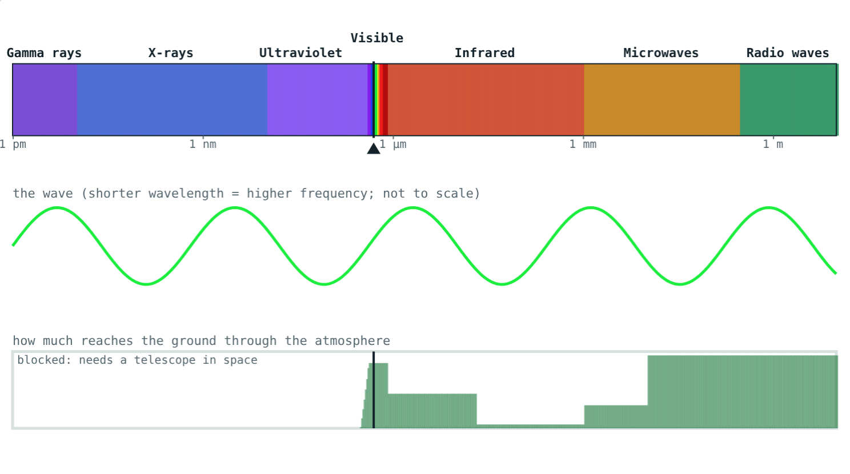
Light We Can and Cannot See
STD 9 SCIENCE · CH. 18 OBSERVING SPACE: TELESCOPES
Lesson 1 · Visual Science & Maths
Notes:
Goal: students can name the parts of the electromagnetic spectrum in order, use c = νλ, and say which radiation reaches the ground.

Slide 2
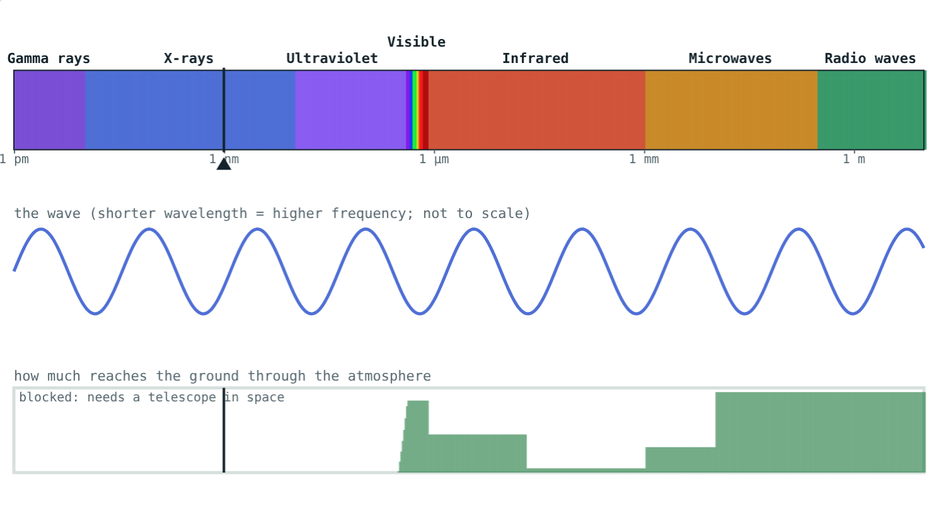
More than meets the eye
Our eyes see only a thin slice of the radiation that stars and galaxies send us.
What else is out there, and how do we detect it?
X-rays: invisible, and stopped by the air
Notes:
Ask students which invisible radiations they already know: X-rays at the hospital, microwaves, radio, UV from the Sun.

Slide 3
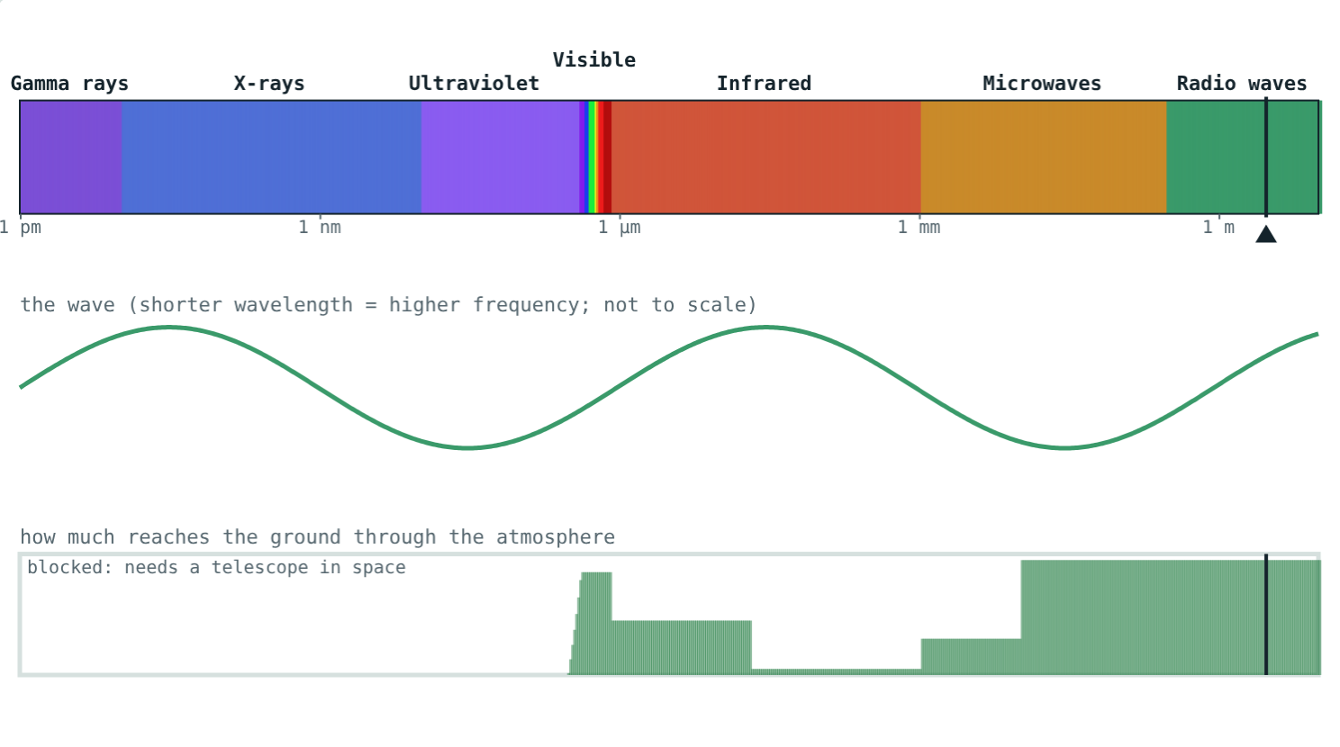
Electromagnetic waves
c = ν × λ = 3 × 10⁸ m/s
Need no medium: they cross empty space
All travel at the same speed in a vacuum
Shorter wavelength means higher frequency
A 3 m radio wave: 10⁸ Hz
Notes:
Contrast with sound, which needs a medium.

Slide 4
The electromagnetic spectrum
Type | Wavelength (approx.) | Sent out by
Gamma rays | below 0.01 nm | Exploding stars
X-rays | 0.01 to 10 nm | Very hot gas, black holes
Ultraviolet | 10 to 400 nm | Hot young stars
Visible | 400 to 800 nm | Stars like the Sun
Infrared | 800 nm to 1 mm | Dust clouds, cool stars
Microwaves | 1 mm to about 30 cm | Big Bang afterglow
Radio | longer than about 30 cm | Galaxies, pulsars
Notes:
1 nm = 10⁻⁹ m. Band edges are approximate; they overlap in practice.

Slide 5
Visible light
About 400 nm (violet) to 800 nm (red)
The only part our eyes detect
Reaches the ground through the air
Green light: 500 nm
Notes:
VIBGYOR runs from short to long wavelength.

Slide 6
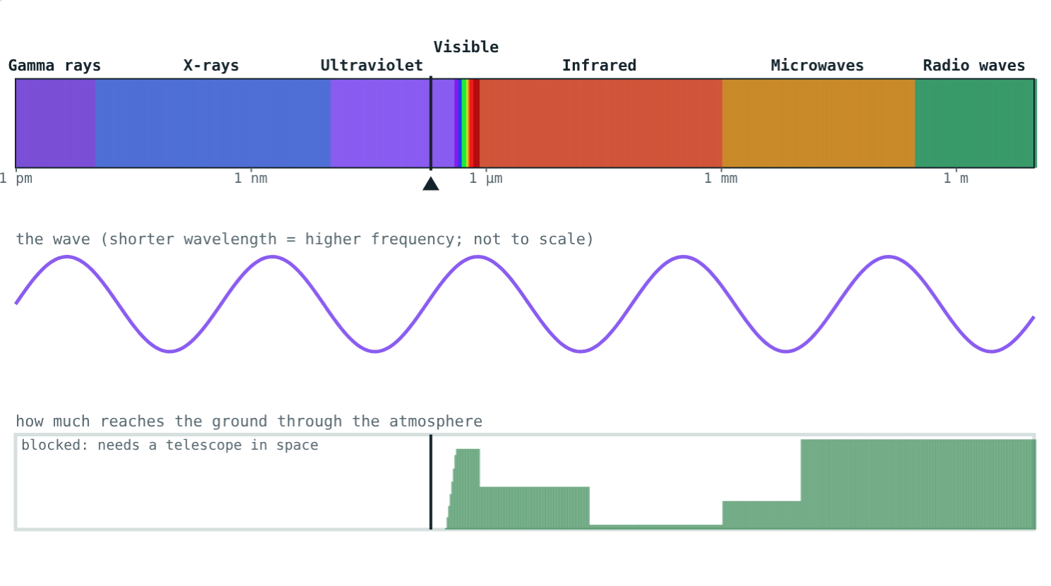
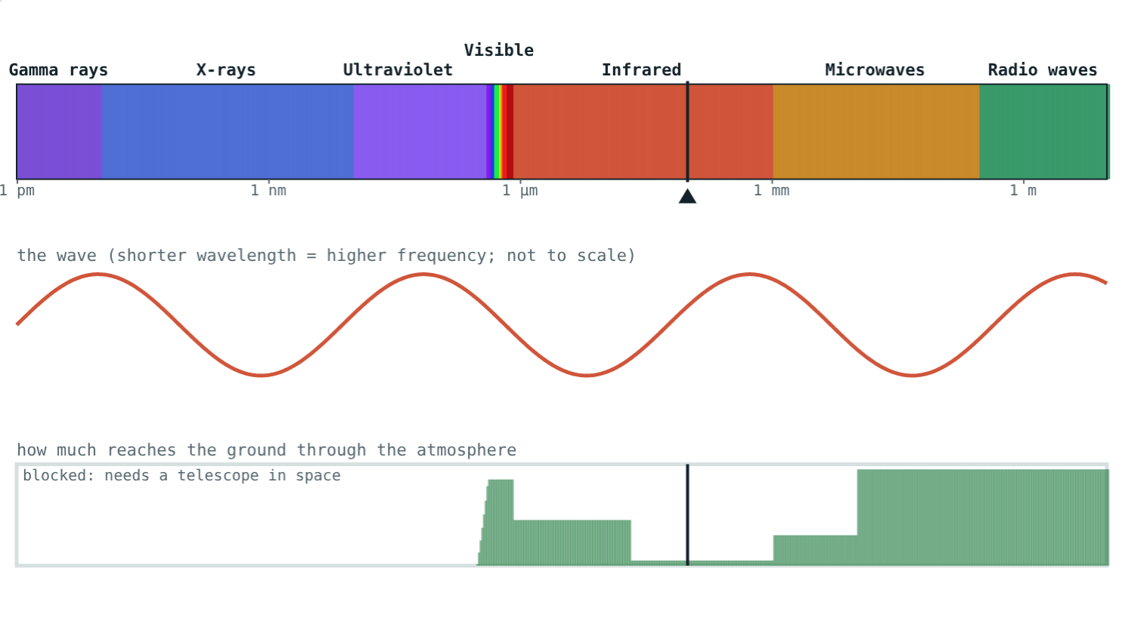
Shorter and longer than light
Shorter than violet; absorbed by the ozone layer.
Longer than red; much is absorbed by water vapour.
Notes:
Both are invisible to us but easy to detect with instruments.

Slide 7




Why observe them all?
Hottest gas
Dusty nurseries
Cold gas
Stars
Shines in X-rays.
Newborn stars hidden in dust glow in infrared.
Hydrogen between the stars is seen in radio.
Stars like the Sun shine most in visible light.
Notes:
Each wavelength reveals a different part of the same object.

Slide 8
Worked examples
Green light
FM radio
λ = 500 nm. Find the frequency.
A station broadcasts at 100 MHz. Find λ.
λ = 5 × 10⁻⁷ m
ν = 3 × 10⁸ ÷ 5 × 10⁻⁷ = 6 × 10¹⁴ Hz
ν = 10⁸ Hz
λ = 3 × 10⁸ ÷ 10⁸ = 3 m
Notes:
Watch the powers of ten carefully.

Slide 9
Radio versus X-ray
Compare a 1 m radio wave with a 1 nm X-ray:
10⁹
times longer
3 × 10⁸
m/s, both of them
A long radio wave
Different wavelengths, same speed in empty space.
Notes:
The X-ray's frequency is a billion times higher.

Slide 10

Common mistakes
“Radio waves are sound”
“X-rays travel faster”
They are electromagnetic, like light.
All travel at 3 × 10⁸ m/s in a vacuum.
Wrong direction
“Space is dark”
Shorter wavelength, higher frequency.
It is full of radiation we cannot see.
Notes:
A radio set turns radio waves into sound; the waves themselves are not sound.

Slide 11
Quick check
1
What is the range of wavelengths of visible light?
2
Which travels fastest in empty space: X-rays, radio or light?
3
A radio wave has ν = 3 × 10⁹ Hz. Find its wavelength.
4
Which kinds of radiation from space reach the ground easily?
Notes:
Answers: 1) About 400 nm to 800 nm. 2) All travel at the same speed. 3) 0.1 m. 4) Visible light and radio waves.

Slide 12
Explore the spectrum yourself
Open the Light We Can and Cannot See lesson on the Visual Science & Maths website. Slide from gamma rays to radio waves.
Next lesson: Optical and radio telescopes
Notes:
Homework idea: list five everyday uses of invisible electromagnetic waves.

