Slide 1
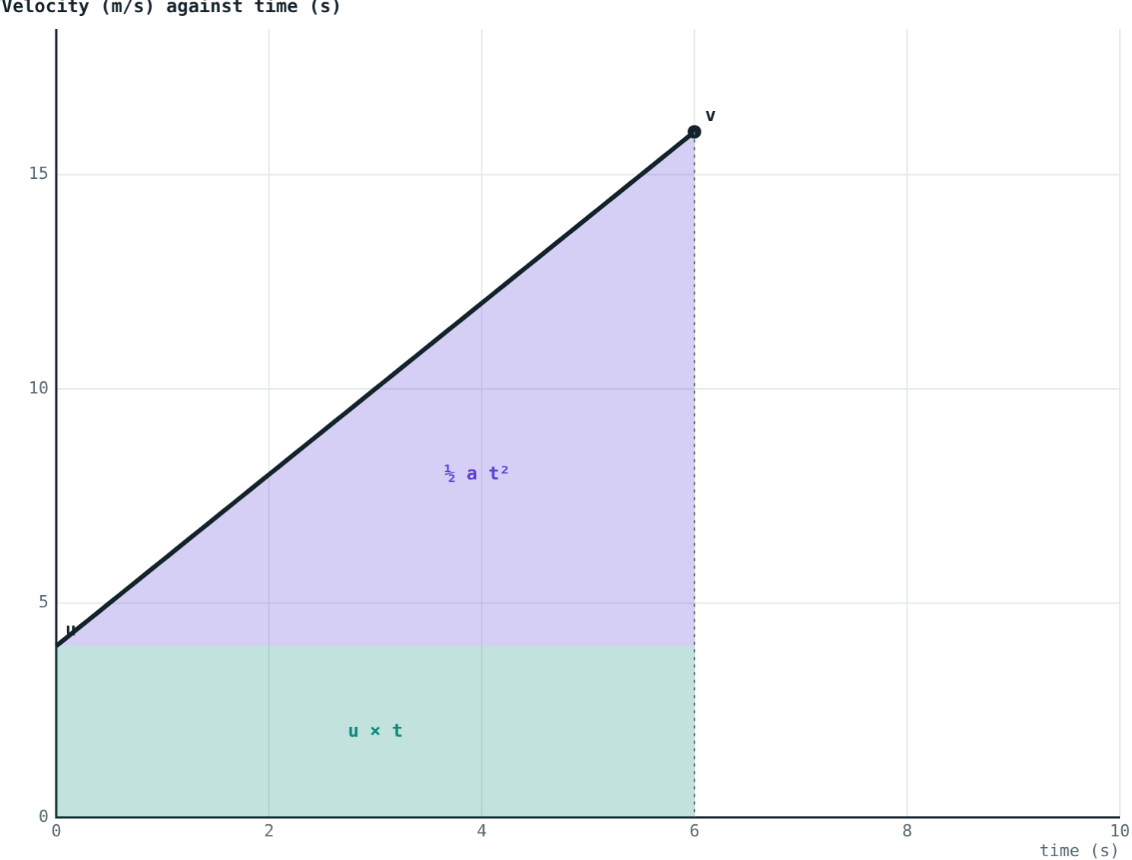
Equations of Motion
STD 9 SCIENCE · CH. 1 LAWS OF MOTION
Lesson 6 · Visual Science & Maths
Notes:
Goal: students can derive the three equations of motion from a velocity–time graph and choose the right one for a problem.

Slide 2
Five quantities, three equations
Symbol | Meaning | Unit
u | Initial velocity | m/s
v | Final velocity | m/s
a | Acceleration (uniform) | m/s²
t | Time taken | s
s | Displacement | m
Notes:
The equations only apply when the acceleration is uniform. Any three known quantities let you find the other two.

Slide 3
1. Velocity and time
v = u + at
Slope of the velocity–time graph = acceleration:
a = (v − u) ÷ t
Multiply both sides by t: at = v − u
Rearrange: v = u + at
The line rises from u to v in time t
Notes:
This is just the definition of acceleration rearranged.

Slide 4
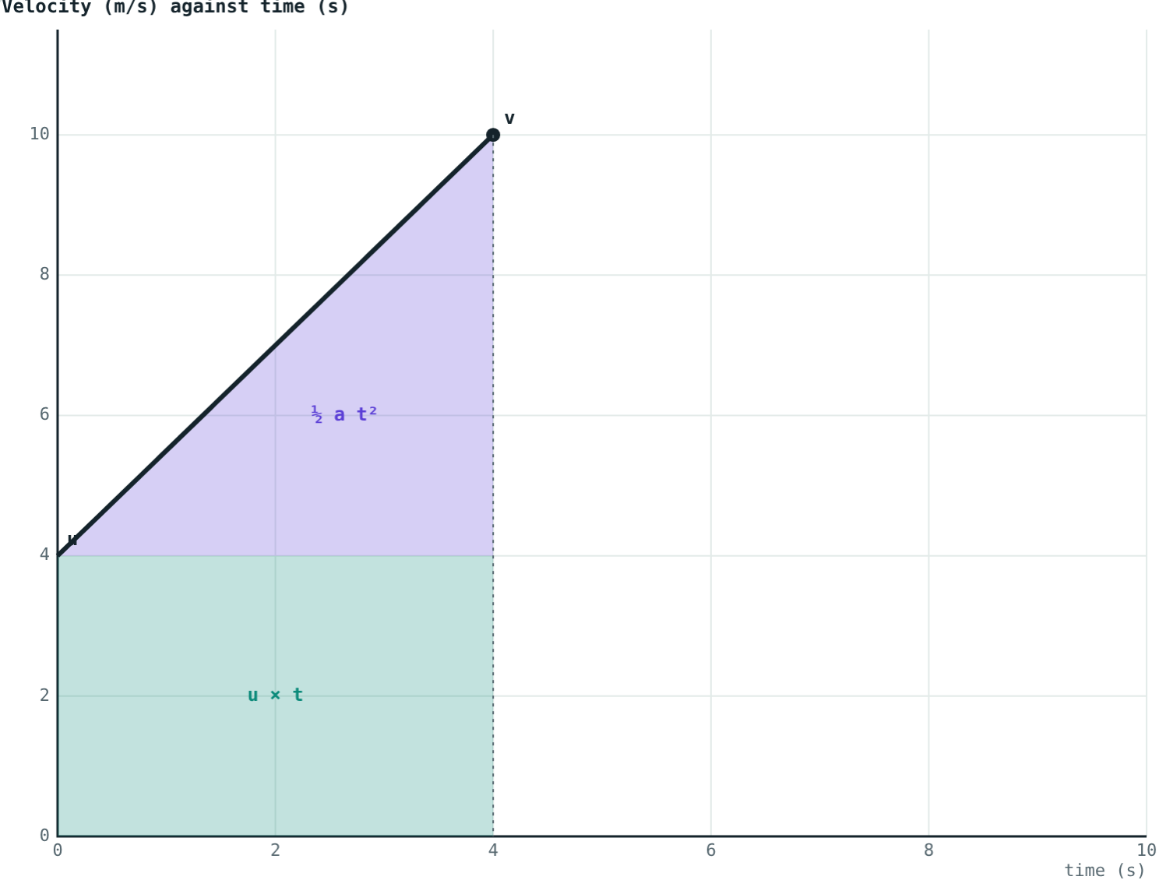
2. Displacement and time
s = ut + ½at²
Area under the graph = displacement:
Rectangle: height u, width t, area ut
Triangle: base t, height at, area ½at²
Add them: s = ut + ½at²
Teal rectangle + violet triangle
Notes:
The triangle's height is v − u, which equals at from the first equation.

Slide 5
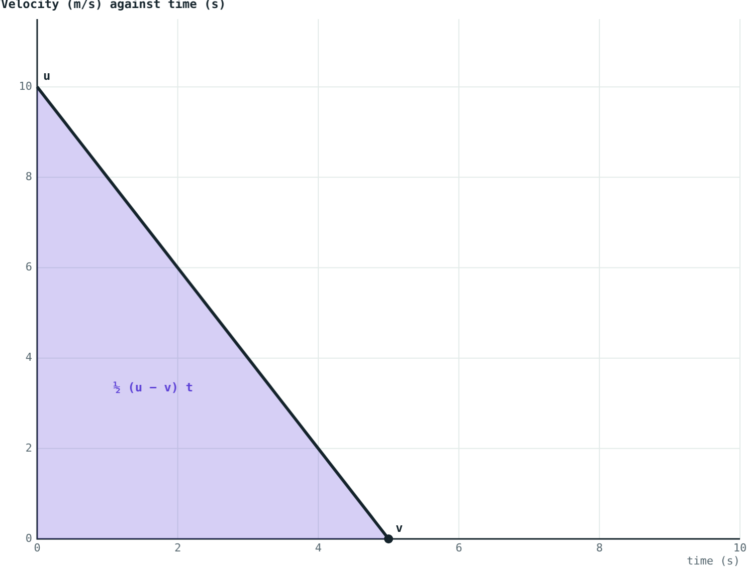
3. Velocity and displacement
v² = u² + 2as
The whole area is a trapezium:
s = ½(u + v) × t
Substitute t = (v − u) ÷ a
s = (v² − u²) ÷ 2a
So v² = u² + 2as
Slowing from 10 m/s to rest: s = 25 m
Notes:
The difference of two squares (v + u)(v − u) = v² − u² makes this step work.

Slide 6
Which equation to use
Equation | Connects | Leaves out
v = u + at | u, v, a, t | s
s = ut + ½at² | u, a, t, s | v
v² = u² + 2as | u, v, a, s | t
Notes:
Strategy: list what you know, circle what you want, and choose the equation that leaves out the quantity you neither know nor want.

Slide 7
Worked examples
A car pulling away
A cyclist going downhill
A car starts from rest and accelerates at 2 m/s² for 6 s. Find v and s.
A cyclist at 4 m/s accelerates at 1.5 m/s² for 4 s. Find v and s, then check.
v = 0 + 2 × 6 = 12 m/s
s = 0 + ½ × 2 × 36 = 36 m
v = 4 + 1.5 × 4 = 10 m/s
s = 16 + 12 = 28 m
Check: 16 + 2 × 1.5 × 28 = 100 = 10²
Notes:
Checking with the third equation is a quick way to catch arithmetic errors.

Slide 8
Worked example: rolling to a stop
A ball rolls at 10 m/s and decelerates uniformly at 2 m/s². How far does it roll, and for how long?
v = 0, a = −2; no time given, so use v² = u² + 2as
0 = 100 − 4s, so s = 25 m
0 = 10 − 2t, so t = 5 s
u = 10 m/s, a = −2 m/s², stops after 25 m
Notes:
Two hidden facts: 'stops' means v = 0, and 'decelerates' means a is negative.

Slide 9
Hidden values
u = 0
v = 0
a < 0
“Starts from rest”
“Comes to rest”
“Slows down”
The initial velocity is zero.
Also “stops” or “brought to a halt”.
Deceleration: put a minus sign on a.
Notes:
Ask students to underline these phrases in word problems.

Slide 10

Common mistakes
Positive a for slowing down
Missing hidden zeros
Slowing down needs a negative a in the equations.
From rest: u = 0. Comes to rest: v = 0.
Using them for any motion
Mixing units
They only work for uniform acceleration.
Use m, s, m/s and m/s². Convert km/h first.
Notes:
Sign errors in deceleration problems are the most common mistake.

Slide 11
Quick check
1
A bike starts from rest with a = 3 m/s². What is its velocity after 4 s?
2
Which equation would you use if the time is not given?
3
A car at 20 m/s brakes and comes to rest. What is v?
4
A ball starts from rest with a = 4 m/s². How far does it go in 3 s?
Notes:
Answers: 1) 12 m/s. 2) v² = u² + 2as. 3) 0 m/s. 4) 18 m.

Slide 12
Test the equations
Open the Equations of Motion lesson on the Visual Science & Maths website. Change u, a and t, and watch every equation update.
Next lesson: Uniform circular motion
Notes:
Homework idea: write three word problems of your own, one for each equation, and swap them with a classmate.

