Slide 1
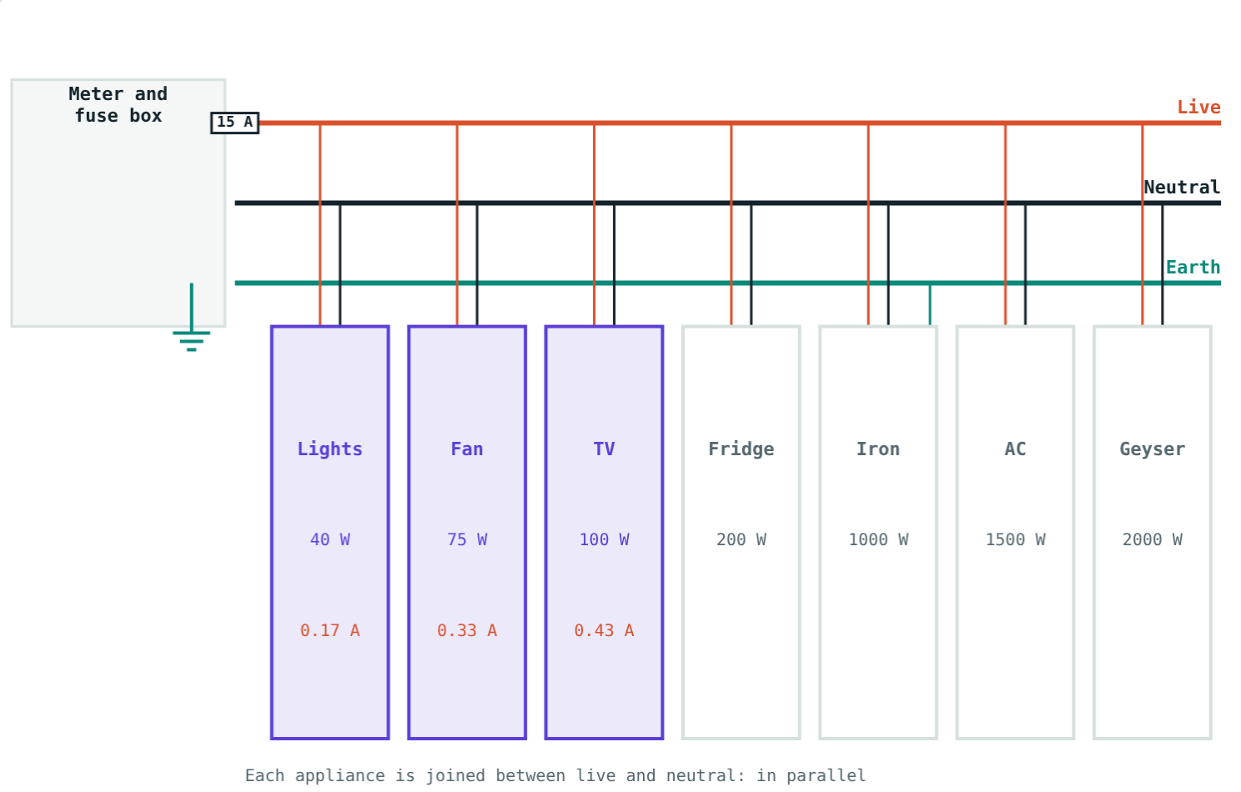
Electricity at Home
STD 9 SCIENCE · CH. 3 CURRENT ELECTRICITY
Lesson 4 · Visual Science & Maths
Notes:
Goal: students can describe the three-wire system, explain why appliances are in parallel, calculate I = P/V, and explain fuses, MCBs and earthing.

Slide 2
Behind the switch board
Every switch board hides three wires, a fuse and an arrangement that lets each appliance work on its own.
How does it all work, and how does it keep you safe?
Lights, fan and TV on a 15 A circuit
Notes:
Start with what students can see at home: switches, sockets, the meter, the MCB box.

Slide 3
Three wires
L
N
E
Live
Neutral
Earth
Red or brown. Carries current at high potential (about 230 V).
Black or blue. Completes the circuit back to the supply.
Green or yellow. Joined to a metal plate buried in the ground.
Notes:
The supply in India is about 230 V (often quoted as 220 V).

Slide 4
Appliances in parallel
I = P ÷ V
Each appliance is joined between live and neutral
Each gets the full 230 V
Each has its own switch
Currents add up in the main wires
215 W in total: 0.93 A
Notes:
Switches always go in the live wire.

Slide 5
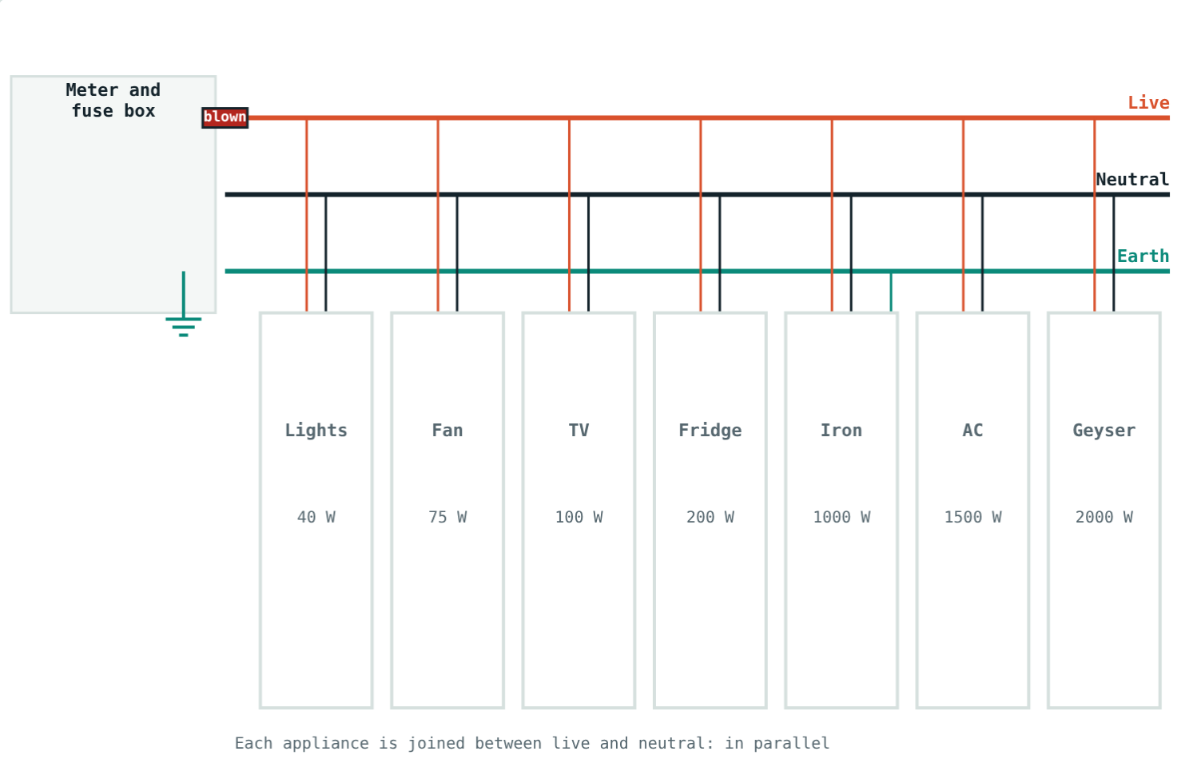
The fuse at work
0.93 A: well below the 15 A rating.
19.6 A: the fuse melts and cuts the supply.
A fuse or MCB protects the wiring from overheating and fire.
Notes:
An MCB is a switch that trips instead of melting, and can be reset.

Slide 6
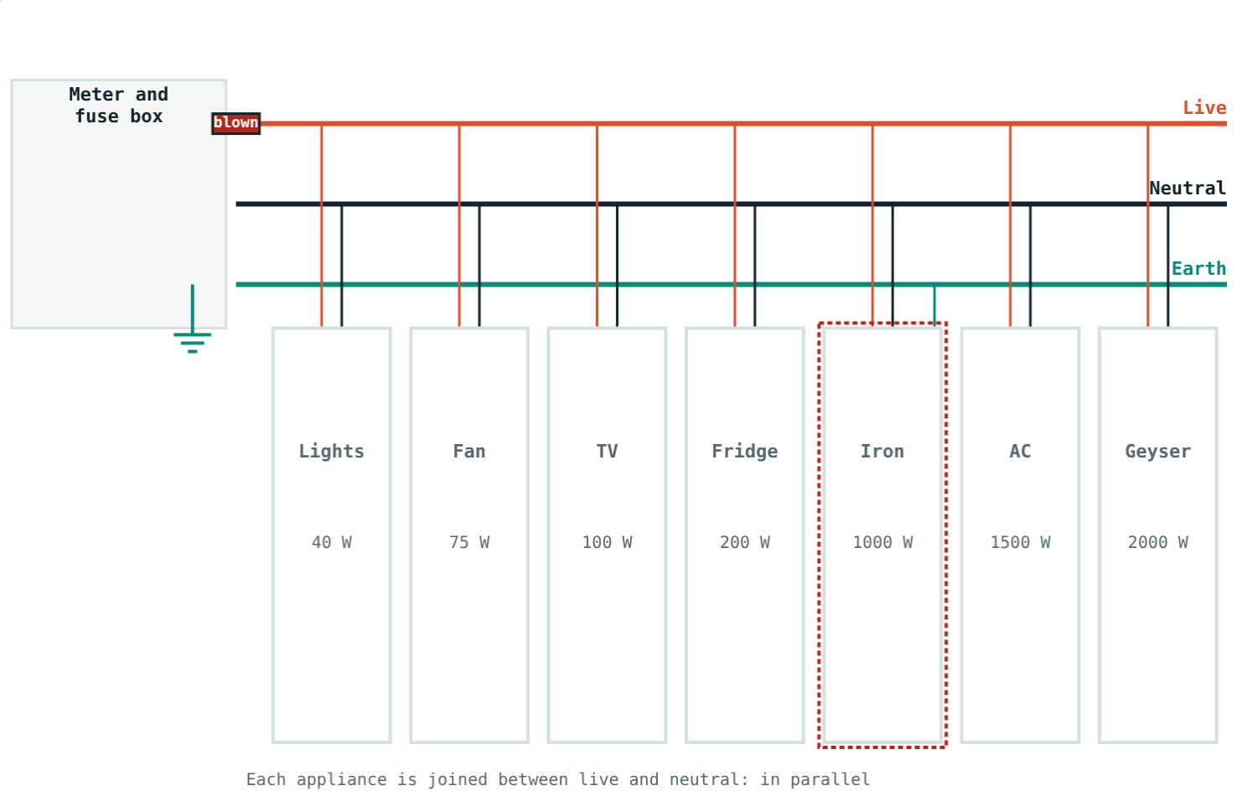
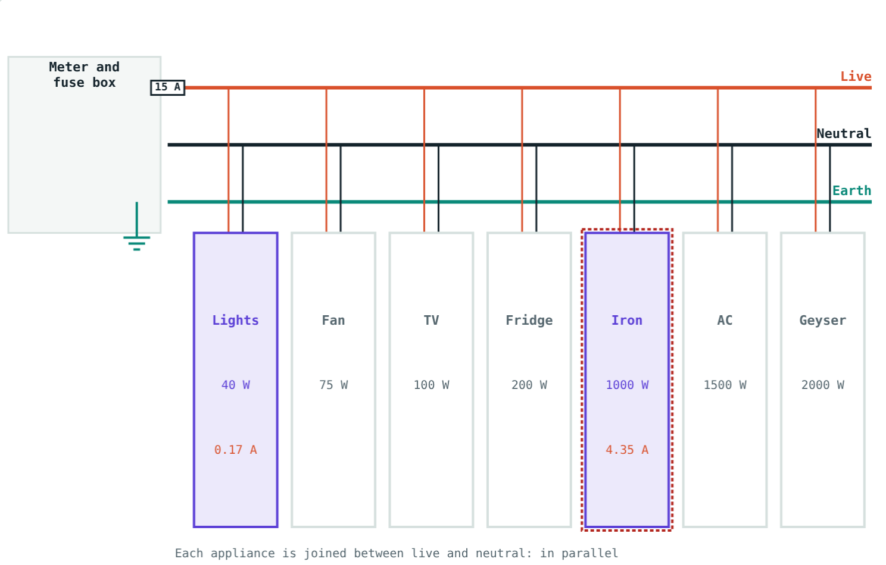
Why metal appliances are earthed
Fault current flows to earth, the fuse blows: safe.
Fuse does not blow; the iron's body is live: danger.
Notes:
The earth wire carries current only when there is a fault.

Slide 7
Worked examples
An electric iron
How many bulbs?
A 1000 W iron runs on 230 V. Find the current.
How many 100 W bulbs can run on a 5 A circuit at 230 V?
I = 1000 ÷ 230 ≈ 4.35 A
Max power = 230 × 5 = 1150 W
1150 ÷ 100 = 11.5, so 11 bulbs
Notes:
Always round down when counting appliances against a fuse rating.

Slide 8
Worked example: will the fuse blow?
A 15 A circuit supplies a 2000 W geyser, a 1500 W AC and a 1000 W iron together. Will the fuse blow?
Total power = 4500 W
I = 4500 ÷ 230 ≈ 19.6 A
19.6 A > 15 A: yes, it blows
4500 W on a 15 A circuit
Notes:
Heavy appliances should be on separate, higher-rated circuits.

Slide 9




Safety precautions
Out of reach
Unplug first
Dry hands
Shock victim
Keep switches and sockets away from small children.
Switch off and unplug before cleaning or repairs.
Never touch switches with wet hands; wear rubber soles.
Do not touch. Switch off or use a dry wooden stick.
Notes:
Discuss each precaution and the physics behind it: water and bodies conduct; rubber and dry wood insulate.

Slide 10

Common mistakes
Switch in neutral
Higher fuse “for safety”
Switches and fuses go in the live wire.
Use the correct rating or it will not protect.
Earth carries current normally
Touching a shock victim
Only when there is a fault.
Switch off the supply first.
Notes:
These are life-safety points, not just exam points.

Slide 11
Quick check
1
What colour is the earth wire's insulation?
2
How are household appliances connected?
3
A 2300 W geyser runs on 230 V. Find the current.
4
What does a fuse do when the current is too large?
Notes:
Answers: 1) Green or yellow. 2) In parallel. 3) 10 A. 4) It melts and breaks the circuit.

Slide 12
Wire a house yourself
Open the Electricity at Home lesson on the Visual Science & Maths website. Switch on appliances, overload the fuse and test the earth wire.
That completes Chapter 3: Current Electricity
Notes:
Homework idea: with an adult, find the MCB box at home and note the rating of each MCB.

