Slide 1
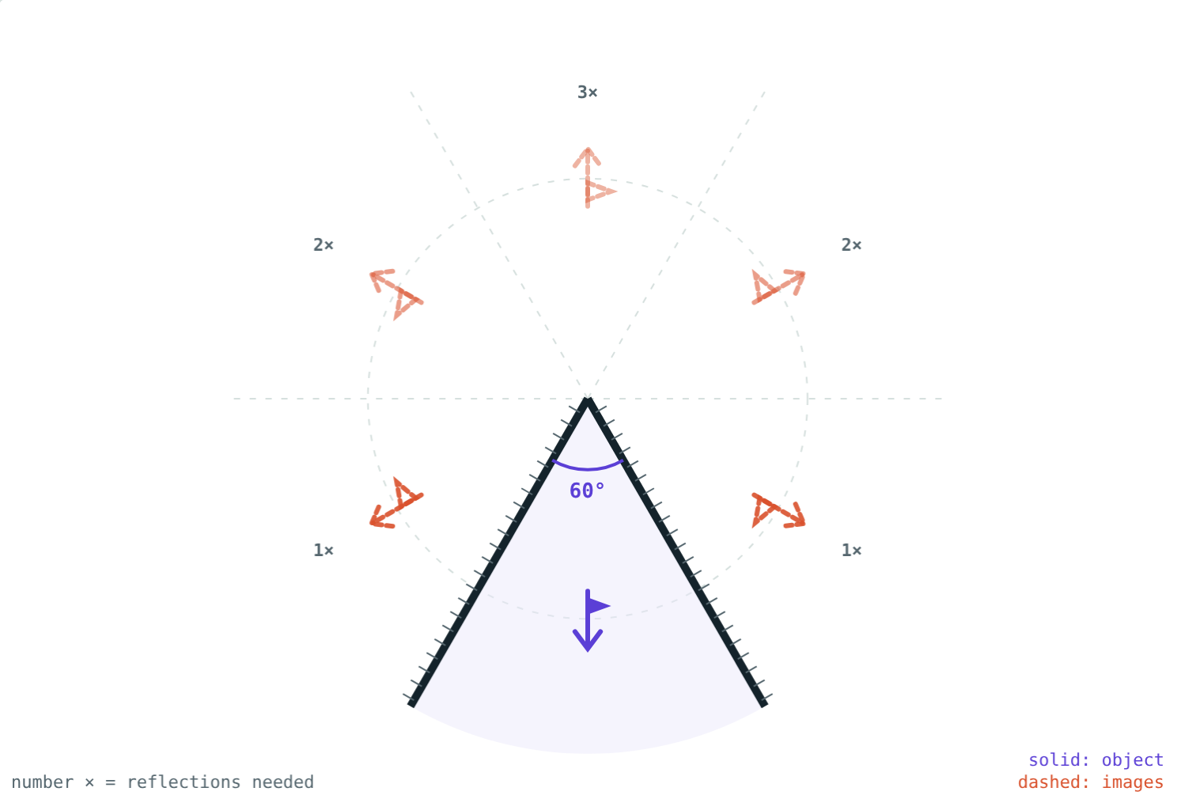
Images in Inclined Mirrors
STD 9 SCIENCE · CH. 11 REFLECTION OF LIGHT
Lesson 2 · Visual Science & Maths
Notes:
Goal: students can use n = 360°/A − 1 in both directions and explain the kaleidoscope and periscope.

Slide 2
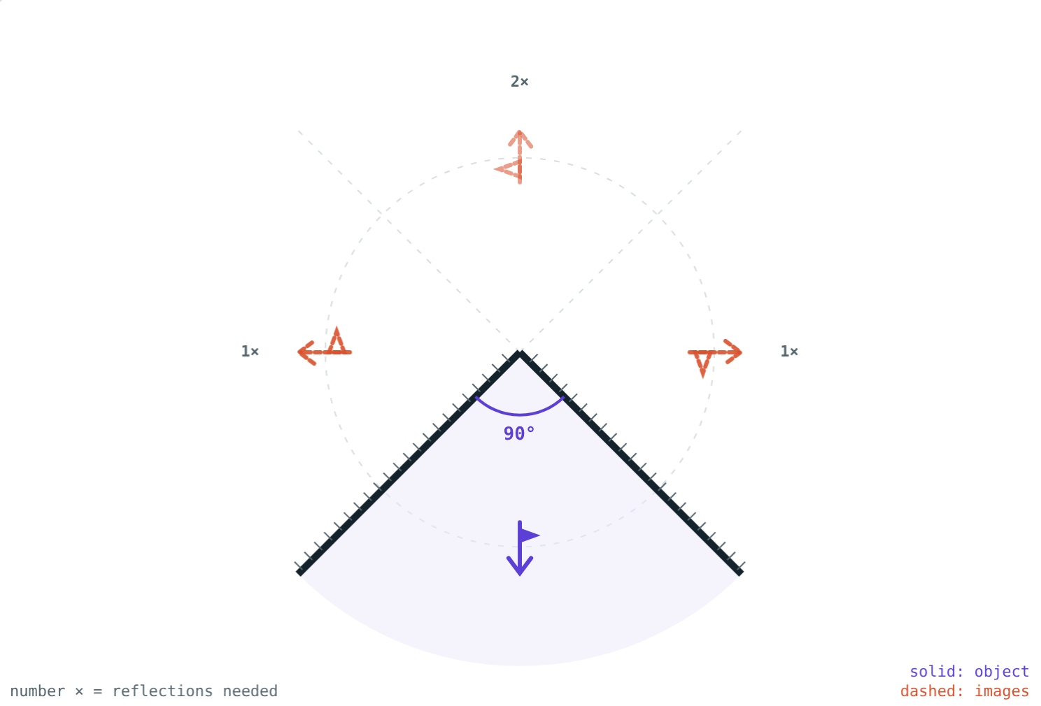
A crowd of you
In a tailor's shop, two mirrors at an angle show several copies of you at once.
How many images, and where do they come from?
Mirrors at 90°: three images
Notes:
If possible, bring two mirrors and a coin and let students count.

Slide 3
Mirrors at an angle
n = 360° ÷ A − 1
Light reflects from one mirror, then the other
Smaller angle: more reflections, more images
Works neatly when 360° ÷ A is a whole number
Object placed midway between the mirrors
60°: 360 ÷ 60 − 1 = 5 images
Notes:
The −1 removes the object itself from the count.

Slide 4
Angle and number of images
Angle A | 120° | 90° | 72° | 60° | 45° | 30°
360° ÷ A | 3 | 4 | 5 | 6 | 8 | 12
Images n | 2 | 3 | 4 | 5 | 7 | 11
Notes:
Ask: what happens as A approaches 0°?

Slide 5
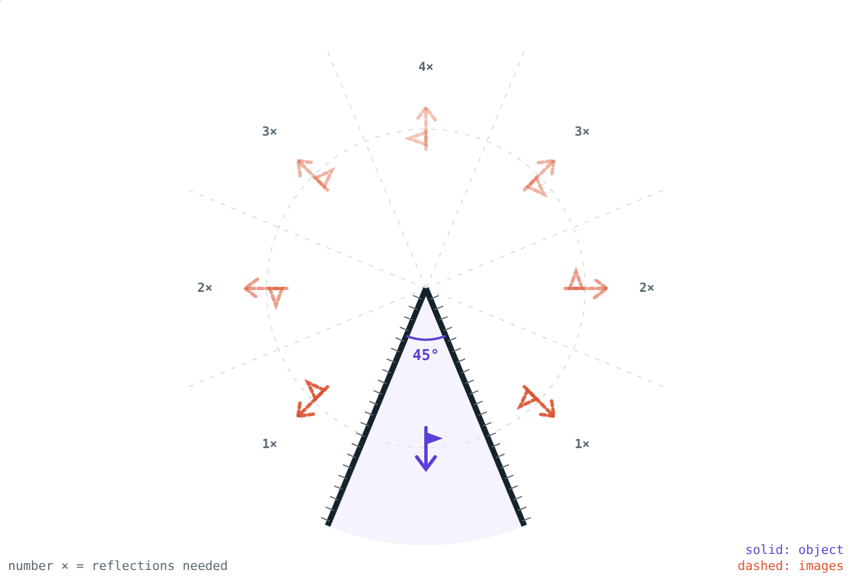
Closing the mirrors
3 images: two from one reflection, one from two.
7 images: the far ones need four reflections.
Notes:
The more reflections an image needs, the dimmer it is.

Slide 6
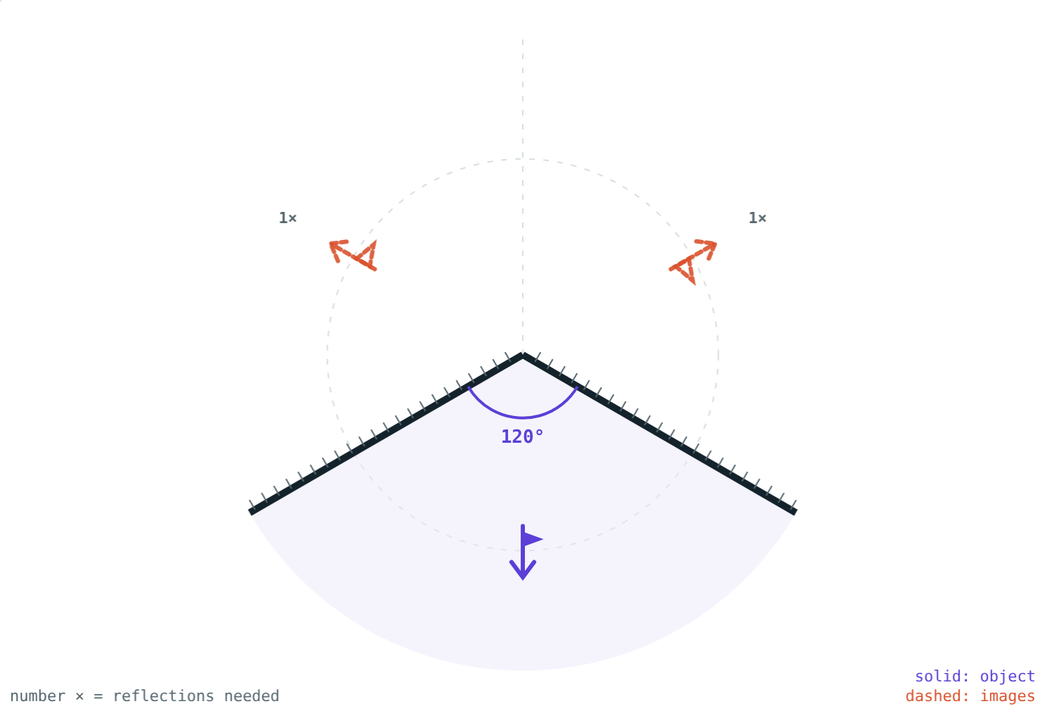
Reversed or not?
Every reflection swaps left and right
One reflection: image reversed
Two reflections: reversed twice, so the right way round
Watch the flags in the simulation
120°: two images, both reversed
Notes:
Use a printed letter F as the object to make this vivid.

Slide 7




Using inclined mirrors
Kaleidoscope
Periscope
Parallel mirrors
Tailor's mirrors
Three mirror strips at 60° turn bits of glass into patterns.
Two parallel mirrors at 45° let you see over a wall.
Facing mirrors give an endless row of images.
Angled mirrors show you from several sides.
Notes:
A periscope's two mirrors each turn the light through 90°.

Slide 8
Worked examples
Counting images
Finding the angle
Two mirrors are at 40° with a coin between them. How many images form?
A student sees 11 images of a pencil between two mirrors. Find the angle.
360° ÷ 40° = 9
n = 9 − 1 = 8 images
360° ÷ A = 11 + 1 = 12
A = 360° ÷ 12 = 30°
Notes:
For the reverse problem, add 1 before dividing into 360°.

Slide 9
Inside a kaleidoscope
360° ÷ 60° − 1:
5
images of a bead
6
copies in the pattern
The six copies sit evenly around the centre: that is the symmetry you see.
Each pair of mirrors at 60°
Notes:
Turning the tube moves the beads and the whole pattern changes.

Slide 10

Common mistakes
Forgetting the −1
“Smaller angle, fewer images”
360° ÷ A counts the object too.
It is the other way round.
All images alike
Any angle at all
Odd numbers of reflections give reversed images.
The rule is neat when 360° ÷ A is whole.
Notes:
For angles like 50°, the count depends on where the object is placed.

Slide 11
Quick check
1
How many images do two mirrors at 72° form?
2
Three images are seen. What is the angle between the mirrors?
3
Which instrument uses two parallel mirrors each at 45°?
4
What happens to the number of images as the angle gets smaller?
Notes:
Answers: 1) 4. 2) 90°. 3) A periscope. 4) It increases; parallel mirrors give endless images.

Slide 12
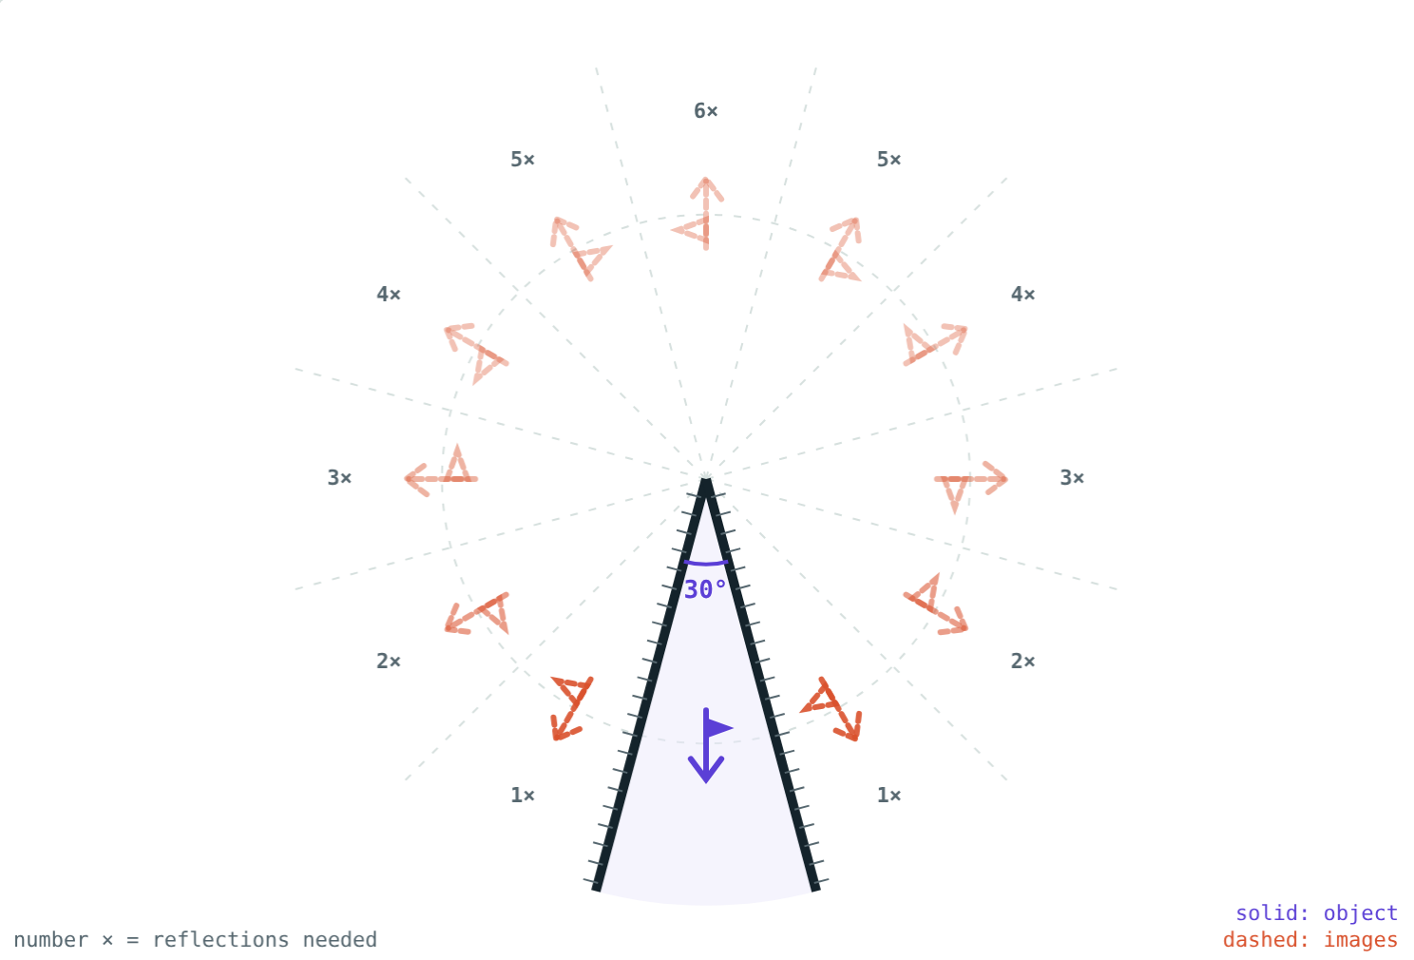
Count the images yourself
Open the Images in Inclined Mirrors lesson on the Visual Science & Maths website. Change the angle and count the dashed images.
Next lesson: Spherical mirrors
Notes:
Project idea: build a kaleidoscope from three mirror strips and a cardboard tube.

