Slide 1
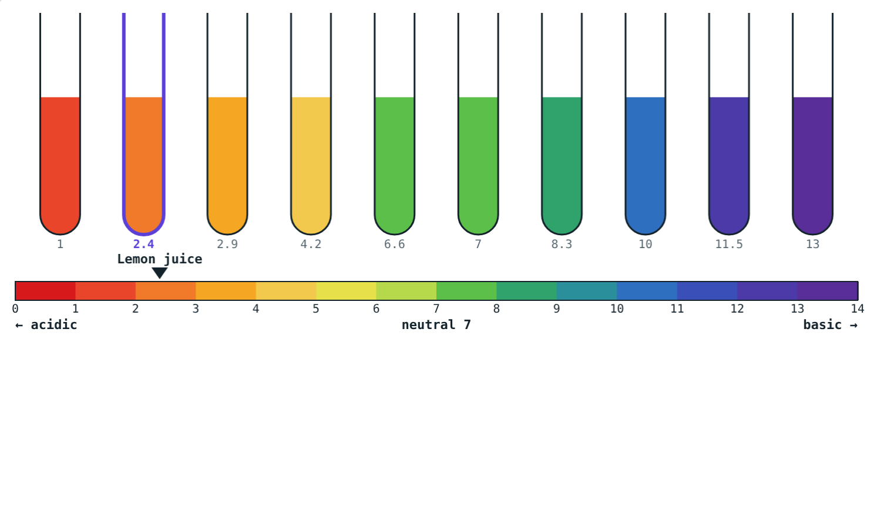
Acids, Bases, Indicators and pH
STD 9 SCIENCE · CH. 5 ACIDS, BASES AND SALTS
Lesson 1 · Visual Science & Maths
Notes:
Goal: students can define acids and bases (Arrhenius), tell strong from weak, use indicators, and read the pH scale.

Slide 2
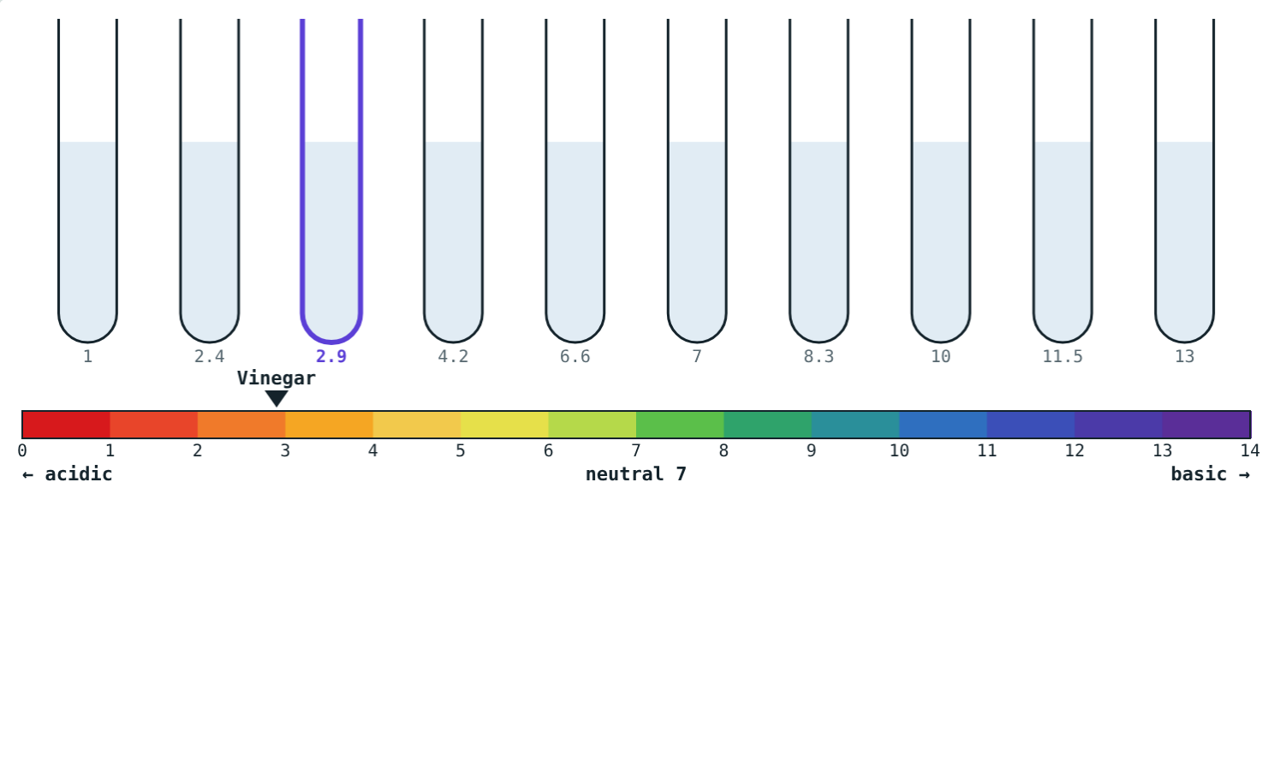
They all look the same
Ten clear solutions: some are acids, some are bases, one is pure water.
How can we tell them apart safely?
Without an indicator, they look alike
Notes:
Never taste or touch lab chemicals; indicators let us test safely.

Slide 3
Acids and bases
H⁺
OH⁻
Strong
Acid
Base
or weak?
Gives H⁺ ions in water. Sour taste. HCl → H⁺ + Cl⁻
Gives OH⁻ ions in water. Bitter, soapy. NaOH → Na⁺ + OH⁻
Strong ones break up fully into ions; weak ones only partly.
Notes:
Strong acids: HCl, H₂SO₄, HNO₃. Weak: acetic, citric. Strong bases: NaOH, KOH. Weak: ammonia solution.

Slide 4
Indicator colours
Indicator | Acid | Neutral | Base
Litmus | Red | Purple | Blue
Phenolphthalein | Colourless | Colourless | Pink
Methyl orange | Red (strong acids) | Yellow | Yellow
Turmeric | Yellow | Yellow | Red-brown
Notes:
Natural indicators: turmeric, beetroot, red cabbage, hibiscus, rose petals.

Slide 5
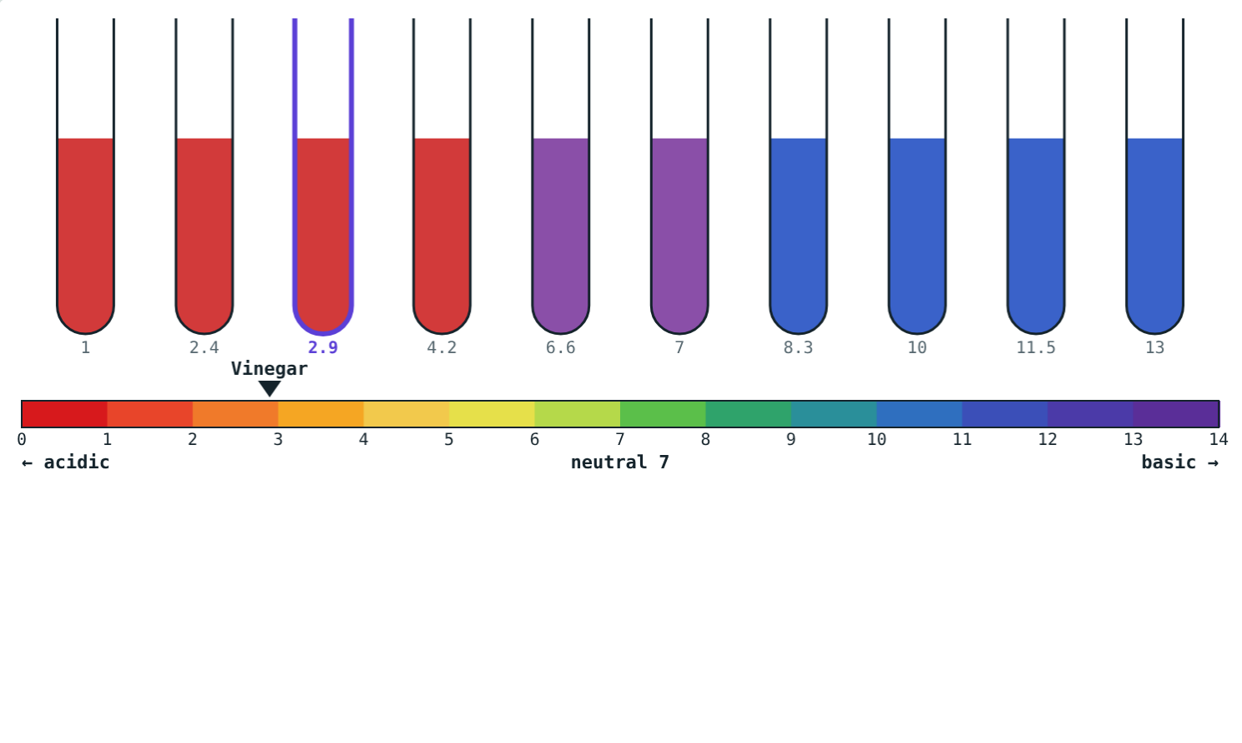
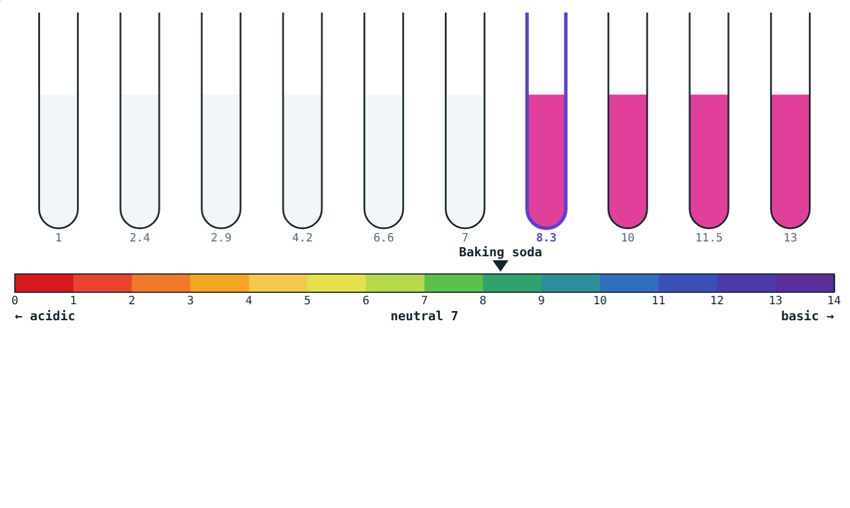
Litmus and phenolphthalein
Red in acids, purple when neutral, blue in bases.
Pink only in bases.
Notes:
Phenolphthalein cannot tell an acid from a neutral solution.

Slide 6
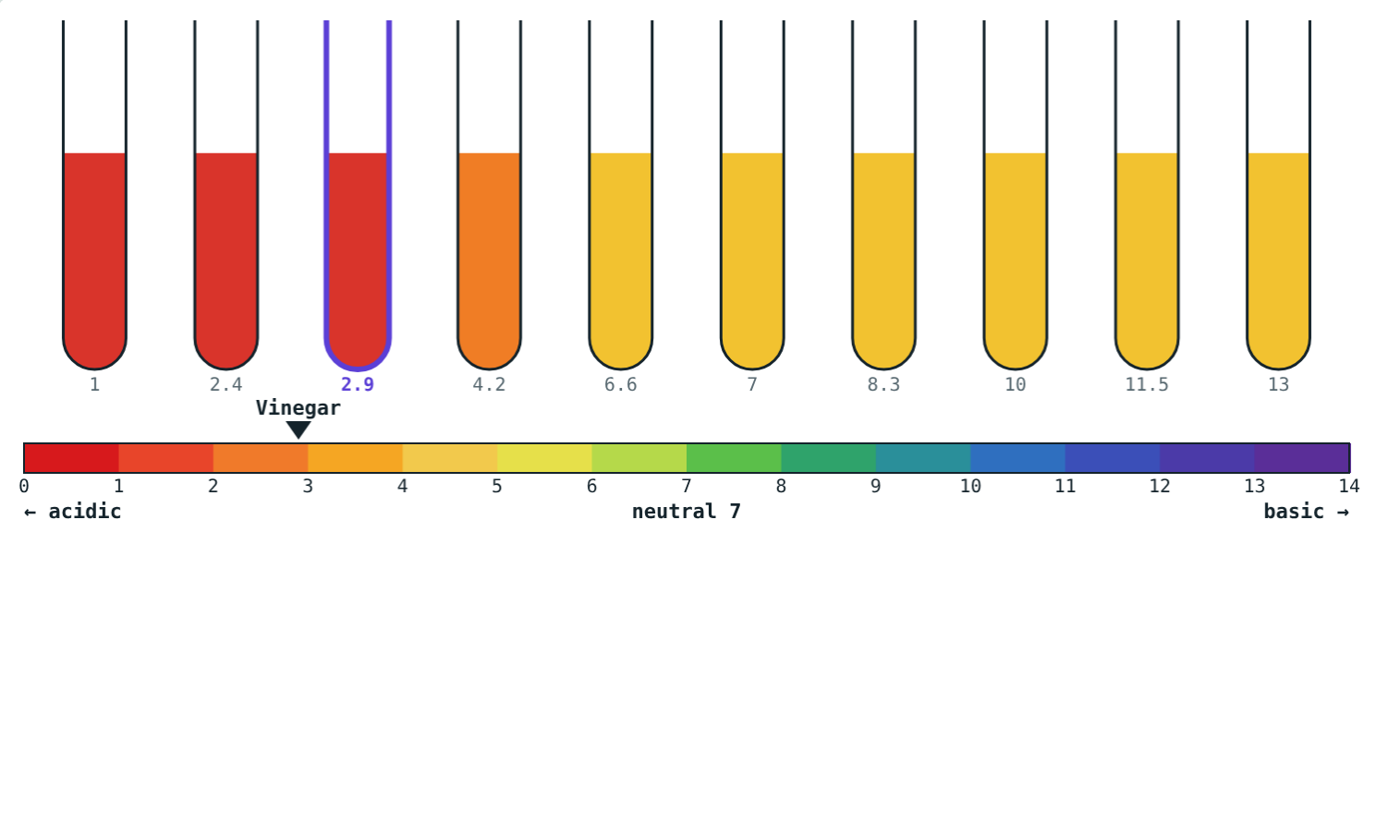
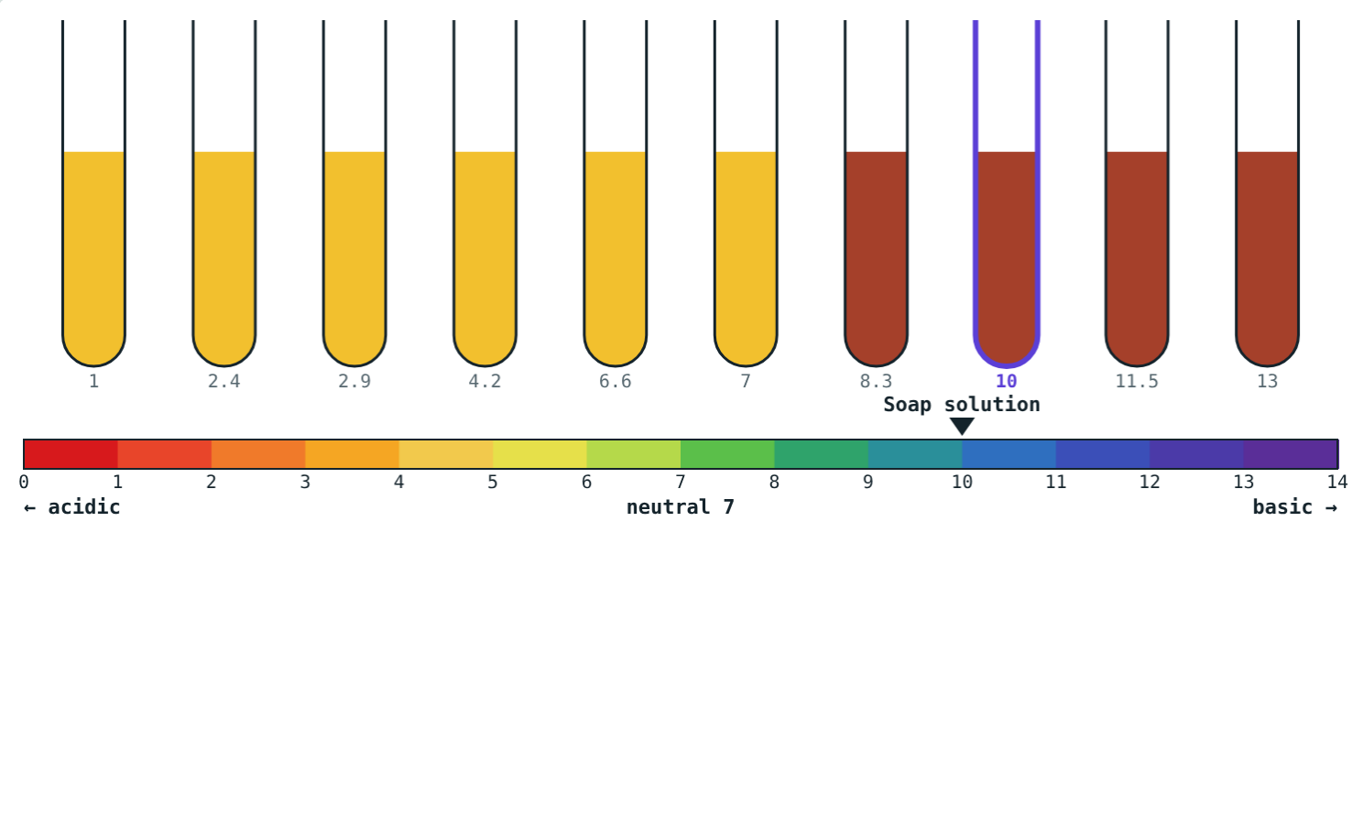
Methyl orange and turmeric
Red in strong acids, yellow otherwise.
Turns red-brown in bases, like soap.
Notes:
A turmeric stain turns red when washed with soap for this reason.

Slide 7
The pH scale
0 ← acid · 7 · base → 14
Below 7: acidic; lower is more acidic
7: neutral (pure water)
Above 7: basic; higher is more basic
Each step = 10 times more or fewer H⁺
Universal indicator shows the whole scale
Notes:
pH 4 has 10 times the H⁺ of pH 5, and 1000 times that of pure water.

Slide 8
Worked examples
Reading the scale
Factors of ten
Classify pH 3, pH 9 and pH 7.
Vinegar pH 3, tomato juice pH 4. How many times more H⁺ in vinegar?
pH 3: acidic
pH 9: basic
pH 7: neutral
1 pH unit: 10 times
Versus water (pH 7): 10 000 times
Notes:
The pH scale is logarithmic; students only need the factor-of-ten idea.

Slide 9
Worked example: choosing an indicator
A solution stays colourless with phenolphthalein. Is it acidic?
Colourless means acidic or neutral
So not necessarily
Use litmus or universal indicator to decide
Phenolphthalein: colourless in acids and neutral solutions
Notes:
Choosing the right indicator matters.

Slide 10

Common mistakes
pH as a ruler
Lower pH = weaker
Each step is a factor of ten.
Lower pH is more acidic.
Phenolphthalein for acids
All bases are alkalis
It shows only bases (pink).
Only soluble bases are alkalis.
Notes:
Correct the factor-of-ten misconception early.

Slide 11
Quick check
1
What ions does an acid give in water?
2
What colour does red litmus turn in soap solution?
3
A solution has pH 12. Is it acidic, neutral or basic?
4
How many times more H⁺ does pH 2 have than pH 4?
Notes:
Answers: 1) H⁺ ions. 2) Blue. 3) Strongly basic. 4) 100 times.

Slide 12
Test solutions yourself
Open the Indicators and pH lesson on the Visual Science & Maths website. Switch indicators and tap each tube.
Next lesson: Neutralisation and salts
Notes:
Homework idea: make a red cabbage indicator at home and test lemon juice, soap and baking soda.

