Slide 1
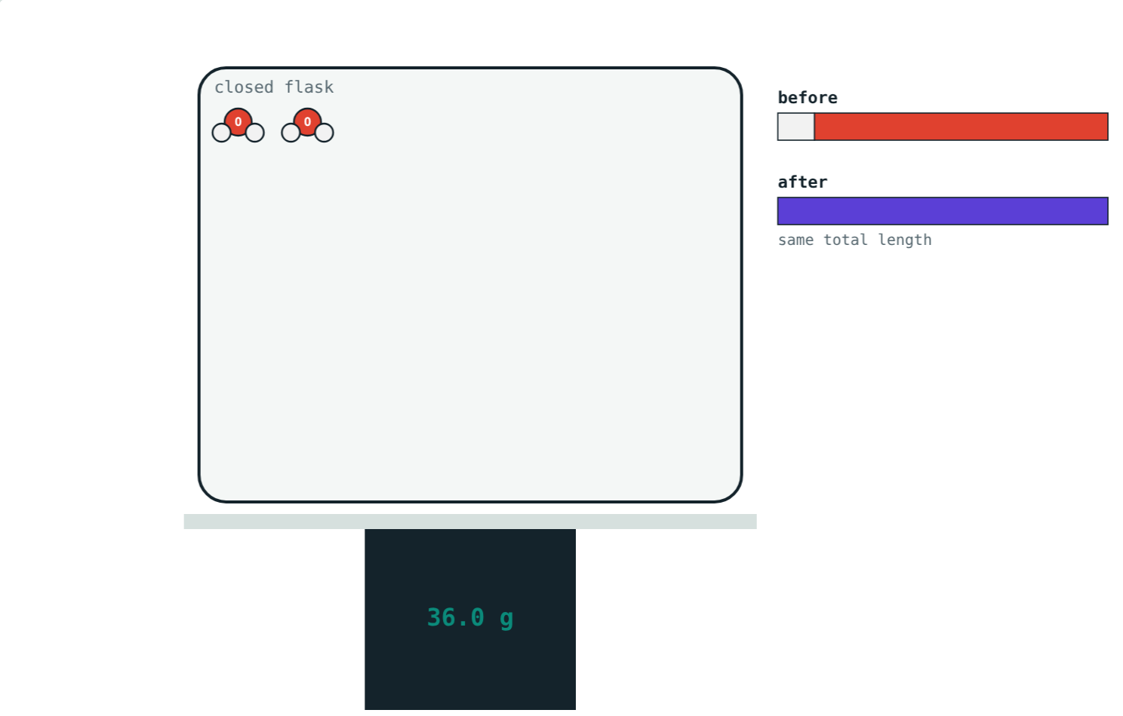
Laws of Chemical Combination
STD 9 SCIENCE · CH. 4 MEASUREMENT OF MATTER
Lesson 1 · Visual Science & Maths
Notes:
Goal: students can state the laws of conservation of mass and constant proportions, use them in simple calculations, and link them to Dalton's atomic theory.

Slide 2
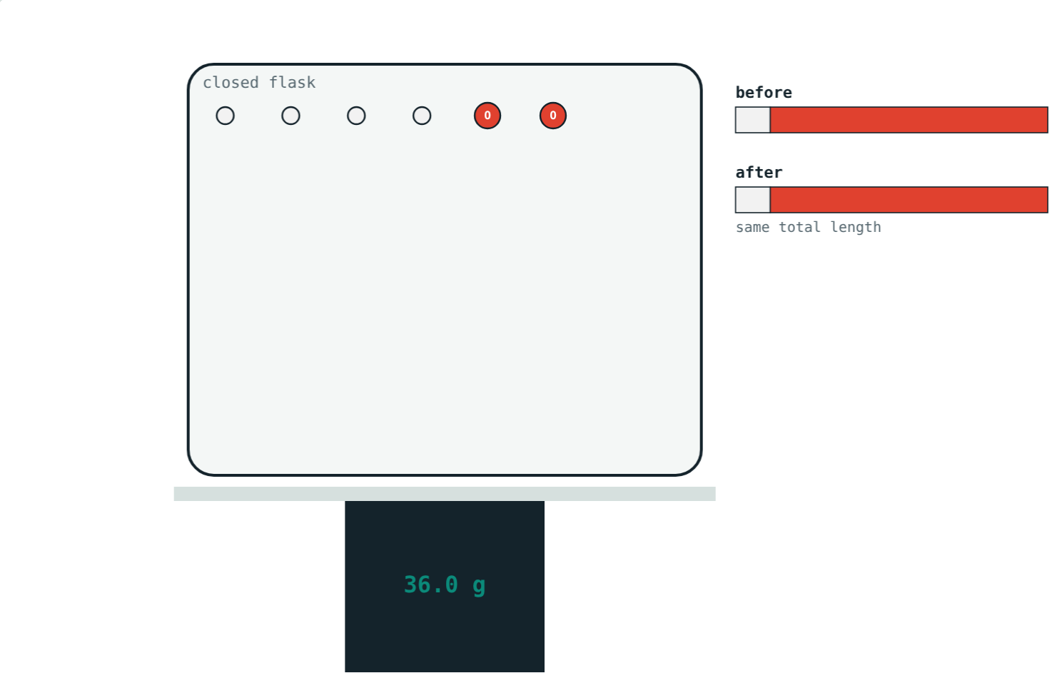
Where does the candle go?
A burning candle seems to vanish, yet an iron nail gets heavier as it rusts.
Is mass really lost or gained in a reaction?
4 g hydrogen + 32 g oxygen in a closed flask: 36 g
Notes:
The candle's products are gases that escape; the nail gains oxygen from the air. In a closed container, mass stays the same.

Slide 3
Conservation of mass
In a chemical reaction, the total mass of reactants equals the total mass of products.
Mass is neither created nor destroyed
Use a closed container so no gas escapes
Atoms are only rearranged
After the reaction: still 36 g on the balance
Notes:
Antoine Lavoisier showed this with careful weighing in the 18th century.

Slide 4
Before and after
4 g hydrogen + 32 g oxygen = 36 g
36 g of water, the same total
Notes:
Count the dots: each is a mole of atoms. The same atoms are there, regrouped.

Slide 5
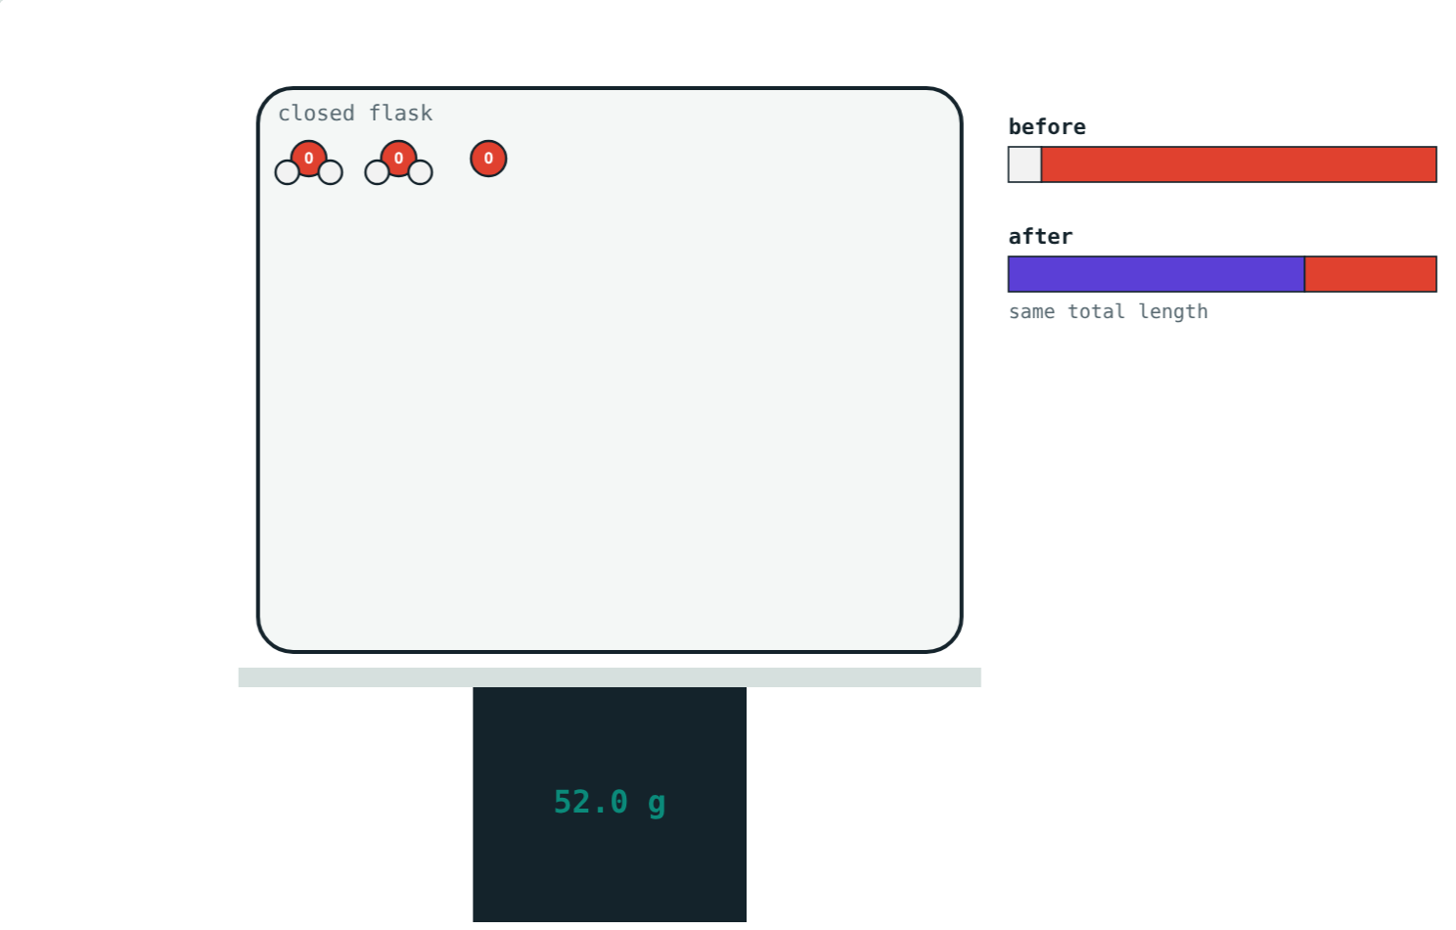
Constant proportions
A compound always contains the same elements in the same proportion by mass.
Water: H : O = 1 : 8
Carbon dioxide: C : O = 3 : 8
Magnesium oxide: Mg : O = 3 : 2
Extra of either element is left over
4 g H with 48 g O: 36 g water + 16 g O left
Notes:
Water from any source has the same 1 : 8 ratio.

Slide 6




Dalton's atomic theory
Atoms
Identical atoms
Rearranged
Whole numbers
All matter is made of tiny particles called atoms.
Atoms of one element are alike; different elements differ.
Atoms are not created or destroyed in a reaction.
Atoms combine in simple whole-number ratios.
Notes:
Point 3 explains conservation of mass; point 4 explains constant proportions.

Slide 7
Worked examples
Making water
Checking samples
4 g of hydrogen reacts completely with 32 g of oxygen. What mass of water forms?
Sample A: 2 g H, 16 g O. Sample B: 5 g H, 40 g O. Same compound?
4 + 32 = 36 g
A: 2 : 16 = 1 : 8
B: 5 : 40 = 1 : 8 → both water
Notes:
Simplify each ratio and compare.

Slide 8
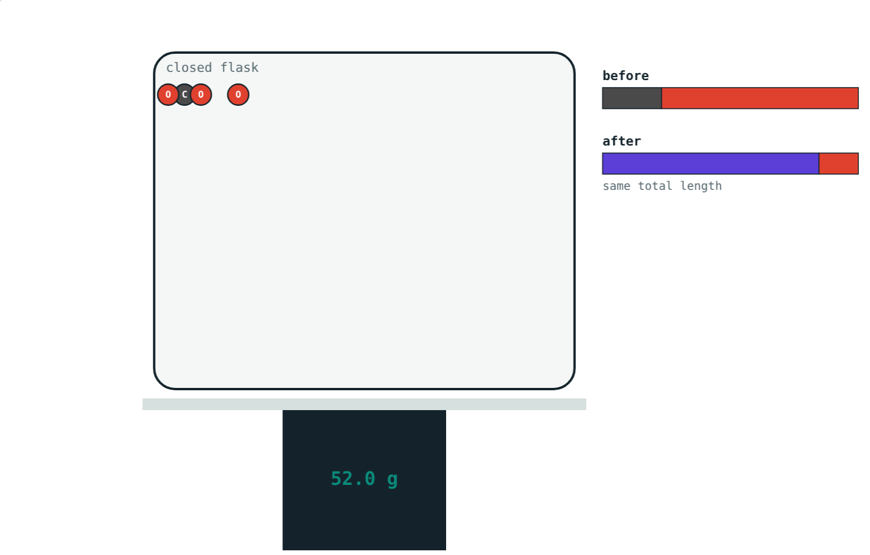
Worked example: too much oxygen
12 g of carbon is burnt in 40 g of oxygen. C : O = 3 : 8. What forms, and what is left over?
Oxygen needed = 12 × 8/3 = 32 g
CO₂ formed = 44 g
Oxygen left = 40 − 32 = 8 g
12 g carbon + 40 g oxygen
Notes:
Total mass is still 52 g: 44 g of CO₂ plus 8 g of oxygen.

Slide 9
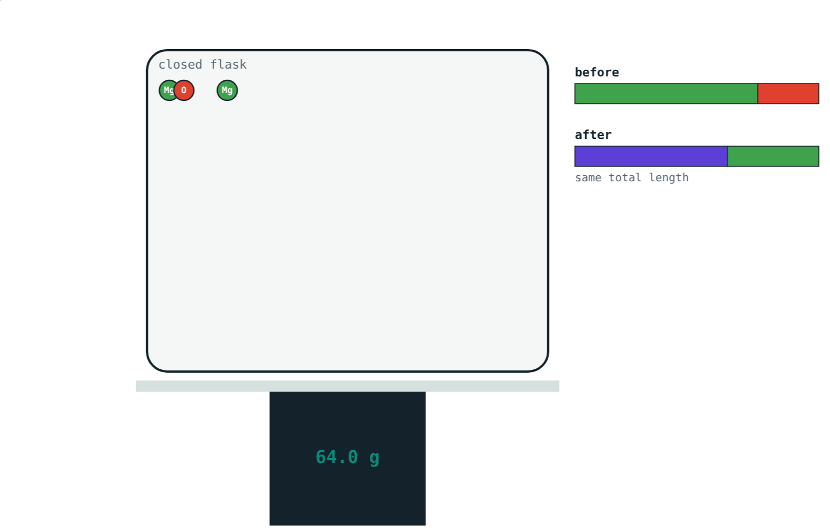
Burning magnesium
Mg : O = 3 : 2, so 16 g of oxygen reacts with 24 g of magnesium:
40 g
magnesium oxide
24 g
magnesium left
The element in short supply decides how much product forms.
48 g magnesium with only 16 g oxygen
Notes:
This idea becomes the 'limiting reactant' in higher classes.

Slide 10

Common mistakes
“The candle lost mass”
Adding everything
Its products escaped as gases.
Excess reactant is left over, not turned into product.
Ratio by atoms
Mixtures too
Constant proportions is about mass.
Only compounds have fixed ratios.
Notes:
The 2 : 1 atom ratio of water versus its 1 : 8 mass ratio is a good discussion point.

Slide 11
Quick check
1
10 g of calcium carbonate gives 5.6 g of calcium oxide. How much CO₂ forms?
2
State the law of constant proportions.
3
What is the mass ratio of hydrogen to oxygen in water?
4
Which point of Dalton's theory explains conservation of mass?
Notes:
Answers: 1) 4.4 g. 2) A compound always contains the same elements in the same proportion by mass. 3) 1 : 8. 4) Atoms are neither created nor destroyed in a reaction.

Slide 12
Weigh a reaction yourself
Open the Laws of Chemical Combination lesson on the Visual Science & Maths website. Change the amounts and watch the balance.
Next lesson: Atoms, molecules and molecular mass
Notes:
Homework idea: research Lavoisier's experiment with mercury oxide.

