Slide 1
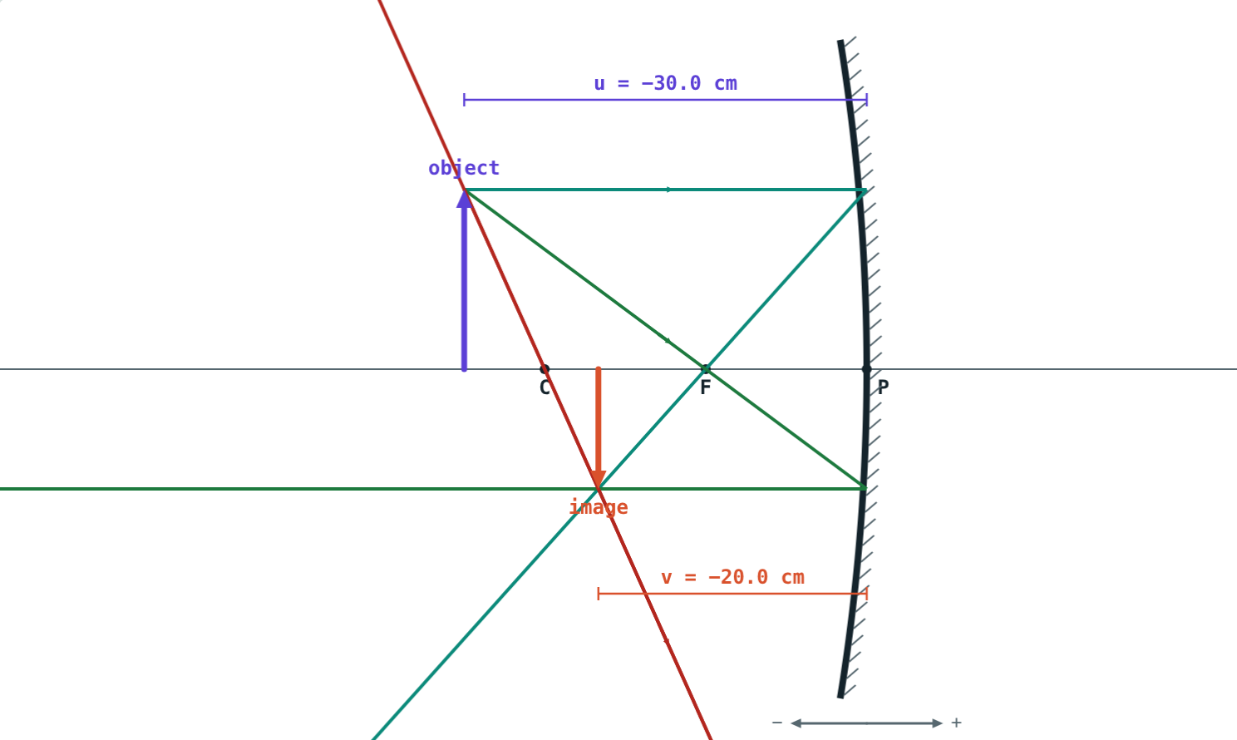
The Mirror Formula and Magnification
STD 9 SCIENCE · CH. 11 REFLECTION OF LIGHT
Lesson 4 · Visual Science & Maths
Notes:
Goal: students can apply the Cartesian sign convention, the mirror formula and the magnification formula.

Slide 2
Exactly where?
A ray diagram gives a rough answer. To place a screen to catch the image, you need a number.
How far from the mirror is the image, exactly?
u = −30 cm, v = −20 cm
Notes:
Recall the ray diagram from the last lesson, then promise a formula that gives the same answer.

Slide 3
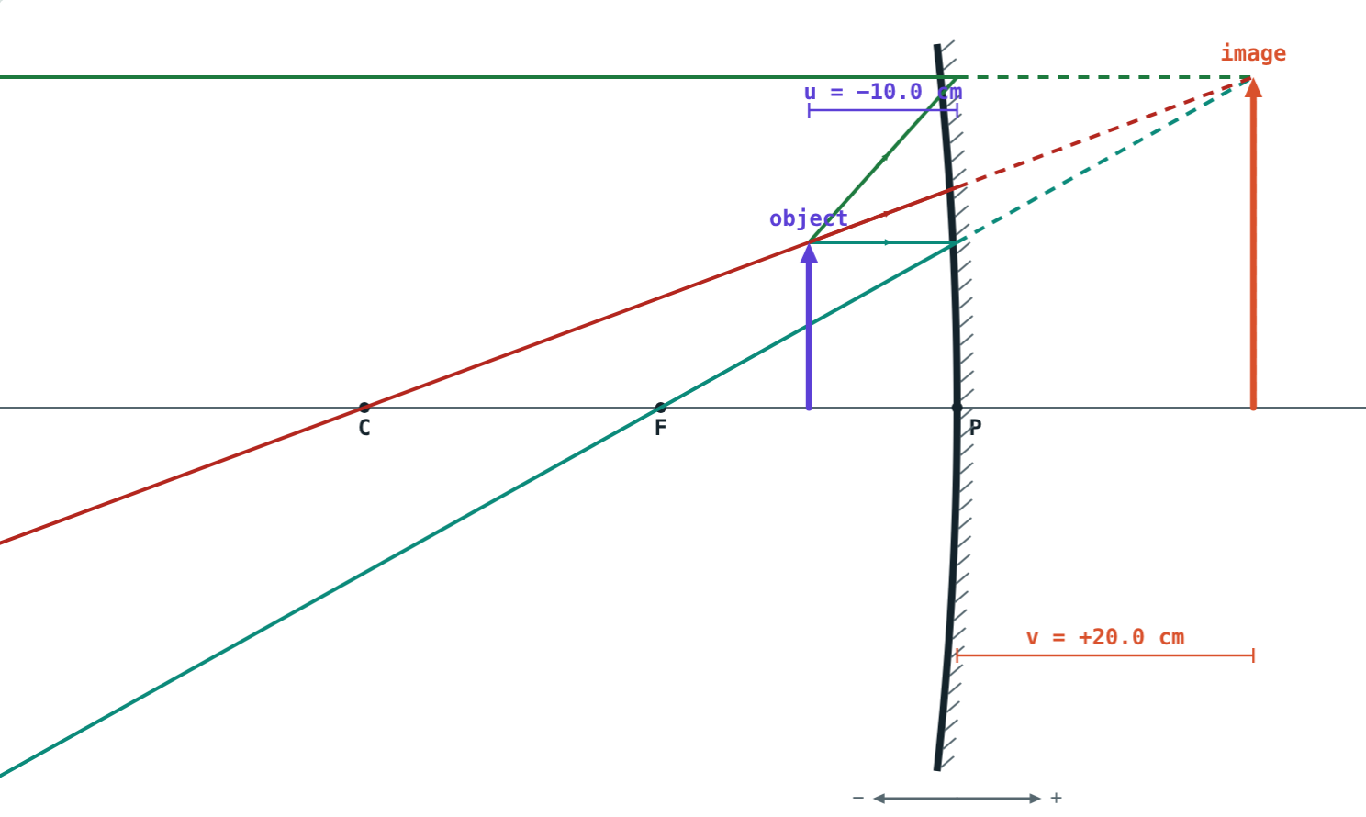
Cartesian sign convention
Pole P is the origin; light travels left to right
Right of P: positive. Left of P: negative
So the object distance u is always negative
Up is positive, down is negative
f: concave negative, convex positive
Distances measured from P
Notes:
It is the same as the x and y axes of a graph, with P at the origin.

Slide 4
The mirror formula
1/v + 1/u = 1/f
Put in every value with its sign
v negative: real image, in front
v positive: virtual image, behind
Turn 1/v over at the end
1/(−20) + 1/(−30) = 1/(−12)
Notes:
Check with the example on screen: −1/20 − 1/30 = −5/60 = −1/12.

Slide 5
Magnification
m = h₂/h₁ = −v/u
m negative: inverted (real)
m positive: erect (virtual)
|m| > 1 magnified, = 1 same size, < 1 diminished
m = +2: erect and twice the size
Notes:
Magnification has no unit.

Slide 6
Signs at a glance
 | Concave, real image | Concave, object inside F | Convex
u | − | − | −
v | − | + | +
f | − | − | +
m | − | + | + (less than 1)
Notes:
Students can use this table to sanity-check their answers.

Slide 7
Worked example: a real image
A 6 cm candle stands 30 cm from a concave mirror, f = 12 cm. Find the image.
1/v = −1/12 + 1/30 = −3/60
v = −20 cm
m = −(−20)/(−30) = −0.67; h₂ = −4 cm
Real, inverted, diminished
Concave, f = 12 cm, object at 30 cm
Notes:
A screen 20 cm in front of the mirror would show a 4 cm inverted image.

Slide 8
Worked example: a shaving mirror
A face is 10 cm from a concave mirror, f = 20 cm. Where is the image, and what is m?
1/v = −1/20 + 1/10 = 1/20
v = +20 cm
m = −(20)/(−10) = +2
Concave, f = 20 cm, face at 10 cm
Notes:
Positive v: behind the mirror, virtual. Positive m: erect.

Slide 9
Worked examples: convex mirrors
Finding v
Finding f
An object is 20 cm from a convex mirror, f = 20 cm. Find v and m.
An object 12 cm from a convex mirror gives an image 6 cm behind it. Find f.
1/v = 1/20 + 1/20 = 1/10
v = +10 cm
m = −10/(−20) = +0.5
1/f = 1/6 + 1/(−12) = 1/12
f = +12 cm
Notes:
A positive f confirms that the mirror is convex.

Slide 10

Common mistakes
Leaving out signs
Positive f for concave
Write u, v and f with signs first.
Concave f is negative.
Forgetting to flip
Ignoring the sign of m
The formula gives 1/v, not v.
Negative m means inverted.
Notes:
Insist on writing 'Given: u = …, f = …' with signs before any calculation.

Slide 11
Quick check
1
In the Cartesian sign convention, is the object distance u positive or negative?
2
A concave mirror has f = −10 cm and u = −30 cm. Find v.
3
An image has m = +2. Describe it.
4
An object 15 cm from a convex mirror forms an image 7.5 cm behind it. Find m.
Notes:
Answers: 1) Always negative. 2) v = −15 cm. 3) Virtual, erect, twice the size of the object. 4) m = −(+7.5)/(−15) = +0.5.

Slide 12
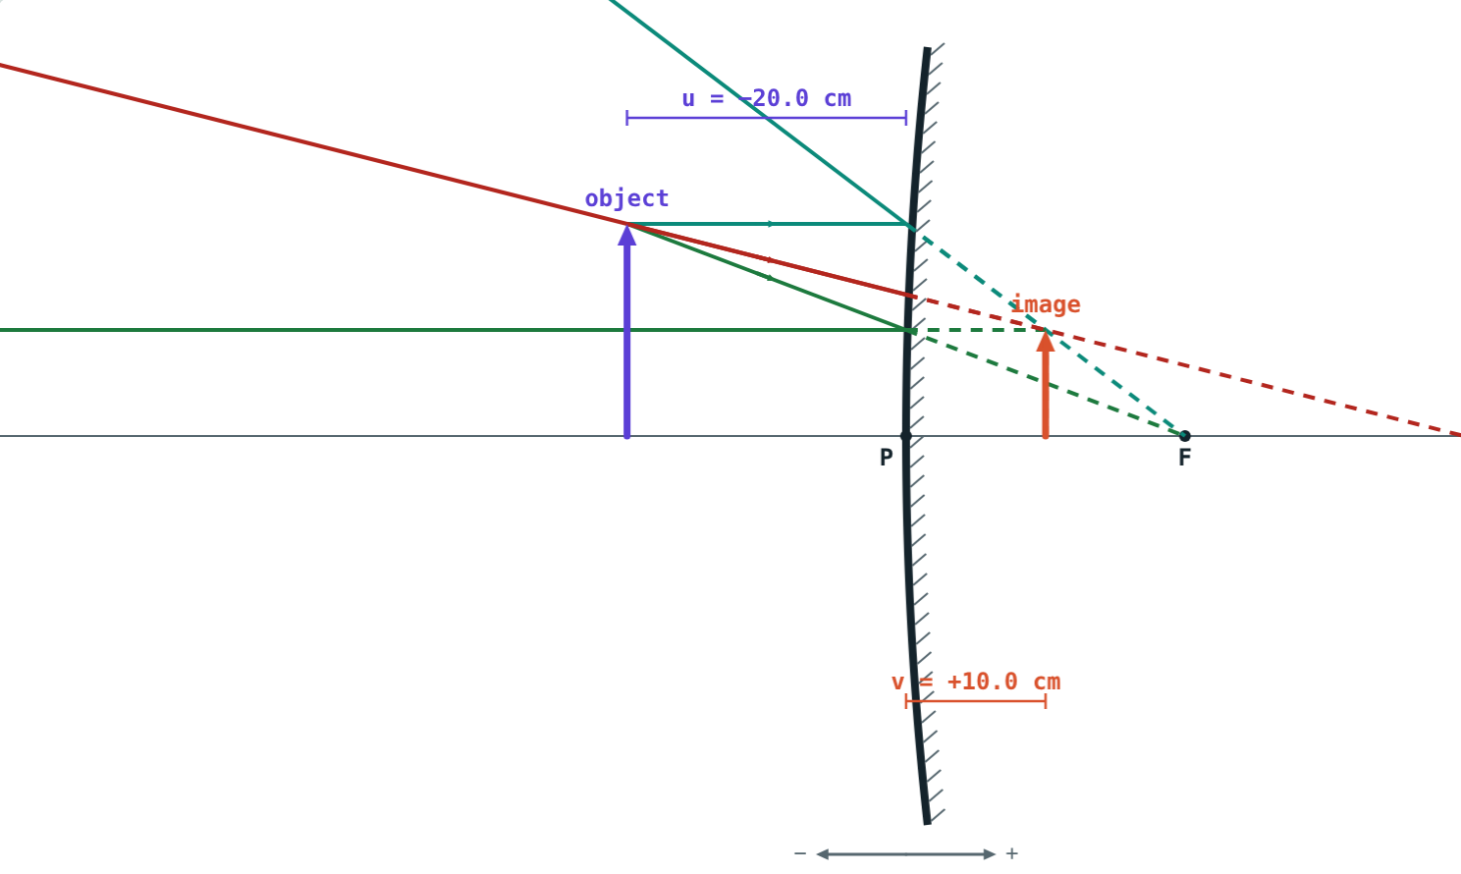
Check every answer live
Open the Mirror Formula lesson on the Visual Science & Maths website. Set u and f, and compare your calculation with the readouts.
That completes Chapter 11: Reflection of Light
Notes:
Homework: the textbook's numerical problems, checked with the simulation.

