Slide 1
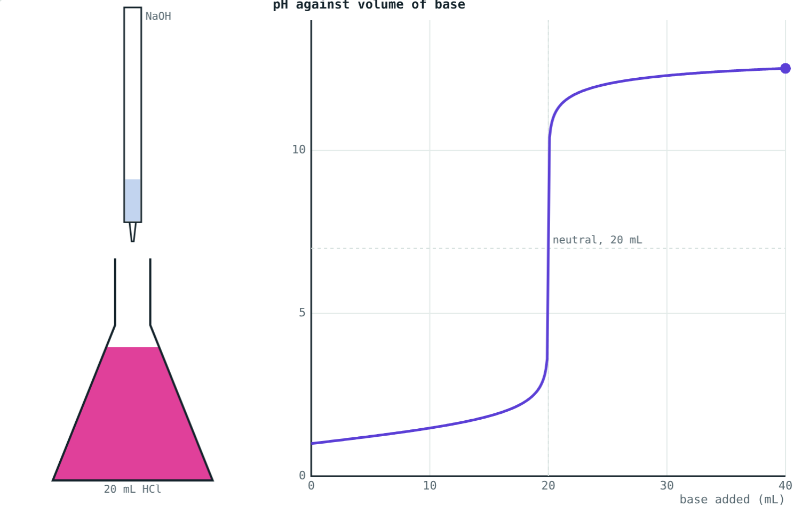
Neutralisation and Salts
STD 9 SCIENCE · CH. 5 ACIDS, BASES AND SALTS
Lesson 2 · Visual Science & Maths
Notes:
Goal: students can write neutralisation equations, describe a titration and end point, and name salts.

Slide 2
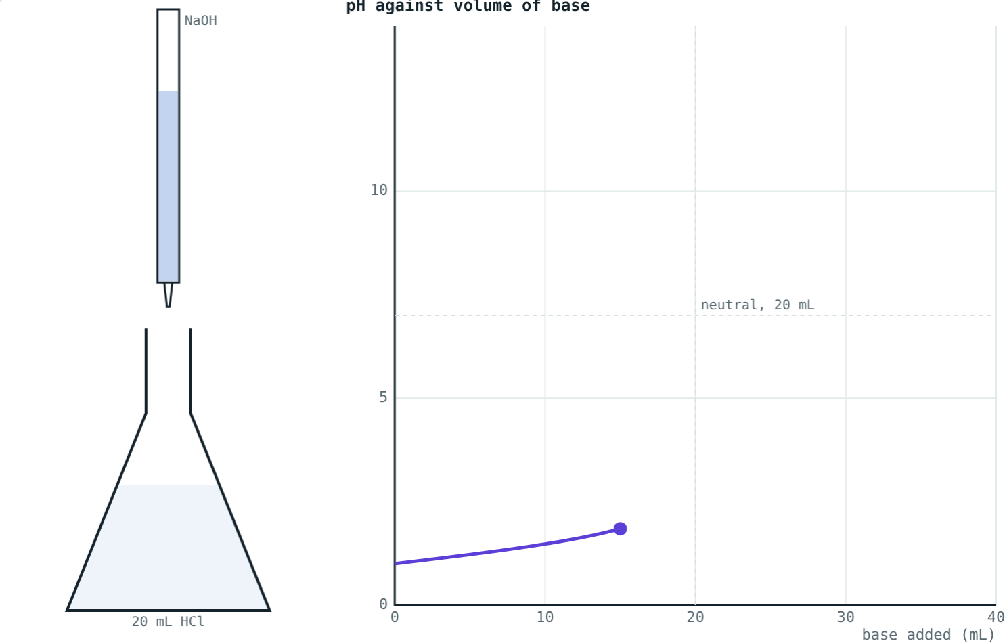
Cancelling out
An antacid soothes an acidic stomach. Lime fixes sour soil. Baking soda eases an ant sting.
What do all three have in common?
Base slowly neutralising acid
Notes:
All are neutralisation reactions.

Slide 3
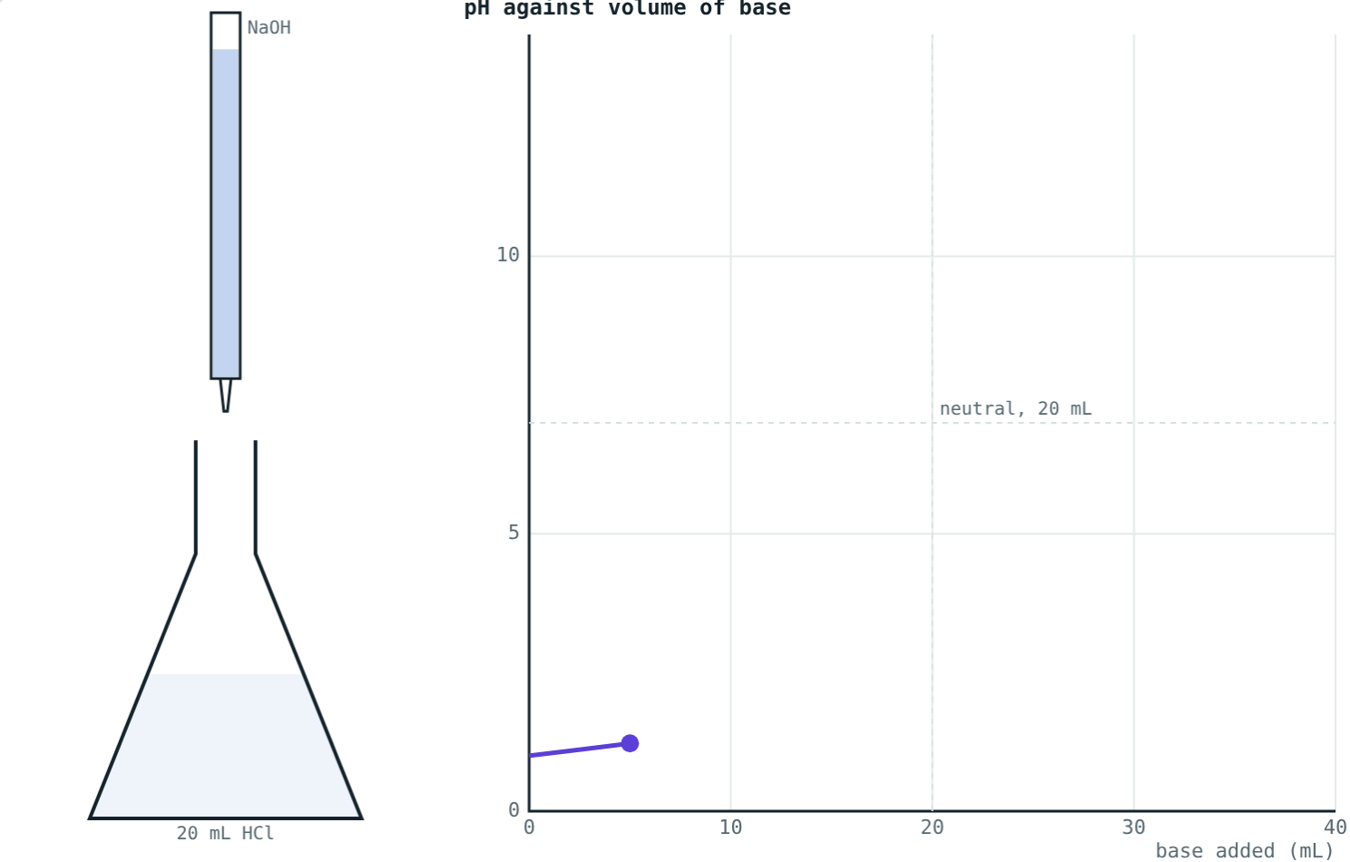
Neutralisation
acid + base → salt + water
HCl + NaOH → NaCl + H₂O
Really: H⁺ + OH⁻ → H₂O
The other ions form the salt
Heat is given out
Titration just started: still acidic
Notes:
Focus on the ionic picture: the H⁺ and OH⁻ make water.

Slide 4
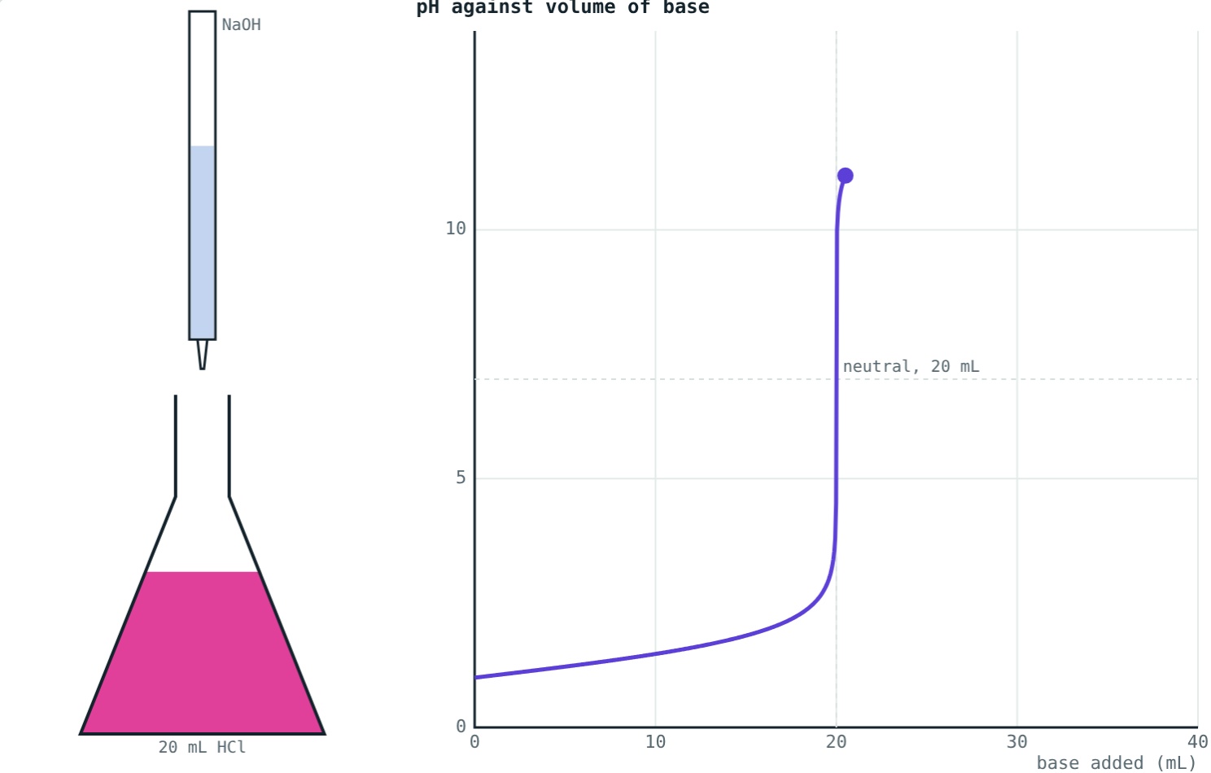
Before and after the end point
Still acidic: colourless, pH about 1.8.
Just past neutral: pink, pH jumps to about 11.
Notes:
Near 20 mL, one drop of base changes the pH from about 4 to about 10.

Slide 5
Titration
Base added drop by drop from a burette
Indicator in the acid
End point: indicator changes colour
pH curve jumps steeply at the end point
The full curve: slow rise, sharp jump, level off
Notes:
Equal strengths: 20 mL of base for 20 mL of acid.

Slide 6
Naming salts
Acid | Base | Salt
HCl | NaOH | Sodium chloride, NaCl
H₂SO₄ | NaOH | Sodium sulphate, Na₂SO₄
HNO₃ | KOH | Potassium nitrate, KNO₃
HCl | NH₄OH | Ammonium chloride, NH₄Cl
Notes:
Metal from the base, ending from the acid. Salts dissociate into ions in water.

Slide 7
Worked examples
Sulphuric acid
An ant sting
Write the equation for H₂SO₄ with NaOH and name the salt.
Vinegar or baking soda on an ant sting?
H₂SO₄ + 2NaOH → Na₂SO₄ + 2H₂O
Salt: sodium sulphate
The sting is acidic
Use baking soda (a base)
Notes:
Balance H₂SO₄: two H⁺ need two OH⁻.

Slide 8
Worked example: the end point
20 mL of 0.1 M HCl is titrated with 0.1 M NaOH. Find the volume at the end point and the salt formed.
H⁺ = 0.1 × 20 = 2 mmol
Base needed = 2 ÷ 0.1 = 20 mL
Salt = 2 mmol NaCl (0.117 g)
Pink just past 20 mL
Notes:
mmol = molarity × mL.

Slide 9




Neutralisation in daily life
Antacids
Stings
Soil
Teeth
Milk of magnesia neutralises extra stomach acid.
Baking soda neutralises an acidic ant or bee sting.
Lime (calcium hydroxide) corrects acidic soil.
Basic toothpaste neutralises acid from bacteria.
Notes:
Ask students for more examples from home.

Slide 10

Common mistakes
“Salt = table salt”
Forgetting water
Any neutralisation product is a salt.
Acid + base gives salt and water.
Unbalanced H₂SO₄
Gradual colour change
It needs 2NaOH.
The pH jumps sharply at the end point.
Notes:
Balancing diprotic acids is a common slip.

Slide 11
Quick check
1
What are the products of neutralisation?
2
Which salt forms from nitric acid and potassium hydroxide?
3
When does phenolphthalein turn pink in a titration of HCl with NaOH?
4
Why does a farmer add lime to acidic soil?
Notes:
Answers: 1) A salt and water. 2) Potassium nitrate. 3) Just past the end point, when the solution becomes basic. 4) To neutralise the excess acid.

Slide 12
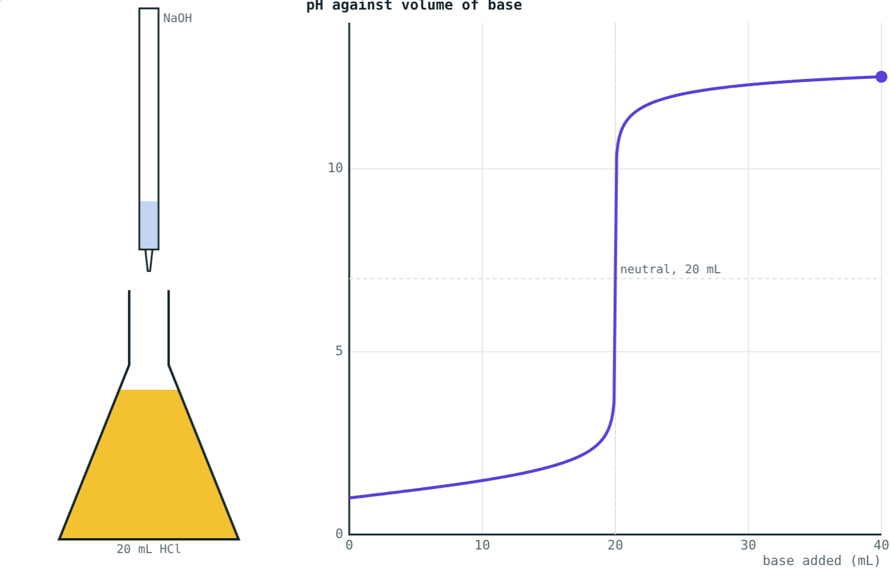
Run a titration yourself
Open the Neutralisation lesson on the Visual Science & Maths website. Change the acid, base and indicator, and watch the curve.
That completes Chapter 5: Acids, Bases and Salts
Notes:
Homework idea: test whether toothpaste is acidic or basic using a natural indicator.

