Slide 1
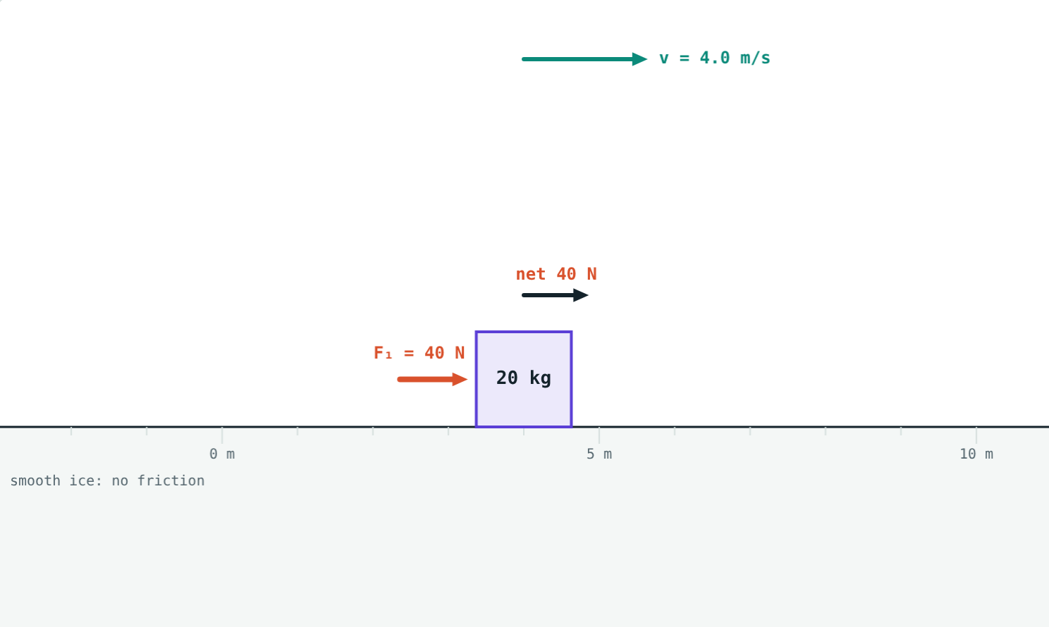
Newton's Laws of Motion
STD 9 SCIENCE · CH. 1 LAWS OF MOTION
Lesson 8 · Visual Science & Maths
Notes:
Goal: students can tell balanced from unbalanced forces, state Newton's three laws, explain inertia, and use F = ma.

Slide 2
Why do things move the way they do?
A bus brakes and passengers lurch forward. A gun fires and kicks back against the shoulder.
What rules connect forces and motion?
A 40 N push on a 20 kg crate on smooth ice
Notes:
Collect students' everyday observations about pushes, pulls and sudden stops.

Slide 3
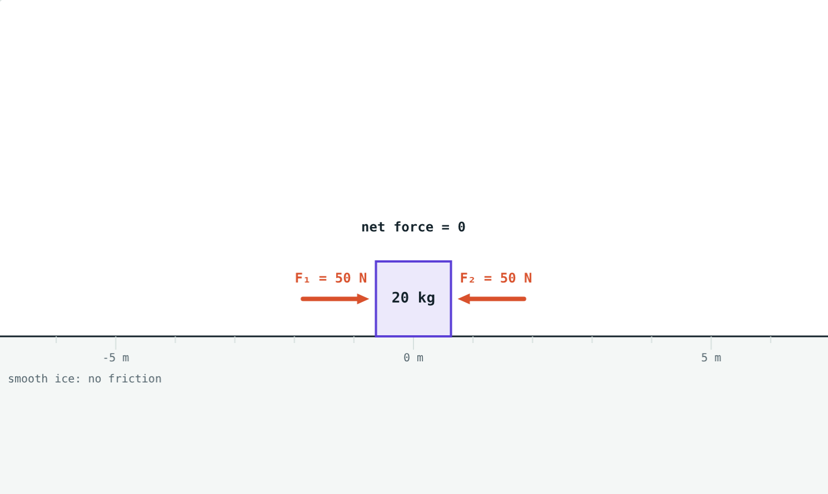
Balanced and unbalanced forces
50 N each way: net force 0, the crate stays at rest.
40 N one way: net force 40 N, the crate speeds up.
Only an unbalanced (net) force changes the motion.
Notes:
Tug of war is the classic example of balanced forces: the rope does not move although both teams pull hard.

Slide 4
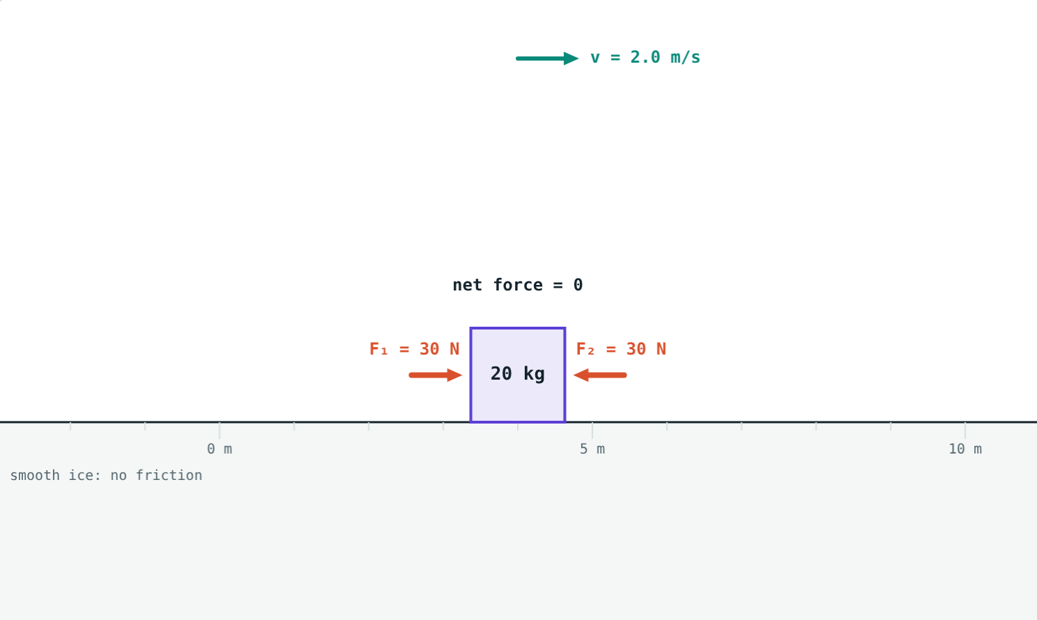
First law: inertia
An object stays at rest, or in uniform motion in a straight line, unless an unbalanced force acts on it.
Inertia: the tendency to keep doing what it is doing
More mass, more inertia
No net force does not mean no motion
Balanced forces on a moving crate: it keeps sliding at 2 m/s
Notes:
The crate in the picture has two equal pushes on it and keeps moving at constant velocity. This surprises students who think motion needs a force.

Slide 5



Three kinds of inertia
Inertia of rest
Inertia of motion
Inertia of direction
Flick a card from under a coin: the coin drops straight into the glass.
When a bus brakes, passengers keep moving forward.
On a sharp turn, passengers feel pushed to the side.
Notes:
Do the coin and card demonstration if you can. It works best with a smooth card and a heavy coin.

Slide 6
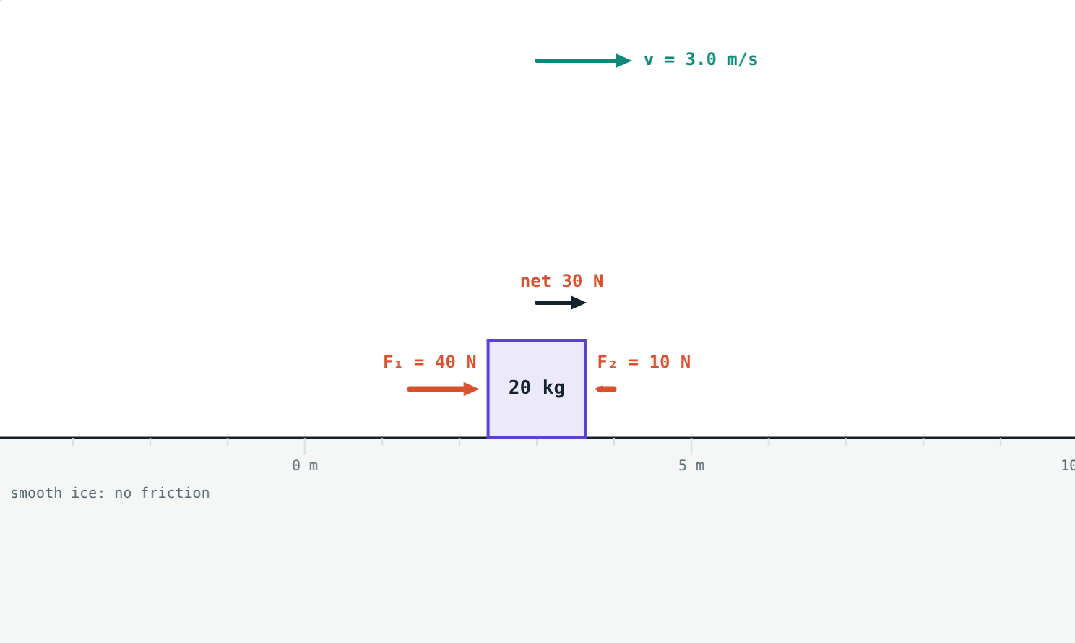
Second law: F = ma
F = ma
Momentum P = mv (kg·m/s)
Rate of change of momentum ∝ applied force
For a fixed mass: F = ma
1 newton gives 1 kg an acceleration of 1 m/s²
Net 30 N on 20 kg: a = 1.5 m/s²
Notes:
Write 1 N = 1 kg × 1 m/s² = 1 kg·m/s² on the board.

Slide 7
Balanced, yet moving
With balanced forces on a moving crate:
0 N
net force
2 m/s
velocity, unchanged
30 N each way on a crate already moving at 2 m/s
Zero net force means zero acceleration, not zero velocity.
Notes:
This is the first and second laws together: F = 0 gives a = 0, so the velocity stays the same.

Slide 8




Third law: action and reaction
Rocket
Gun
Walking
Swimming
Pushes gases down; the gases push it up.
Pushes the bullet forward; the bullet pushes it back.
Your foot pushes the ground back; the ground pushes you forward.
Hands push water back; water pushes the swimmer forward.
Notes:
Every action force has an equal and opposite reaction force, acting at the same time on a different object. The balloon-powered boat is a great class demonstration.

Slide 9
Worked examples
Pushing a crate
A car pulling away
40 N right and 10 N left act on a 20 kg crate on ice. Find the acceleration.
What force gives a 1200 kg car an acceleration of 1.5 m/s²?
Net force = 40 − 10 = 30 N
a = 30 ÷ 20 = 1.5 m/s²
F = ma = 1200 × 1.5 = 1800 N
Notes:
Always find the net force first.

Slide 10
Worked examples: time matters
Catching a cricket ball
Pushing against motion
A 0.15 kg ball at 20 m/s is stopped in 0.1 s. Find the force. What if stopping takes 0.3 s?
A 20 kg crate slides at 3 m/s. A 20 N push acts against it. When does it stop?
Change in momentum = 0.15 × 20 = 3 kg·m/s
Force = 3 ÷ 0.1 = 30 N
Force = 3 ÷ 0.3 = 10 N
a = −20 ÷ 20 = −1 m/s²
0 = 3 − 1 × t, so t = 3 s
Notes:
Pulling the hands back while catching increases the time and reduces the force. The second example uses v = u + at from Lesson 6.

Slide 11

Common mistakes
“Action and reaction cancel”
“Motion needs a force”
They act on different objects, so they never cancel.
Forces change motion. Without friction, motion continues by itself.
Ignoring direction
Grams in F = ma
Opposite forces subtract. Find the net force first.
Mass must be in kg: 150 g = 0.15 kg.
Notes:
The first two are deep misconceptions; spend time on them.

Slide 12
Quick check
1
A book lies still on a table. Are the forces on it balanced or unbalanced?
2
A bus starts suddenly and passengers fall backwards. Which kind of inertia?
3
A net force of 12 N acts on a 4 kg trolley. Find its acceleration.
4
A swimmer pushes water backwards. What does the reaction force do?
Notes:
Answers: 1) Balanced. 2) Inertia of rest. 3) 3 m/s². 4) It pushes the swimmer forwards.

Slide 13
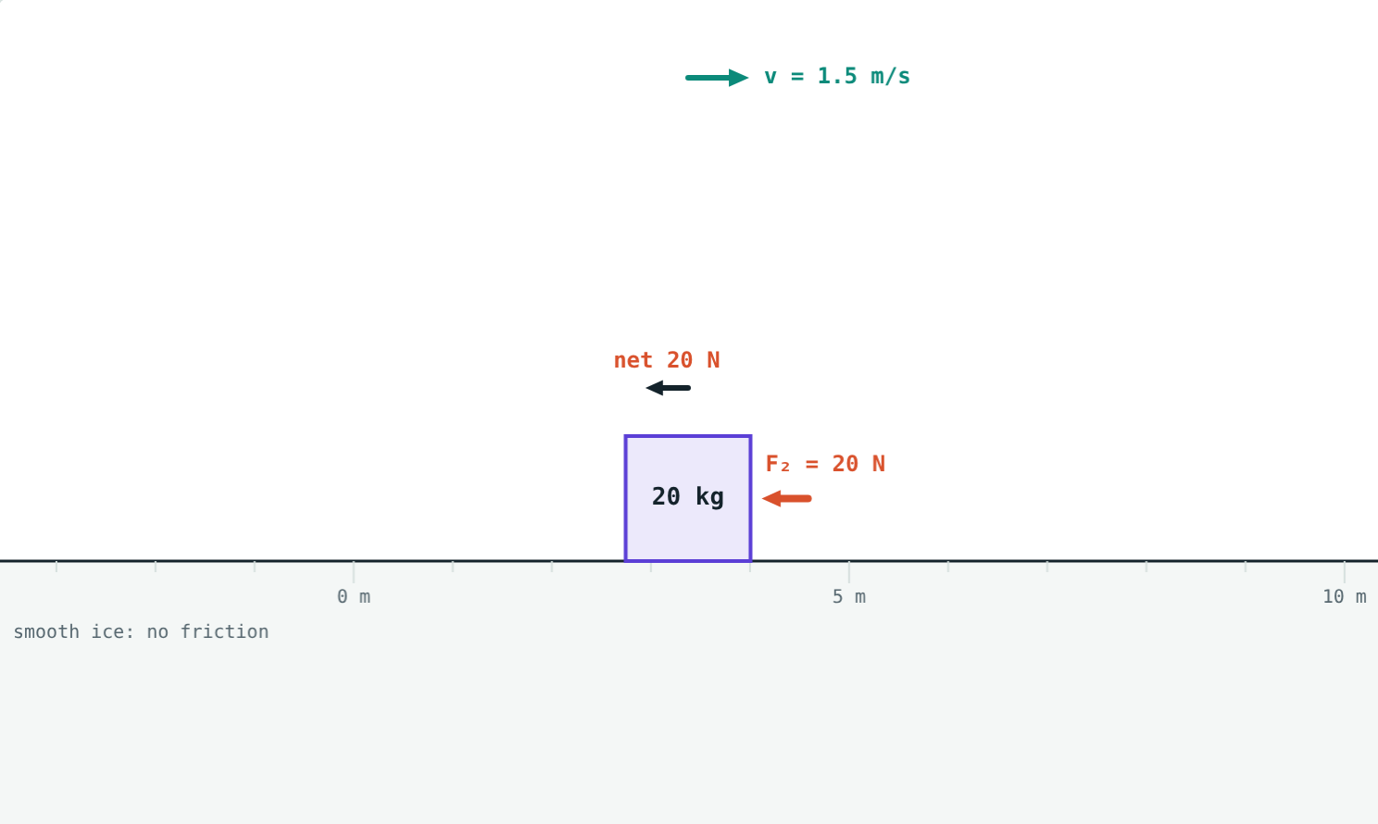
Push the crate yourself
Open the Newton's Laws lesson on the Visual Science & Maths website. Balance the forces, unbalance them, and watch the velocity.
Next lesson: Conservation of momentum
Notes:
Homework idea: make a balloon-powered boat or car and explain its motion using the third law.

