Slide 1
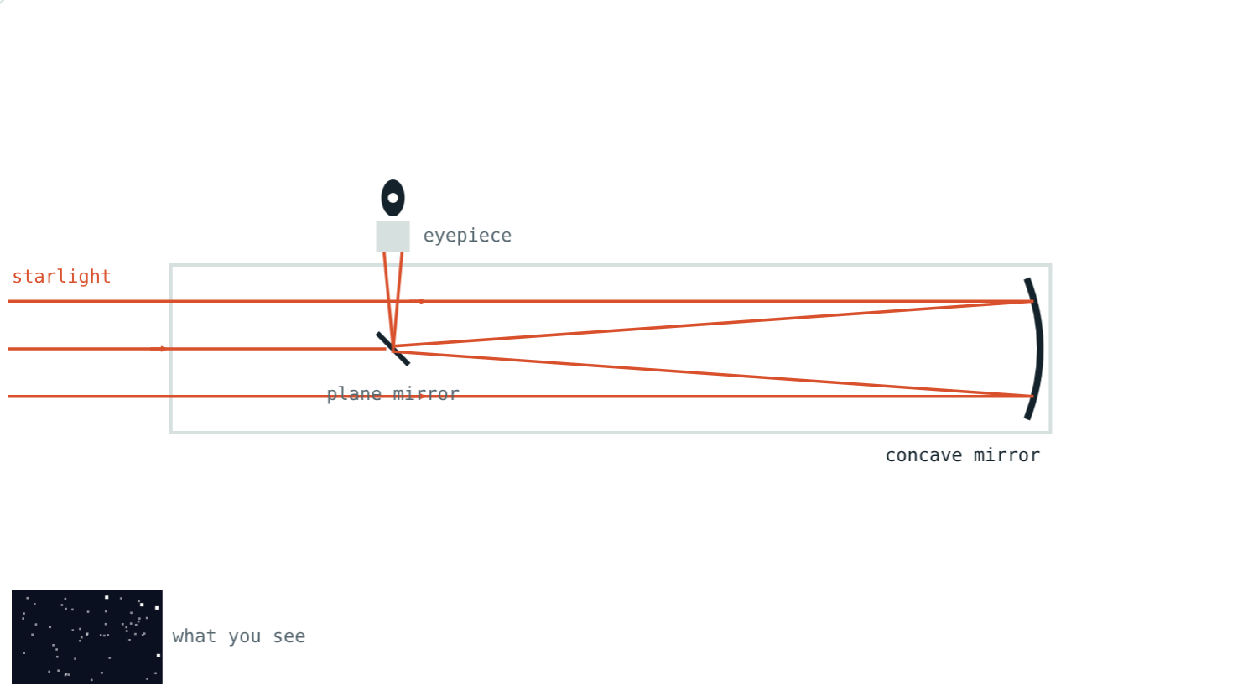
Optical and Radio Telescopes
STD 9 SCIENCE · CH. 18 OBSERVING SPACE: TELESCOPES
Lesson 2 · Visual Science & Maths
Notes:
Goal: students can describe refracting, Newtonian, Cassegrain and radio telescopes and explain why aperture matters.

Slide 2
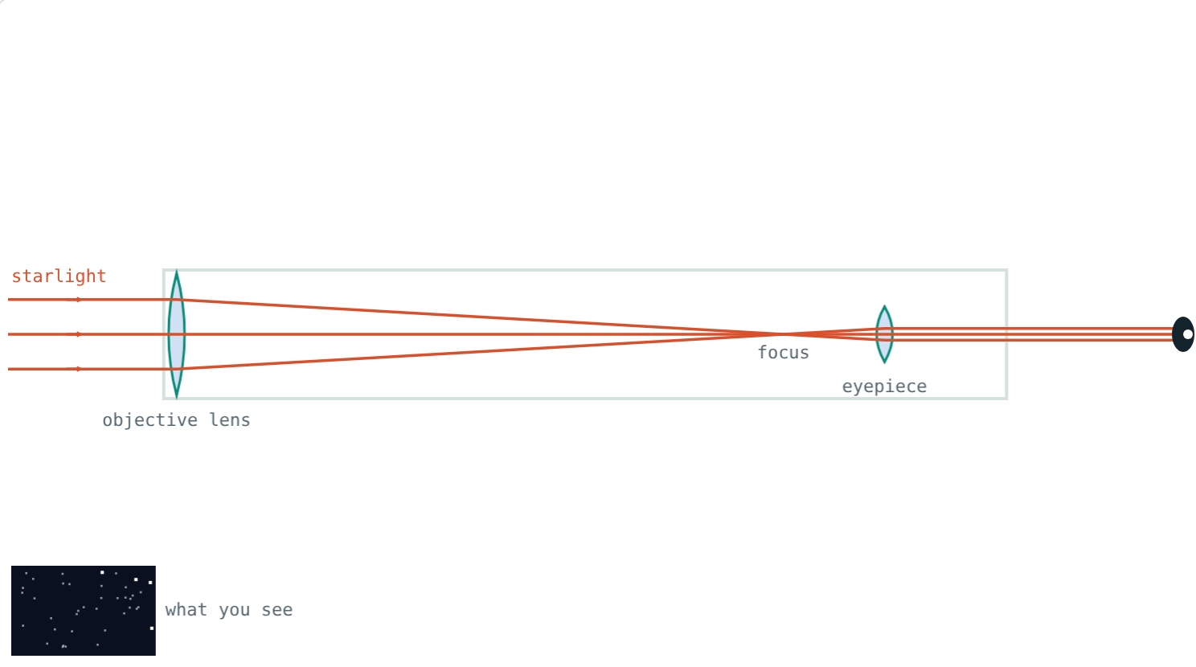
Galileo's first look
In 1609 Galileo turned a small telescope to the sky and saw craters on the Moon and four moons circling Jupiter.
What does a telescope do that the eye cannot?
A refracting telescope like Galileo's
Notes:
Two jobs: gather more light, and show finer detail.

Slide 3

Gathering light
light gathered ∝ D²
D is the aperture: width of the main lens or mirror
Your pupil is about 7 mm wide at night
Twice the width collects four times the light
14 cm: about 400 times your eye
Notes:
Light collected depends on area, and area goes as the square of the width.

Slide 4
Refracting telescope
Convex objective lens focuses the light
Eyepiece lens magnifies the image
Big lenses sag and give coloured fringes
Largest ever: about 1 m wide
Objective, focus, eyepiece
Notes:
Coloured fringes happen because different colours focus at slightly different points.

Slide 5
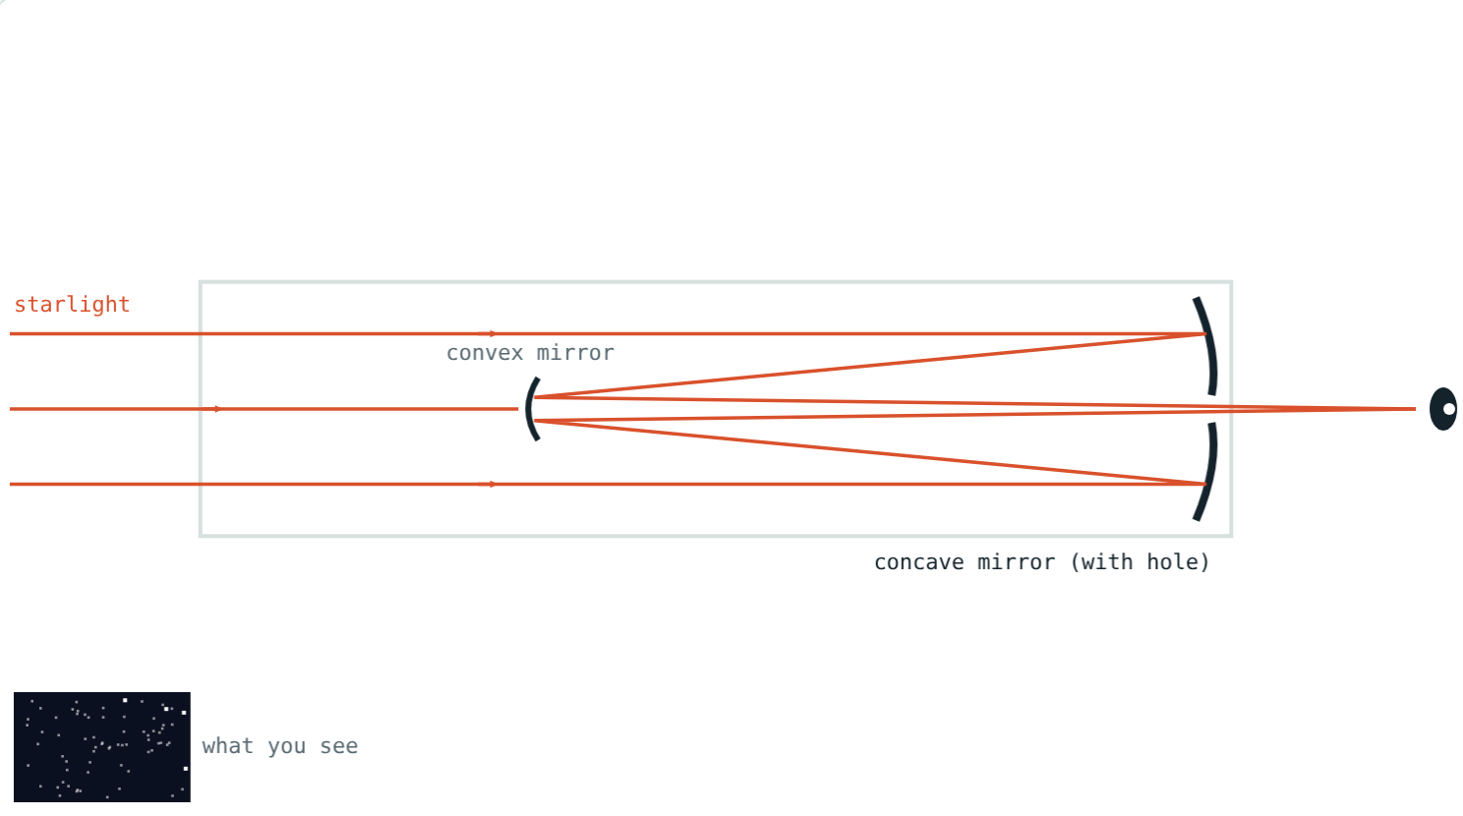
Two kinds of reflector
Concave mirror + plane mirror at 45°; eyepiece at the side.
Concave mirror with a hole + convex mirror; eyepiece at the back.
Notes:
Newton built the first reflecting telescope in 1668.

Slide 6



Why mirrors win
Support
No colour fringes
Huge sizes
A mirror can be held up from behind; a lens only at its edge.
All colours reflect to the same focus.
Mirrors can be 10 m wide, even made of segments.
Notes:
Every large modern telescope is a reflector.

Slide 7
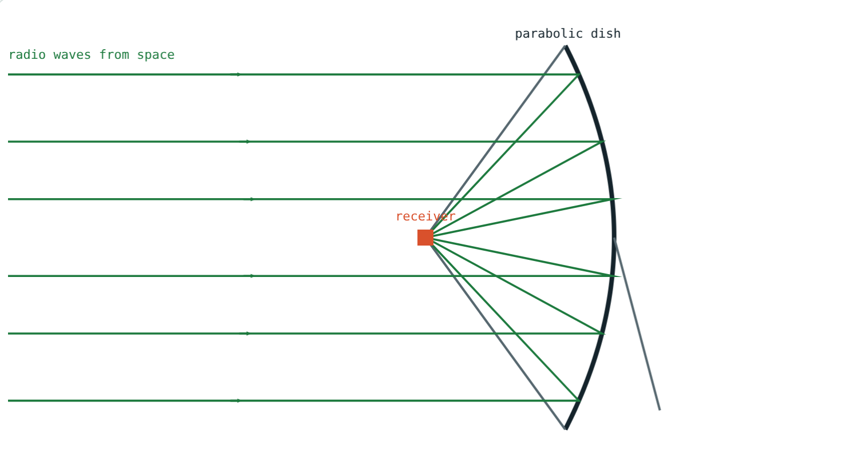
Radio telescopes
A parabolic metal dish reflects radio waves
The receiver sits at the focus
Radio waves are long, so dishes are huge
GMRT near Pune: 30 dishes, each 45 m wide
Parallel waves meet at the receiver
Notes:
GMRT is run by NCRA-TIFR; its dishes are spread over about 25 km near Narayangaon.

Slide 8
Worked examples
A small telescope
Doubling
D = 14 cm, pupil = 0.7 cm. How much more light?
A 50 cm mirror is replaced by a 100 cm one. How much more light?
14 ÷ 0.7 = 20
20² = 400 times
2² = 4 times
Notes:
Square the ratio of widths.

Slide 9
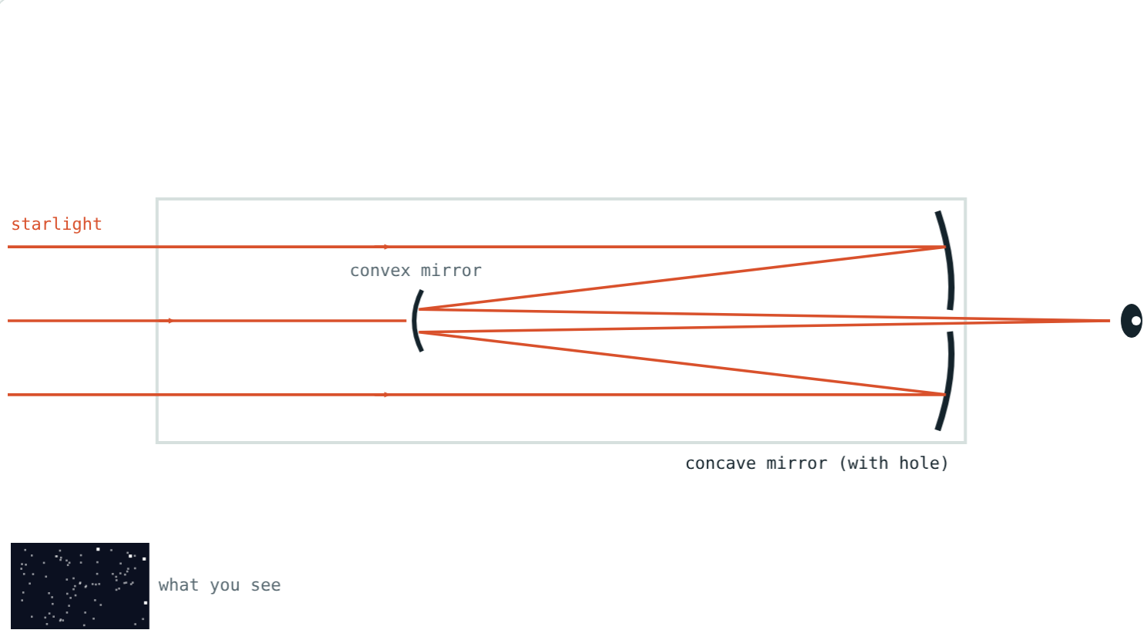
The Hubble Space Telescope
240 cm ÷ 0.7 cm ≈ 343, and 343² ≈
1.2 lakh
times your eye
2.4 m
mirror width
A 2.4 m Cassegrain-type mirror
It can see objects billions of times fainter than the eye can.
Notes:
Hubble's design is a Cassegrain variant called Ritchey–Chrétien.

Slide 10

Common mistakes
“Just a magnifier”
“Twice as wide, twice the light”
First, it collects light.
Four times: area goes as D².
Mixing up reflectors
“Radio telescopes hear sounds”
Newtonian: plane mirror. Cassegrain: convex mirror.
They detect radio waves.
Notes:
Ask students to correct each statement in their own words.

Slide 11
Quick check
1
Which telescope uses a concave mirror and a plane mirror?
2
Why are all very large telescopes reflectors?
3
A telescope's aperture is tripled. How much more light does it gather?
4
Where is the GMRT?
Notes:
Answers: 1) Newtonian. 2) Big lenses sag and give coloured fringes; mirrors can be supported from behind. 3) 9 times. 4) Near Narayangaon, about 80 km from Pune.

Slide 12
Trace the light yourself
Open the Optical and Radio Telescopes lesson on the Visual Science & Maths website. Switch designs and change the aperture.
Next lesson: Telescopes in space
Notes:
Activity: make a simple refractor from two magnifying lenses and a paper tube.

