Slide 1
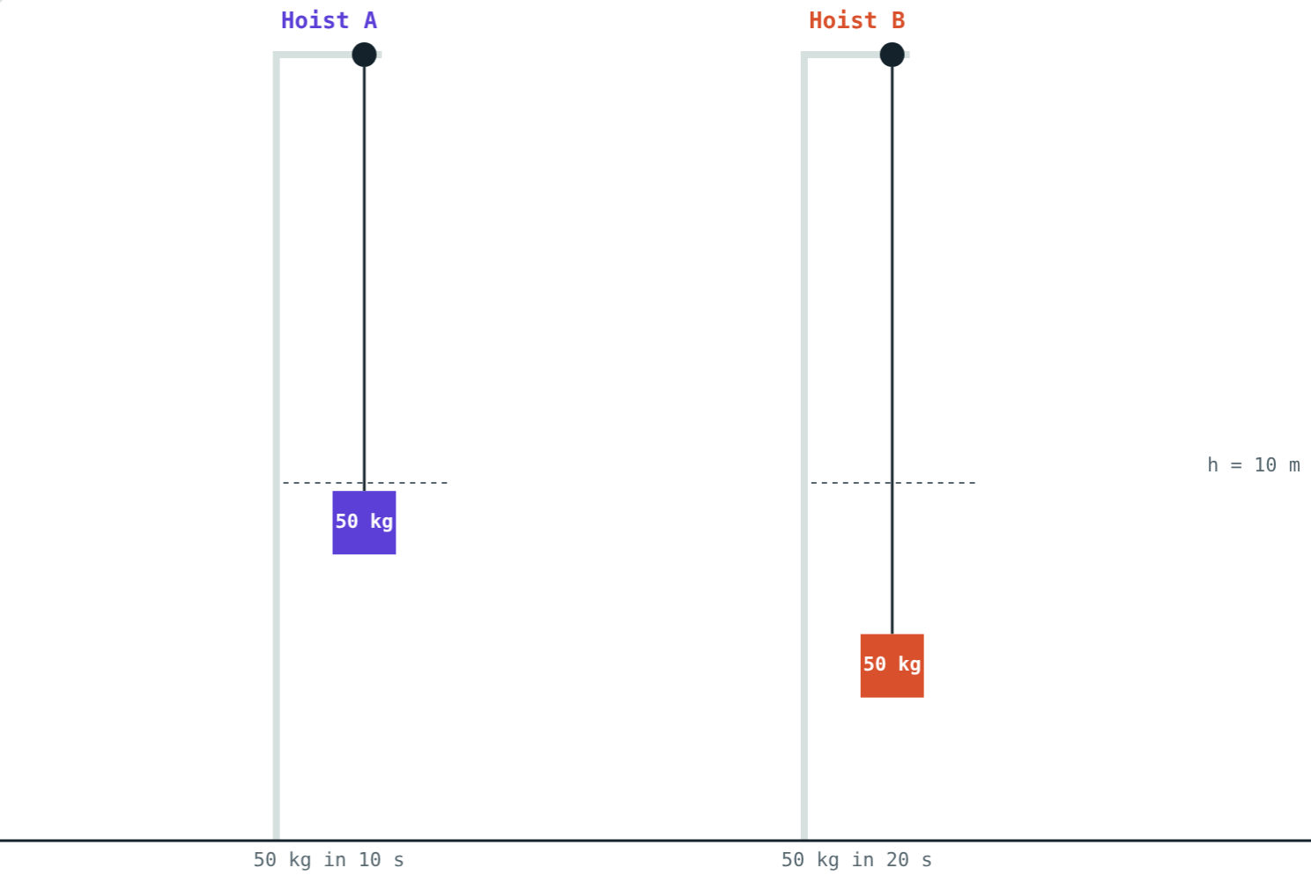
Power
STD 9 SCIENCE · CH. 2 WORK AND ENERGY
Lesson 4 · Visual Science & Maths
Notes:
Goal: students can calculate power, use watts, kilowatts and horsepower, and work out electricity use in kWh.

Slide 2
Same work, different speed
Two students carry identical bags up the same staircase. One runs, one walks.
Who does more work? Who is more powerful?
Same load, same height: A takes 10 s, B takes 20 s
Notes:
They do the same work. The runner is more powerful because she does it faster.

Slide 3
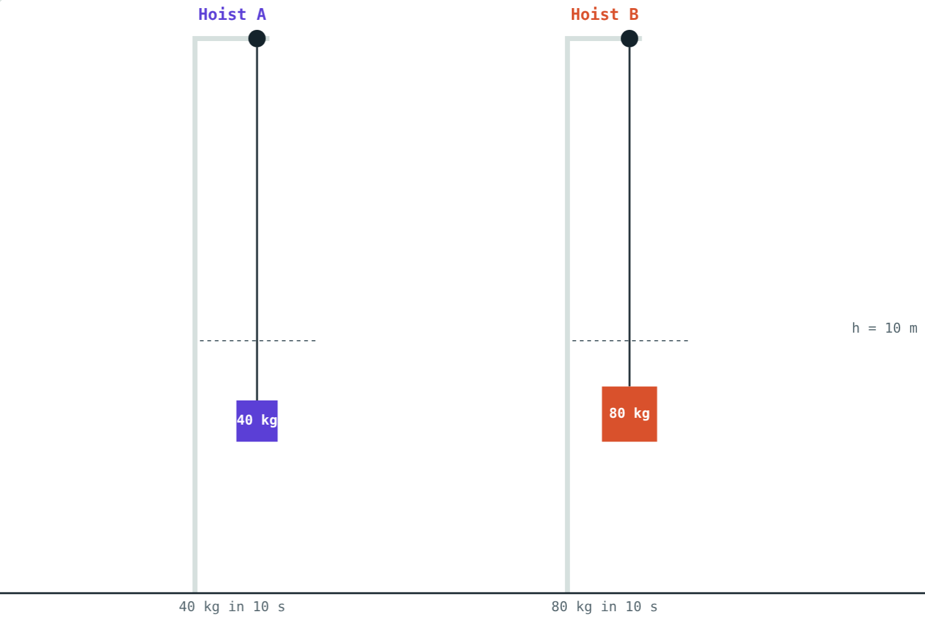
Power
P = W ÷ t
The rate of doing work
Unit: watt (W) = 1 J per second
1 kW = 1000 W
1 horsepower (hp) = 746 W
B lifts twice the load in the same time: twice the power
Notes:
Power is also the rate at which energy is transferred, for example by an electric heater.

Slide 4
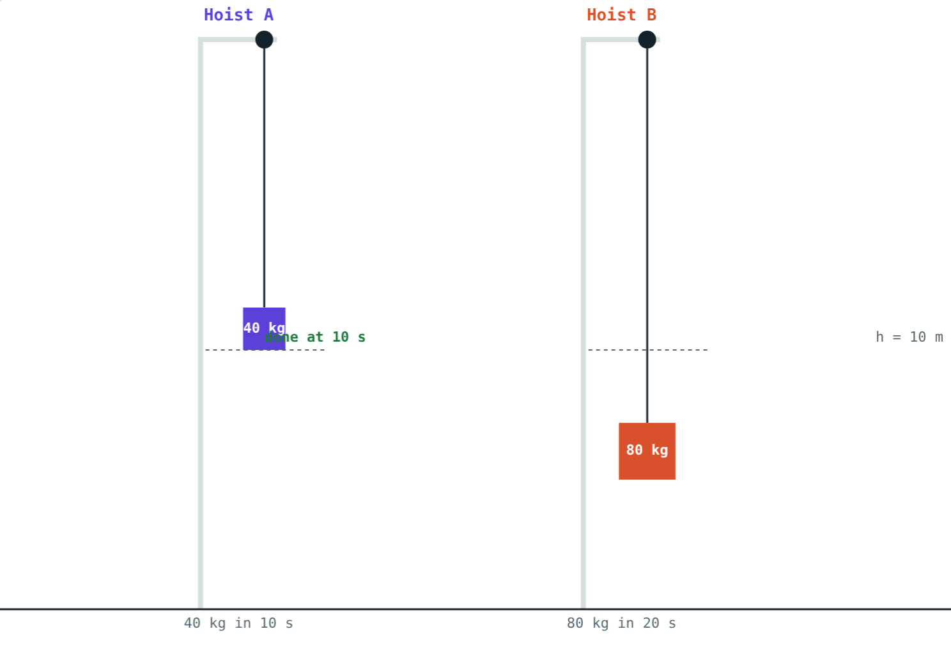
Comparing hoists
Same 4900 J of work: A 490 W, B 245 W.
Twice the work in twice the time: both 392 W.
Notes:
Power depends on both work and time.

Slide 5
Who is more powerful?
Same work, 4900 J each. A takes 10 s, B takes 20 s:
490 W
hoist A
245 W
hoist B
Doing the same work in half the time means twice the power.
Both lift 50 kg through 10 m
Notes:
P = 4900 ÷ 10 and 4900 ÷ 20.

Slide 6
The kilowatt hour
1 kWh
3.6 MJ
kW × h
The “unit” on your bill
In joules
How to calculate
Energy used by 1 kW for 1 hour.
1000 W × 3600 s = 3.6 × 10⁶ J.
Units = power in kW × time in hours.
Notes:
The kWh is a unit of energy, not power. Students often mix these up.

Slide 7
Worked examples
Climbing the stairs
A water pump
Raju (50 kg) runs up stairs 12 m high in 20 s. Find his work and power.
A pump lifts 200 kg of water 15 m in 60 s. Find its power in W and hp.
W = 50 × 9.8 × 12 = 5880 J
P = 5880 ÷ 20 = 294 W
W = 200 × 9.8 × 15 = 29 400 J
P = 29 400 ÷ 60 = 490 W
In hp: 490 ÷ 746 ≈ 0.66 hp
Notes:
Remind students to use seconds for watts.

Slide 8
Worked example: the geyser bill
A 1500 W geyser runs 40 minutes a day. Find the units used in 30 days and the cost at ₹8 per unit.
Per day: 1.5 kW × ⅔ h = 1 kWh
In 30 days: 30 kWh
Cost: 30 × 8 = ₹240
Power × time = energy
Notes:
Have students check a real electricity bill at home.

Slide 9
Household appliances
Appliance | Power | Units in 4 h a day for 30 days
LED bulb | 9 W | 1.1 kWh
Ceiling fan | 75 W | 9 kWh
Television | 100 W | 12 kWh
Iron | 1000 W | 120 kWh
Geyser | 2000 W | 240 kWh
Notes:
Units = kW × 4 × 30. The lesson page has a calculator for this.

Slide 10

Common mistakes
Work vs power
Minutes for watts
Work in J; power in J/s = W.
Use seconds for watts, hours for kWh.
Watts in kWh
“kWh is power”
Divide by 1000 first.
kWh is a unit of energy.
Notes:
Unit errors are the main source of wrong answers in this lesson.

Slide 11
Quick check
1
A motor does 6000 J of work in 30 s. Find its power.
2
How many joules are in 1 kWh?
3
How many watts make 1 horsepower?
4
Two equal-mass girls climb the same stairs in 10 s and 15 s. Who is more powerful?
Notes:
Answers: 1) 200 W. 2) 3.6 × 10⁶ J. 3) 746 W. 4) The one who takes 10 s.

Slide 12
Race the hoists yourself
Open the Power lesson on the Visual Science & Maths website. Compare two hoists, then work out your home's electricity use.
Next lesson: Simple machines
Notes:
Homework idea: list the appliances at home, their power ratings and daily use, and estimate the monthly bill.

