Slide 1
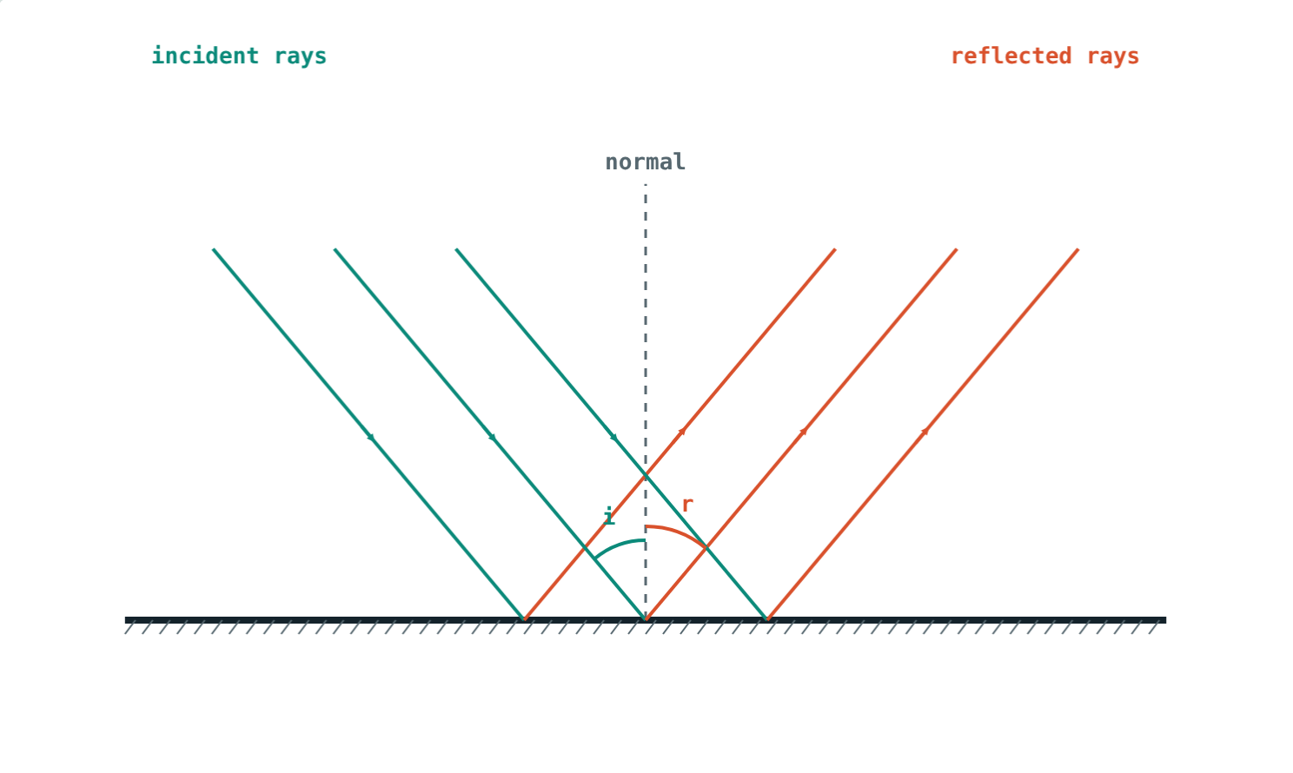
Reflection and Plane Mirrors
STD 9 SCIENCE · CH. 11 REFLECTION OF LIGHT
Lesson 1 · Visual Science & Maths
Notes:
Goal: students can state the laws of reflection, tell regular from irregular reflection, and describe the image in a plane mirror.

Slide 2
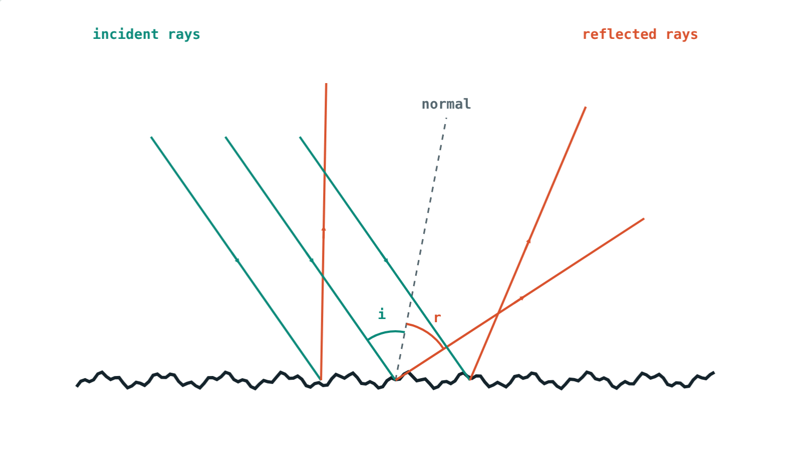
Mirror or paper?
A mirror shows your face. A sheet of white paper reflects light too, yet shows no image at all.
What makes the difference?
A rough surface scatters the light
Notes:
Let students guess before revealing: smoothness. Both surfaces obey the same laws.

Slide 3
The laws of reflection
∠i = ∠r
Angles are measured from the normal
Incident ray, normal and reflected ray lie in one plane
Incident and reflected rays are on opposite sides of the normal
i = 40°, so r = 40°
Notes:
The normal is the line at 90° to the mirror at the point where the ray strikes.

Slide 4
Regular and irregular reflection
Parallel rays stay parallel: a clear image.
Each ray obeys i = r, but the rays scatter.
Notes:
Diffuse reflection is why we can read a page or see a wall from any direction.

Slide 5
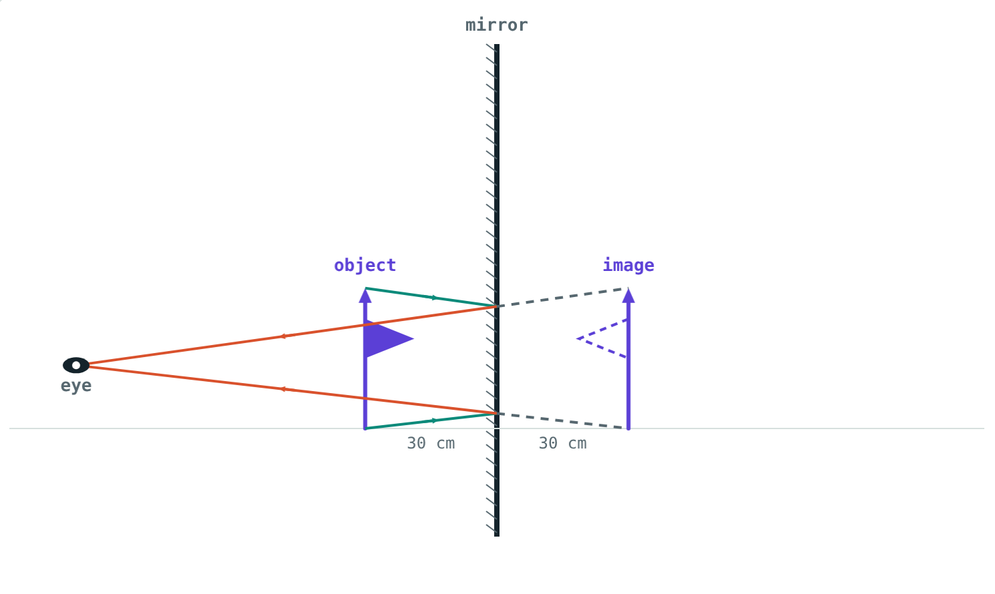
The image in a plane mirror
Virtual: cannot be caught on a screen
Erect and the same size as the object
As far behind the mirror as the object is in front
Laterally inverted: left and right swapped
Rays only seem to come from behind the mirror
Notes:
The eye traces the reflected rays back in straight lines to the image point.

Slide 6




Lateral inversion around you
Ambulance
Your hands
Clocks
Writing
The word is painted reversed so drivers read it in their mirrors.
Raise your right hand: your image raises its left.
A clock in a mirror seems to run backwards.
Words in a mirror read from right to left.
Notes:
Ask students to write their name so that it reads correctly in a mirror.

Slide 7
Worked examples
Walking towards a mirror
A candle
Asha stands 3 m from a mirror, then walks 1 m closer. How far is she from her image each time?
A candle is 15 cm in front of a plane mirror. How far apart are the candle and its image?
3 + 3 = 6 m
2 + 2 = 4 m
Image 15 cm behind the mirror
15 + 15 = 30 cm
Notes:
Moving 1 m towards the mirror brings you 2 m closer to your image.

Slide 8
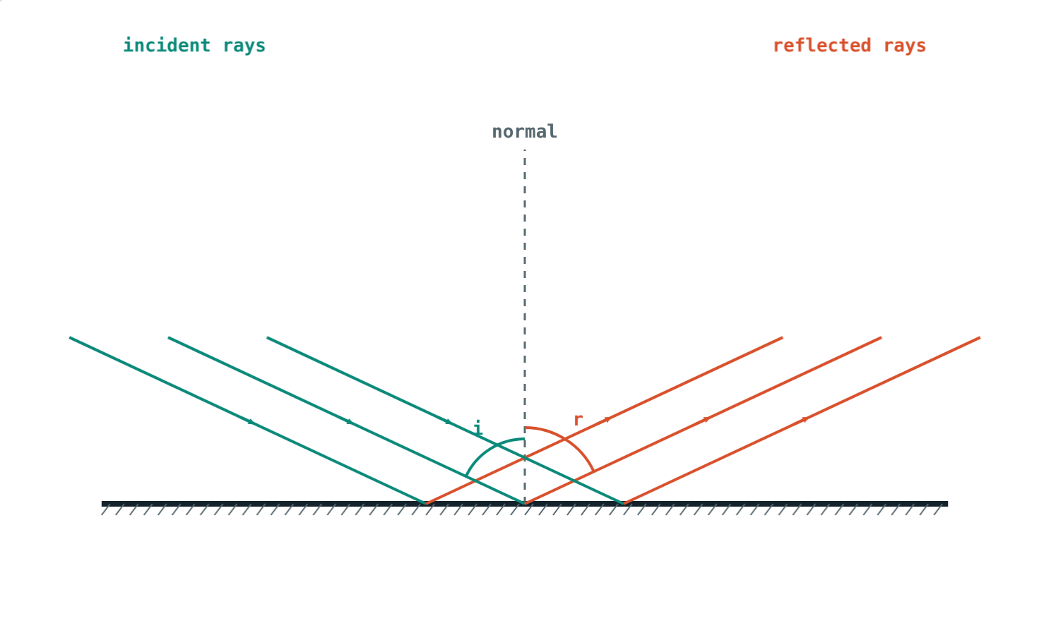
Worked example: angle from the surface
A ray makes 25° with the surface of a mirror. Find i, r and the angle between the incident and reflected rays.
i = 90° − 25° = 65°
r = i = 65°
Angle between rays = 65° + 65° = 130°
i = r = 65°
Notes:
The classic trap is to take i as 25°.

Slide 9
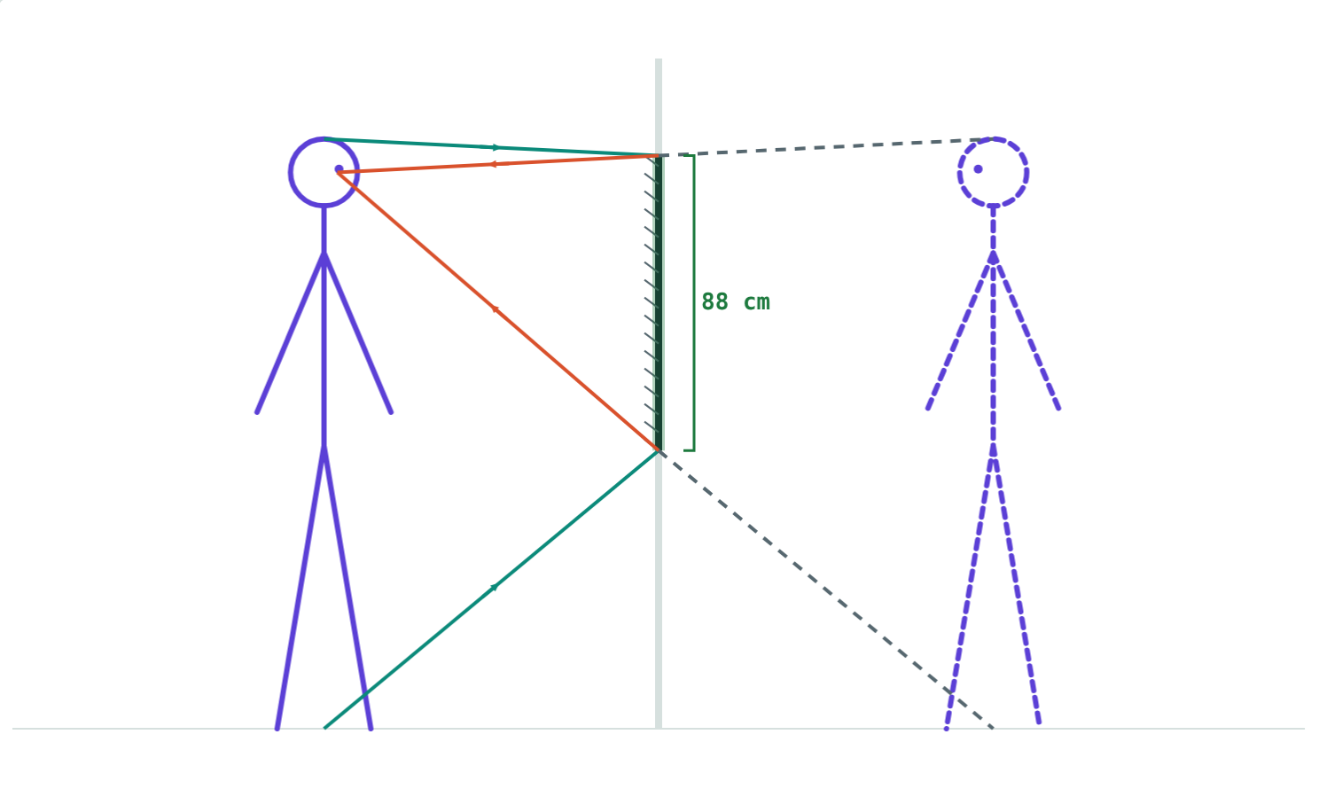
A mirror for the hall
To see himself head to toe:
88 cm
mirror length
83 cm
bottom edge above floor
Rohan: 176 cm tall, eyes at 166 cm
Half your height is enough, at any distance.
Notes:
Top edge: halfway between eyes and top of head, (166 + 176) ÷ 2 = 171 cm.

Slide 10

Common mistakes
Angle from the mirror
Image on the mirror
Measure i and r from the normal.
It is as far behind as the object is in front.
“Rough surfaces break the laws”
A full-height mirror
Each ray still obeys i = r.
Half your height is enough.
Notes:
Drawing the normal first avoids the first mistake.

Slide 11
Quick check
1
A ray hits a mirror with i = 40°. What is the angle of reflection?
2
Why can you read a book from almost any direction?
3
A candle is 15 cm in front of a plane mirror. Describe its image.
4
Why is AMBULANCE written reversed on the front of an ambulance?
Notes:
Answers: 1) 40°. 2) The rough page reflects light irregularly in all directions. 3) Virtual, erect, same size, 15 cm behind the mirror. 4) Lateral inversion: it reads correctly in a driver's rear-view mirror.

Slide 12
Bounce some light yourself
Open the Reflection and Plane Mirrors lesson on the Visual Science & Maths website. Sweep the angle, roughen the surface and move the object.
Next lesson: Images in inclined mirrors
Notes:
Homework idea: measure the angles of incidence and reflection with a mirror strip, a protractor and pins.

