Slide 1
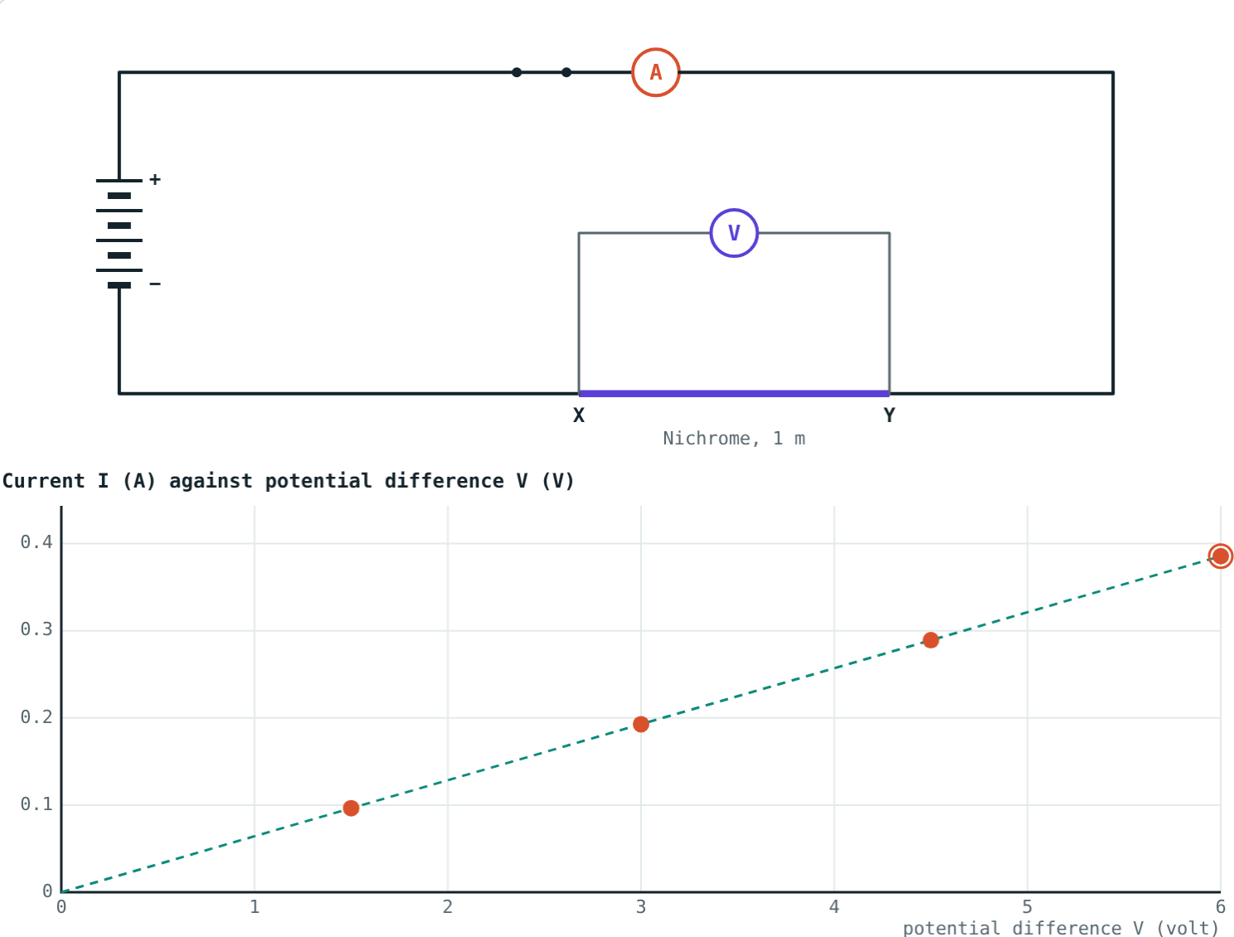
Resistance and Ohm's Law
STD 9 SCIENCE · CH. 3 CURRENT ELECTRICITY
Lesson 2 · Visual Science & Maths
Notes:
Goal: students can state Ohm's law, use V = IR, describe the experiment, use R = ρL/A, and distinguish conductors from insulators.

Slide 2
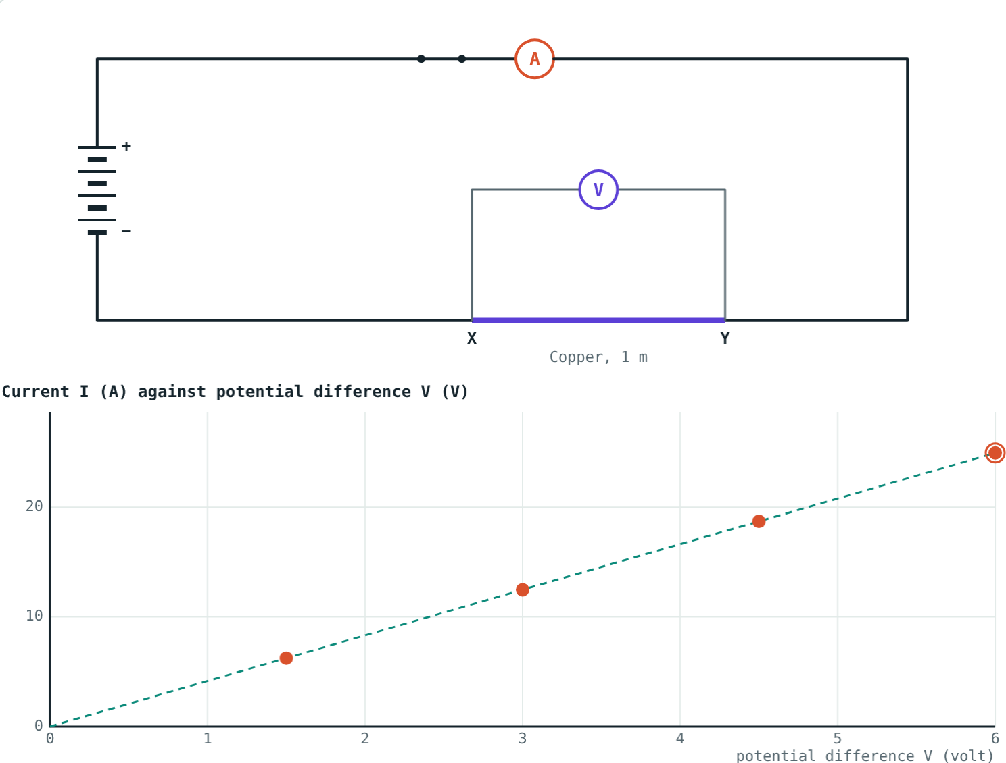
Same cell, very different currents
One cell drives a large current through copper, a small one through nichrome, and almost none through rubber.
What controls the size of the current?
Copper wire: about 25 A from four cells
Notes:
The answer is resistance, which depends on the material and the shape of the wire.

Slide 3
Ohm's law
V = I × R
If the physical state stays the same, current is proportional to potential difference.
Resistance R = V ÷ I, in ohms (Ω)
1 Ω: 1 V drives 1 A
Caused by electrons colliding with atoms
Readings for 1 to 4 cells lie on a straight line
Notes:
'Physical state' mainly means temperature.

Slide 4
The experiment
Cells | V (volt) | I (ampere) | V ÷ I (ohm)
1 | 1.5 | 0.096 | 15.6
2 | 3.0 | 0.193 | 15.6
3 | 4.5 | 0.289 | 15.6
4 | 6.0 | 0.386 | 15.6
Notes:
Readings for a nichrome wire 1 m long and 0.3 mm in diameter. V ÷ I stays the same: that constant is the resistance.

Slide 5
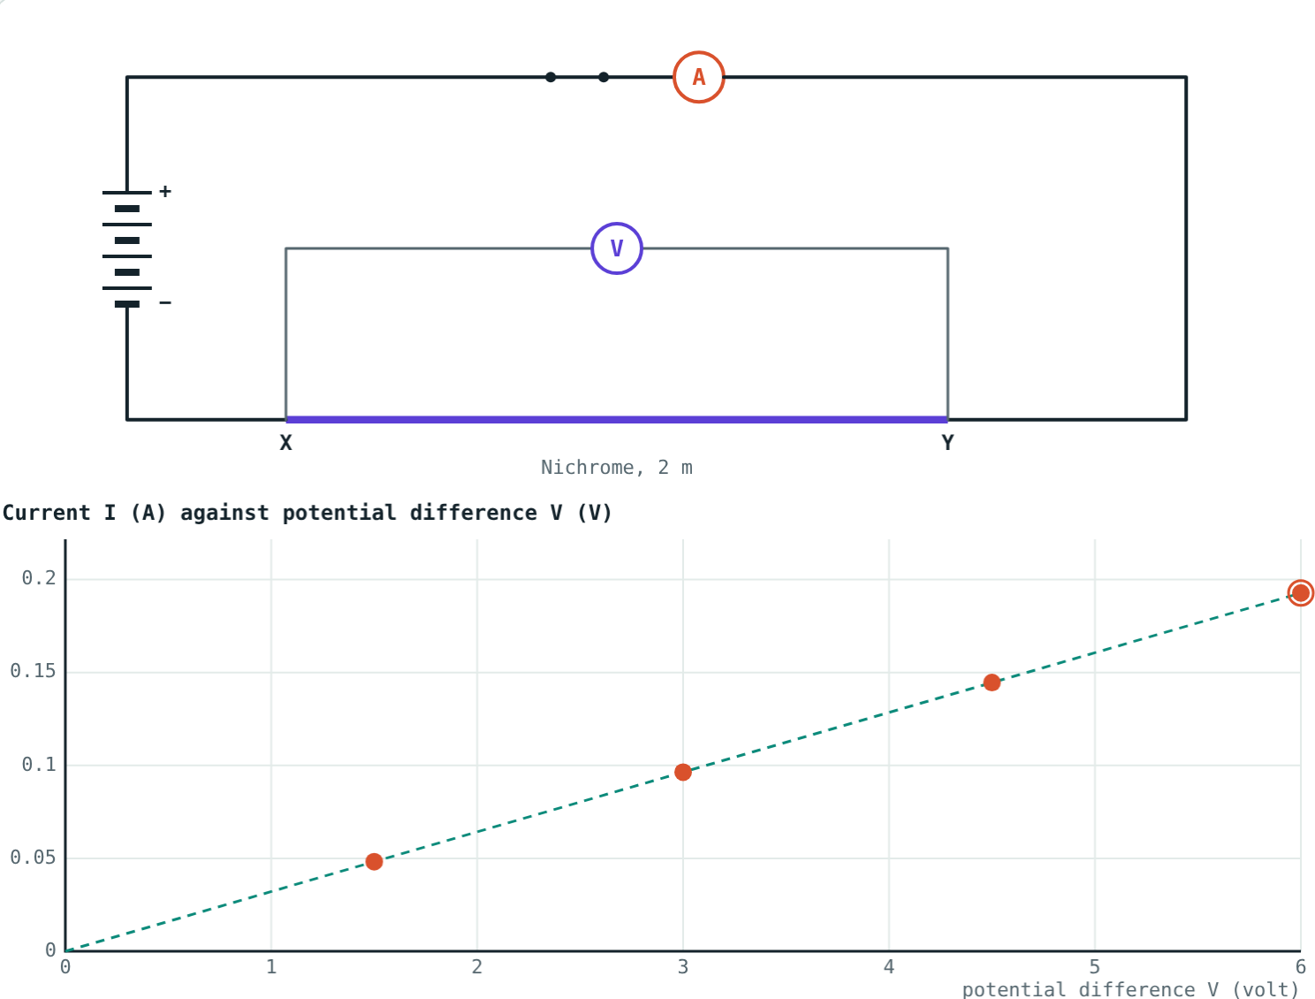
What decides resistance
R = ρ L ÷ A
Longer wire: more resistance
Thicker wire: less resistance
Material: resistivity ρ in Ω m
Hotter metal: more resistance
A 2 m wire: twice the resistance, half the slope
Notes:
Doubling the diameter makes the area four times larger.

Slide 6
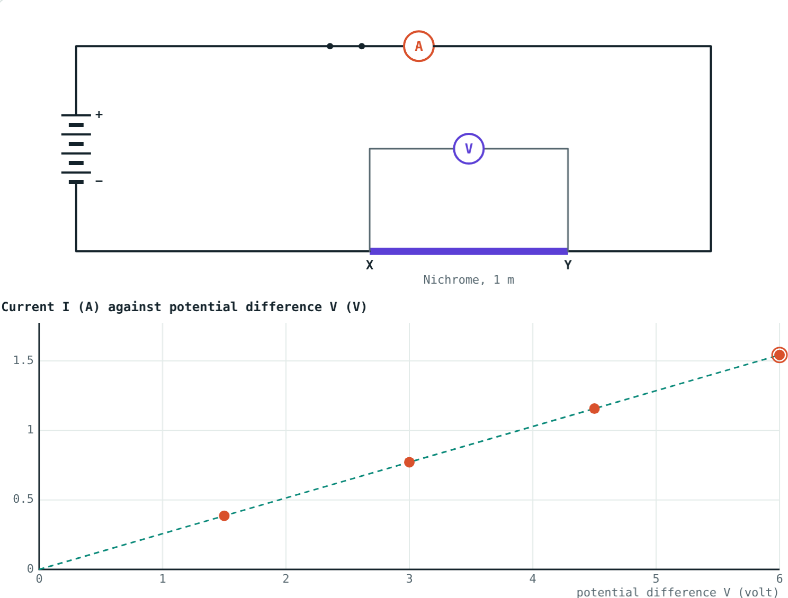
Length and thickness
Nichrome 2 m: R = 31.1 Ω.
Nichrome 0.6 mm: R = 3.9 Ω.
R ∝ L, and R ∝ 1/A.
Notes:
Compare the slopes of the two graphs: a steeper line means less resistance.

Slide 7
Conductors and insulators
Material | Resistivity (Ω m) | Type and use
Copper | 1.7 × 10⁻⁸ | Conductor: connecting wires
Aluminium | 2.7 × 10⁻⁸ | Conductor: power lines
Nichrome | 1.1 × 10⁻⁶ | High resistance: heater elements
Glass | about 10¹⁰ to 10¹⁴ | Insulator
Rubber | about 10¹³ | Insulator: gloves, cable covers
Notes:
Conductors have very low resistance; insulators have extremely high resistance.

Slide 8
Worked examples
An electric iron
A resistor and a cell
An iron draws 4 A from 230 V. Find its resistance.
A 5 Ω resistor is joined across a 1.5 V cell. Find the current.
R = 230 ÷ 4 = 57.5 Ω
I = 1.5 ÷ 5 = 0.3 A
Notes:
Rearrange V = IR as needed.

Slide 9
Worked example: R = ρL/A
Find the resistance of a nichrome wire 1 m long and 0.3 mm in diameter (ρ = 1.1 × 10⁻⁶ Ω m).
r = 1.5 × 10⁻⁴ m, A = πr² ≈ 7.07 × 10⁻⁸ m²
R = 1.1 × 10⁻⁶ × 1 ÷ 7.07 × 10⁻⁸ ≈ 15.6 Ω
The simulation gives the same 15.6 Ω
Notes:
Halve the diameter and convert mm to m before squaring.

Slide 10

Common mistakes
Diameter as radius
Ohm's law always holds
Halve it, and convert mm to m.
Only at constant temperature.
Double thickness, half R
Resistance vs resistivity
Double diameter gives a quarter of R.
Ω for a wire; Ω m for a material.
Notes:
The area mistake is the most common in R = ρL/A problems.

Slide 11
Quick check
1
12 V drives 0.5 A through a resistor. Find its resistance.
2
What shape is the I–V graph for a wire obeying Ohm's law?
3
A wire is replaced by one twice as long. What happens to R?
4
Which material is used in heater elements, and why?
Notes:
Answers: 1) 24 Ω. 2) A straight line through the origin. 3) It doubles. 4) Nichrome: high resistivity and it does not burn easily when hot.

Slide 12
Run the experiment yourself
Open the Resistance and Ohm's Law lesson on the Visual Science & Maths website. Record readings, change the wire, and test insulators.
Next lesson: Resistors in series and parallel
Notes:
Homework idea: find the power rating and voltage on three appliances and work out each one's resistance.

