Slide 1
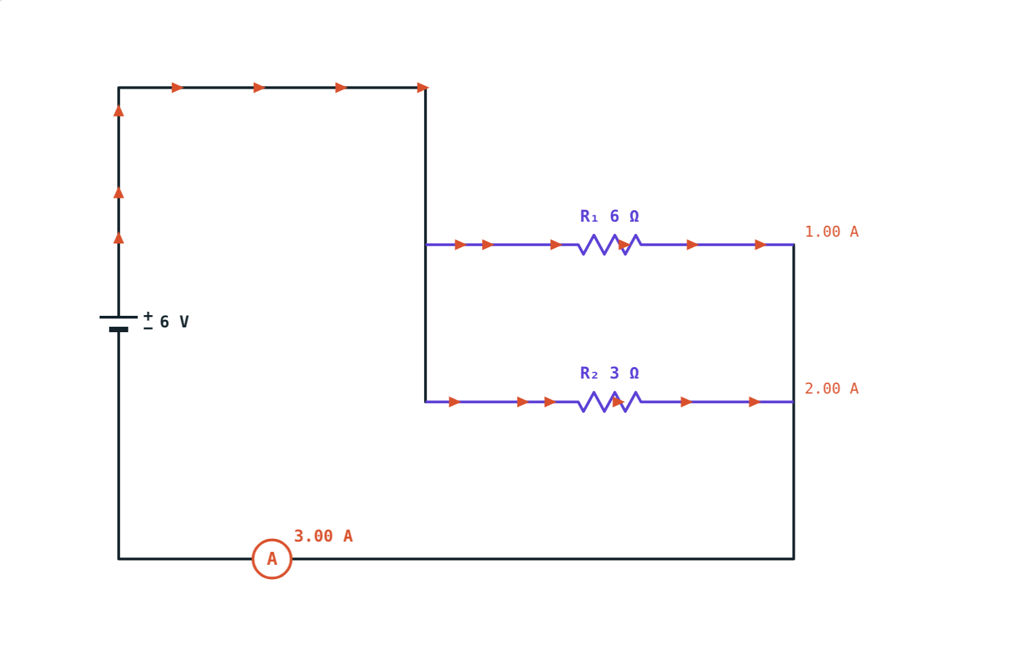
Resistors in Series and Parallel
STD 9 SCIENCE · CH. 3 CURRENT ELECTRICITY
Lesson 3 · Visual Science & Maths
Notes:
Goal: students can calculate effective resistance in series and parallel, and find the current and voltage for each resistor.

Slide 2
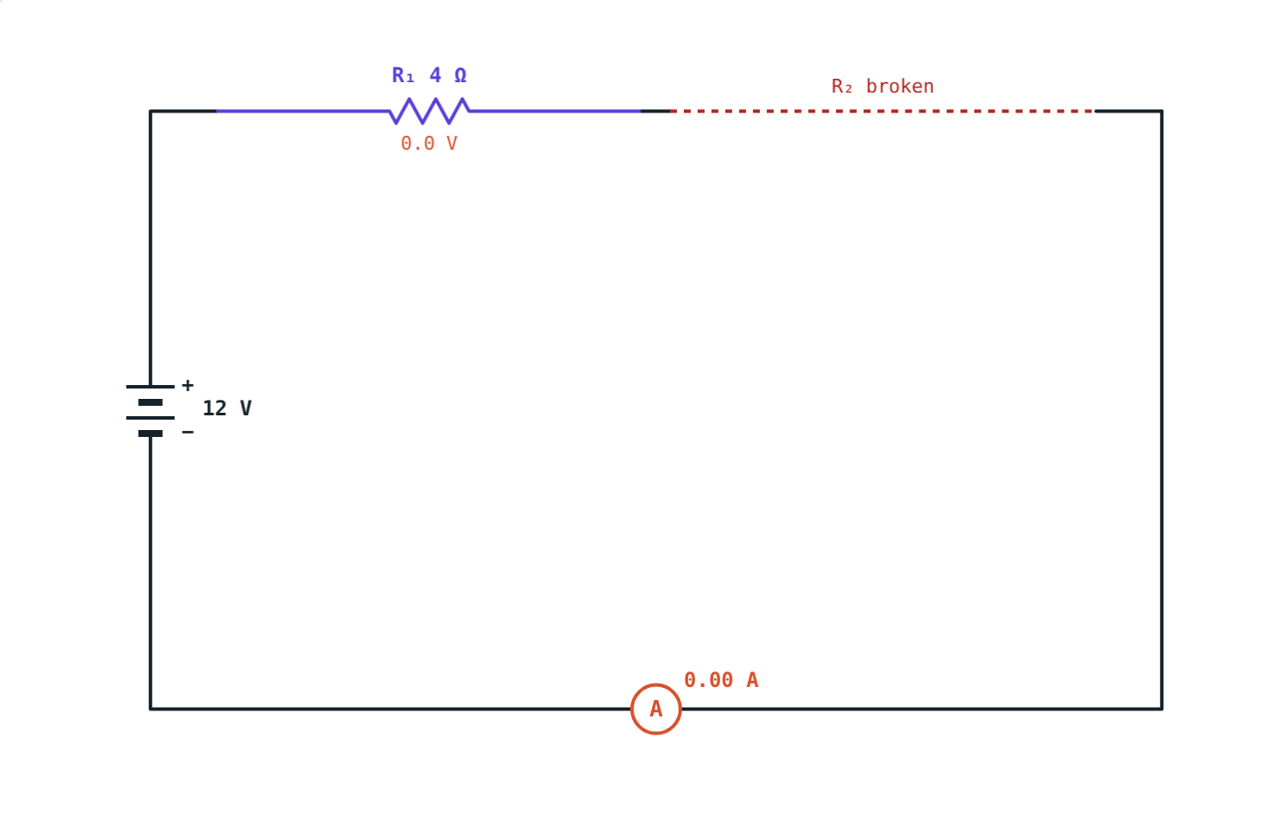
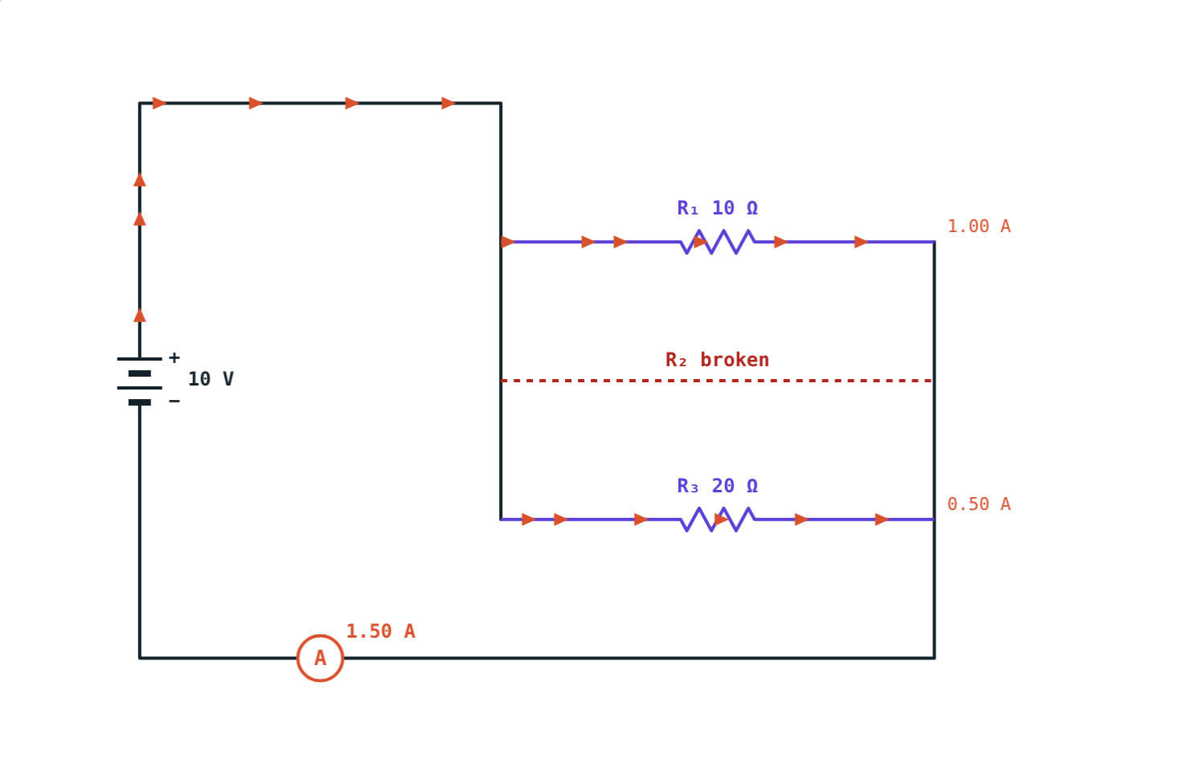
One fails, what happens to the rest?
One path: break one resistor and everything stops.
Separate paths: the others keep working.
Notes:
Link to old festival light strings (series) and house lights (parallel).

Slide 3
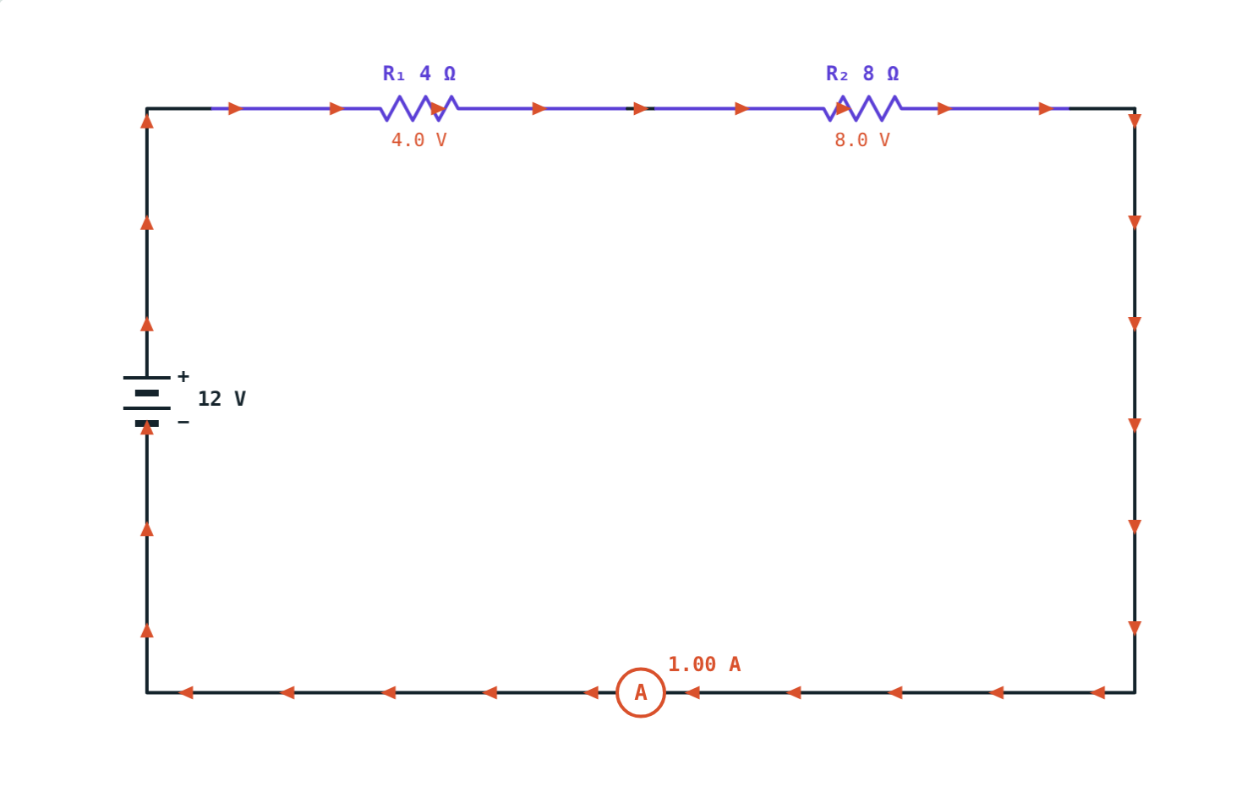
Resistors in series
Rs = R₁ + R₂ + R₃
Joined end to end: one path
Same current through each
Voltages add up to the total
Rs is bigger than any one resistor
4 Ω + 8 Ω on 12 V: 1 A, split 4 V and 8 V
Notes:
Series connection is used to increase resistance.

Slide 4
Resistors in parallel
1/Rp = 1/R₁ + 1/R₂ + 1/R₃
Joined between the same two points
Same voltage across each
Branch currents add up to the total
Rp is smaller than the smallest resistor
6 Ω and 3 Ω on 6 V: 1 A + 2 A = 3 A
Notes:
Parallel connection is used to reduce resistance.

Slide 5
Series or parallel?
 | Series | Parallel
Effective resistance | Sum (bigger) | Reciprocal of sum of reciprocals (smaller)
Current | Same in each | Divides; adds to the total
Potential difference | Divides; adds to the total | Same across each
If one breaks | All stop | Others keep working
Notes:
Students can copy this summary table.

Slide 6
Worked example: series
4 Ω and 8 Ω are joined in series to 12 V. Find Rs, the current and each voltage.
Rs = 4 + 8 = 12 Ω
I = 12 ÷ 12 = 1 A
V₁ = 4 V, V₂ = 8 V (total 12 V)
Readouts match the working
Notes:
Check: the voltages add up to the battery voltage.

Slide 7
Worked example: parallel
6 Ω and 3 Ω are joined in parallel across 6 V. Find Rp and each branch current.
1/Rp = 1/6 + 1/3 = 3/6, so Rp = 2 Ω
I₁ = 6 ÷ 6 = 1 A, I₂ = 6 ÷ 3 = 2 A
Total = 3 A = 6 ÷ 2 ✓
Branch currents 1 A and 2 A
Notes:
Remember to take the reciprocal at the end.

Slide 8
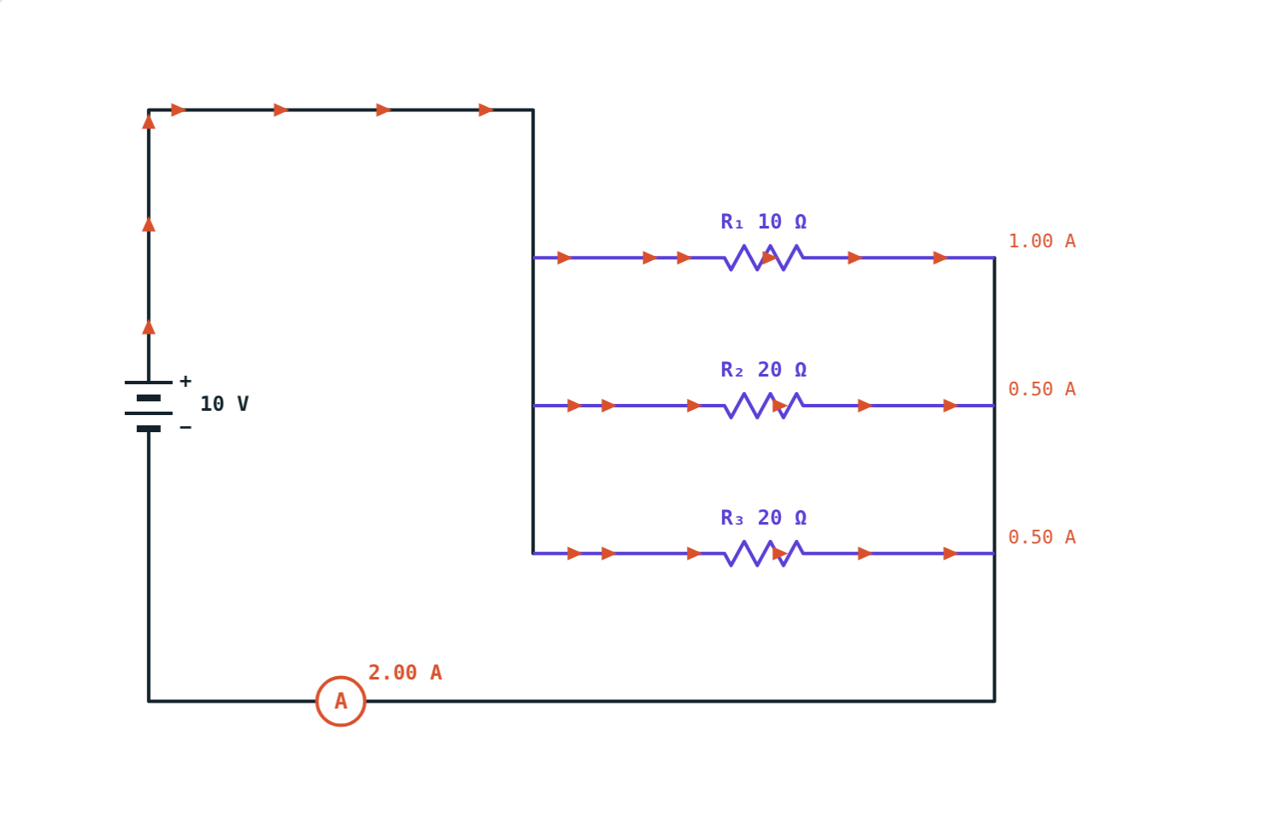
Three in parallel
1/Rp = 0.1 + 0.05 + 0.05 = 0.2:
5 Ω
effective resistance
2 A
total current
5 Ω is less than the smallest resistor, 10 Ω.
10 Ω, 20 Ω and 20 Ω across 10 V
Notes:
Branch currents: 1 A, 0.5 A and 0.5 A.

Slide 9



Where you see each
Parallel: homes
Series: old light strings
Series: cells in a torch
Every appliance gets the full voltage and its own switch.
One failed bulb puts the whole string out.
Cells in series add their voltages.
Notes:
Ask students to find one more example of each at home.

Slide 10

Common mistakes
Not flipping 1/Rp
Adding parallel resistors
Take the reciprocal at the end.
That is only for series.
Same current in parallel
Voltages add in parallel
Same voltage, not current.
Each branch has the full voltage.
Notes:
The reciprocal step is the most common slip.

Slide 11
Quick check
1
Find the effective resistance of 2 Ω, 3 Ω and 5 Ω in series.
2
Find the effective resistance of two 10 Ω resistors in parallel.
3
In a parallel circuit, what is the same for every resistor?
4
Why are household appliances connected in parallel?
Notes:
Answers: 1) 10 Ω. 2) 5 Ω. 3) The potential difference. 4) Each gets the full voltage and works independently.

Slide 12
Build circuits yourself
Open the Series and Parallel lesson on the Visual Science & Maths website. Change the resistors, switch connections, and break one.
Next lesson: Electricity at home
Notes:
Homework idea: draw the circuit diagram for the lights and fans in one room of your home.

