Slide 1
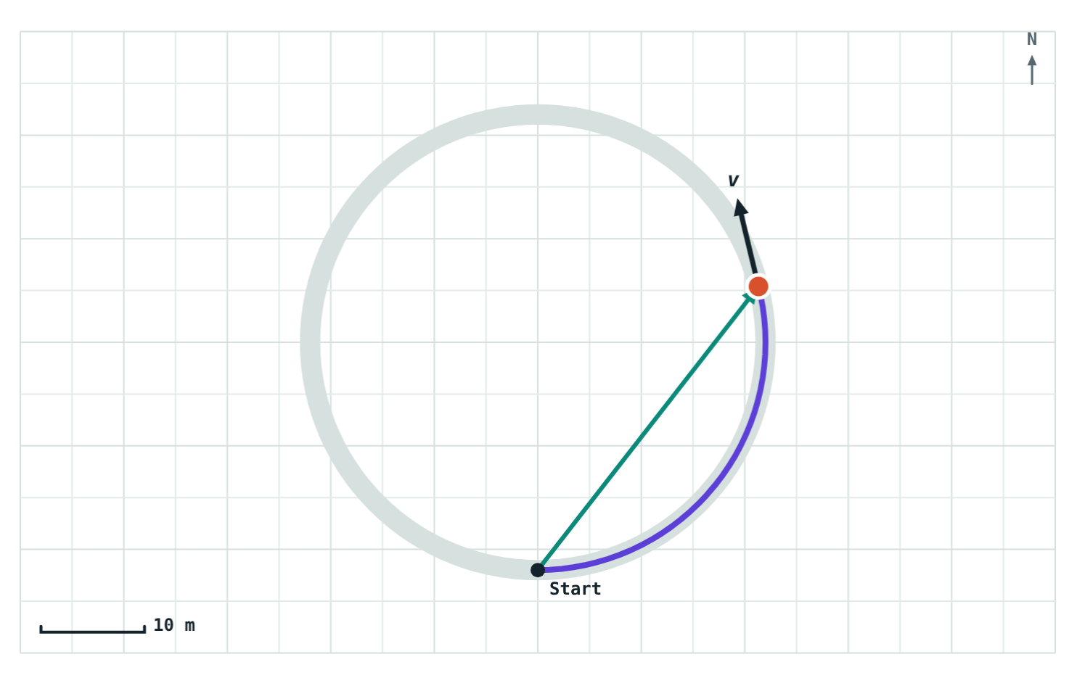
Speed and Velocity
STD 9 SCIENCE · CH. 1 LAWS OF MOTION
Lesson 2 · Visual Science & Maths
Notes:
Lesson 2 of Chapter 1. Goal: students can calculate speed and velocity, convert between km/h and m/s, and explain why velocity can change while speed stays the same.

Slide 2

Same speed, different velocity
Two cyclists leave the same crossroads at 5 m/s. One heads north, the other heads east.
5 m/s north
Are they moving at the same speed?
Do they have the same velocity?
5 m/s east
Notes:
Take a show of hands for each question. Most will say the speeds are equal; some will hesitate on velocity. Today's lesson explains why the velocities differ.

Slide 3
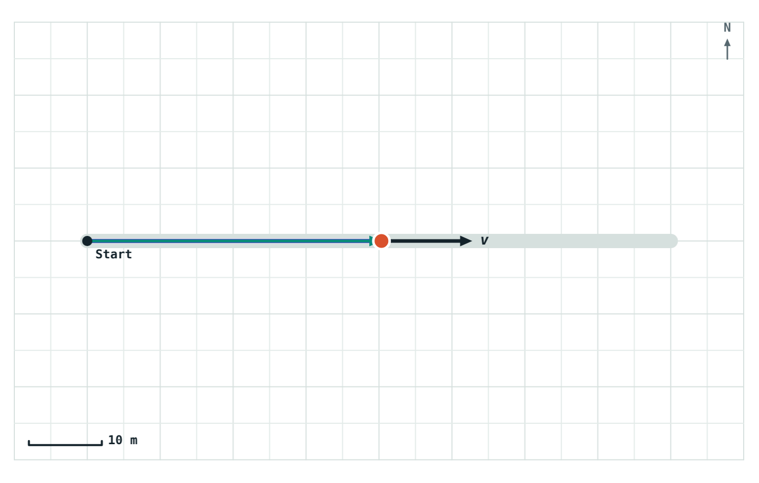
Speed: how fast
speed = distance ÷ time
The distance travelled in unit time
Size only, no direction: a scalar
SI unit: metres per second (m/s)
Average speed = total distance ÷ total time
40 m along a straight road in 5 s: speed = 8 m/s
Notes:
Stress the word 'distance': speed uses the whole path, not the straight-line displacement.

Slide 4
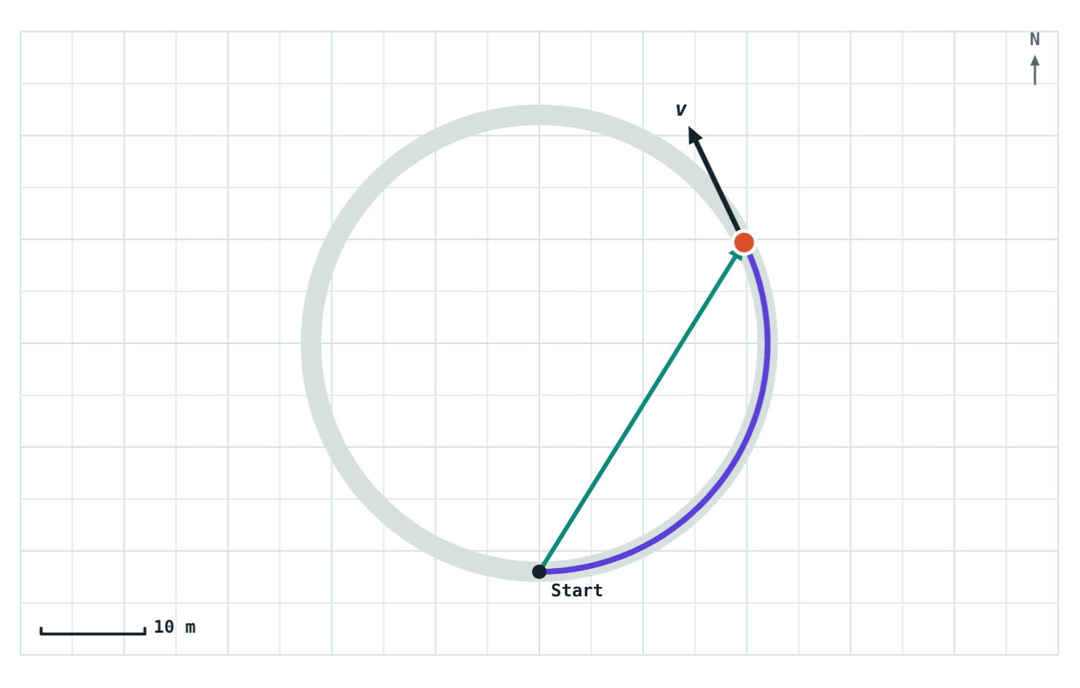
Velocity: how fast, and which way
velocity = displacement ÷ time
The displacement in unit time
Size and direction: a vector
Unit m/s, always with a direction: “5 m/s north”
Without a direction it is only a speed
The arrow v is the velocity: its length is the speed, it points the way the cyclist moves
Notes:
Link back to the hook: both cyclists had a speed of 5 m/s, but velocities of 5 m/s north and 5 m/s east. Different directions mean different velocities.

Slide 5



Three ways velocity can change
The speed changes
The direction changes
Both change
An auto-rickshaw speeds up along a straight road.
A cyclist rides round a circular track at a steady speed.
A car slows down as it turns a corner.
Notes:
Ask for an everyday example of each. The middle card surprises most students: constant speed, yet changing velocity.

Slide 6
Changing km/h into m/s
1 km = 1000 m and 1 h = 3600 s, so
km/h | m/s
18 | 5
36 | 10
54 | 15
72 | 20
90 | 25
1 km/h = 5/18 m/s
km/h to m/s: multiply by 5/18
m/s to km/h: multiply by 18/5 (= 3.6)
Notes:
A quick check: every 18 km/h is 5 m/s. Have students fill in 108 km/h (30 m/s) themselves.

Slide 7
Speed or velocity?
 | Speed | Velocity
Defined as | Distance ÷ time | Displacement ÷ time
Direction | Not included (scalar) | Included (vector)
Unit | m/s | m/s, with a direction
Average over a round trip | More than zero | Zero
Changes when | Speeding up or slowing down | Speed or direction changes
Notes:
Pairs with the distance/displacement table from Lesson 1: speed goes with distance, velocity goes with displacement.

Slide 8
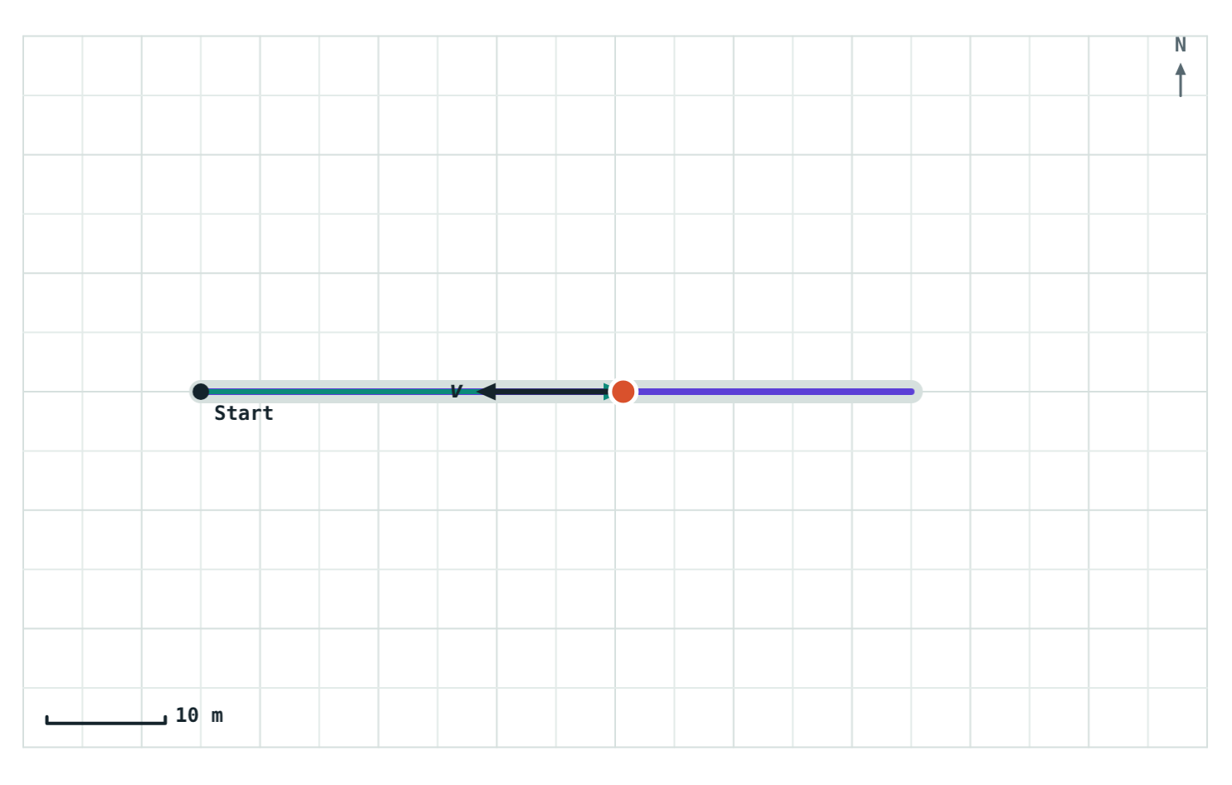
A round trip: speed yes, velocity no
At the finish: 120 m in 15 s, back at the start.
8 m/s
average speed
0 m/s
average velocity
Displacement is zero, so the average velocity is zero, even though the rider never stopped.
Riding 60 m east and back at 8 m/s, shown on the way back
Notes:
Average speed = 120 m ÷ 15 s = 8 m/s. Average velocity = 0 m ÷ 15 s = 0. Ask: what is the size of the velocity at any moment during the ride? Still 8 m/s; only the average is zero.

Slide 9
Worked examples
A bus journey
Back to Riya's walk
A bus covers 90 km in 1.5 hours. Find its average speed in km/h and m/s.
Riya walked 40 m east, then 30 m north, in 50 s. Find her average speed and velocity.
Average speed = 90 ÷ 1.5 = 60 km/h
In m/s: 60 × 5/18 = 16.7 m/s
Average speed = 70 ÷ 50 = 1.4 m/s
Average velocity = 50 ÷ 50 = 1 m/s, 37° N of E
Notes:
Riya's walk reuses the Lesson 1 example. Average velocity (1 m/s) is less than average speed (1.4 m/s) because the displacement cuts the corner.

Slide 10
Worked example: one lap
A cyclist rides once around a circular track 200 m long in 40 s. Find her average speed and average velocity.
Average speed = 200 ÷ 40 = 5 m/s
She ends where she started, so displacement = 0 and average velocity = 0 m/s
Follow-up: what is her average velocity after half a lap (20 s)? The diameter is 200 ÷ π ≈ 63.7 m.
Notes:
Follow-up answer: 63.7 m ÷ 20 s ≈ 3.2 m/s, in the direction straight across the track.

Slide 11

Common mistakes
Mixing units
Using displacement for speed
Don't divide metres by hours. Convert first: 1 km/h = 5/18 m/s.
Speed uses the whole path (distance). Velocity uses displacement.
Steady speed = steady velocity
No direction
Only in a straight line. Turning changes the velocity.
A velocity without a direction is just a speed.
Notes:
Unit mixing is the most common error in numerical problems on this topic.

Slide 12
Quick check
1
An auto-rickshaw circles a roundabout at a steady 20 km/h. Is its velocity constant?
2
A train moves at 54 km/h. What is that in m/s?
3
A runner finishes one lap of a 400 m track in 100 s. Average speed? Average velocity?
4
Can average velocity ever be larger than average speed?
Notes:
Answers: 1) No; its direction keeps changing, so its velocity changes. 2) 54 × 5/18 = 15 m/s. 3) Average speed 4 m/s; average velocity 0. 4) No; displacement is never more than distance, and both are divided by the same time.

Slide 13
Ride it yourself
Open the Speed and Velocity lesson on the Visual Science & Maths website. Change the speed, pick a route, and watch the velocity arrow.
Next lesson: Uniform and non-uniform motion
Notes:
Homework idea: time yourself walking a measured distance at school and work out your average speed in m/s and km/h.

