Slide 1
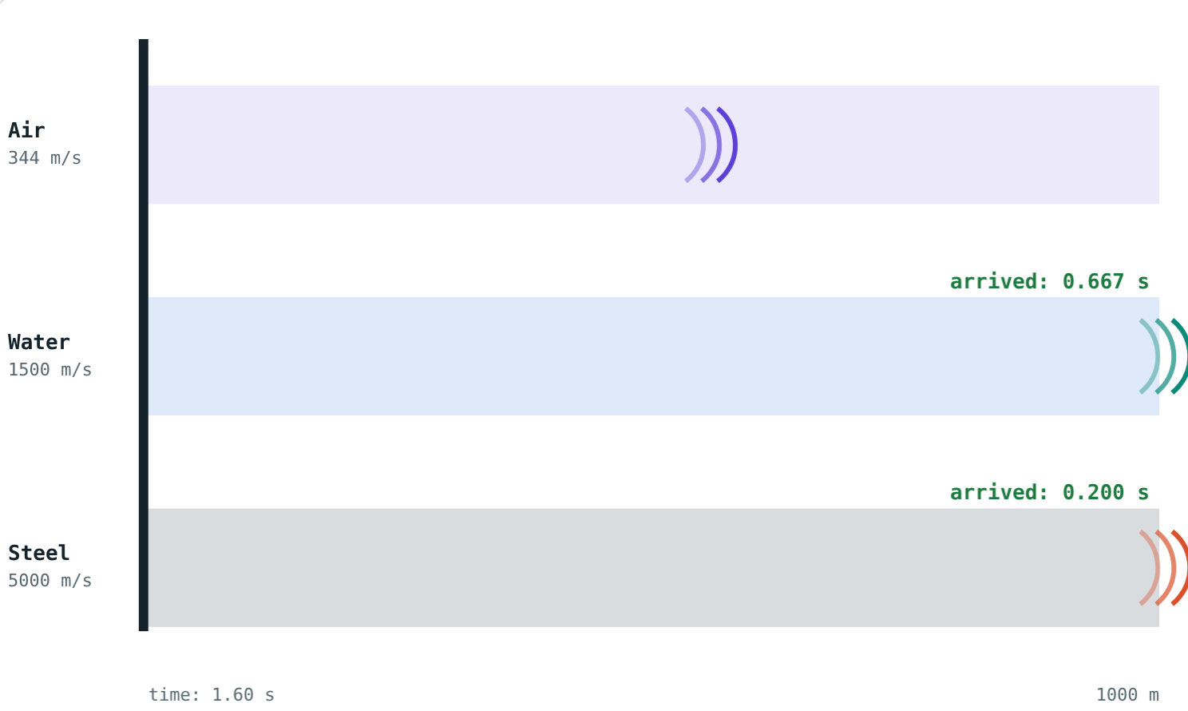
The Speed of Sound
STD 9 SCIENCE · CH. 12 STUDY OF SOUND
Lesson 2 · Visual Science & Maths
Notes:
Goal: students can compare the speed of sound in different media, use v ≈ 332 + 0.6t, and find distances from the lightning-thunder gap.

Slide 2
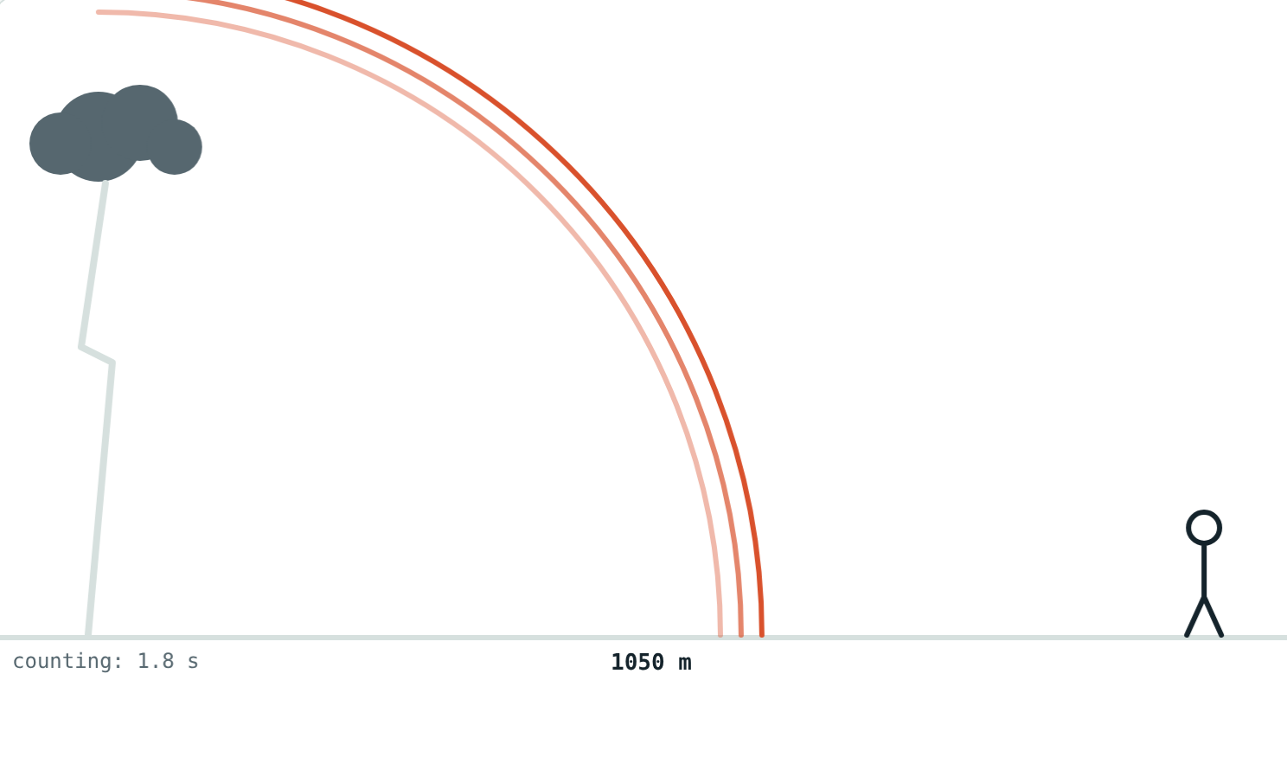
See first, hear later
At a cricket match you see the bat hit the ball before you hear the crack. In a storm, the flash comes before the thunder.
Why does the sound arrive late?
The thunder still on its way
Notes:
Light is almost a million times faster than sound in air.

Slide 3
Speed depends on the medium
Medium | Approximate speed
Air at 0 °C | 332 m/s
Air at 20 °C | 344 m/s
Water | about 1500 m/s
Steel | about 5000 m/s
Notes:
Fastest in solids, slower in liquids, slowest in gases.

Slide 4
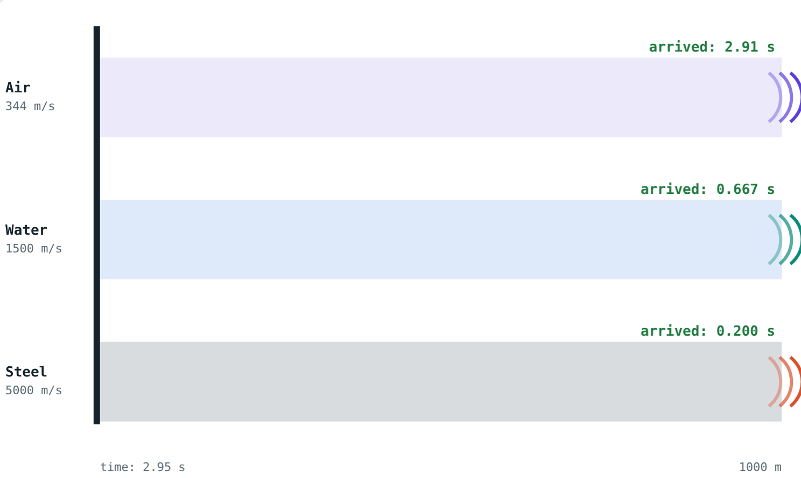
The race
Steel and water have arrived; air is halfway.
Air finally arrives over 1000 m.
Notes:
Tightly linked particles pass the push on faster.

Slide 5
Temperature matters
v ≈ 332 + 0.6 t
t is the air temperature in °C
About 0.6 m/s faster per degree
Faster in a lighter gas: hydrogen beats oxygen
Frequency and loudness do not matter
Air at 20 °C: 344 m/s
Notes:
Warmer gas particles move faster and pass the disturbance more quickly.

Slide 6
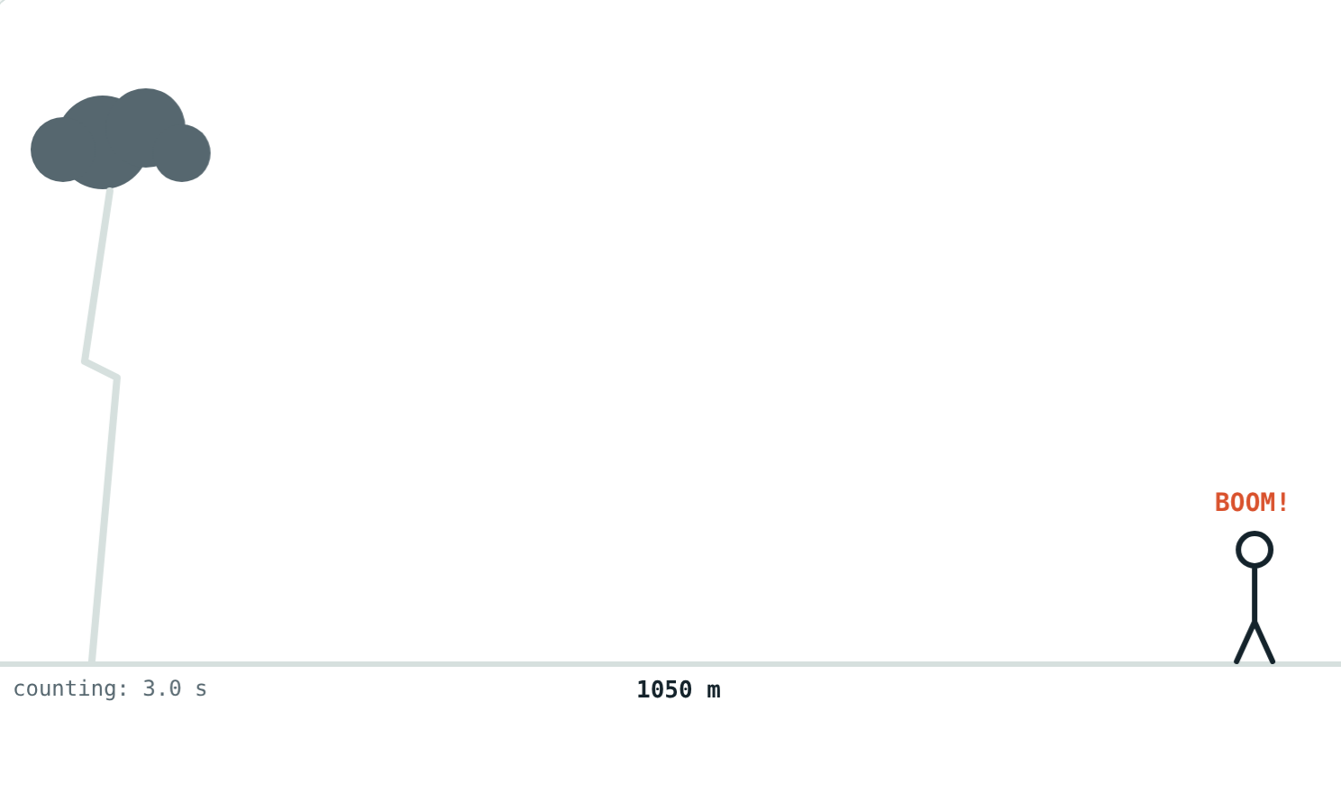
Lightning and thunder
distance = v × t
Light: 3 × 10⁸ m/s, arrives almost at once
Thunder: a few hundred m/s
Count seconds from flash to thunder
3 s at 350 m/s: 1050 m away
Notes:
A rough rule: every 3 seconds is about 1 km.

Slide 7
Worked examples
Warm and cold air
The storm
Find v at 20 °C. At what temperature is v = 350 m/s?
Thunder is heard 3 s after the flash at 30 °C. How far away?
332 + 0.6 × 20 = 344 m/s
(350 − 332) ÷ 0.6 = 30 °C
v = 332 + 18 = 350 m/s
350 × 3 = 1050 m
Notes:
Always find v for the temperature first.

Slide 8
An ear to the rail
Through steel and through air (20 °C):
0.2 s
through steel
2.9 s
through air
A tap 1000 m away
You hear the same tap twice, about 2.7 s apart.
Notes:
This is why people once put an ear to the rail to hear an approaching train.

Slide 9




Where it matters
Storms
Races
Railways
Concerts
Time the thunder to judge how far away the lightning is.
Timekeepers start their watches at the smoke, not the bang.
A train is heard through the rail before through the air.
All notes arrive together: speed does not depend on frequency.
Notes:
Over 100 m, the starting gun's sound arrives about 0.3 s late.

Slide 10

Common mistakes
“Fastest in air”
“High notes travel faster”
Slowest in gases, fastest in solids.
All frequencies travel together.
Ignoring temperature
“Thunder comes later”
About 0.6 m/s more per °C.
It happens with the flash; it arrives later.
Notes:
Point out that students hear the same mistakes in everyday speech; ask for a counter-example to each.

Slide 11
Quick check
1
In which medium does sound travel fastest: air, water or steel?
2
Find the speed of sound in air at 25 °C.
3
Thunder comes 5 s after the flash (v = 340 m/s). How far away is the storm?
4
Is sound faster in hydrogen or oxygen at the same temperature?
Notes:
Answers: 1) Steel. 2) 347 m/s. 3) 1700 m. 4) Hydrogen.

Slide 12
Race some sound yourself
Open the Speed of Sound lesson on the Visual Science & Maths website. Change the temperature and the distance, then press Play.
Next lesson: Echo and reverberation
Notes:
Homework idea: time the thunder in the next storm and estimate the distance.

