Slide 1
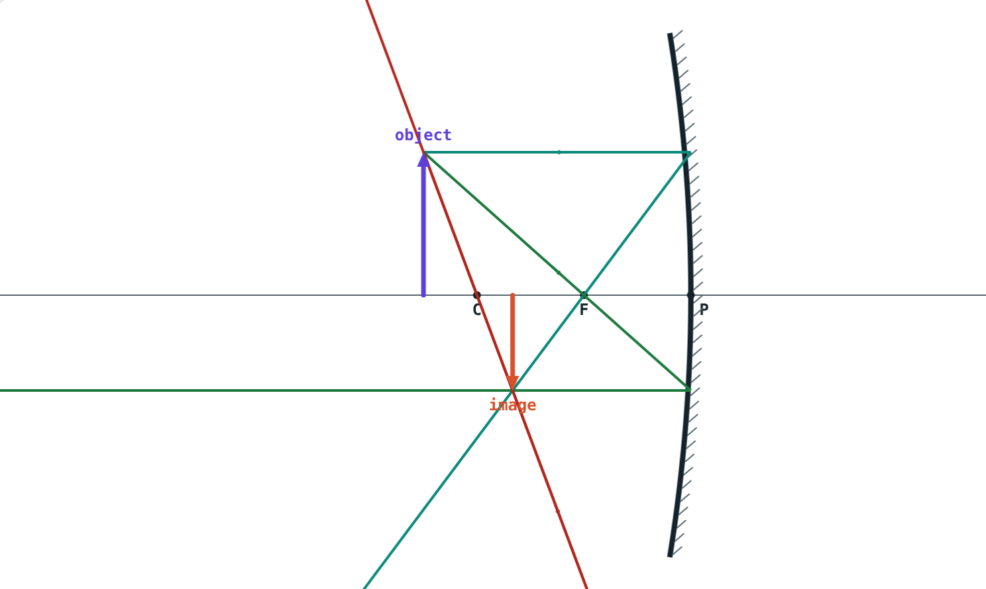
Spherical Mirrors and Ray Diagrams
STD 9 SCIENCE · CH. 11 REFLECTION OF LIGHT
Lesson 3 · Visual Science & Maths
Notes:
Goal: students can name the parts of a spherical mirror, draw ray diagrams with the three rules, and describe the images for each object position.

Slide 2
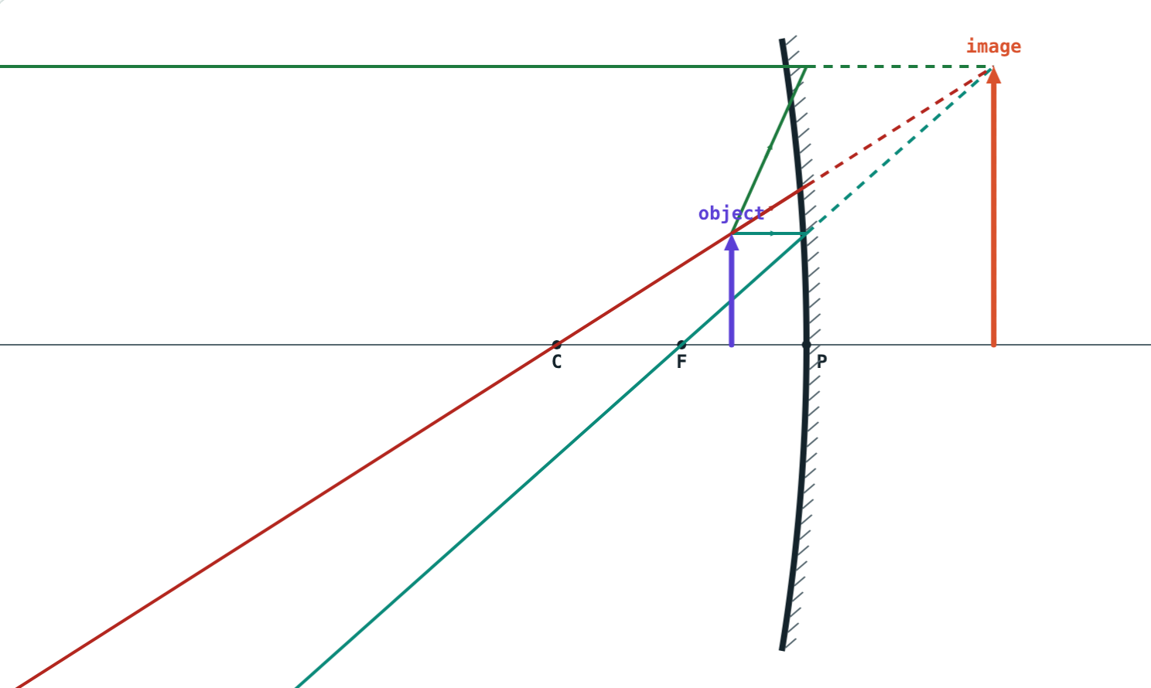
The spoon test
Look into the hollow of a steel spoon: you are upside down. Bring it very close: you are huge and upright. Turn it over: you are small and upright.
How can one spoon do all three?
Object inside F: large and upright
Notes:
Let students try with real spoons before the explanation.

Slide 3
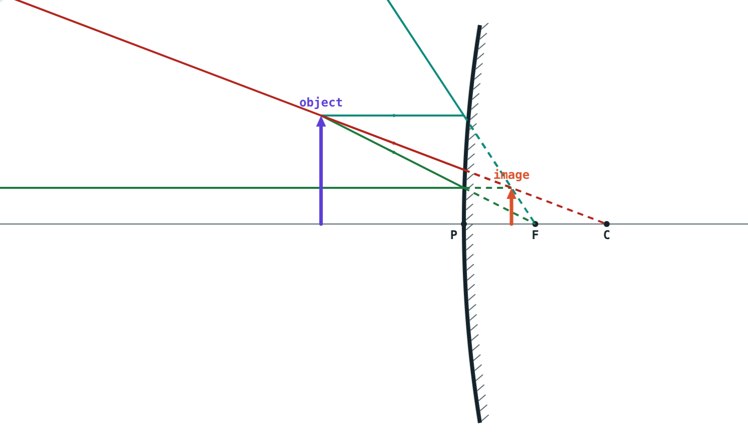
Concave and convex
Concave: the hollow side reflects
Concave mirrors converge parallel rays
Convex: the bulging side reflects
Convex mirrors make parallel rays diverge
Convex mirror: rays spread out
Notes:
Both are pieces of a hollow sphere; which side is silvered decides the type.

Slide 4
Words you need
Term | Meaning
Pole P | Centre of the mirror's surface
Centre of curvature C | Centre of the sphere the mirror is part of
Radius of curvature R | Radius of that sphere, PC
Principal axis | Line through P and C
Principal focus F | Where parallel rays meet (or seem to come from)
Focal length f | PF; f = R ÷ 2
Notes:
F is halfway between P and C.

Slide 5
Three rays to find an image
Ray 1
Ray 2
Ray 3
Parallel to the axis
Through F
Through C
Reflects through F (or seems to come from F).
Reflects parallel to the axis.
Hits at right angles and comes straight back.
Notes:
Any two rays are enough; the third is a check.

Slide 6
Images formed by a concave mirror
Object | Image | Size | Nature
At infinity | At F | Point-sized | Real, inverted
Beyond C | Between F and C | Diminished | Real, inverted
At C | At C | Same size | Real, inverted
Between C and F | Beyond C | Magnified | Real, inverted
At F | At infinity | Highly magnified | Real, inverted
Between F and P | Behind the mirror | Magnified | Virtual, erect
Notes:
Walk the object in with the simulation's Play button and tick off each row.

Slide 7
Far and near
Small, real and inverted, between F and C.
Large, virtual and erect, behind the mirror.
Notes:
Real images form where rays really meet; virtual ones where they only seem to.

Slide 8
Convex mirrors
Image always virtual, erect and diminished
Always behind the mirror, between P and F
Shows a wide area in a small space
Rays seem to come from behind the mirror
Notes:
This is why the image in a car's side mirror looks further away than it is.

Slide 9




Uses of spherical mirrors
Dentist and shaving
Torches and headlamps
Solar cookers
Rear-view mirrors
Concave, object inside F: large, upright image.
Concave, bulb at F: a parallel beam.
Concave: sunlight concentrated at F.
Convex: a wide view, upright image.
Notes:
Also: convex mirrors at sharp bends in hill roads and in shops.

Slide 10
Worked examples
From R to f
Predicting an image
A concave mirror has R = 36 cm. Where is its principal focus?
An object is 25 cm from a concave mirror with f = 10 cm. Describe the image.
f = R ÷ 2 = 36 ÷ 2 = 18 cm
C is at 2f = 20 cm: object beyond C
Image: between F and C, real, inverted, diminished
Notes:
Locate C first, then use the table.

Slide 11

Common mistakes
“F is at C”
“Concave always inverts”
F is halfway: f = R ÷ 2.
Inside F the image is virtual and erect.
Virtual for every case
“Convex can magnify”
Only when the object is inside F.
Its image is always smaller.
Notes:
Ask students to sketch the diagram rather than memorise the table.

Slide 12
Quick check
1
Where do rays parallel to the axis of a concave mirror meet after reflection?
2
Where should a torch bulb be placed to give a parallel beam?
3
Describe the image of an object at C of a concave mirror.
4
Why are convex mirrors used as rear-view mirrors?
Notes:
Answers: 1) At the principal focus F. 2) At F. 3) At C, same size, real and inverted. 4) They give a wide field of view with an erect image.

Slide 13
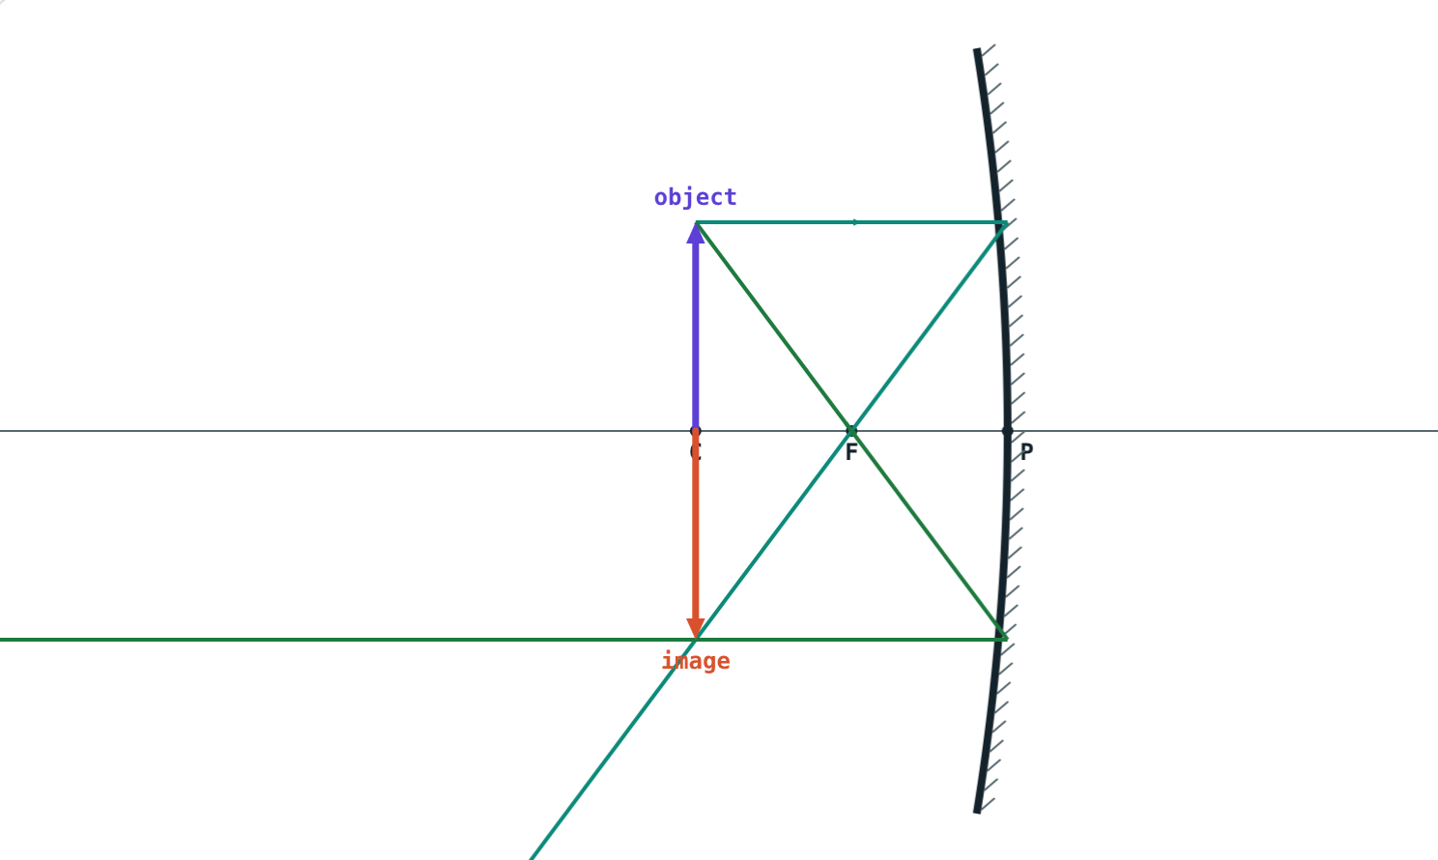
Draw ray diagrams live
Open the Spherical Mirrors lesson on the Visual Science & Maths website. Walk the object towards the mirror and watch the image change.
Next lesson: The mirror formula and magnification
Notes:
Homework: draw all six concave-mirror ray diagrams on graph paper.

