Slide 1
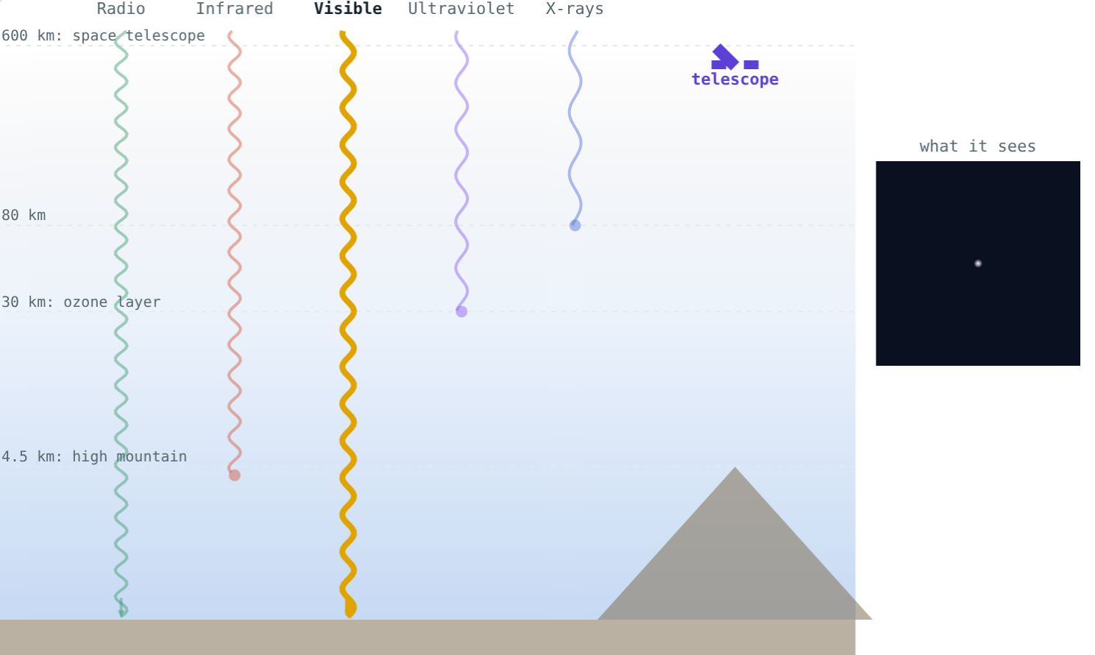
Telescopes in Space
STD 9 SCIENCE · CH. 18 OBSERVING SPACE: TELESCOPES
Lesson 3 · Visual Science & Maths
Notes:
Goal: students can explain why some telescopes must be in space and name Hubble, Chandra, Astrosat and the GMRT.

Slide 2
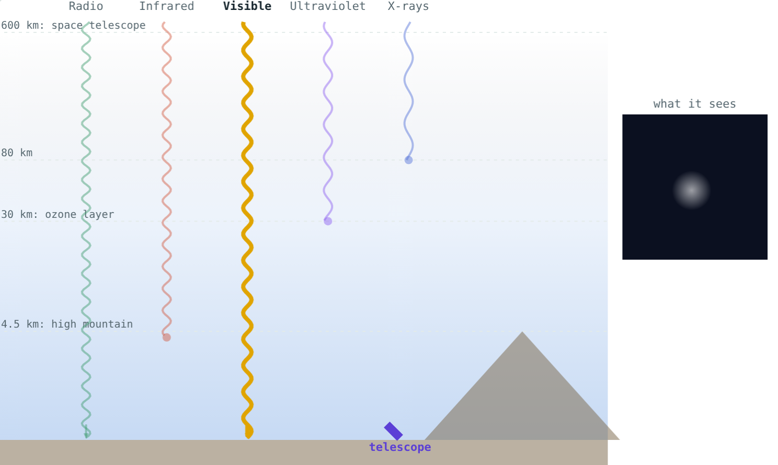
Twinkle, twinkle
Stars twinkle. Planets hardly do. Neither is really flickering.
What makes starlight shimmer?
Moving air blurs and dims the star
Notes:
The cause is our own atmosphere.

Slide 3




Problems with the air
Absorbs
Moves
Weather
Light
X-rays, most UV and much infrared never reach the ground.
Shifting air bends light: twinkling and blurring.
Clouds block the view.
Daylight and city lights hide faint stars.
Notes:
Radio waves pass through clouds and can be observed by day.

Slide 4
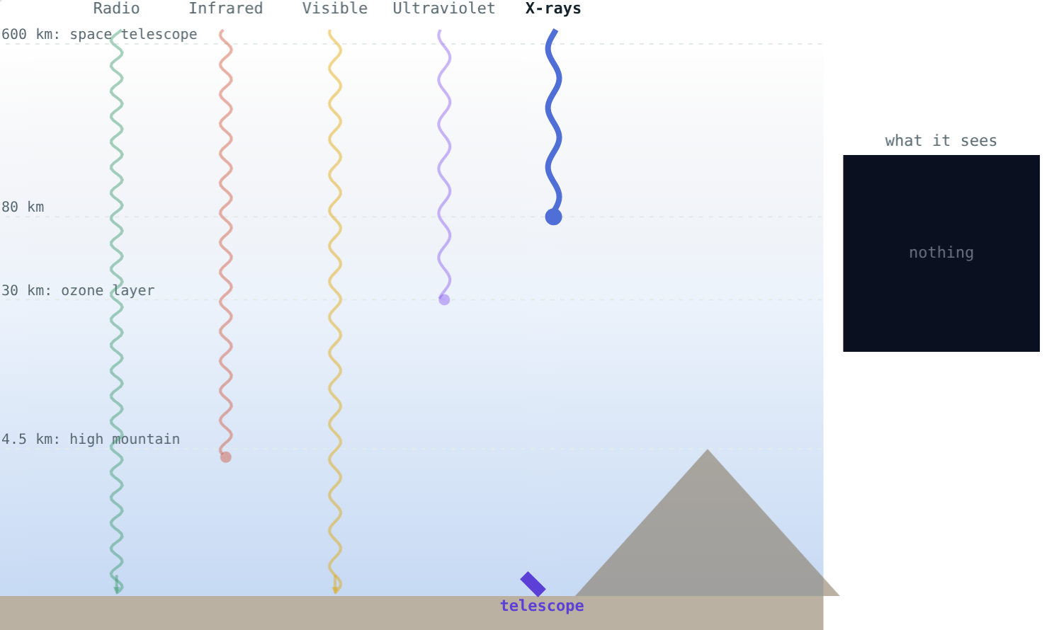
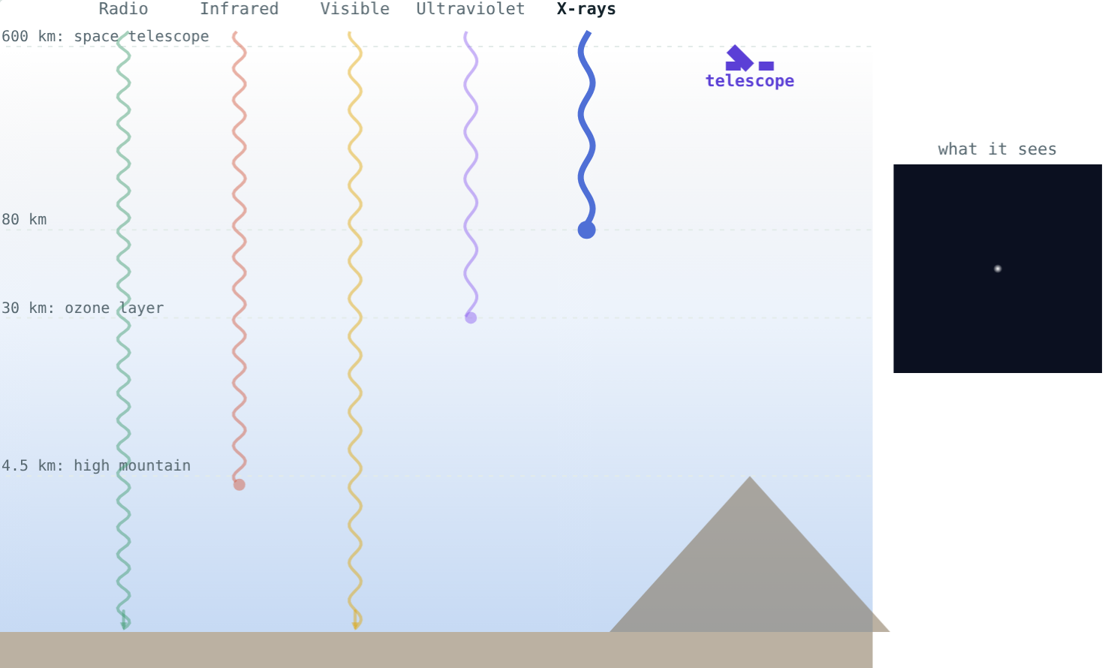
X-rays: ground or space?
Absorbed about 80 km up: nothing arrives.
Above the air, X-rays can be detected.
Notes:
This is why X-ray astronomy began only with rockets and satellites.

Slide 5

Going higher
Mountains: above much of the air and water vapour
Hanle, Ladakh: about 4500 m high
Space: every wavelength, day and night, no blurring
Infrared reaches a high mountain
Notes:
The Indian Astronomical Observatory at Hanle is one of the highest in the world.

Slide 6
Some space telescopes
Telescope | Launched | Observes
Hubble | 1990 | Visible, UV, near infrared
Chandra | 1999 | X-rays
Astrosat (ISRO) | 2015 | UV, X-rays, visible
James Webb | 2021 | Infrared
Notes:
Chandra is named after Subrahmanyan Chandrasekhar. Astrosat is India's first space observatory.

Slide 7

Radio stays on the ground
Radio waves pass through air and clouds
Work day and night
GMRT near Pune: 30 dishes of 45 m
Radio reaches the ground
Notes:
Ground telescopes are cheaper, bigger and easier to repair.

Slide 8
Worked examples
Choosing a site
Signals from Hubble
To study X-rays from gas around a black hole, where must the telescope be?
Hubble is about 550 km up. How long do its radio signals take to reach the ground?
X-rays are absorbed about 80 km up
So: in space (Chandra, Astrosat)
t = 550 000 ÷ 3 × 10⁸ ≈ 0.0018 s
Notes:
Under two milliseconds.

Slide 9
The GMRT's collecting area
π × 22.5² ≈ 1590 m² per dish:
1590 m²
one dish
47 700 m²
all 30 dishes
30 dishes, each 45 m wide
About seven football fields of collecting area.
Notes:
Spreading the dishes over 25 km also gives very fine detail.

Slide 10

Common mistakes
“Closer to the stars”
“Stars really flicker”
550 km is nothing on a cosmic scale; the gain is getting above the air.
Twinkling is caused by our air.
“Radio needs space”
“Ground telescopes are useless”
Radio waves pass through the air.
They are cheaper, bigger and easy to repair.
Notes:
Ask students to correct each statement in their own words.

Slide 11
Quick check
1
What is the main reason X-ray telescopes are put in space?
2
Why do stars twinkle?
3
Which organisation launched Astrosat?
4
Which kind of telescope works well on the ground, even through clouds?
Notes:
Answers: 1) The atmosphere absorbs X-rays. 2) Moving layers of air bend their light. 3) ISRO. 4) A radio telescope.

Slide 12
Place a telescope yourself
Open the Telescopes in Space lesson on the Visual Science & Maths website. Choose the radiation and the site.
That completes Chapter 18: Observing Space
Notes:
Research idea: find out what Astrosat has discovered since 2015.

