Slide 1
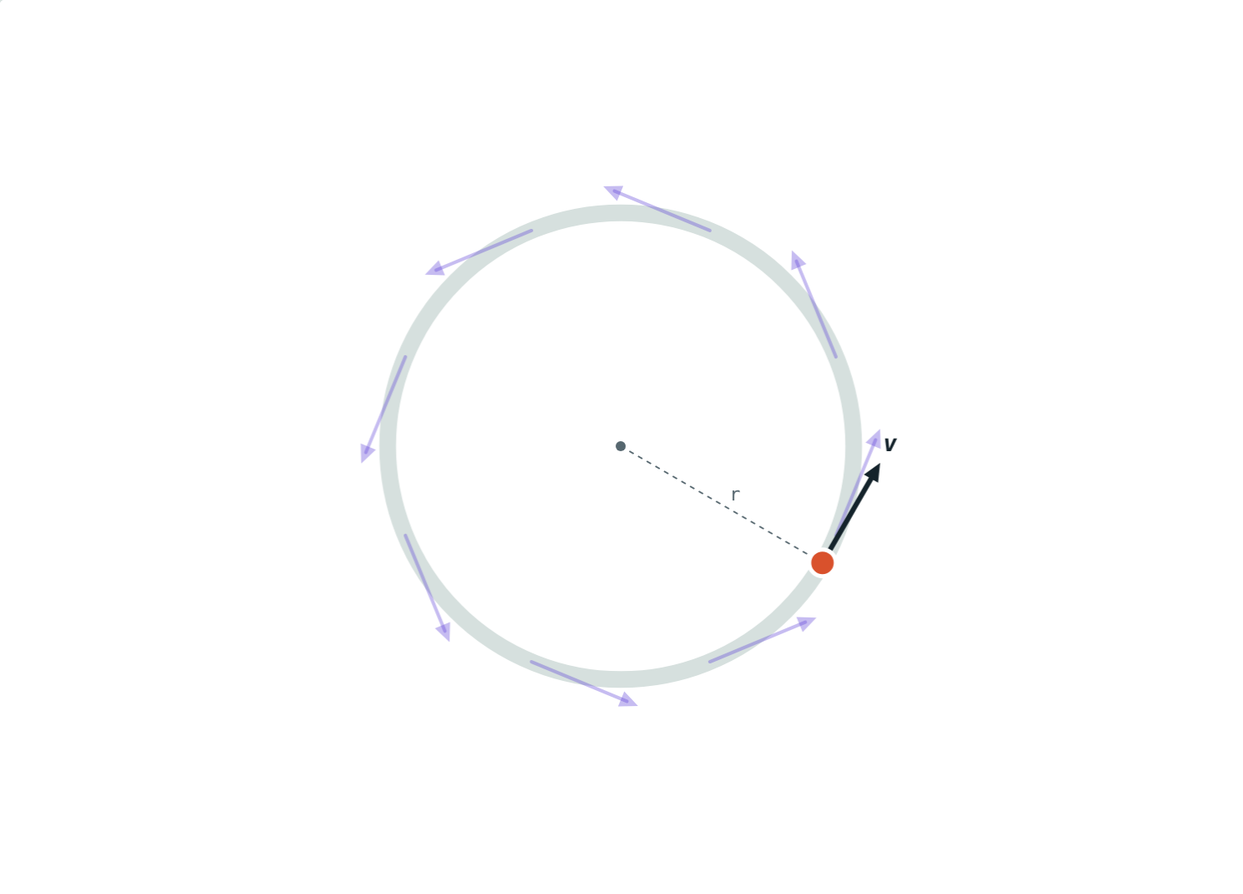
Uniform Circular Motion
STD 9 SCIENCE · CH. 1 LAWS OF MOTION
Lesson 7 · Visual Science & Maths
Notes:
Goal: students can explain why uniform circular motion is accelerated, describe the direction of velocity (tangent), and use v = 2πr/t.

Slide 2
Same speed, changing velocity
A merry-go-round turns at a steady rate. Every horse keeps the same speed all the way round.
So is each horse's velocity constant too?
Faded arrows: the velocity at earlier points
Notes:
Most students say yes. The faded arrows show the direction changing all the way round.

Slide 3
Uniform circular motion
Motion along a circular path at constant speed.
The speed stays the same
The direction changes at every point
So the velocity keeps changing
A changing velocity means acceleration: it is accelerated motion
The velocity arrow turns as the object goes round
Notes:
Link back to Lesson 2: velocity changes when speed or direction changes.

Slide 4
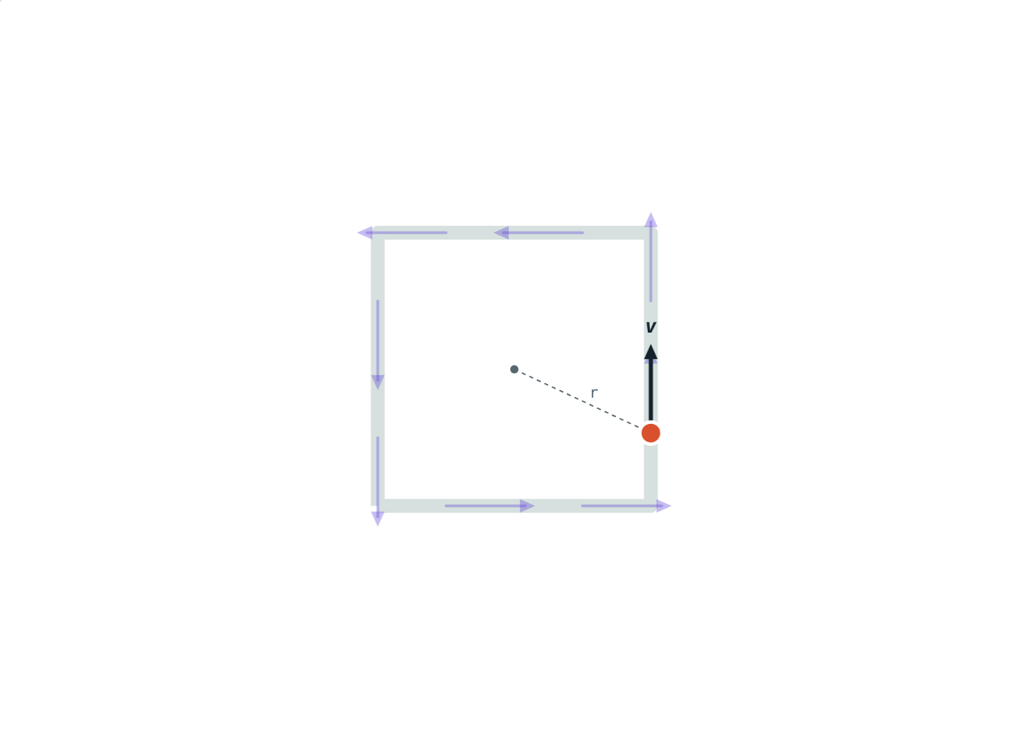
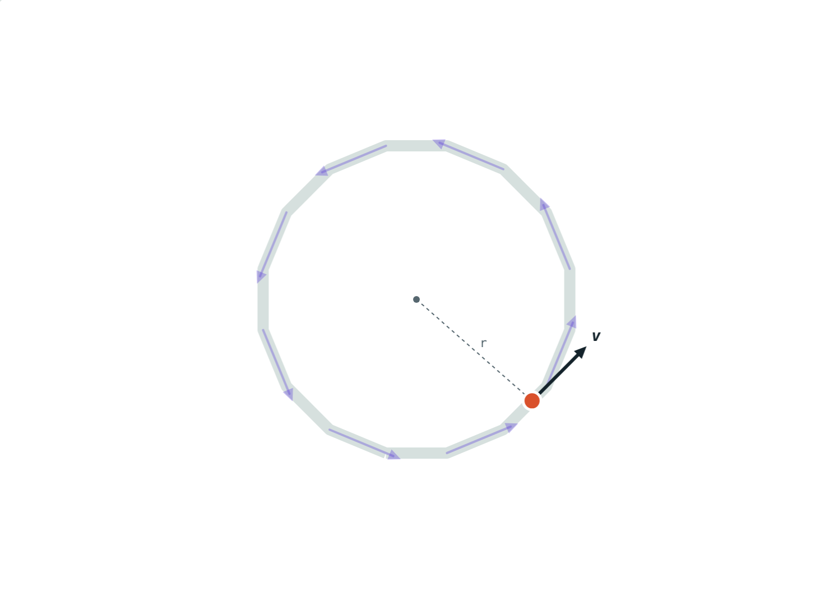
From polygon to circle
Direction changes only at the 4 corners.
Sixteen smaller turns. A circle has a turn at every point.
Notes:
Draw a square, then an octagon, then a 16-sided shape on the board. As sides increase, the path approaches a circle and the direction changes more and more often.

Slide 5
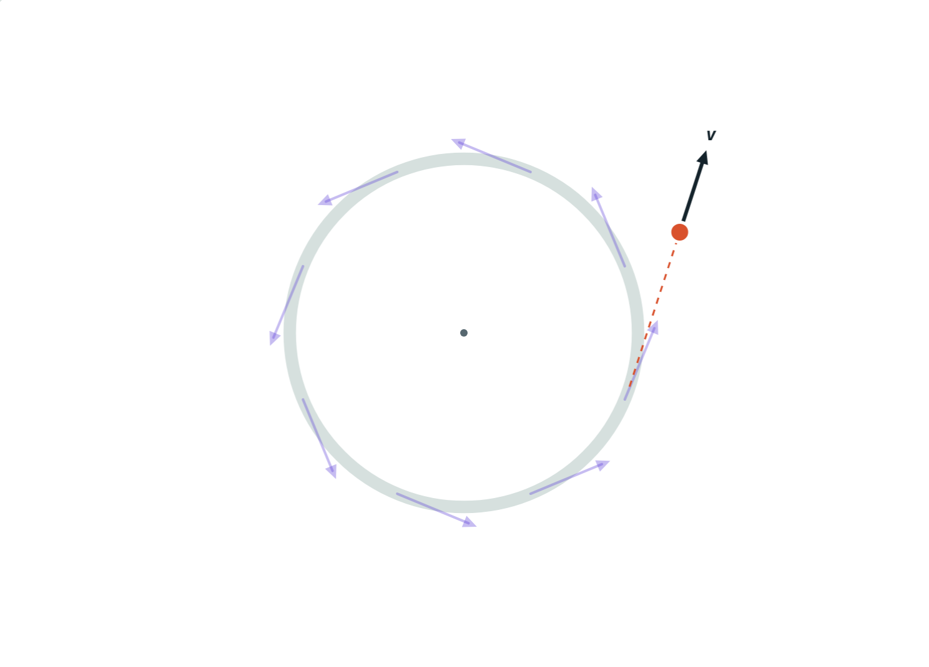
Velocity is along the tangent
At any point, the velocity points along the tangent, at right angles to the radius.
Let go, and the object moves off along the tangent
Mud flies off a spinning bicycle wheel
Sparks leave a grinding wheel
A coin slides off a turning disc
Released object: straight along the tangent
Notes:
Correct the common belief that a released object flies straight outwards.

Slide 6
Finding the speed
v = 2πr ÷ t
One round = circumference = 2πr
t = time for one complete round
r = radius, not diameter
Use π = 3.14 or 22/7
Distance in one round ÷ time for one round
Notes:
This is just speed = distance ÷ time, with the circumference as the distance.

Slide 7



Where you see it
Clock hands
Satellites
Grinding wheel
The tip of the second hand moves round at a steady speed.
Many satellites circle the Earth at nearly constant speed.
Sparks fly off along the tangent.
Notes:
Ask for more: a ceiling fan blade, a stone in a sling, a car on a roundabout.

Slide 8
Worked examples
A cycling track
The second hand
A cyclist rides once round a track of radius 35 m in 44 s. Find her speed (π = 22/7).
The second hand of a clock is 10 cm long. Find the speed of its tip.
v = 2 × 22/7 × 35 ÷ 44 = 220 ÷ 44 = 5 m/s
r = 0.1 m, t = 60 s
v = 2 × 3.14 × 0.1 ÷ 60 ≈ 0.0105 m/s
Notes:
The second example shows the importance of converting cm to m.

Slide 9
Worked example: a merry-go-round
A child sits 3 m from the centre of a merry-go-round that makes one round every 6 s. Find the speed, and the distance and displacement after one round.
v = 2 × 3.14 × 3 ÷ 6 = 3.14 m/s
Distance in one round = 18.84 m
Displacement after one round = 0
Back at the start after one round: displacement 0
Notes:
This links back to Lesson 1: a full lap has distance but zero displacement.

Slide 10

Common mistakes
“Constant speed, no acceleration”
“It flies straight outwards”
The direction keeps changing, so the velocity does too.
A released object leaves along the tangent.
Using the diameter
Wrong time
r is the radius. Halve a diameter first.
In v = 2πr/t, t is the time for one full round.
Notes:
The first two are conceptual errors worth discussing in class.

Slide 11
Quick check
1
In uniform circular motion, which stays constant: speed or velocity?
2
A stone whirled on a string is released. Which way does it move?
3
Find the speed for r = 7 m and one round in 11 s (π = 22/7).
4
Why is uniform circular motion called accelerated motion?
Notes:
Answers: 1) Speed. 2) Along the tangent. 3) 4 m/s. 4) Its velocity changes because its direction changes.

Slide 12
Go round yourself
Open the Uniform Circular Motion lesson on the Visual Science & Maths website. Try a square, a polygon and a circle, then press Let go.
Next lesson: Newton's laws of motion
Notes:
Homework idea: time one turn of a ceiling fan, measure the blade length, and estimate the speed of the blade tip.

