Slide 1
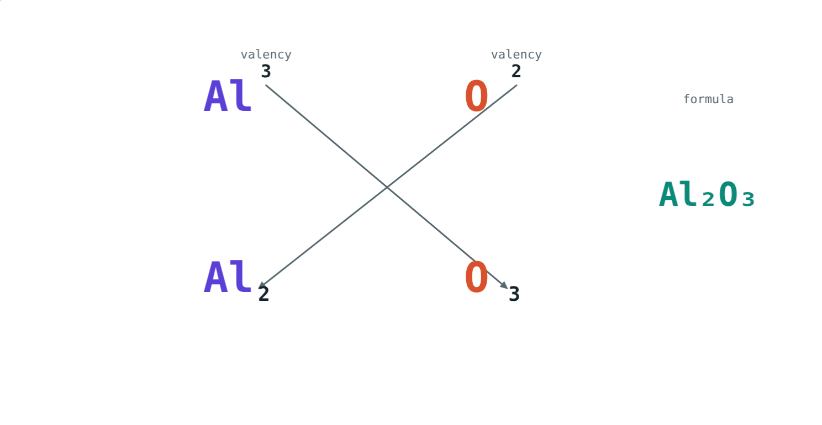
Valency and Chemical Formulae
STD 9 SCIENCE · CH. 4 MEASUREMENT OF MATTER
Lesson 4 · Visual Science & Maths
Notes:
Goal: students can use valencies, including radicals and variable valency, to write formulae by the criss-cross method.

Slide 2
Why H₂O but NaCl?
Water has two hydrogen atoms for each oxygen. Table salt has one sodium for each chlorine. Aluminium oxide has two aluminium for every three oxygen.
What decides these numbers?
Valencies 3 and 2 cross over to give Al₂O₃
Notes:
Each element's combining capacity: its valency.

Slide 3
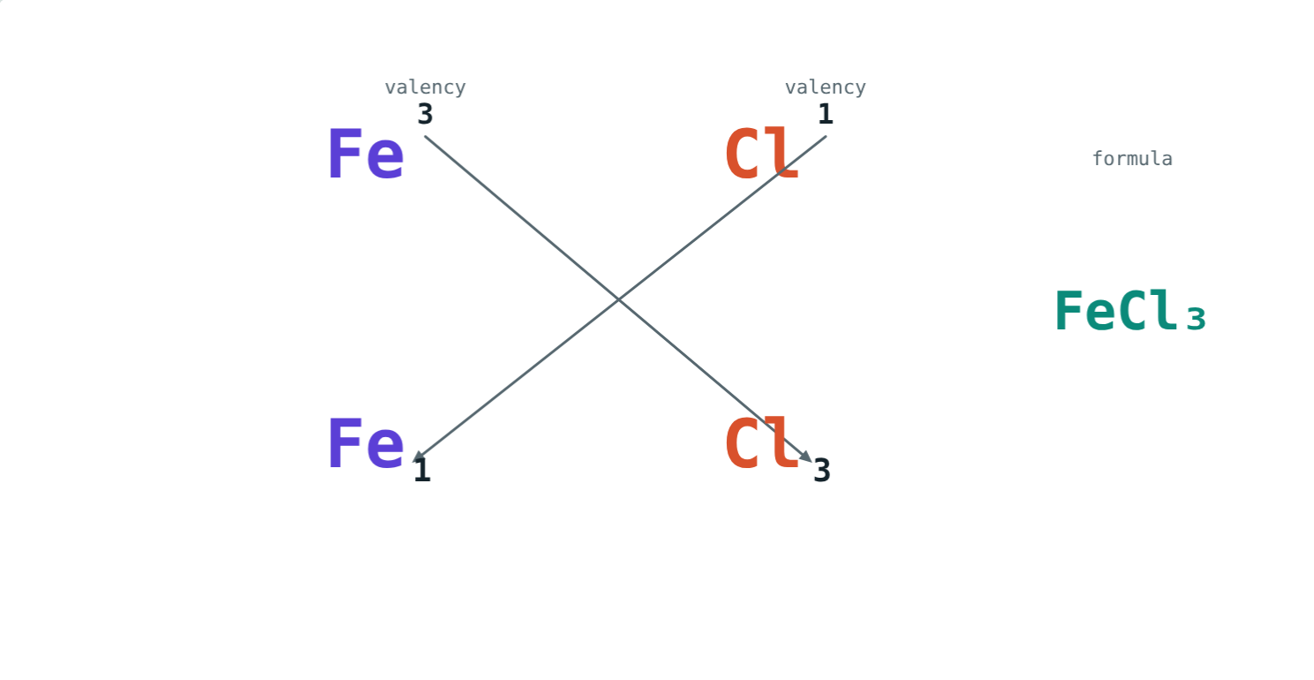
Valency
The combining capacity of an element.
Valency 1: H, Na, K, Cl
Valency 2: O, Mg, Ca
Valency 3: Al; carbon usually 4
Variable: iron 2 or 3, copper 1 or 2
Iron(III) chloride: FeCl₃
Notes:
The Roman numeral in a name shows which valency is used.

Slide 4
Common ions
Valency | Positive ions | Negative ions
1 | Na⁺, K⁺, NH₄⁺, H⁺ | Cl⁻, OH⁻, NO₃⁻
2 | Mg²⁺, Ca²⁺, Cu²⁺, Fe²⁺ | O²⁻, SO₄²⁻, CO₃²⁻
3 | Al³⁺, Fe³⁺ | PO₄³⁻
Notes:
Radicals such as NH₄⁺ and SO₄²⁻ behave as single units.

Slide 5
The criss-cross method
1
2
3
4
Write symbols
Cross over
Simplify
Brackets
Positive part first, with valencies above.
Each valency becomes the other's subscript.
Divide by any common factor.
Bracket a radical if there is more than one.
Notes:
Check: total positive valency equals total negative valency.

Slide 6
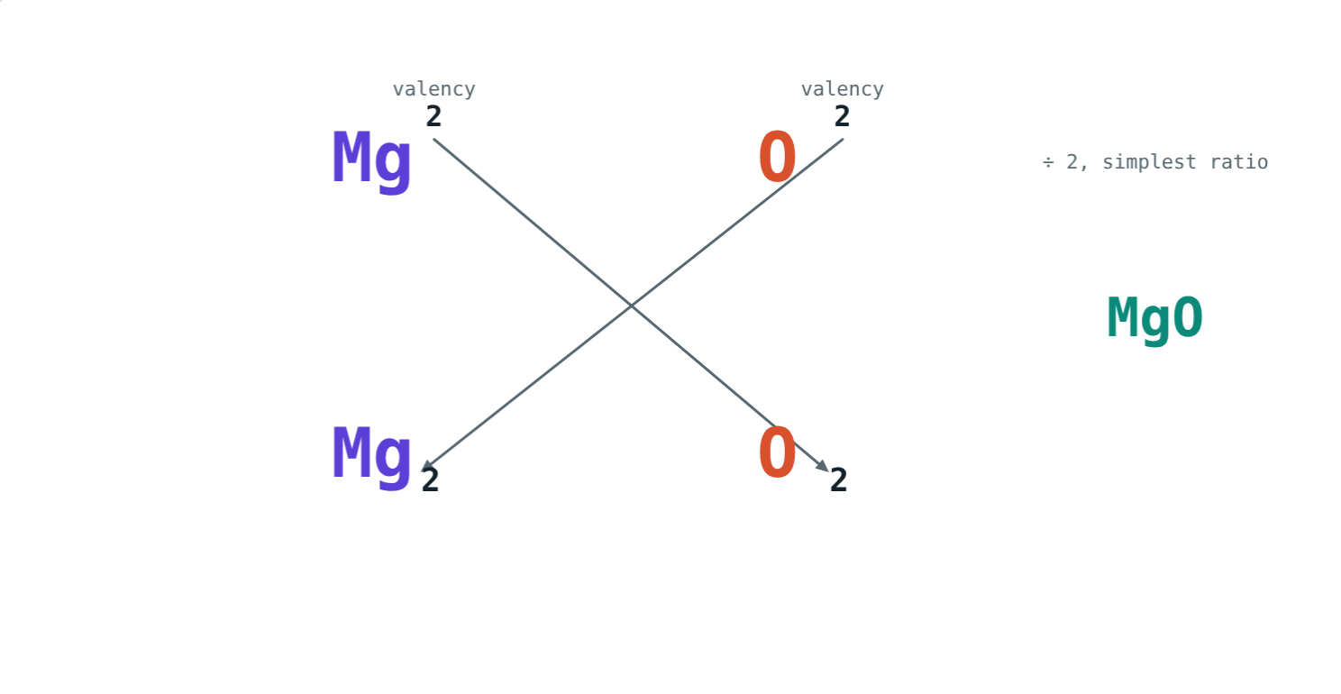
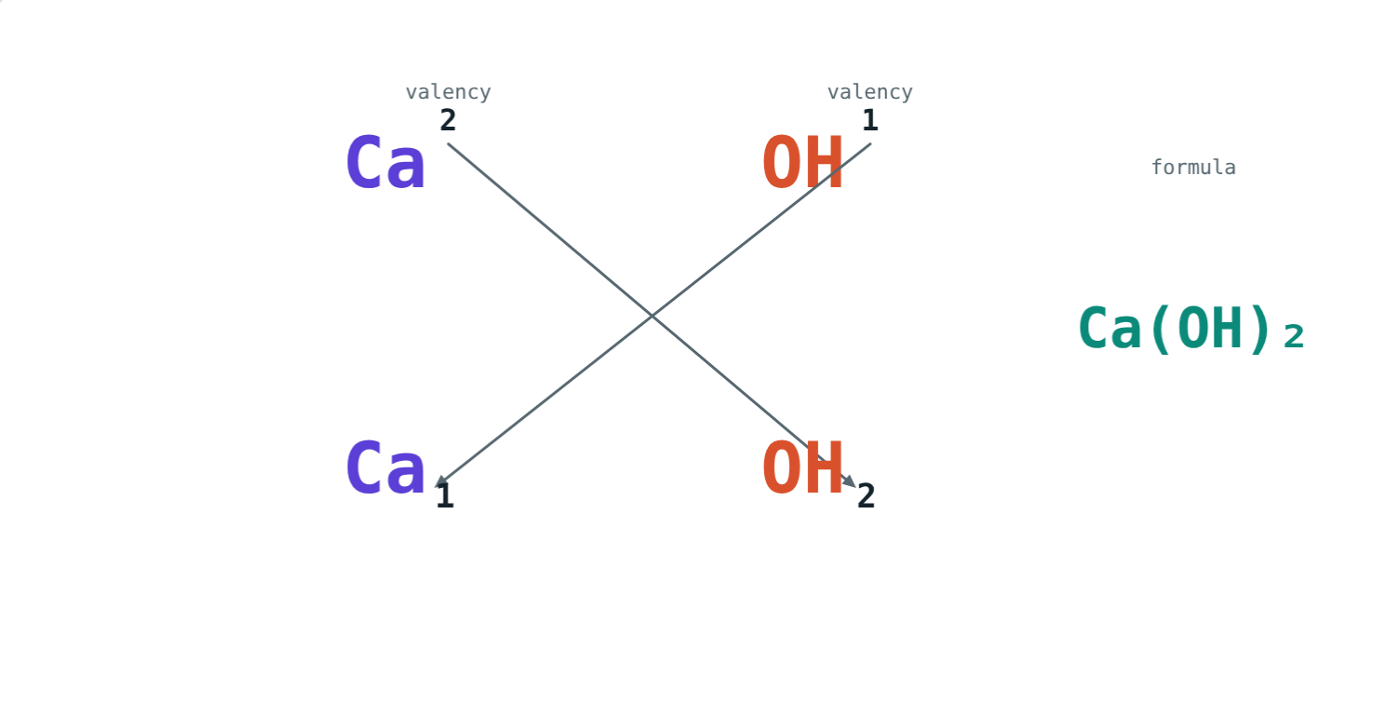
Simplify and bracket
Mg₂O₂ simplifies to MgO.
Two OH groups: Ca(OH)₂.
Notes:
Without brackets, CaOH₂ would mean one oxygen and two hydrogen atoms.

Slide 7
Worked example: aluminium oxide
Write the formula of aluminium oxide and find its formula mass (Al = 27, O = 16).
Al 3, O 2 → Al₂O₃
2 × 27 + 3 × 16 = 102 u
2 × 3 = 3 × 2 = 6
Notes:
Total valency check: 2 × 3 = 6 and 3 × 2 = 6.

Slide 8
Worked examples
Calcium hydroxide
Iron chlorides
Write the formula of calcium hydroxide.
Write iron(II) chloride and iron(III) chloride.
Ca 2, OH 1 → Ca₁(OH)₂
= Ca(OH)₂, 74 u
Iron(II): FeCl₂
Iron(III): FeCl₃
Notes:
Variable valency is shown in the name.

Slide 9
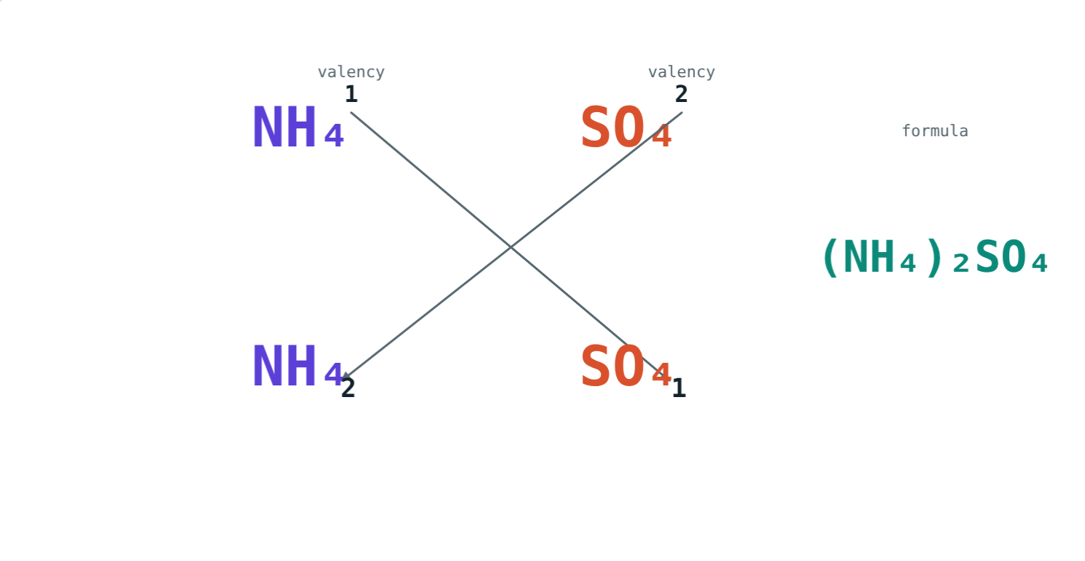
Two radicals together
NH₄ valency 1, SO₄ valency 2:
(NH₄)₂SO₄
formula
132 u
formula mass
Ammonium sulphate, a fertiliser
2 × (14 + 4) + 32 + 4 × 16 = 132 u.
Notes:
Brackets keep each ammonium group together.

Slide 10

Common mistakes
Not simplifying
Missing brackets
Mg₂O₂ → MgO.
Ca(OH)₂, not CaOH₂.
Negative part first
Ignoring the name
Write NaCl, not ClNa.
Iron(III) oxide is Fe₂O₃.
Notes:
Bracket errors are the most common.

Slide 11
Quick check
1
Write the formula of magnesium chloride.
2
What is the valency of oxygen?
3
Write the formula of sodium sulphate.
4
What is a radical?
Notes:
Answers: 1) MgCl₂. 2) 2. 3) Na₂SO₄. 4) A group of atoms acting as one unit with its own valency, such as SO₄²⁻.

Slide 12
Write formulae yourself
Open the Valency lesson on the Visual Science & Maths website. Pick any two ions and follow the criss-cross.
Next chapter: Acids, bases and salts
Notes:
Homework idea: write formulae for ten compounds from the ion table.

