Slide 1
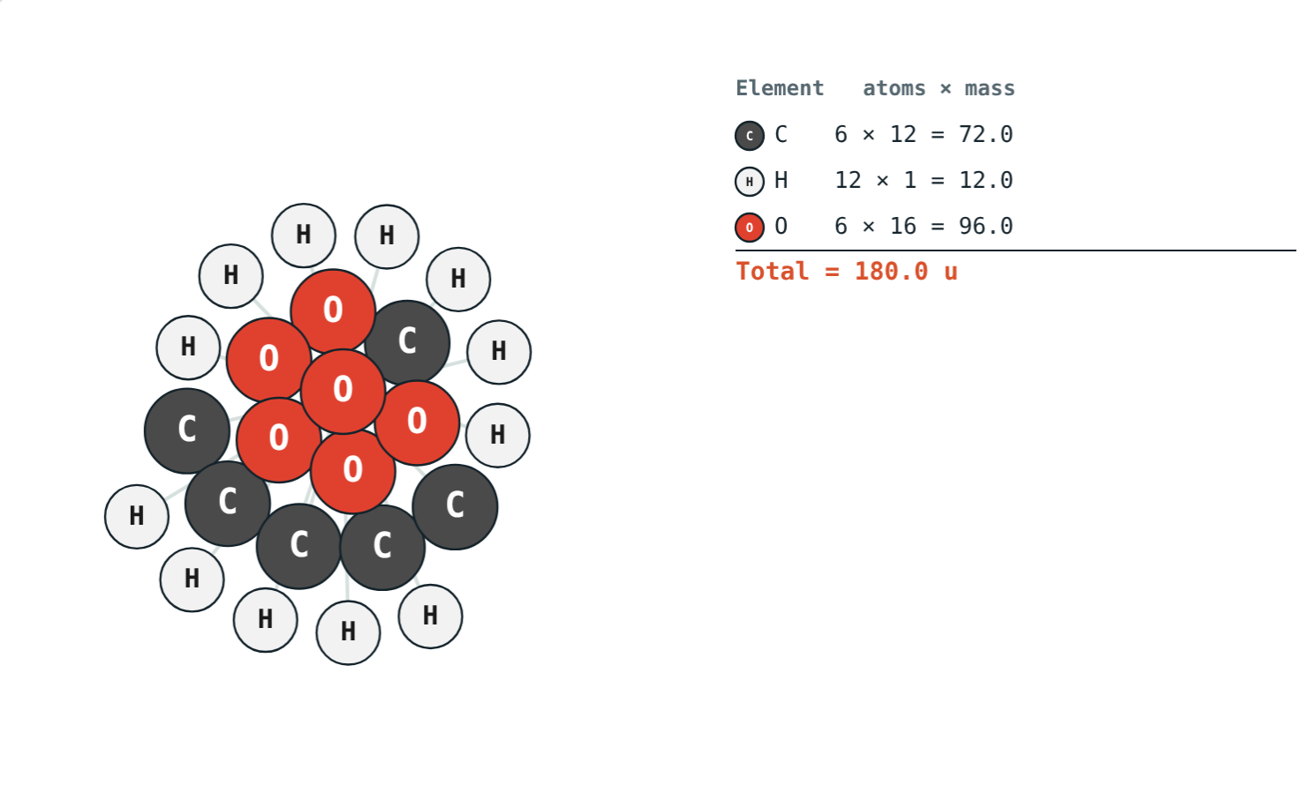
Atoms, Molecules and Molecular Mass
STD 9 SCIENCE · CH. 4 MEASUREMENT OF MATTER
Lesson 2 · Visual Physics
Notes:
Goal: students can tell atoms from molecules, use the atomic mass unit, and calculate molecular masses.

Slide 2
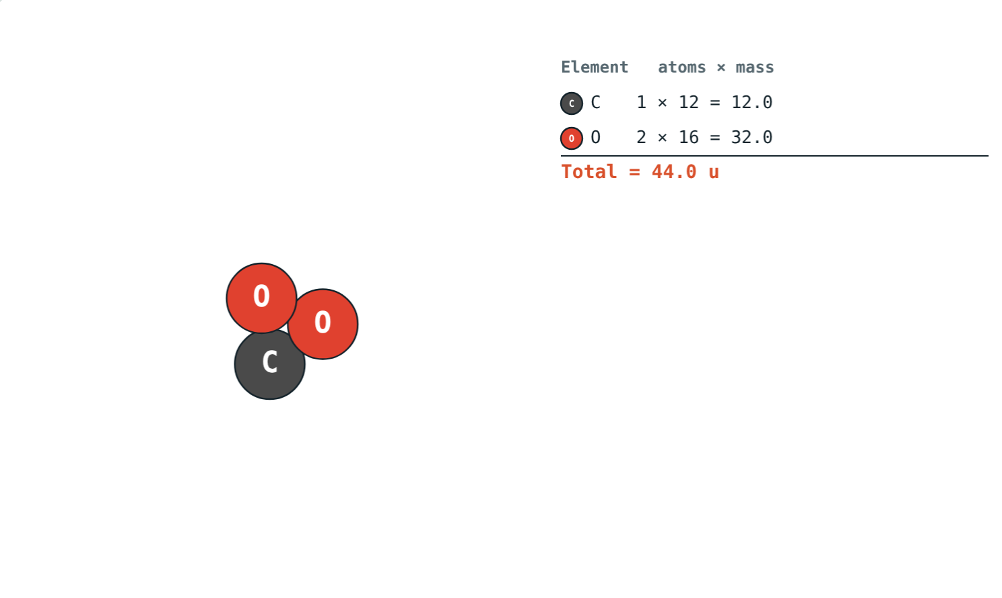
Weighing the unweighable
One carbon atom has a mass of about 2 × 10⁻²⁶ kg, far too small for any balance.
How can we compare the masses of atoms?
CO₂: 12 + 2 × 16 = 44 u
Notes:
We compare them with a standard atom, carbon-12, instead of weighing them in kilograms.

Slide 3
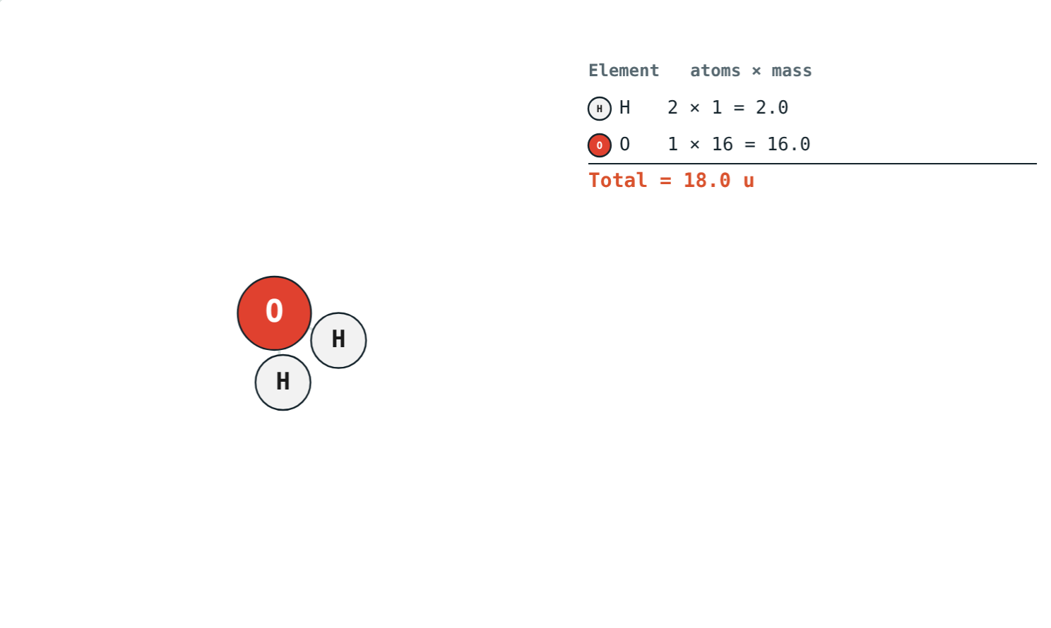
Atoms and molecules
Atom: smallest particle of an element in a reaction
Molecule: smallest particle that exists independently
Element molecules: O₂, H₂, N₂
Compound molecules: H₂O, CO₂, NH₃
A water molecule: two hydrogen atoms and one oxygen atom
Notes:
Noble gases like helium exist as single atoms.

Slide 4
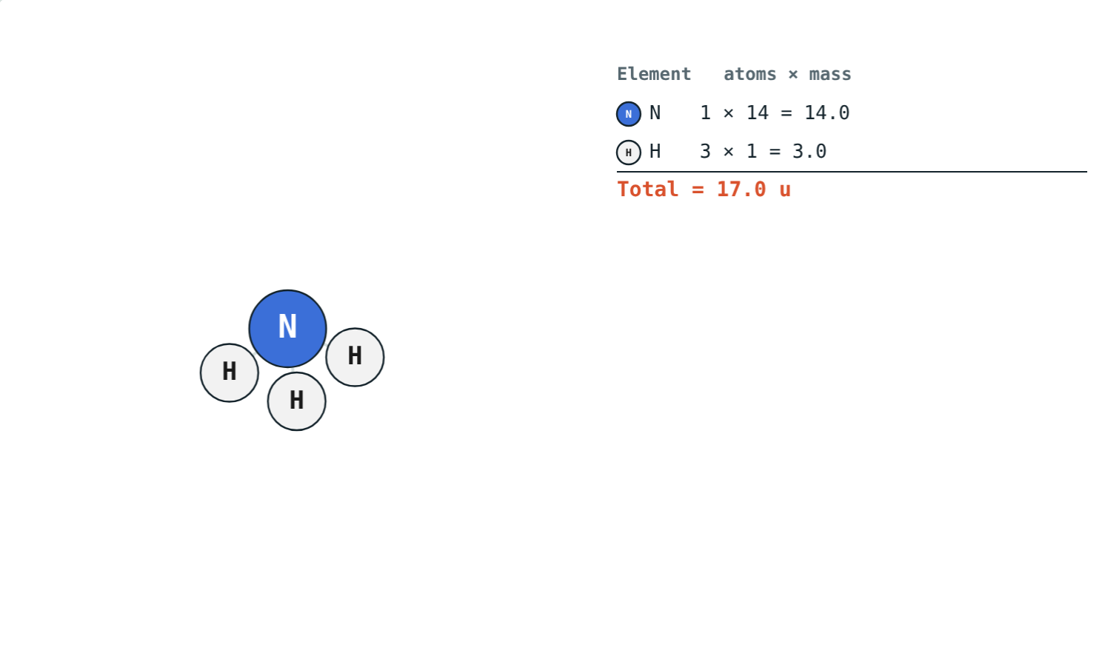
The atomic mass unit
1 u = 1/12 × mass of C-12
Also called the dalton (Da)
1 u ≈ 1.66 × 10⁻²⁷ kg
Relative atomic mass: how many times heavier than 1 u
C = 12, O = 16, H = 1
Ammonia: 14 + 3 × 1 = 17 u
Notes:
Carbon-12 was chosen as the standard by international agreement.

Slide 5
Atomic masses you will need
Element | u | Element | u | Element | u
Hydrogen H | 1 | Sodium Na | 23 | Chlorine Cl | 35.5
Carbon C | 12 | Magnesium Mg | 24 | Calcium Ca | 40
Nitrogen N | 14 | Aluminium Al | 27 | Iron Fe | 56
Oxygen O | 16 | Sulphur S | 32 | Copper Cu | 63.5
Notes:
Students should know the common ones by heart.

Slide 6
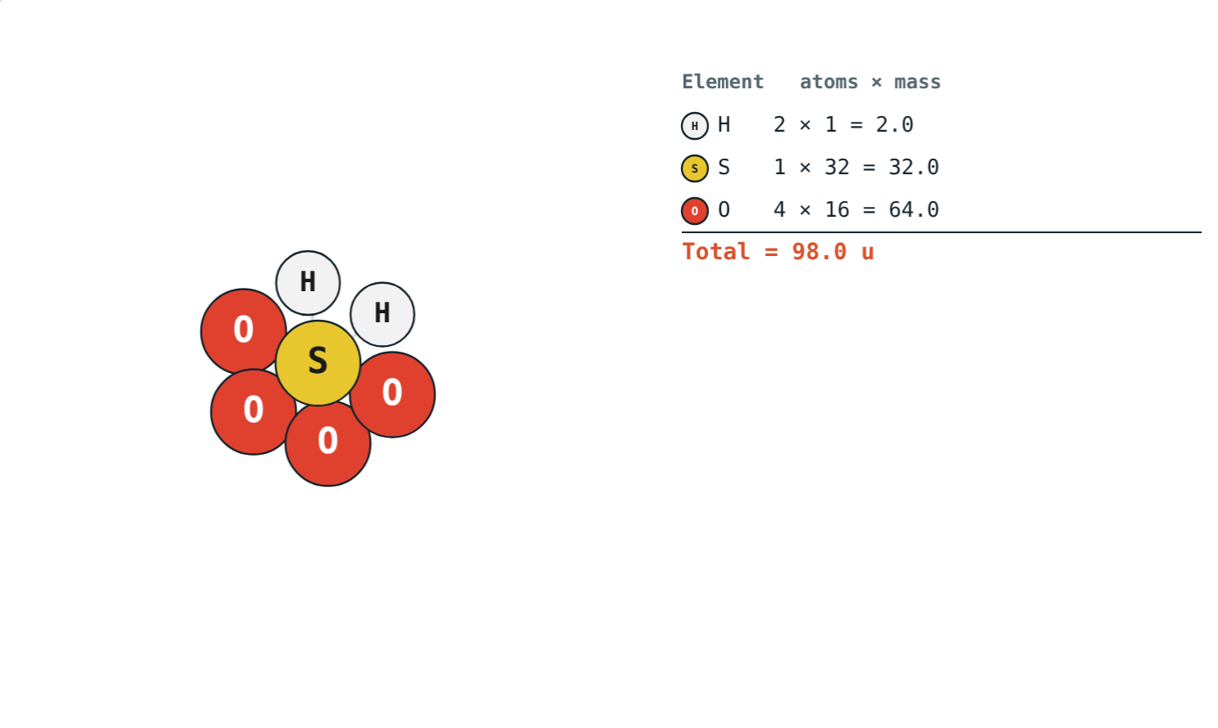
Molecular mass
Sum of atomic masses
Multiply each atomic mass by its number of atoms
Then add them all
H₂O: 2 × 1 + 16 = 18 u
Measured in u
H₂SO₄: 2 + 32 + 64 = 98 u
Notes:
The simulation's table shows each line of the sum.

Slide 7
Worked examples
Ammonia, NH₃
Sulphuric acid, H₂SO₄
Find the molecular mass of ammonia.
Find the molecular mass of sulphuric acid.
1 × 14 + 3 × 1 = 17 u
2 × 1 = 2; 32; 4 × 16 = 64
2 + 32 + 64 = 98 u
Notes:
Set out one line per element.

Slide 8
Worked example: glucose
Find the molecular mass of glucose, C₆H₁₂O₆.
6 × 12 = 72; 12 × 1 = 12; 6 × 16 = 96
72 + 12 + 96 = 180 u
24 atoms in one molecule
Notes:
Glucose is the sugar our bodies use for energy.

Slide 9
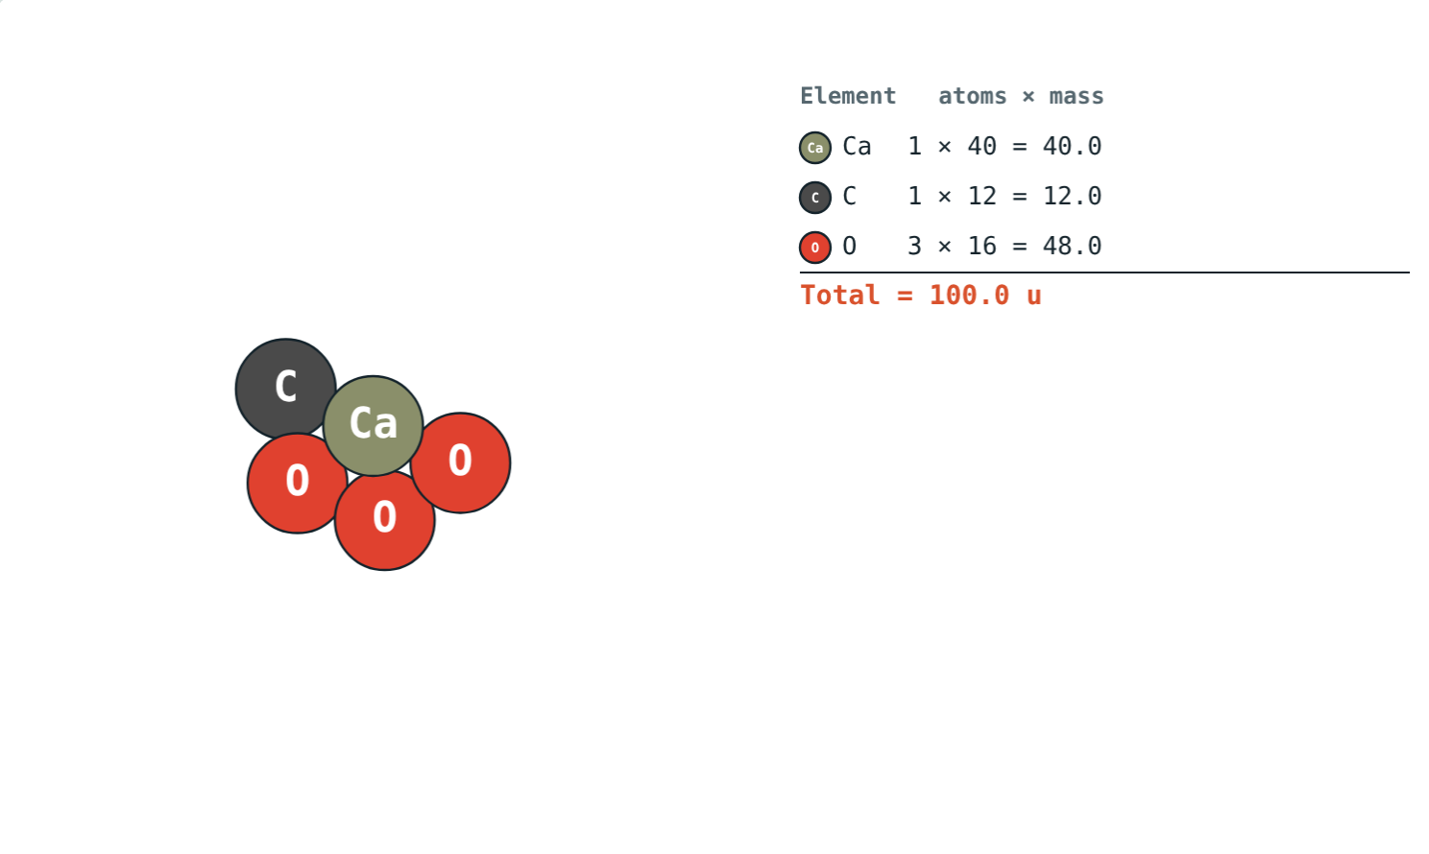
Marble and limestone
40 + 12 + 3 × 16:
100 u
molecular mass
5
atoms in one unit
Calcium carbonate, CaCO₃
The 3 belongs to oxygen only: one Ca, one C, three O.
Notes:
A common trap is to apply the subscript to the whole formula.

Slide 10

Common mistakes
Forgetting subscripts
Subscript on the wrong atom
H₂SO₄ has 4 O atoms: 4 × 16.
In CaCO₃ the 3 is for O only.
Grams for one molecule
Atom vs molecule
Molecular mass is in u.
O is an atom; O₂ is a molecule.
Notes:
Encourage the one-line-per-element layout to avoid these.

Slide 11
Quick check
1
Find the molecular mass of carbon dioxide, CO₂.
2
How is 1 u defined?
3
How many atoms are in one molecule of C₆H₁₂O₆?
4
Find the molecular mass of calcium carbonate, CaCO₃.
Notes:
Answers: 1) 44 u. 2) One-twelfth of the mass of a carbon-12 atom. 3) 24. 4) 100 u.

Slide 12
Build molecules yourself
Open the Atoms and Molecular Mass lesson on the Visual Physics website. Pick a molecule or build your own.
Next lesson: The mole
Notes:
Homework idea: find the formulae of five substances in the kitchen and work out their molecular masses.

