Slide 1
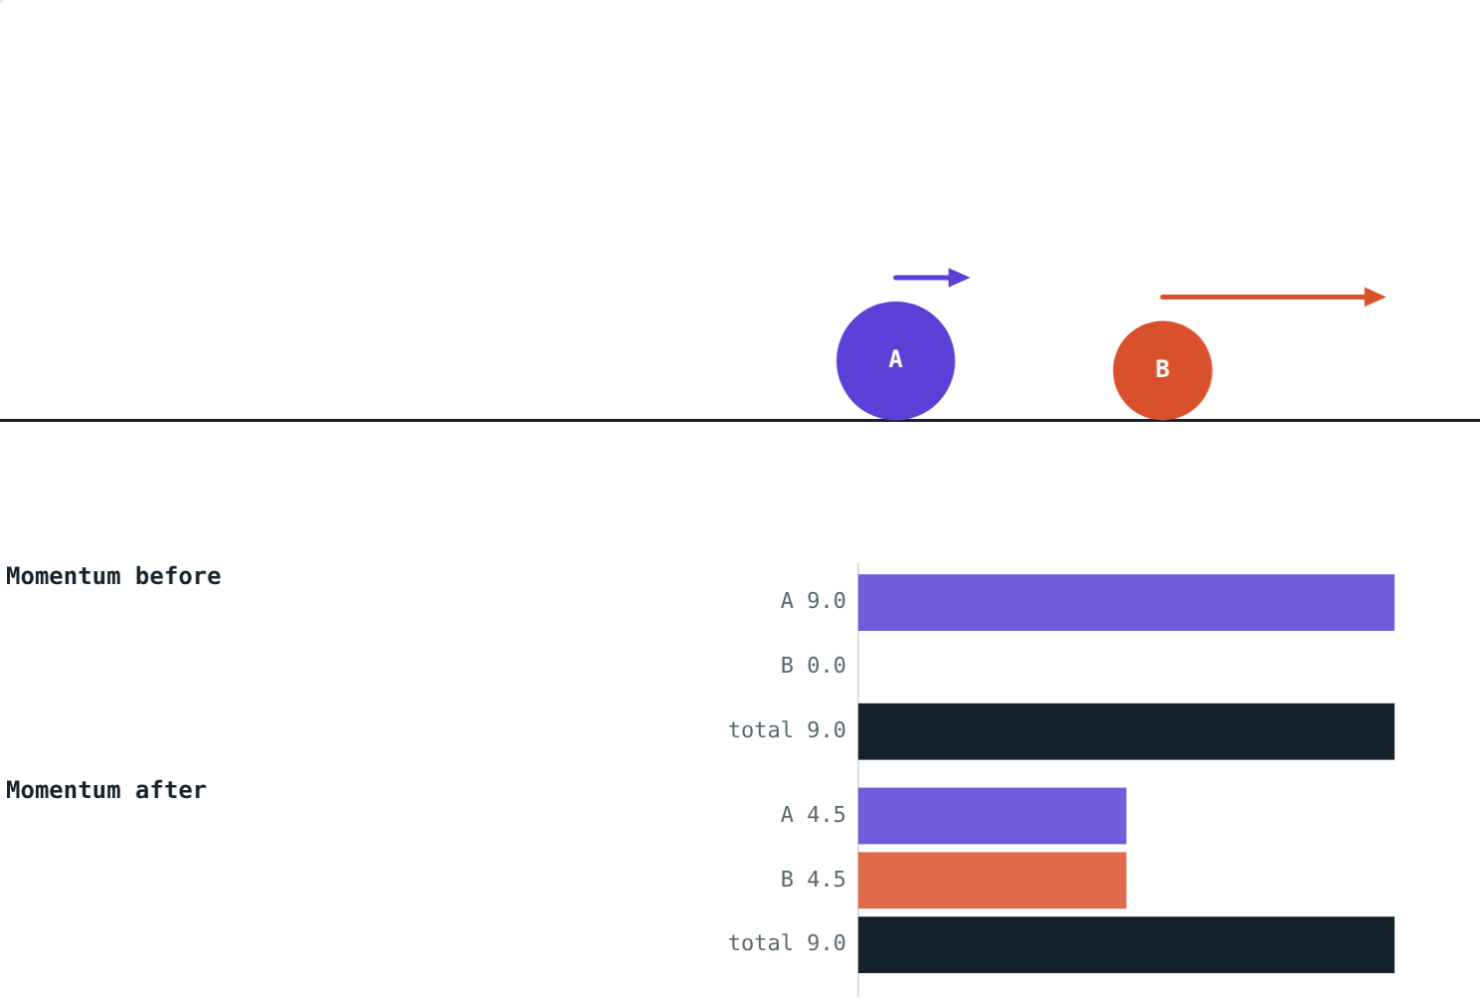
Conservation of Momentum
STD 9 SCIENCE · CH. 1 LAWS OF MOTION
Lesson 9 · Visual Physics
Notes:
Goal: students can state the law of conservation of momentum, explain it using the third law, and solve collision and recoil problems.

Slide 2
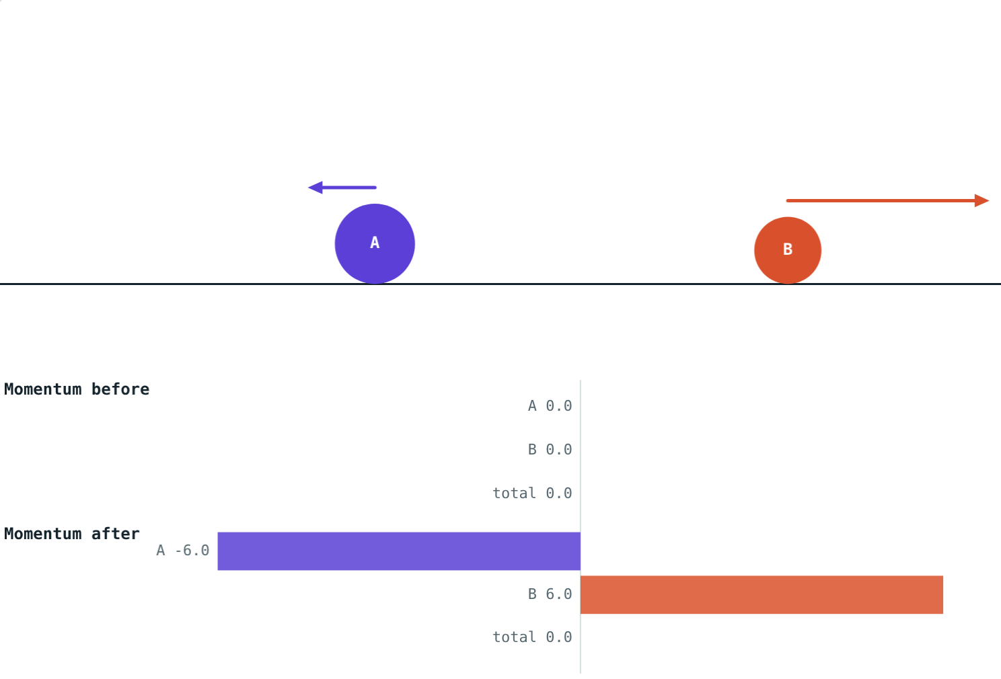
Before and after
Two marbles collide. A gun recoils. A rocket lifts off. Each time, objects push on each other.
What stays the same before and after?
Two balls pushing apart from rest
Notes:
Let students guess: speed? energy? The answer is total momentum.

Slide 3
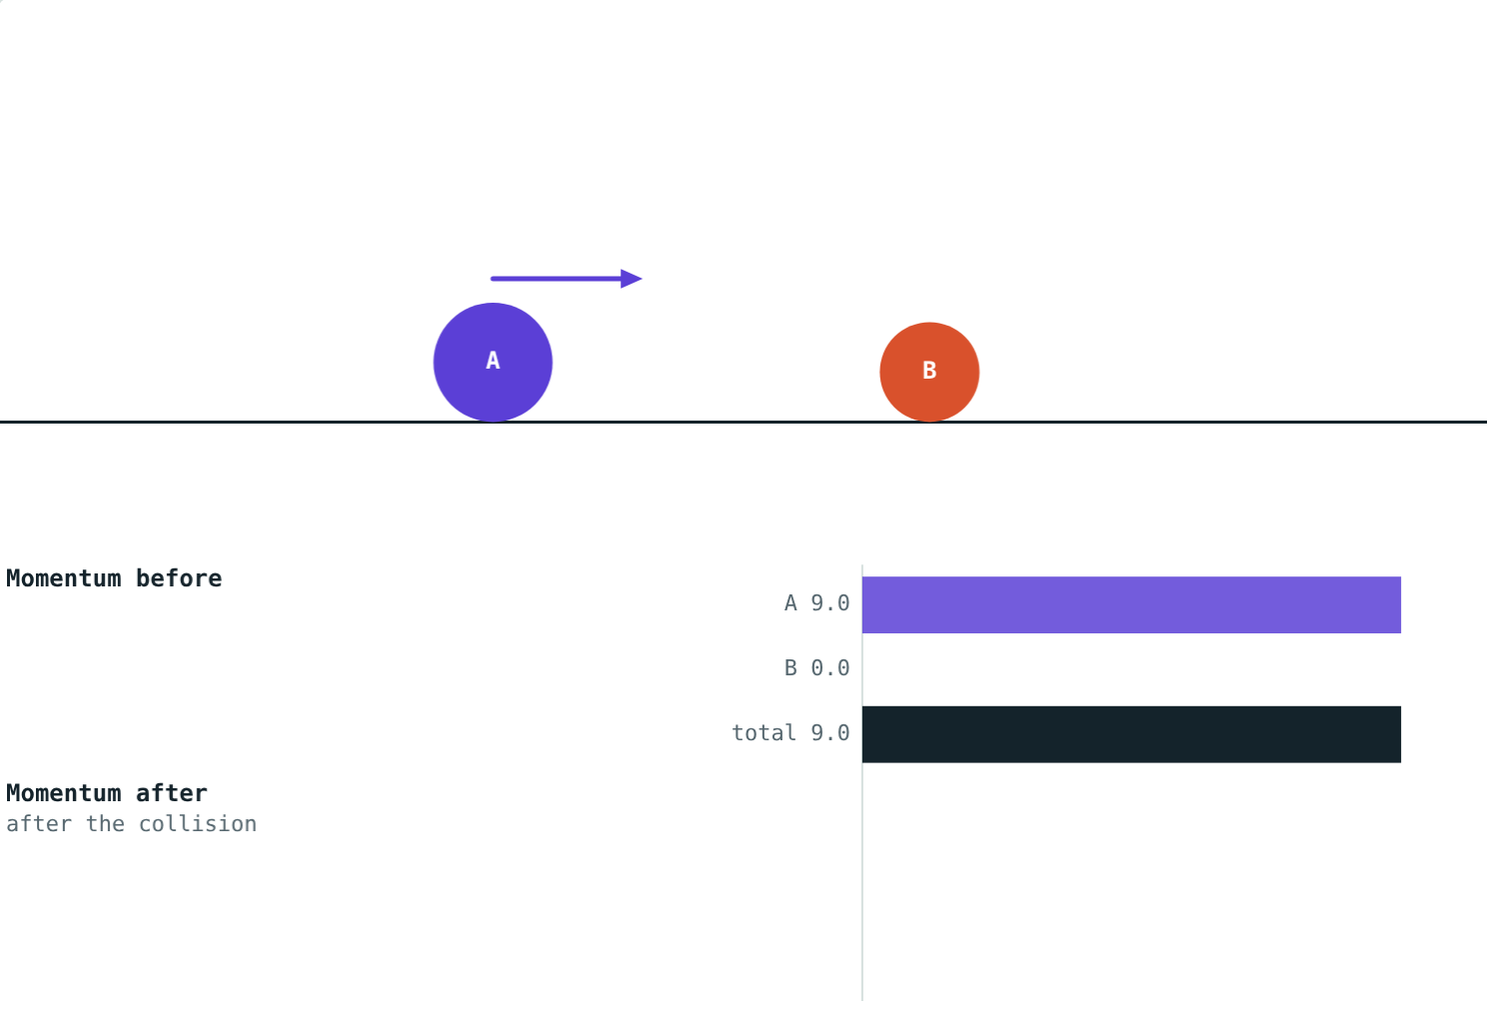
The law
m₁u₁ + m₂u₂ = m₁v₁ + m₂v₂
With no external force, the total momentum of interacting objects stays constant.
Momentum P = mv, in kg·m/s
It has a direction: right +, left −
Before the collision: A carries all 9 kg·m/s
Notes:
Choose one direction as positive at the start of every problem.

Slide 4
Heavy ball hits light ball
A: 3 × 3 = 9 kg·m/s. B: 0. Total 9.
A: 3 × 1.5 = 4.5. B: 1 × 4.5 = 4.5. Total 9.
The momentum is shared out differently, but the total does not change.
Notes:
Compare the black total bars in both pictures: they are the same length.

Slide 5
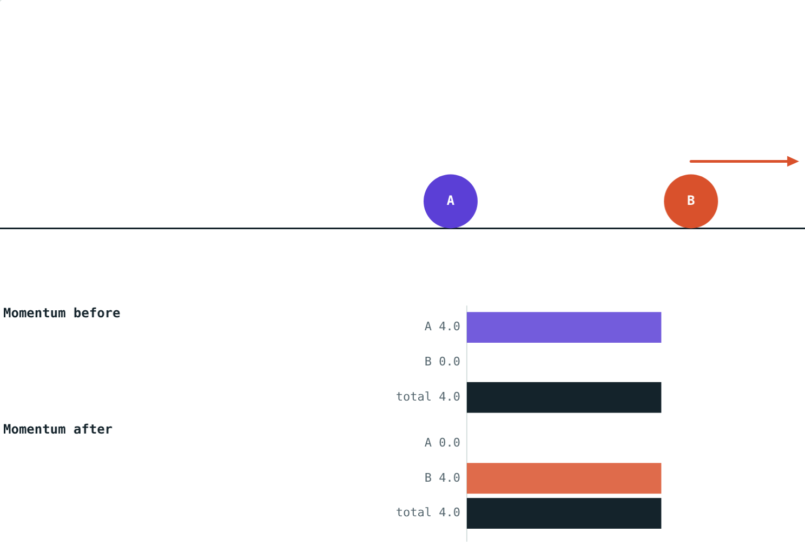
Why it works
It follows from Newton's third law:
A pushes B and B pushes A, equally and oppositely
Both forces act for the same time
So B gains exactly the momentum A loses
The total cannot change
Equal masses: A stops, B carries all the momentum
Notes:
Change in momentum = force × time. Equal and opposite forces for equal times give equal and opposite changes.

Slide 6
Recoil
Total momentum is 0 before, so it must be 0 after:
−6
heavy ball (kg·m/s)
+6
light ball (kg·m/s)
The heavy ball moves back slowly; the light one moves off fast. Guns and rockets work the same way.
3 kg and 1 kg balls push apart from rest
Notes:
Heavy ball: −6 ÷ 3 = −2 m/s. Light ball: 6 ÷ 1 = 6 m/s.

Slide 7

Sticking together
Before: 2 × 3 = 6 kg·m/s. After, both move together:
6
total after (kg·m/s)
2 m/s
common velocity
Energy is lost as heat and sound, but momentum is still conserved.
2 kg at 3 m/s hits 1 kg at rest, and they stick
Notes:
v = 6 ÷ (2 + 1) = 2 m/s.

Slide 8
Worked examples
Gun recoil
Trolleys that stick
A 4 kg gun fires a 20 g bullet at 400 m/s. Find the gun's recoil velocity.
A 2 kg trolley at 3 m/s hits a 1 kg trolley at rest, and they stick. Find their velocity.
0 = 0.02 × 400 + 4v
4v = −8, so v = −2 m/s
Before: 2 × 3 = 6 kg·m/s
3v = 6, so v = 2 m/s
Notes:
The minus sign in the first answer means the gun moves backwards.

Slide 9
Worked example: a missing velocity
A 3 kg ball at 3 m/s hits a 1 kg ball at rest. Afterwards the 3 kg ball moves at 1.5 m/s. Find the velocity of the 1 kg ball.
Before: 3 × 3 + 0 = 9 kg·m/s
After: 3 × 1.5 + 1 × v₂ = 4.5 + v₂
4.5 + v₂ = 9, so v₂ = 4.5 m/s
Total before = total after = 9 kg·m/s
Notes:
Set up 'total before = total after' and solve for the unknown.

Slide 10

Common mistakes
Forgetting signs
Adding speeds
Velocities in the opposite direction are negative.
Add momenta (m × v), not speeds.
“Sticking loses momentum”
Ignoring outside forces
Energy is lost; momentum is not.
The law needs no external force, such as friction.
Notes:
Sign errors in head-on collision problems are the most common mistake.

Slide 11
Quick check
1
Find the momentum of a 0.5 kg ball moving at 6 m/s.
2
Why does a cannon move backwards when it fires?
3
A 1 kg ball at 4 m/s hits an identical ball at rest and stops. How fast does the second ball move?
4
When is total momentum conserved?
Notes:
Answers: 1) 3 kg·m/s. 2) Total momentum must stay zero, so the cannon's backward momentum balances the shell's forward momentum. 3) 4 m/s. 4) When no external force acts.

Slide 12
Collide them yourself
Open the Conservation of Momentum lesson on the Visual Physics website. Change the masses and velocities, and check the totals.
That completes Chapter 1: Laws of Motion
Notes:
Homework idea: explain how a rocket can accelerate in space, where there is no air to push against.

