Slide 1
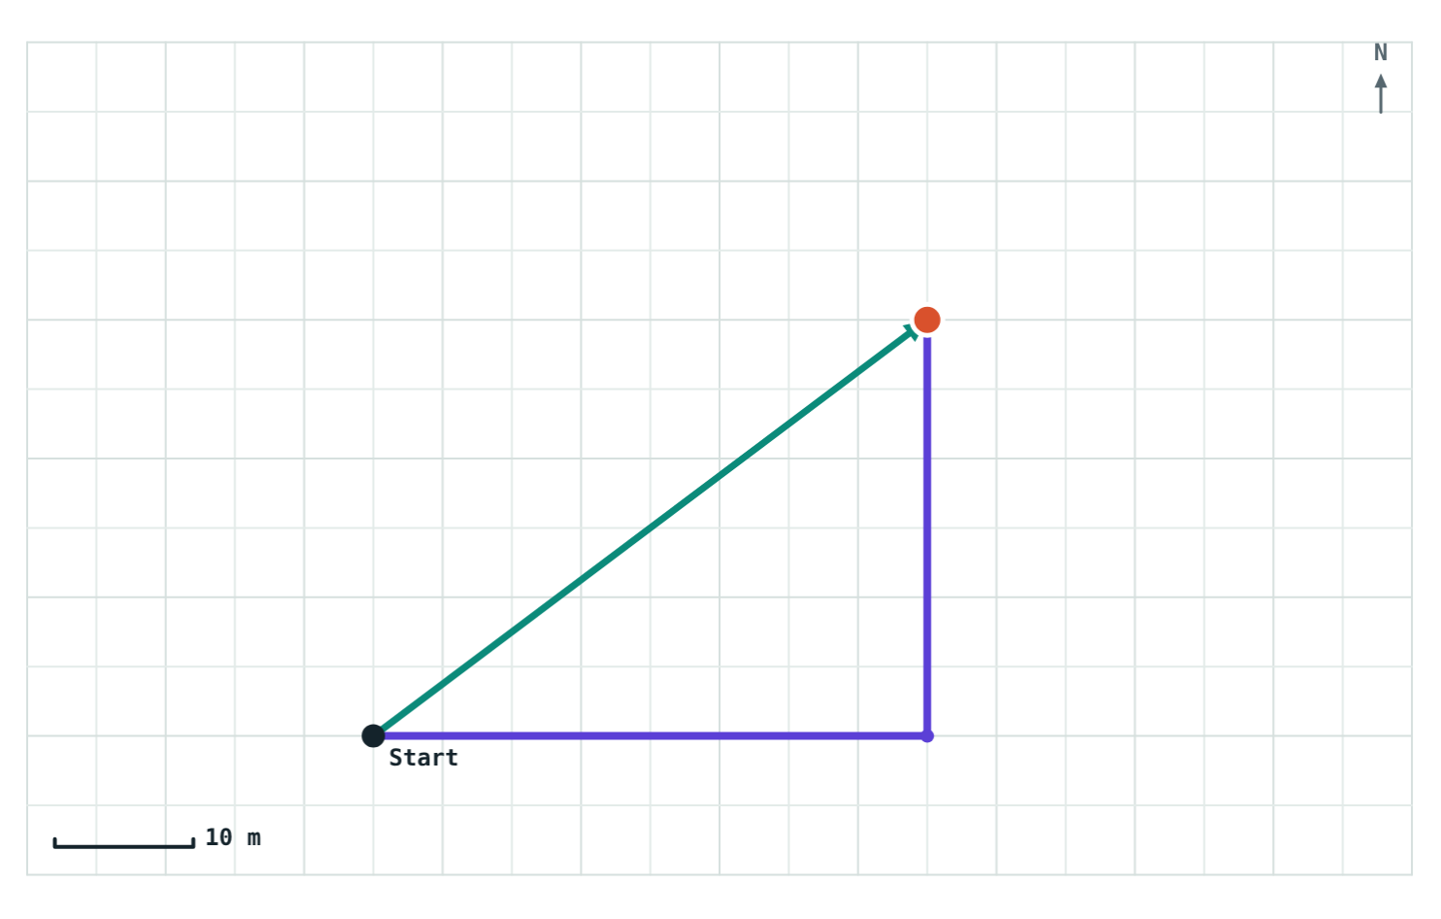
Distance and Displacement
STD 9 SCIENCE · CH. 1 LAWS OF MOTION
Lesson 1 · Visual Physics
Notes:
Lesson 1 of Chapter 1. Goal: students can tell distance from displacement, calculate both for simple routes, and give displacement with a direction.

Slide 2
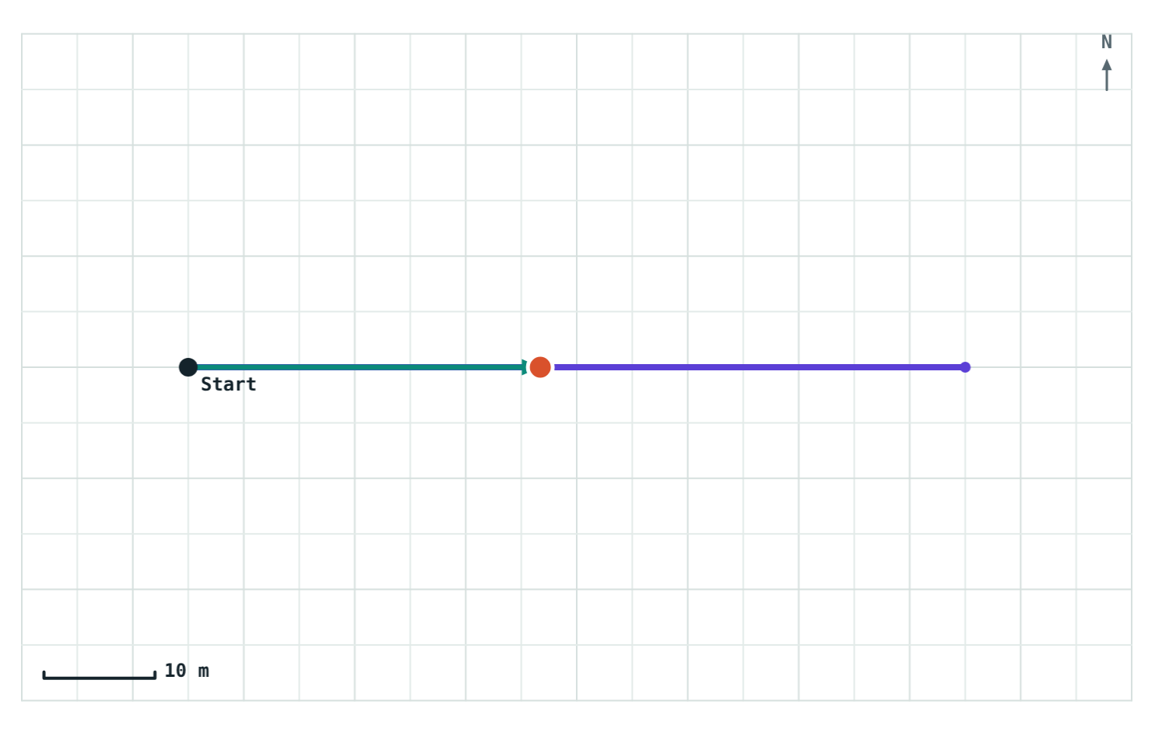
How far did you really go?
Walk 70 m east along a road, then turn around and head back. Part of the way home, two different numbers describe your trip:
108 m
walked along the road
32 m
east of where you started
Violet: path walked. Teal arrow: start to walker.
Notes:
Ask: how far did this person go? Let students argue. Some will say 108 m, some 32 m. Both are right; they are answering different questions. Today we name the two quantities.

Slide 3


Motion depends on the reference point
An object is in motion when its position changes with respect to its surroundings. We judge this against a fixed point called the reference point.
A passenger sits still in a moving bus.
Compared with the seat in front
Compared with a tree outside
AT REST
IN MOTION
Notes:
The same passenger is both at rest and in motion. There is no contradiction once we say what we are comparing with. Ask for another example: a person on an escalator, a sleeping passenger on a plane.

Slide 4
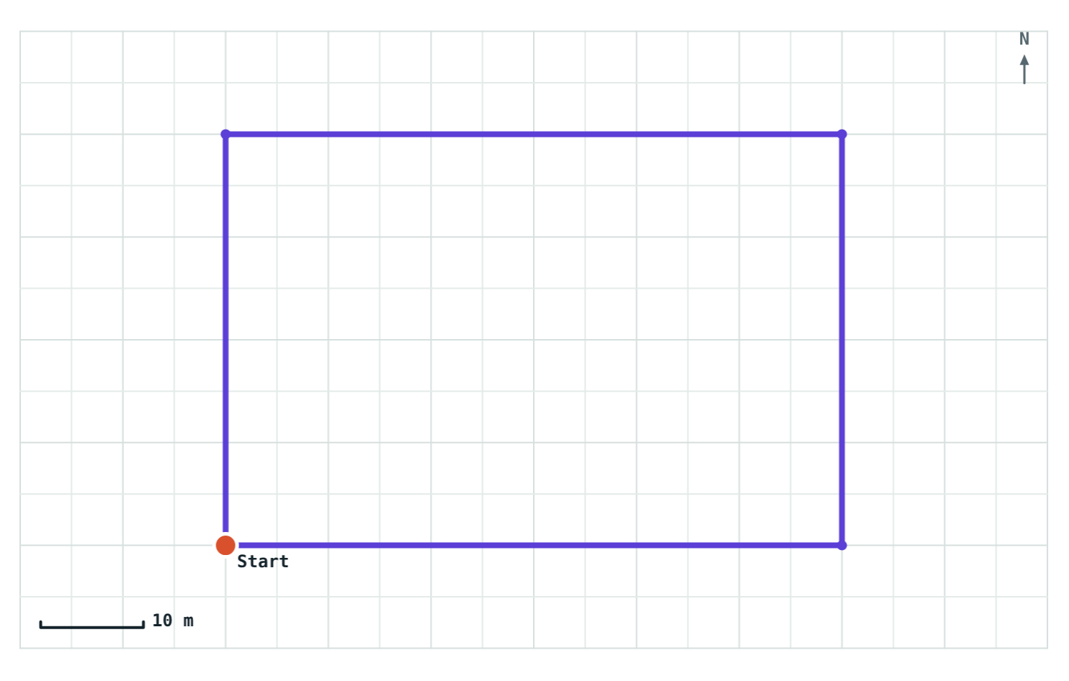
Distance: the length of the path
The total length of the path actually travelled
Has size only, no direction: a scalar
Every step adds to it, so it never decreases
Measured in metres (m)
One lap of a 60 m × 40 m park: distance = 200 m
Notes:
Point out the violet line: that is the distance. 60 + 40 + 60 + 40 = 200 m. Ask: where did the walker finish? Back at the start. Keep that in mind for the next slide.

Slide 5
Displacement: start to finish
The minimum distance between the starting and finishing points, in a straight line
Has size and direction: a vector
Ignores the route taken in between
Can be zero, even after a long walk
Measured in metres (m)
40 m east, then 30 m north: displacement 50 m, 37° north of east
Notes:
The teal arrow is the displacement. It goes straight from Start to the walker, cutting the corner. Ask: in the park lap from the previous slide, what was the displacement? Zero, because the walker ended at the start.

Slide 6
Distance or displacement?
 | Distance | Displacement
Meaning | Length of the actual path | Straight line from start to finish
Direction | Not included (scalar) | Included (vector)
Zero while moving? | No | Yes, after a round trip
Depends on the route? | Yes | No, only on start and end
Unit | metre (m) | metre (m)
Notes:
Use this as a summary students can copy. Cover one column and ask them to fill it in.

Slide 7
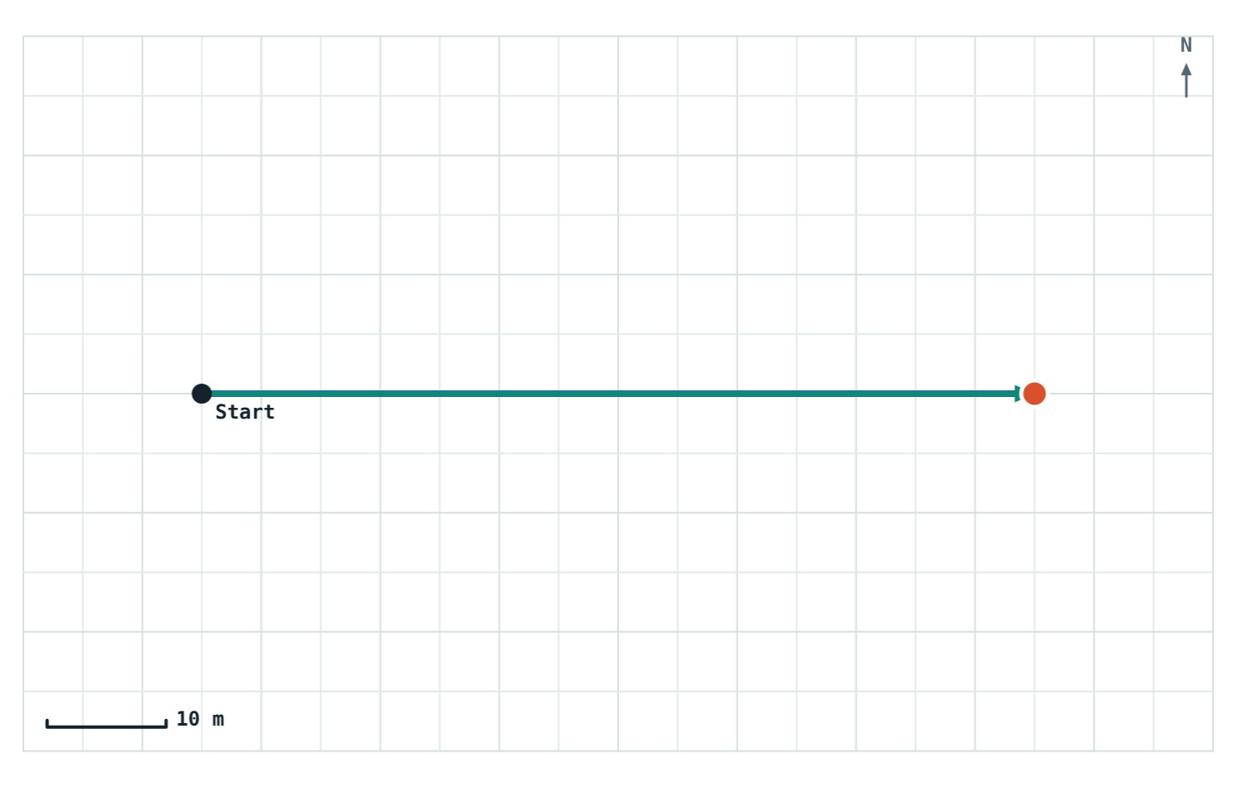
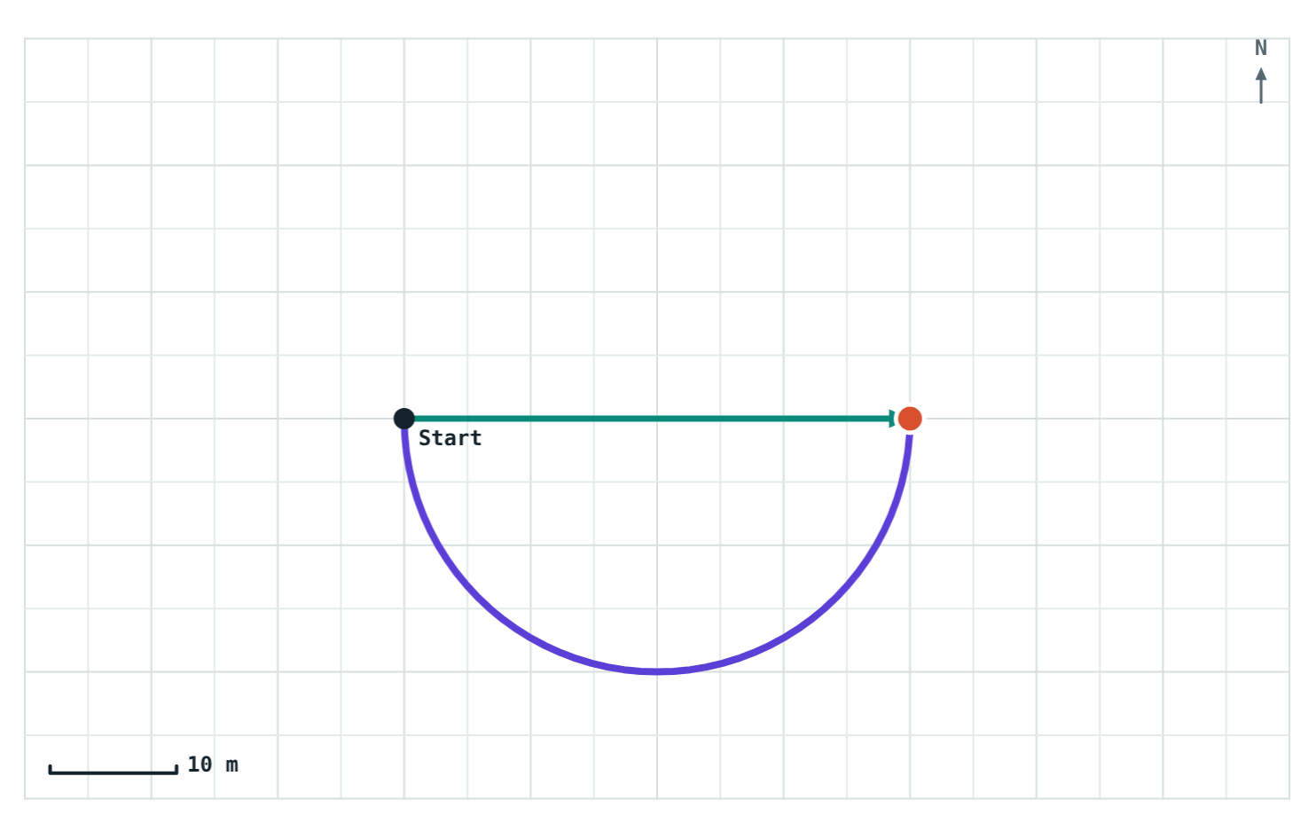
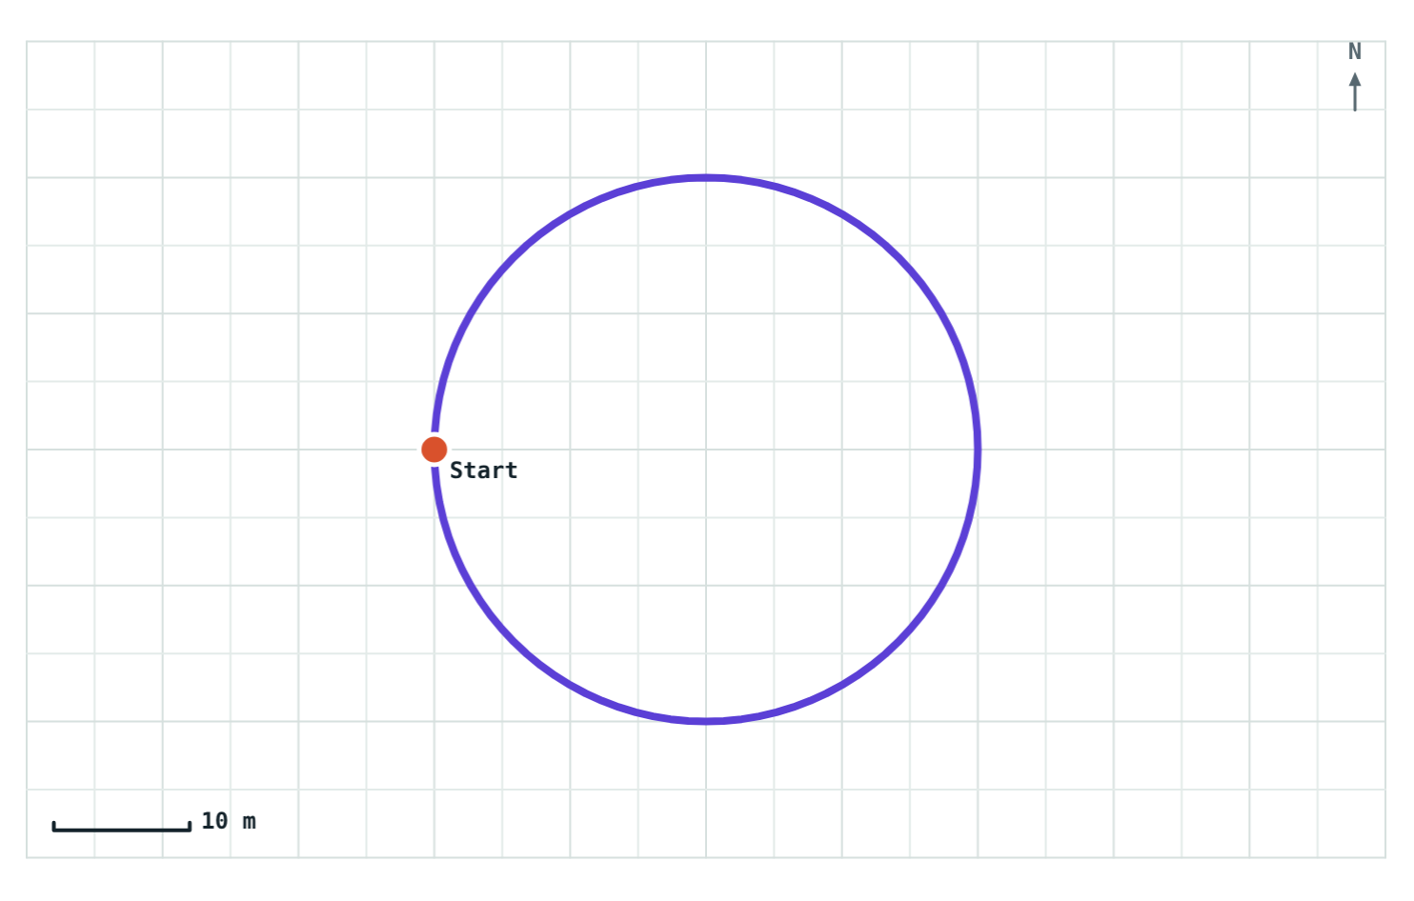
Displacement is never more than distance
Straight walk
Half lap, radius 20 m
Full lap
Distance 70 m
Displacement 70 m
Distance 62.8 m
Displacement 40 m
Distance 125.6 m
Displacement 0 m
Equal: no turns, no turning back
Displacement is the diameter
Back at the start
Notes:
A straight line is the shortest path between two points, so displacement can equal distance but never exceed it. They are equal only for a straight walk in one direction.

Slide 8
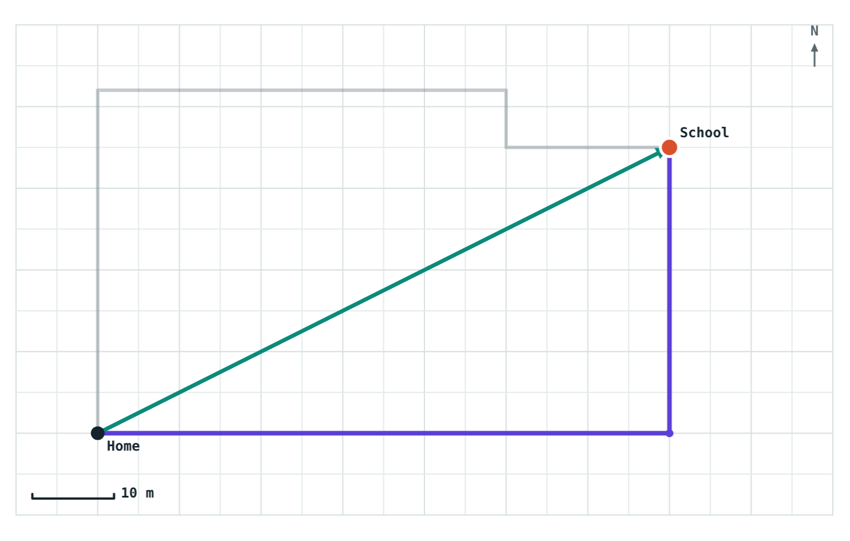
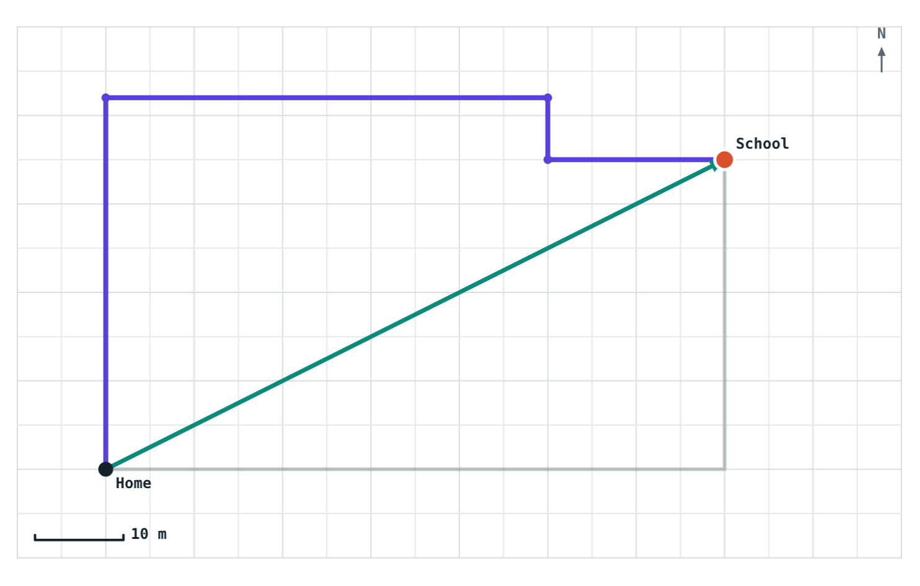
Two routes, one displacement
Route A Distance 105 m Displacement 78.3 m
Route B Distance 119 m Displacement 78.3 m
Same home, same school: the displacement is identical (78.3 m, 27° north of east) however you get there.
Notes:
This mirrors the textbook activity with two students taking different routes to school. Distance depends on the route; displacement depends only on where you start and finish. The faded line in each picture is the other route.

Slide 9
Worked example: going to the shop
Riya walks 40 m east and then 30 m north to reach a shop. Find the distance she walked and her displacement.
Distance
40 + 30 = 70 m
Displacement
√(40² + 30²) = √2500 = 50 m
Direction
tan θ = 30 / 40, so θ ≈ 37° north of east
Answer: 70 m; 50 m, 37° north of east
Notes:
The two legs make a right angle, so displacement comes from Pythagoras: a 3-4-5 triangle scaled by 10. Insist on the direction in the final answer.

Slide 10
Worked example: round the track
An athlete runs around a circular track of radius 50 m. Circumference = 2πr = 2 × 3.14 × 50 = 314 m.
After half a lap
157 m distance 100 m displacement
Directly across: displacement = diameter = 2r
After a full lap
314 m distance 0 m displacement
Back at the start
The same idea in the simulation, on a 20 m track
Notes:
Ask students to predict the displacement after a quarter lap: two radii at right angles, √(50² + 50²) ≈ 70.7 m.

Slide 11

Common mistakes
Leaving out the direction
Adding the legs
Zero means no motion
“50 m” is incomplete. Write “50 m, 37° north of east”.
40 m east + 30 m north is not 70 m of displacement. Draw the straight line.
A full lap is plenty of motion. Only the start and end points coincide.
Notes:
These three account for most lost marks on this topic.

Slide 12
Quick check
1
A car drives 5 km east, then 5 km west. Distance and displacement?
2
Which is a vector: distance, displacement or time?
3
Can displacement ever be larger than distance?
4
Is a student sitting in a moving train at rest or in motion?
Notes:
Answers: 1) Distance 10 km, displacement 0. 2) Displacement. 3) Never; a straight line is the shortest path. 4) Both: at rest compared with the train, in motion compared with the platform.

Slide 13
Walk your own routes
Open the Distance and Displacement lesson on the Visual Physics website. Tap the map to draw any route and watch both numbers change.
Next lesson: Speed and velocity
Notes:
Homework idea: draw the route from home to school on squared paper, then measure both the distance and the displacement.

