Slide 1
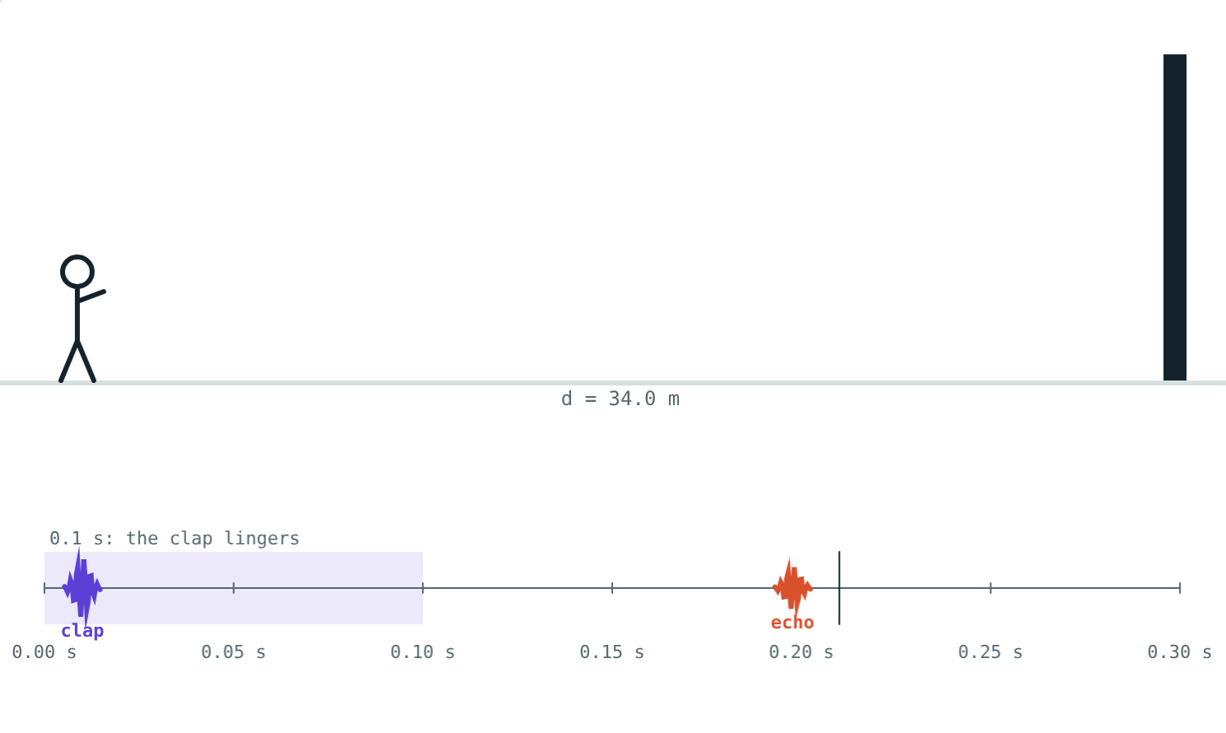
Echo and Reverberation
STD 9 SCIENCE · CH. 12 STUDY OF SOUND
Lesson 3 · Visual Physics
Notes:
Goal: students can state that sound obeys the laws of reflection, explain the 0.1 s condition for an echo, use d = vt/2, and describe reverberation.

Slide 2
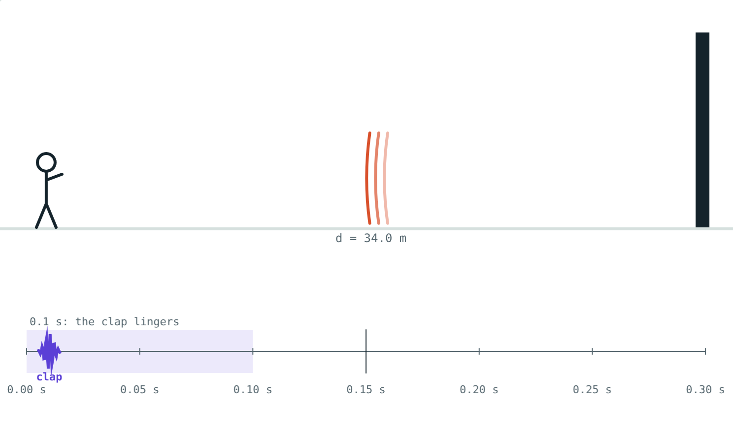
The hills shout back
Shout across a valley and the hills reply. Clap in a small room and you hear nothing extra.
Both are reflections. Why is only one an echo?
The clap on its way back
Notes:
The answer is timing.

Slide 3
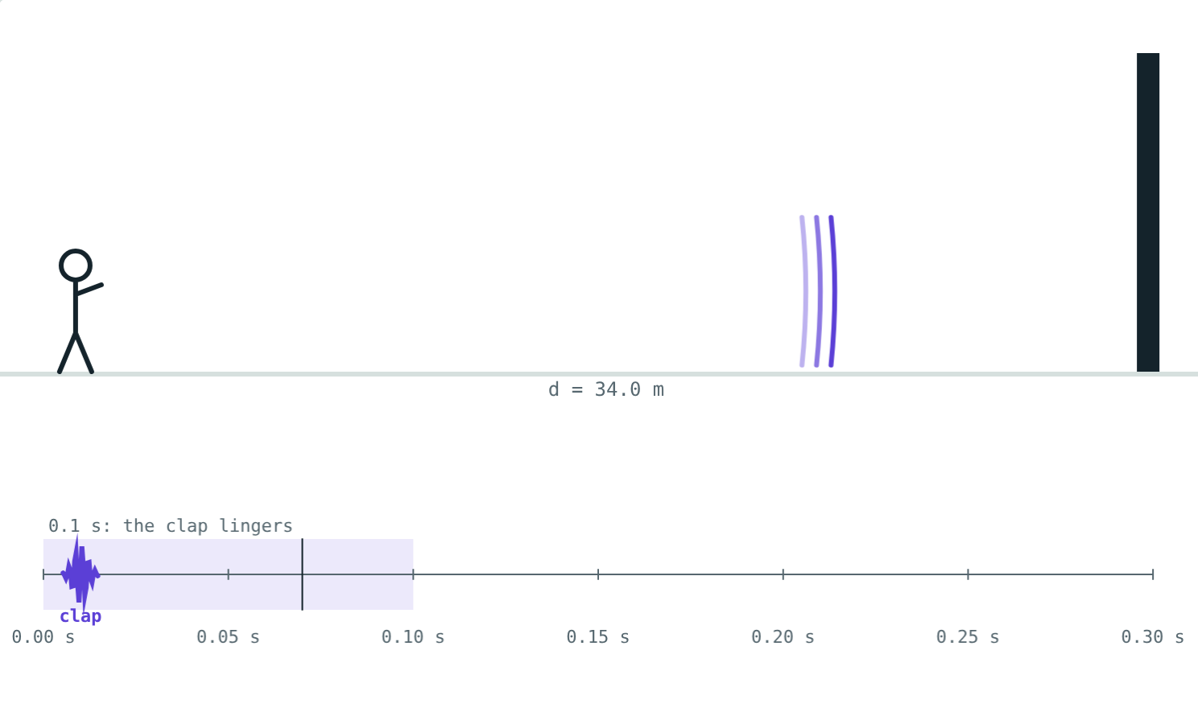
Sound reflects
Hard surfaces reflect sound well
Angle of incidence = angle of reflection
Incident sound, reflected sound and normal in one plane
Check with two tubes and a ticking watch
The clap travelling towards the wall
Notes:
The same laws as for light.

Slide 4
Echo
d = v × t ÷ 2
Our ears hold a sound for about 0.1 s
The echo must return at least 0.1 s later
At 344 m/s that needs d ≥ 17.2 m
34 m: echo after 0.2 s, clearly separate
Notes:
Divide by 2 because the sound goes there and back.

Slide 5
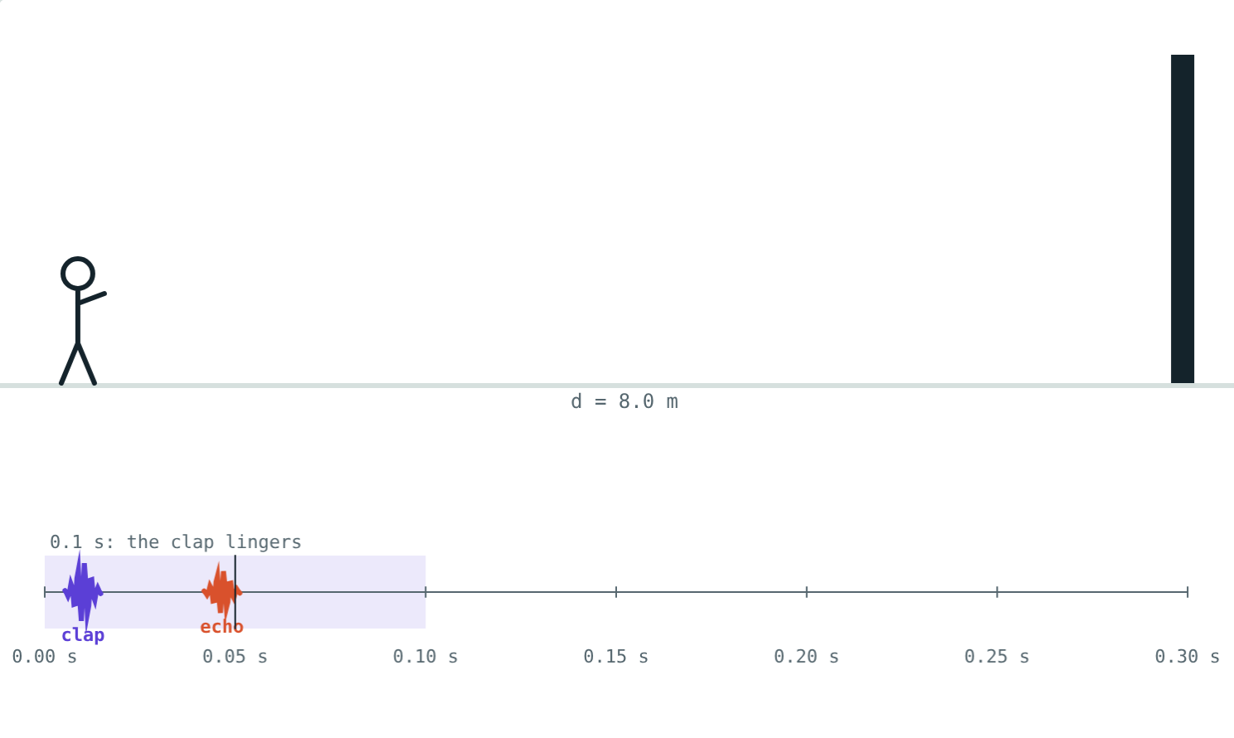
Echo or not?
Echo after 0.2 s: heard separately.
Echo after 0.047 s: merges with the clap.
Notes:
The shaded band on the timeline is the 0.1 s the clap lingers.

Slide 6
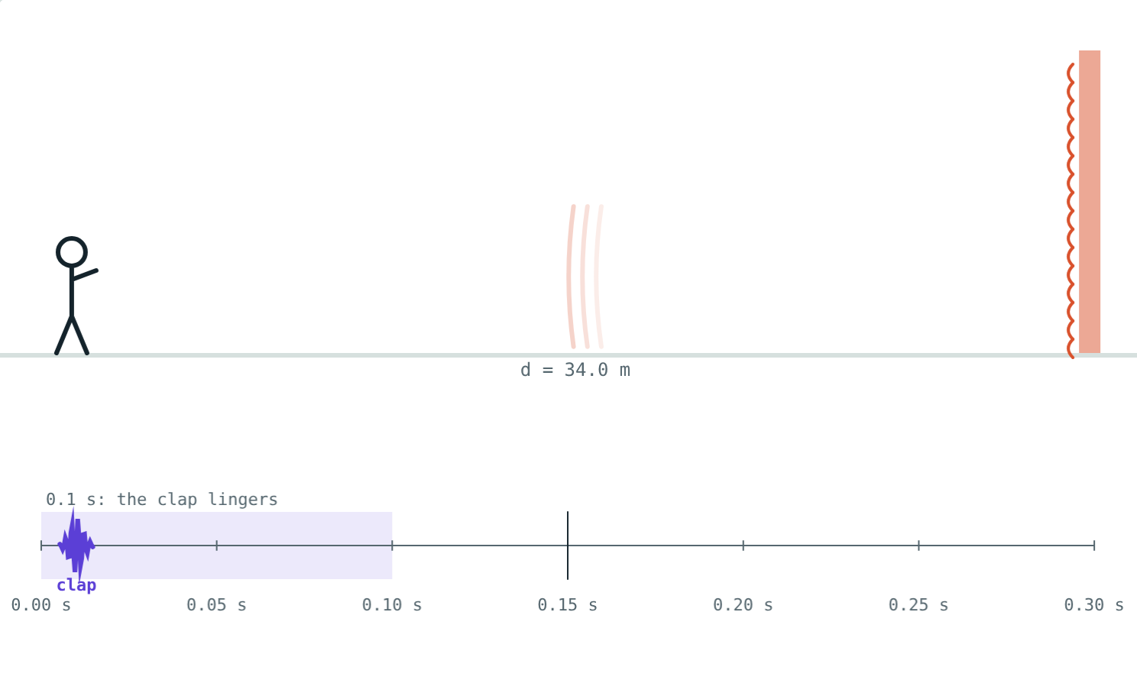
Reverberation
Many overlapping reflections in a closed hall
Sound lingers after the source stops
A little sounds full; too much blurs speech
Reduce it with curtains, carpets, padded seats, panels
Curtains absorb instead of reflecting
Notes:
Concert halls are designed to have just the right amount.

Slide 7




Using reflected sound
Megaphone
Stethoscope
Sound boards
Curved ceilings
A flared tube sends sound forward in one direction.
The heartbeat reflects along the tube to the ears.
A curved board behind the stage spreads sound evenly.
Reflect sound to every part of the hall.
Notes:
Ask which of these students have seen: most will know megaphones and stethoscopes.

Slide 8
Worked examples
The shortest distance
Echo time to distance
Least distance for a distinct echo at 20 °C?
An echo returns 0.5 s after a clap at 20 °C. How far is the wall?
v = 344 m/s; t ≥ 0.1 s
d = 344 × 0.1 ÷ 2 = 17.2 m
d = 344 × 0.5 ÷ 2 = 86 m
Notes:
Work through both before revealing the answers.

Slide 9
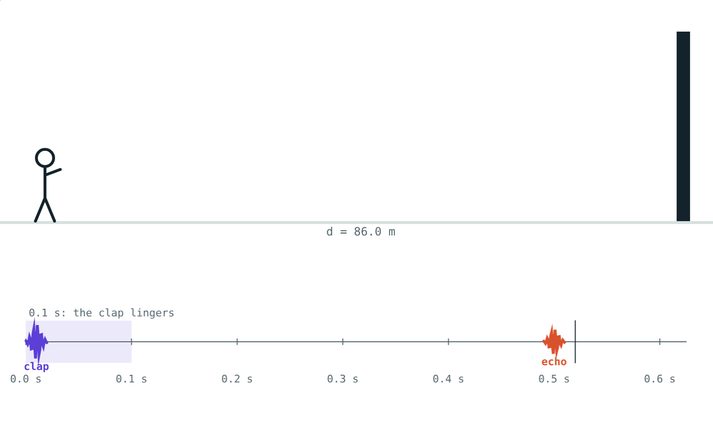
Worked example: speed from an echo
A girl stands 165 m from a cliff. The echo of her clap returns after 1 s. Find the speed of sound.
Distance travelled = 2 × 165 = 330 m
v = 330 ÷ 1 = 330 m/s
Far wall: a clear echo
Notes:
330 m/s means the air is just below 0 °C.

Slide 10

Common mistakes
Forgetting to halve
“Every reflection is an echo”
d = vt ÷ 2.
Only if it returns 0.1 s or more later.
“Always 17.2 m”
“Reverberation is always bad”
That is for 344 m/s.
A little helps music.
Notes:
Ask why bats need 'divide by 2' too when judging distance.

Slide 11
Quick check
1
How long after the original must a reflected sound arrive to be heard as an echo?
2
An echo is heard 2 s after a shout (v = 340 m/s). How far is the cliff?
3
Name two materials that reduce reverberation in a hall.
4
How does a stethoscope carry sound to the doctor's ears?
Notes:
Answers: 1) At least 0.1 s. 2) 340 m. 3) Any two of curtains, carpets, padded seats, fibreboard, acoustic panels. 4) By repeated reflection along its tube.

Slide 12
Clap at a wall yourself
Open the Echo and Reverberation lesson on the Visual Physics website. Move the wall and watch the echo on the timeline.
Next lesson: Ultrasound and SONAR
Notes:
Activity: measure the speed of sound by clapping in time with the echo from a wall 50 m away.

