Slide 1
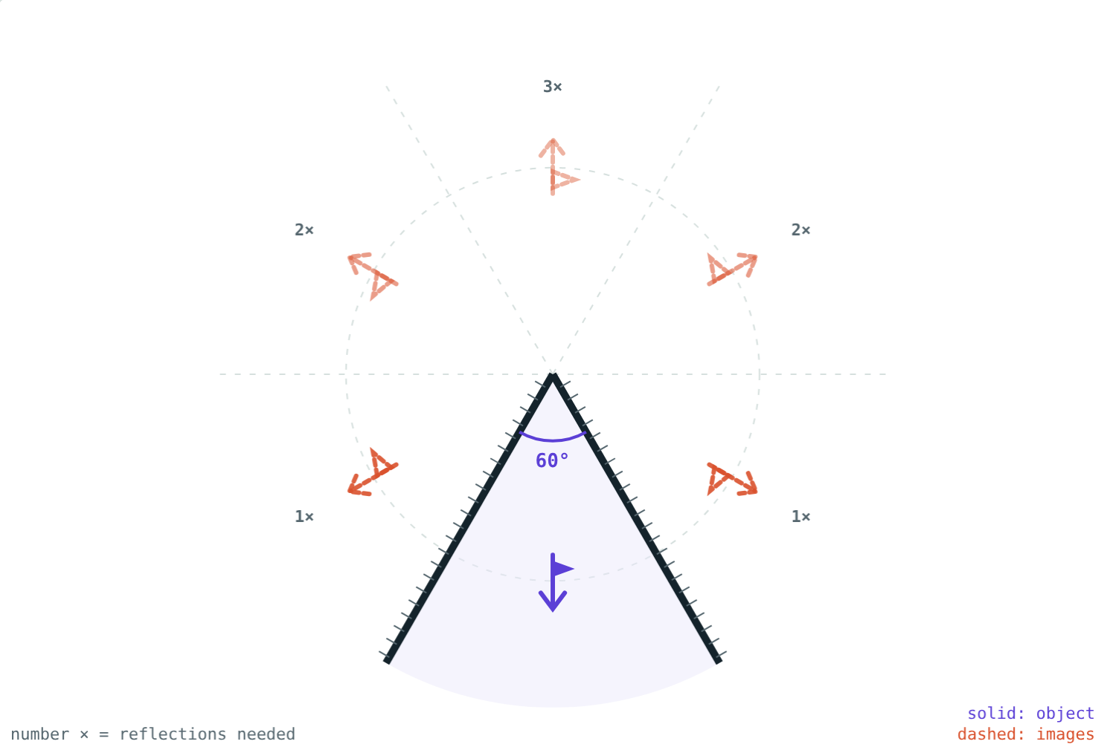
Images in Inclined Mirrors
STD 9 SCIENCE · CH. 11 REFLECTION OF LIGHT
Lesson 2 · Visual Physics
Notes:
Goal: students can use n = 360°/A − 1 in both directions and explain the kaleidoscope and periscope.

Slide 2
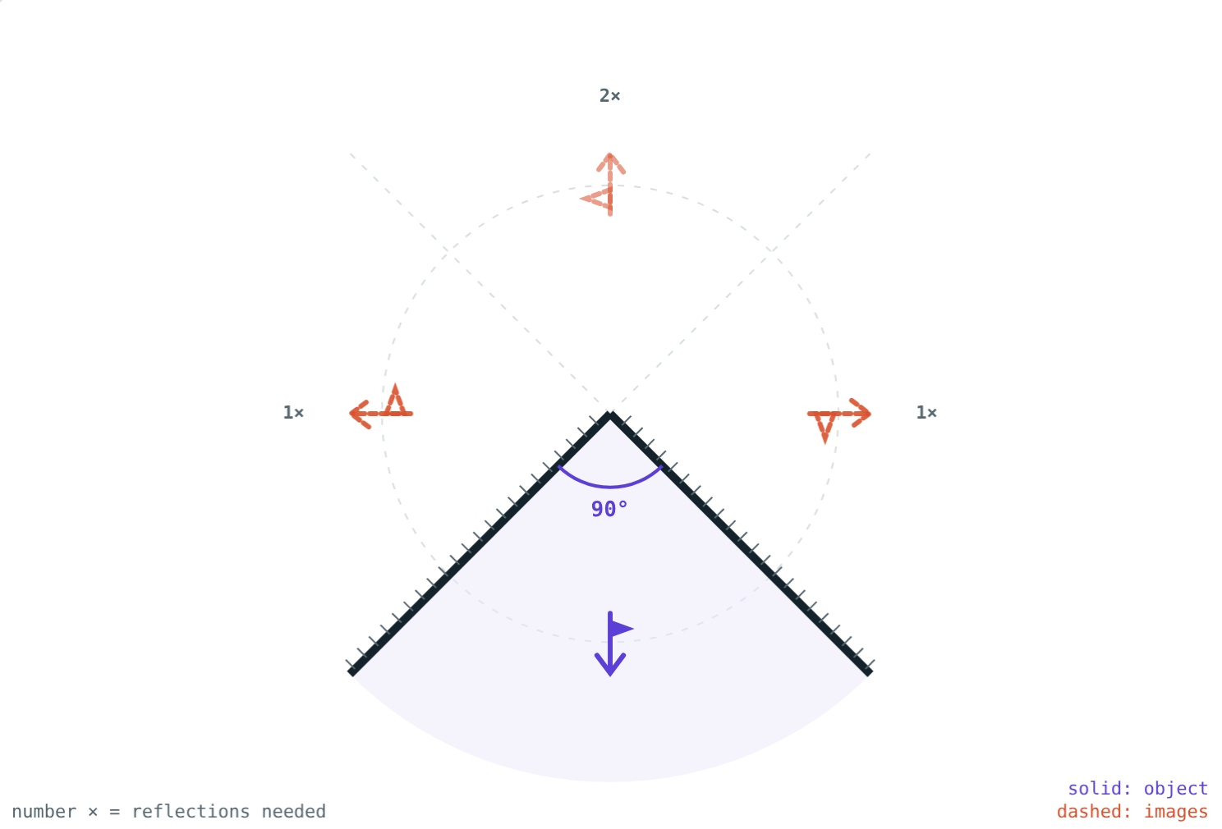
A crowd of you
In a tailor's shop, two mirrors at an angle show several copies of you at once.
How many images, and where do they come from?
Mirrors at 90°: three images
Notes:
If possible, bring two mirrors and a coin and let students count.

Slide 3
Mirrors at an angle
n = 360° ÷ A − 1
Light reflects from one mirror, then the other
Smaller angle: more reflections, more images
Works neatly when 360° ÷ A is a whole number
Object placed midway between the mirrors
60°: 360 ÷ 60 − 1 = 5 images
Notes:
The −1 removes the object itself from the count.

Slide 4
Angle and number of images
Angle A | 120° | 90° | 72° | 60° | 45° | 30°
360° ÷ A | 3 | 4 | 5 | 6 | 8 | 12
Images n | 2 | 3 | 4 | 5 | 7 | 11
Notes:
Ask: what happens as A approaches 0°?

Slide 5
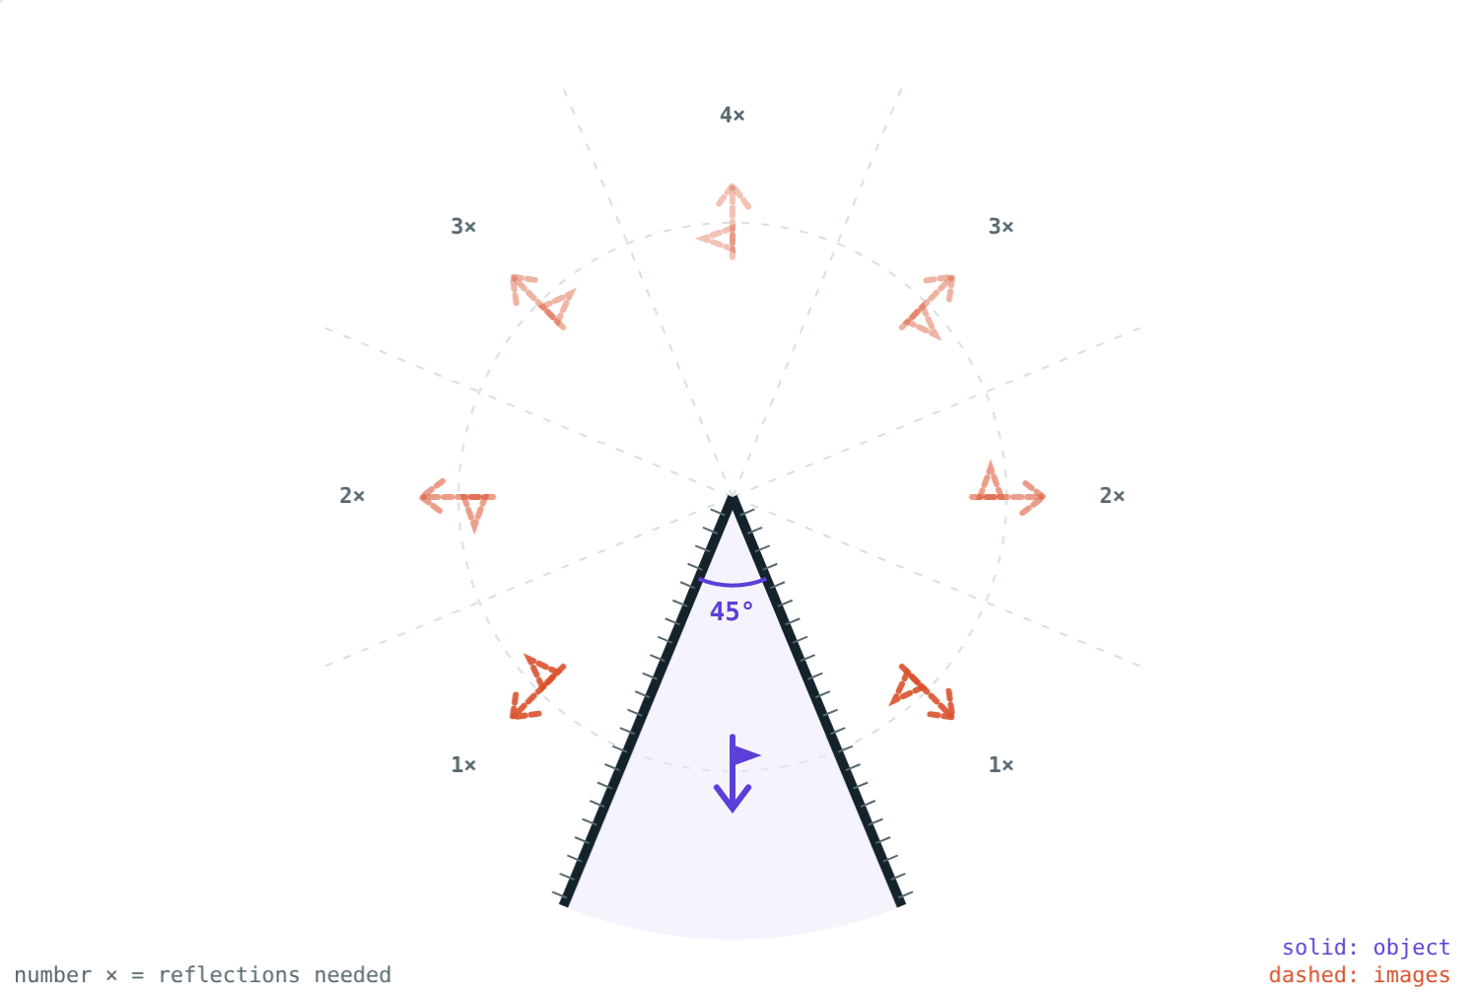
Closing the mirrors
3 images: two from one reflection, one from two.
7 images: the far ones need four reflections.
Notes:
The more reflections an image needs, the dimmer it is.

Slide 6
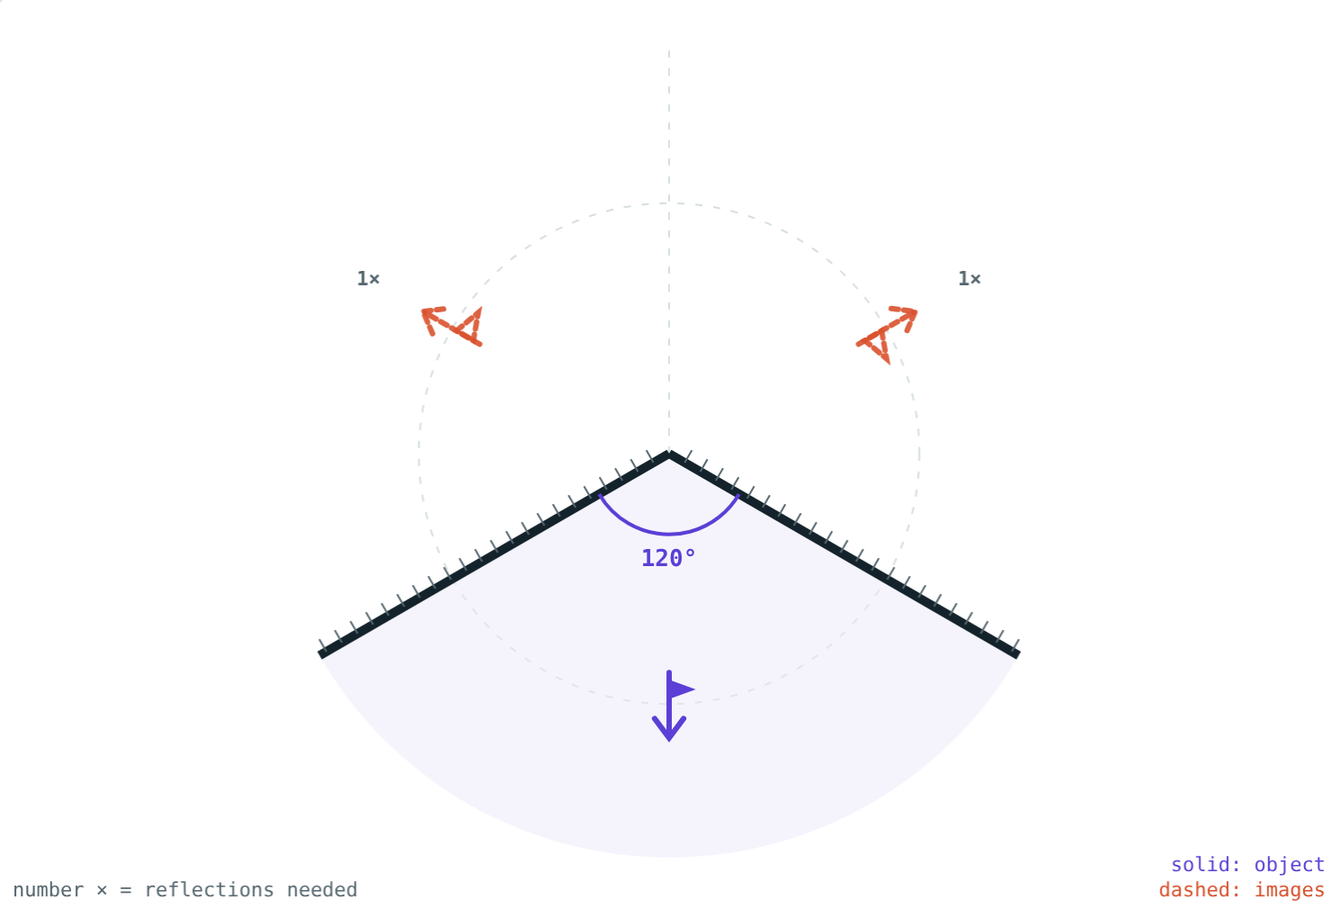
Reversed or not?
Every reflection swaps left and right
One reflection: image reversed
Two reflections: reversed twice, so the right way round
Watch the flags in the simulation
120°: two images, both reversed
Notes:
Use a printed letter F as the object to make this vivid.

Slide 7




Using inclined mirrors
Kaleidoscope
Periscope
Parallel mirrors
Tailor's mirrors
Three mirror strips at 60° turn bits of glass into patterns.
Two parallel mirrors at 45° let you see over a wall.
Facing mirrors give an endless row of images.
Angled mirrors show you from several sides.
Notes:
A periscope's two mirrors each turn the light through 90°.

Slide 8
Worked examples
Counting images
Finding the angle
Two mirrors are at 40° with a coin between them. How many images form?
A student sees 11 images of a pencil between two mirrors. Find the angle.
360° ÷ 40° = 9
n = 9 − 1 = 8 images
360° ÷ A = 11 + 1 = 12
A = 360° ÷ 12 = 30°
Notes:
For the reverse problem, add 1 before dividing into 360°.

Slide 9
Inside a kaleidoscope
360° ÷ 60° − 1:
5
images of a bead
6
copies in the pattern
The six copies sit evenly around the centre: that is the symmetry you see.
Each pair of mirrors at 60°
Notes:
Turning the tube moves the beads and the whole pattern changes.

Slide 10

Common mistakes
Forgetting the −1
“Smaller angle, fewer images”
360° ÷ A counts the object too.
It is the other way round.
All images alike
Any angle at all
Odd numbers of reflections give reversed images.
The rule is neat when 360° ÷ A is whole.
Notes:
For angles like 50°, the count depends on where the object is placed.

Slide 11
Quick check
1
How many images do two mirrors at 72° form?
2
Three images are seen. What is the angle between the mirrors?
3
Which instrument uses two parallel mirrors each at 45°?
4
What happens to the number of images as the angle gets smaller?
Notes:
Answers: 1) 4. 2) 90°. 3) A periscope. 4) It increases; parallel mirrors give endless images.

Slide 12
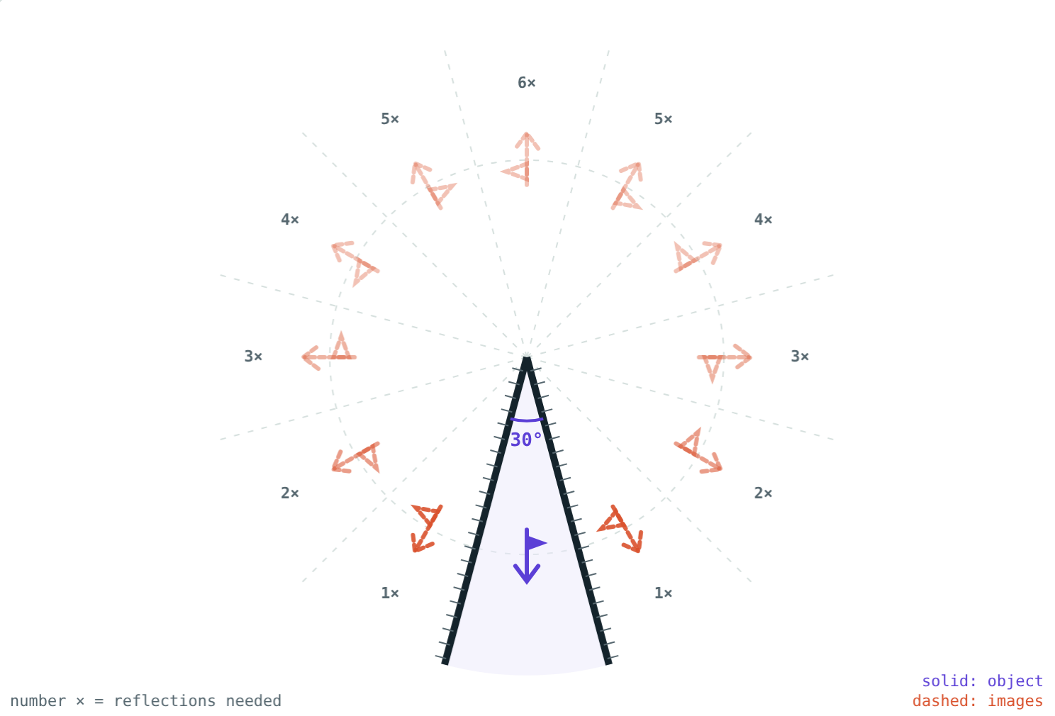
Count the images yourself
Open the Images in Inclined Mirrors lesson on the Visual Physics website. Change the angle and count the dashed images.
Next lesson: Spherical mirrors
Notes:
Project idea: build a kaleidoscope from three mirror strips and a cardboard tube.

