Slide 1
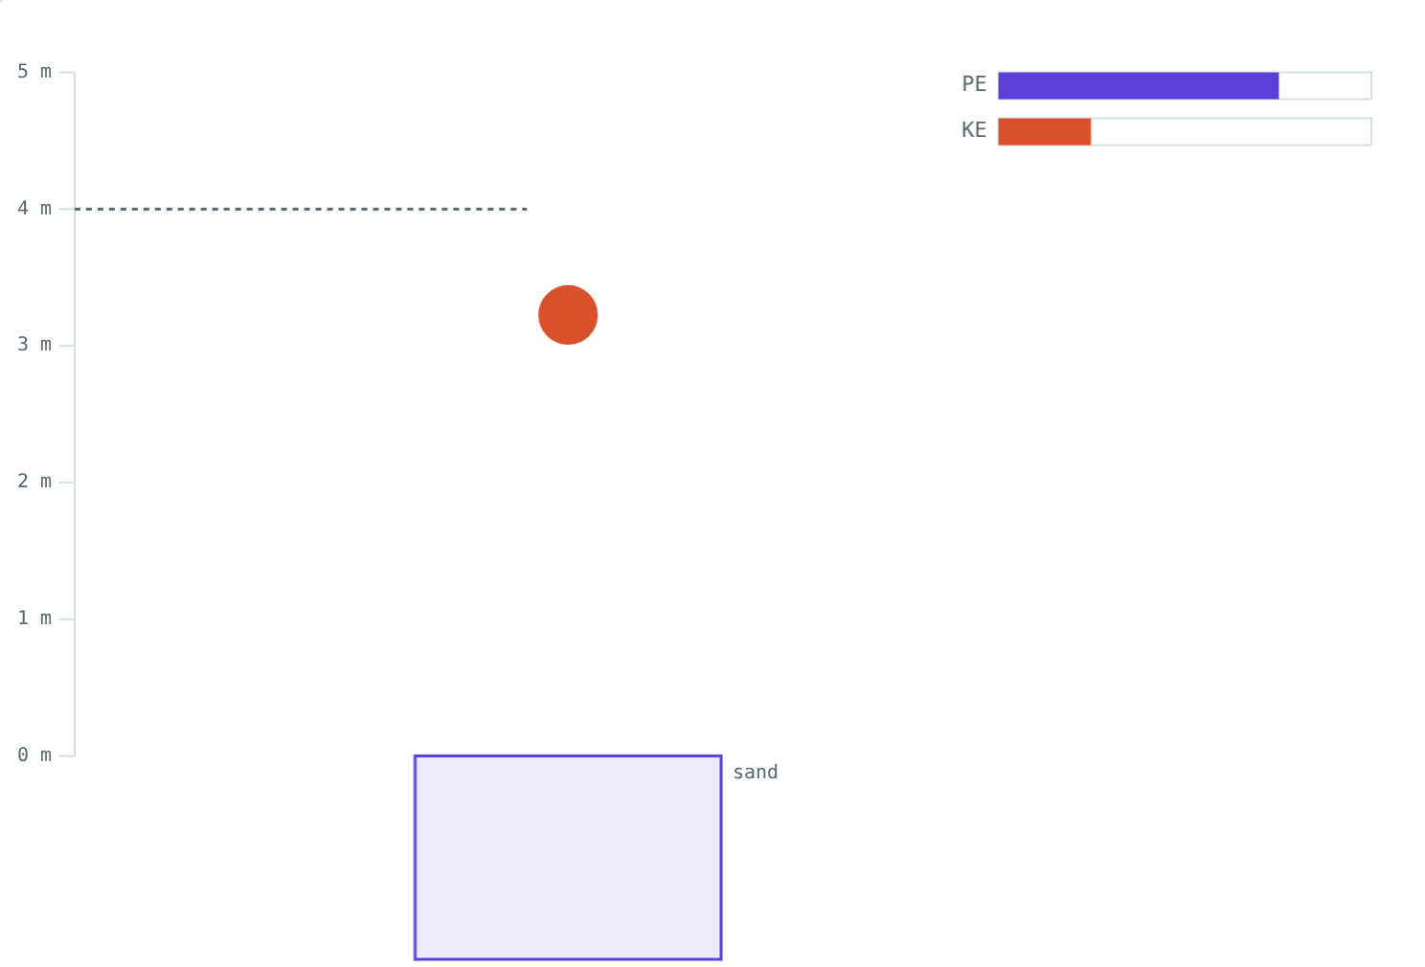
Kinetic and Potential Energy
STD 9 SCIENCE · CH. 2 WORK AND ENERGY
Lesson 2 · Visual Physics
Notes:
Goal: students can define energy, calculate kinetic and potential energy, and explain how each depends on mass, speed and height.

Slide 2
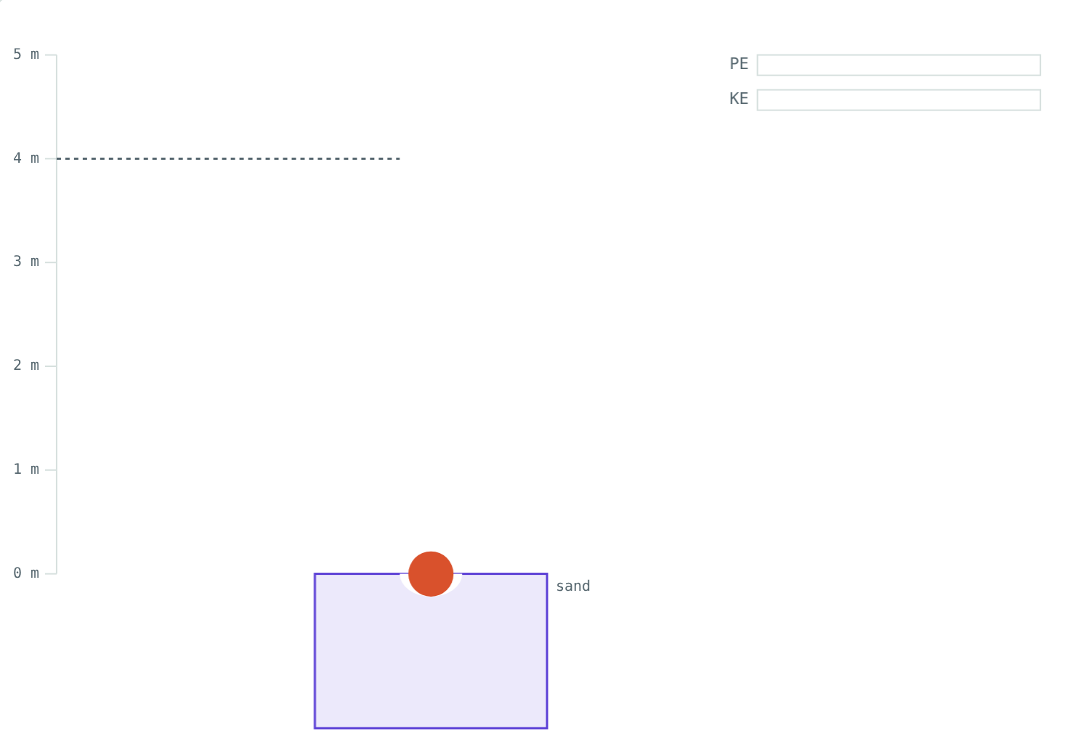
What can do work?
A cricket ball hit for six. Water stored behind a dam. A stretched catapult.
What do all three have in common?
A ball dropped from 4 m leaves a deep dent in the sand
Notes:
Each can do work: push something, turn a turbine, launch a stone. That capacity to do work is energy.

Slide 3
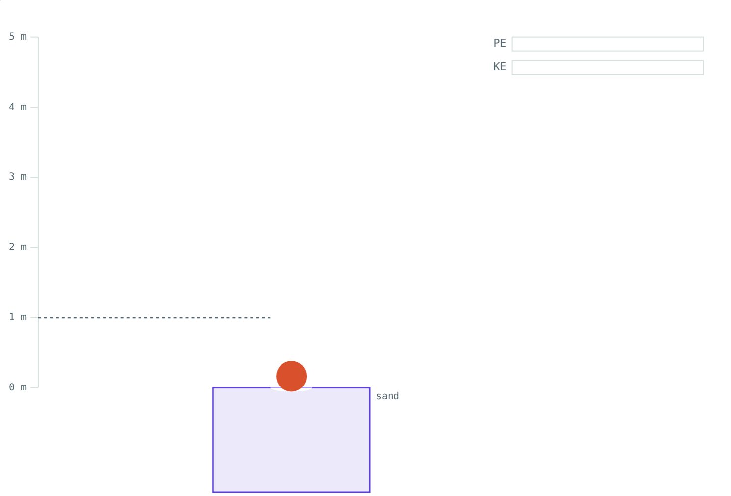
Energy
The capacity of a body to do work is its energy.
Measured in joules (J), like work
Many forms: heat, light, sound, chemical, electrical, nuclear
Mechanical energy: kinetic and potential
Dropped from 1 m: a smaller dent, less energy
Notes:
The dent in the sand measures the work the ball does, and so its energy. This mirrors the NCERT activity of dropping balls into sand.

Slide 4
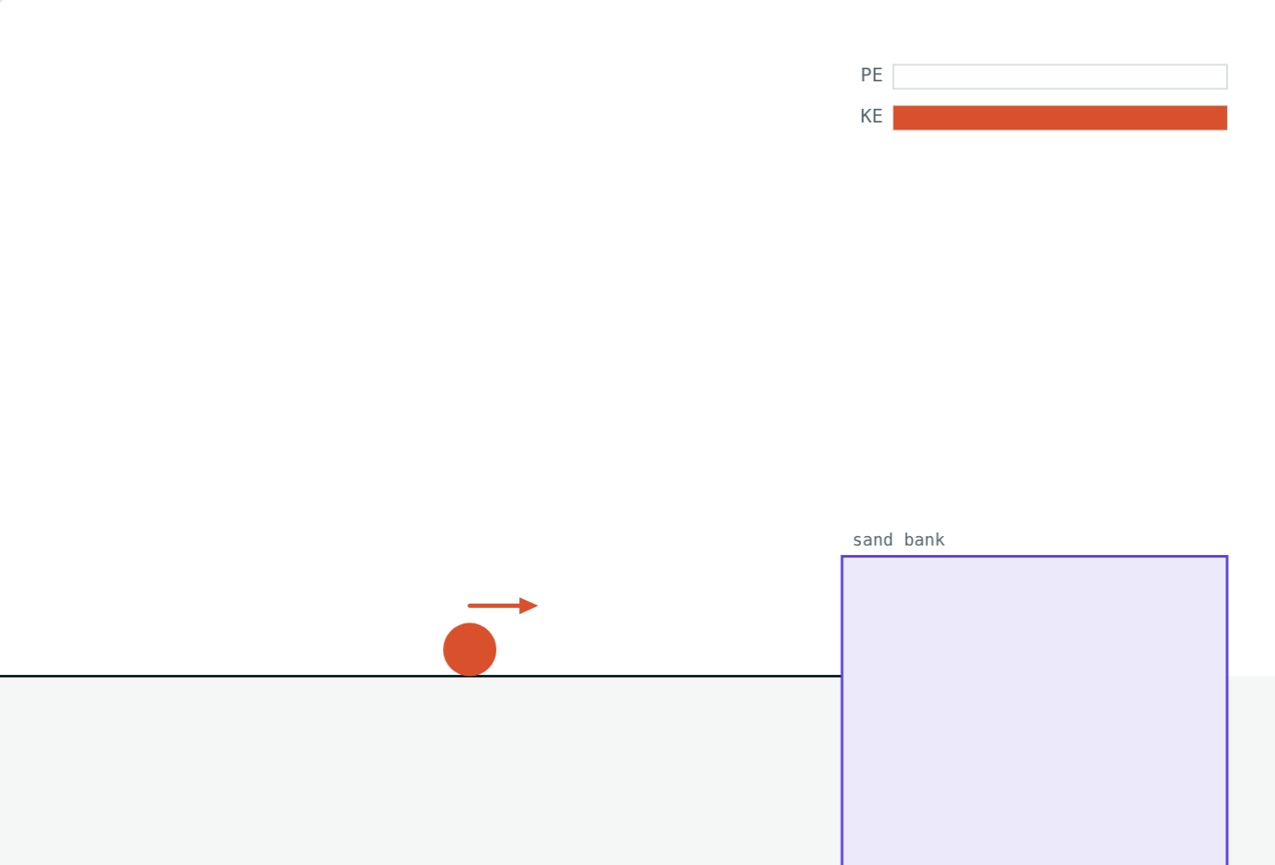
Kinetic energy
K.E. = ½mv²
Energy of motion
Work Fs = mas, and s = v²/2a, so W = ½mv²
Double the mass: double the K.E.
Double the speed: four times the K.E.
A 2 kg ball rolling at 6 m/s: 36 J
Notes:
Walk through the derivation slowly: F = ma, v² = u² + 2as with u = 0, then W = Fs.

Slide 5
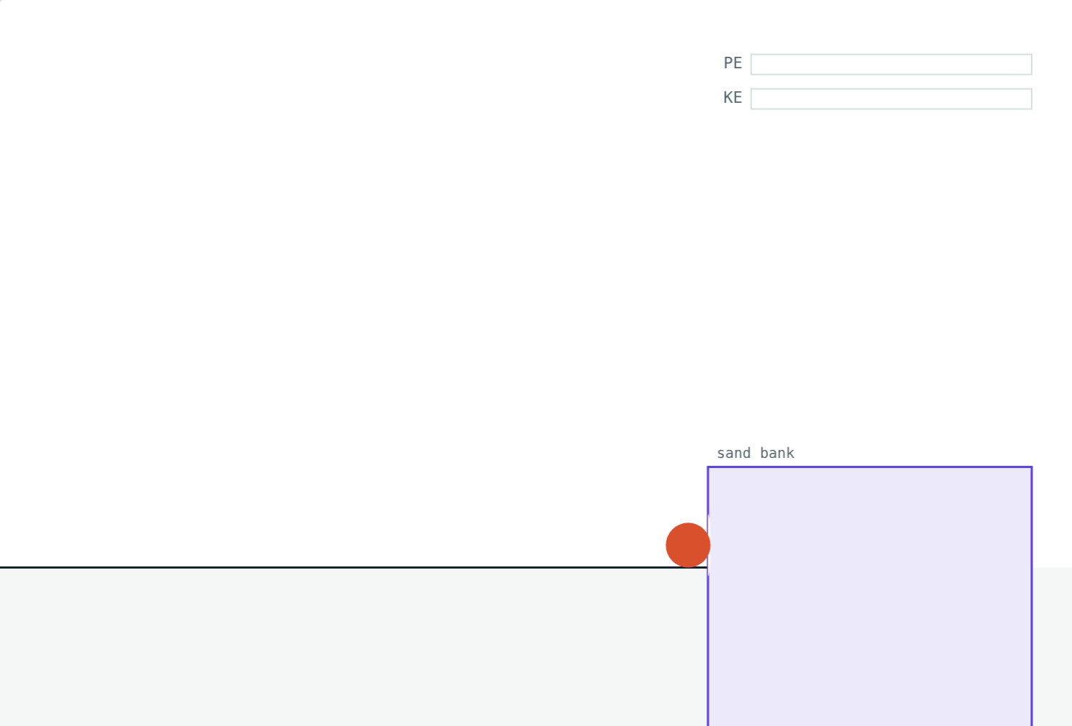
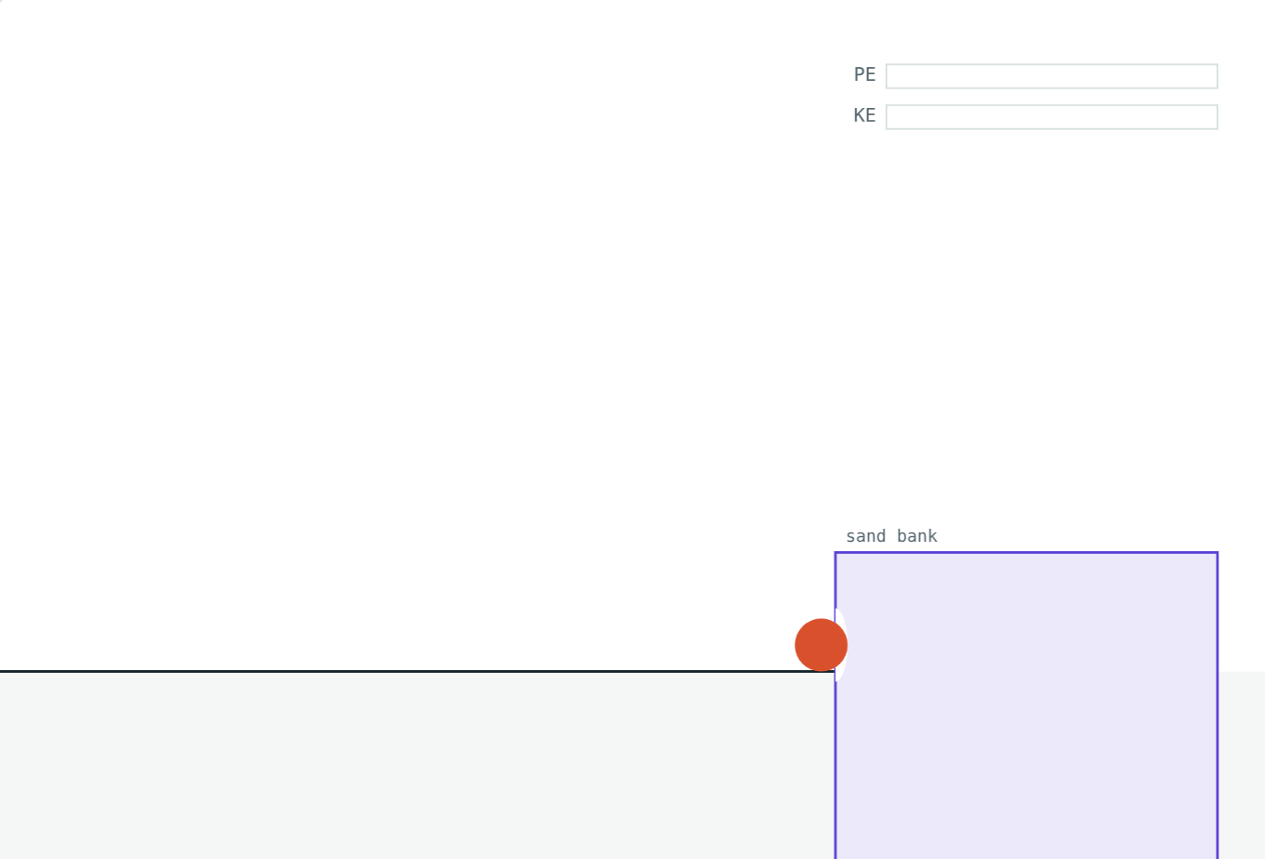
Twice as fast, four times the energy
2 kg at 3 m/s: K.E. = 9 J.
2 kg at 6 m/s: K.E. = 36 J.
Speed is squared, so doubling it quadruples the energy (and the dent).
Notes:
This is why road accidents at high speed are so much more damaging.

Slide 6
Potential energy
P.E. = mgh
Energy of position or shape
Lifting needs force mg through height h
That work is stored: mgh
Depends on height, not the path taken
The raised ball's stored energy turns into motion
Notes:
Shape examples: a stretched rubber band, a wound spring, a drawn bow.

Slide 7
Four times as high, four times the energy
2 kg from 1 m: P.E. = 19.6 J.
2 kg from 4 m: P.E. = 78.4 J.
Notes:
P.E. is directly proportional to height: four times the height gives four times the energy.

Slide 8
Worked examples
A rolling ball
A car slowing down
Find the K.E. of a 0.5 kg ball rolling at 4 m/s.
A 1500 kg car goes at 20 m/s, then slows to 10 m/s. Find its K.E. each time.
½ × 0.5 × 16 = 4 J
½ × 1500 × 400 = 300 kJ
½ × 1500 × 100 = 75 kJ
Notes:
Halving the speed leaves a quarter of the kinetic energy.

Slide 9
Worked example: water on the roof
A tank holds 1000 kg of water 12 m above the ground. Find its potential energy. (g = 9.8 m/s²)
P.E. = 1000 × 9.8 × 12 = 117 600 J
Stored height energy can do work when released
Notes:
This is why roof tanks supply taps below without a pump.

Slide 10

Common mistakes
Not squaring v
Grams, not kilograms
At 4 m/s, use v² = 16.
500 g = 0.5 kg.
Path changes P.E.
Double speed, double K.E.
Only the height matters.
It is four times.
Notes:
Squaring errors are by far the most common.

Slide 11
Quick check
1
Find the K.E. of a 2 kg ball moving at 3 m/s.
2
If an object's speed is doubled, what happens to its K.E.?
3
Find the P.E. of a 5 kg box on a shelf 2 m high.
4
Name an object with potential energy because of its shape.
Notes:
Answers: 1) 9 J. 2) It becomes four times as large. 3) 98 J. 4) A stretched catapult, a wound spring, a drawn bow.

Slide 12
Make a dent yourself
Open the Kinetic and Potential Energy lesson on the Visual Physics website. Change the mass, height and speed, and compare the dents.
Next lesson: Conservation of energy
Notes:
Homework idea: drop a marble into a tray of flour from three heights and measure the dents.

