Slide 1
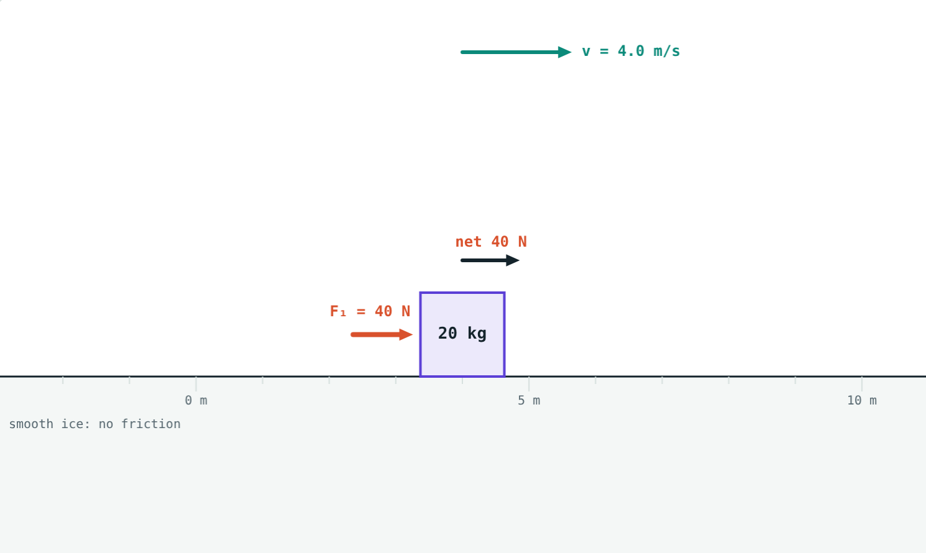
Newton's Laws of Motion
STD 9 SCIENCE · CH. 1 LAWS OF MOTION
Lesson 8 · Visual Physics
Notes:
Goal: students can tell balanced from unbalanced forces, state Newton's three laws, explain inertia, and use F = ma.

Slide 2
Why do things move the way they do?
A bus brakes and passengers lurch forward. A gun fires and kicks back against the shoulder.
What rules connect forces and motion?
A 40 N push on a 20 kg crate on smooth ice
Notes:
Collect students' everyday observations about pushes, pulls and sudden stops.

Slide 3
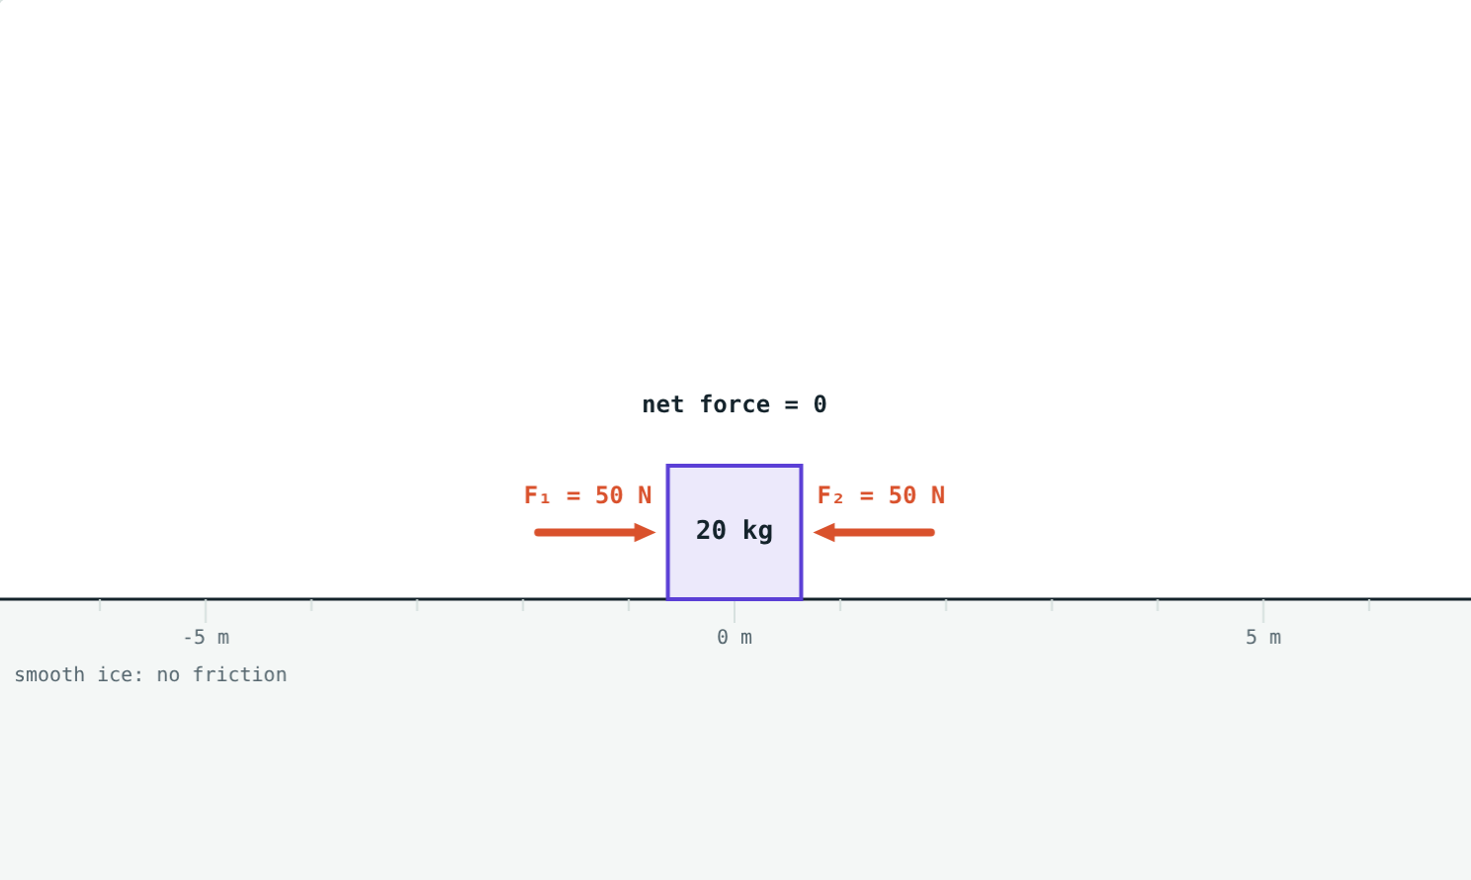
Balanced and unbalanced forces
50 N each way: net force 0, the crate stays at rest.
40 N one way: net force 40 N, the crate speeds up.
Only an unbalanced (net) force changes the motion.
Notes:
Tug of war is the classic example of balanced forces: the rope does not move although both teams pull hard.

Slide 4
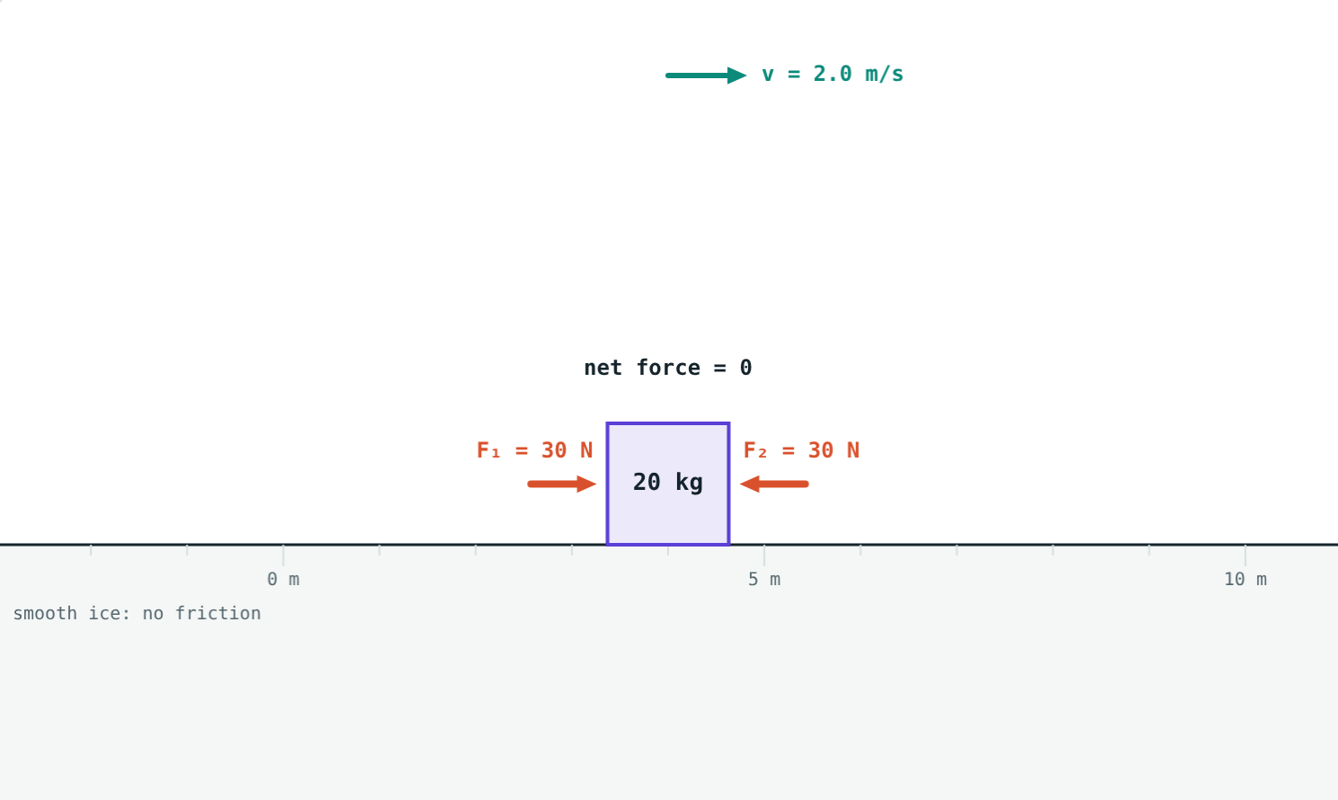
First law: inertia
An object stays at rest, or in uniform motion in a straight line, unless an unbalanced force acts on it.
Inertia: the tendency to keep doing what it is doing
More mass, more inertia
No net force does not mean no motion
Balanced forces on a moving crate: it keeps sliding at 2 m/s
Notes:
The crate in the picture has two equal pushes on it and keeps moving at constant velocity. This surprises students who think motion needs a force.

Slide 5



Three kinds of inertia
Inertia of rest
Inertia of motion
Inertia of direction
Flick a card from under a coin: the coin drops straight into the glass.
When a bus brakes, passengers keep moving forward.
On a sharp turn, passengers feel pushed to the side.
Notes:
Do the coin and card demonstration if you can. It works best with a smooth card and a heavy coin.

Slide 6
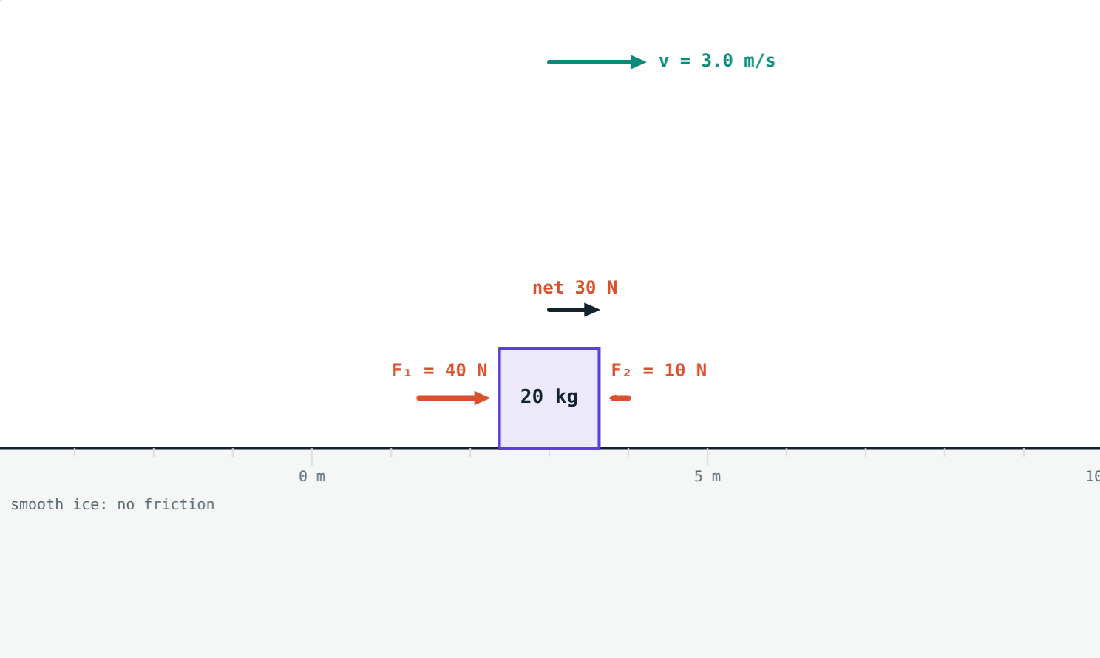
Second law: F = ma
F = ma
Momentum P = mv (kg·m/s)
Rate of change of momentum ∝ applied force
For a fixed mass: F = ma
1 newton gives 1 kg an acceleration of 1 m/s²
Net 30 N on 20 kg: a = 1.5 m/s²
Notes:
Write 1 N = 1 kg × 1 m/s² = 1 kg·m/s² on the board.

Slide 7
Balanced, yet moving
With balanced forces on a moving crate:
0 N
net force
2 m/s
velocity, unchanged
30 N each way on a crate already moving at 2 m/s
Zero net force means zero acceleration, not zero velocity.
Notes:
This is the first and second laws together: F = 0 gives a = 0, so the velocity stays the same.

Slide 8




Third law: action and reaction
Rocket
Gun
Walking
Swimming
Pushes gases down; the gases push it up.
Pushes the bullet forward; the bullet pushes it back.
Your foot pushes the ground back; the ground pushes you forward.
Hands push water back; water pushes the swimmer forward.
Notes:
Every action force has an equal and opposite reaction force, acting at the same time on a different object. The balloon-powered boat is a great class demonstration.

Slide 9
Worked examples
Pushing a crate
A car pulling away
40 N right and 10 N left act on a 20 kg crate on ice. Find the acceleration.
What force gives a 1200 kg car an acceleration of 1.5 m/s²?
Net force = 40 − 10 = 30 N
a = 30 ÷ 20 = 1.5 m/s²
F = ma = 1200 × 1.5 = 1800 N
Notes:
Always find the net force first.

Slide 10
Worked examples: time matters
Catching a cricket ball
Pushing against motion
A 0.15 kg ball at 20 m/s is stopped in 0.1 s. Find the force. What if stopping takes 0.3 s?
A 20 kg crate slides at 3 m/s. A 20 N push acts against it. When does it stop?
Change in momentum = 0.15 × 20 = 3 kg·m/s
Force = 3 ÷ 0.1 = 30 N
Force = 3 ÷ 0.3 = 10 N
a = −20 ÷ 20 = −1 m/s²
0 = 3 − 1 × t, so t = 3 s
Notes:
Pulling the hands back while catching increases the time and reduces the force. The second example uses v = u + at from Lesson 6.

Slide 11

Common mistakes
“Action and reaction cancel”
“Motion needs a force”
They act on different objects, so they never cancel.
Forces change motion. Without friction, motion continues by itself.
Ignoring direction
Grams in F = ma
Opposite forces subtract. Find the net force first.
Mass must be in kg: 150 g = 0.15 kg.
Notes:
The first two are deep misconceptions; spend time on them.

Slide 12
Quick check
1
A book lies still on a table. Are the forces on it balanced or unbalanced?
2
A bus starts suddenly and passengers fall backwards. Which kind of inertia?
3
A net force of 12 N acts on a 4 kg trolley. Find its acceleration.
4
A swimmer pushes water backwards. What does the reaction force do?
Notes:
Answers: 1) Balanced. 2) Inertia of rest. 3) 3 m/s². 4) It pushes the swimmer forwards.

Slide 13
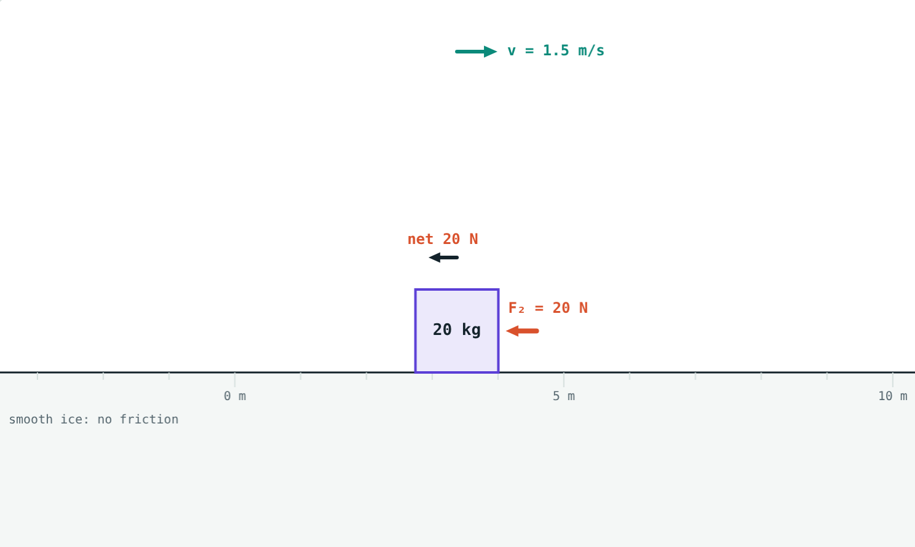
Push the crate yourself
Open the Newton's Laws lesson on the Visual Physics website. Balance the forces, unbalance them, and watch the velocity.
Next lesson: Conservation of momentum
Notes:
Homework idea: make a balloon-powered boat or car and explain its motion using the third law.

