Slide 1
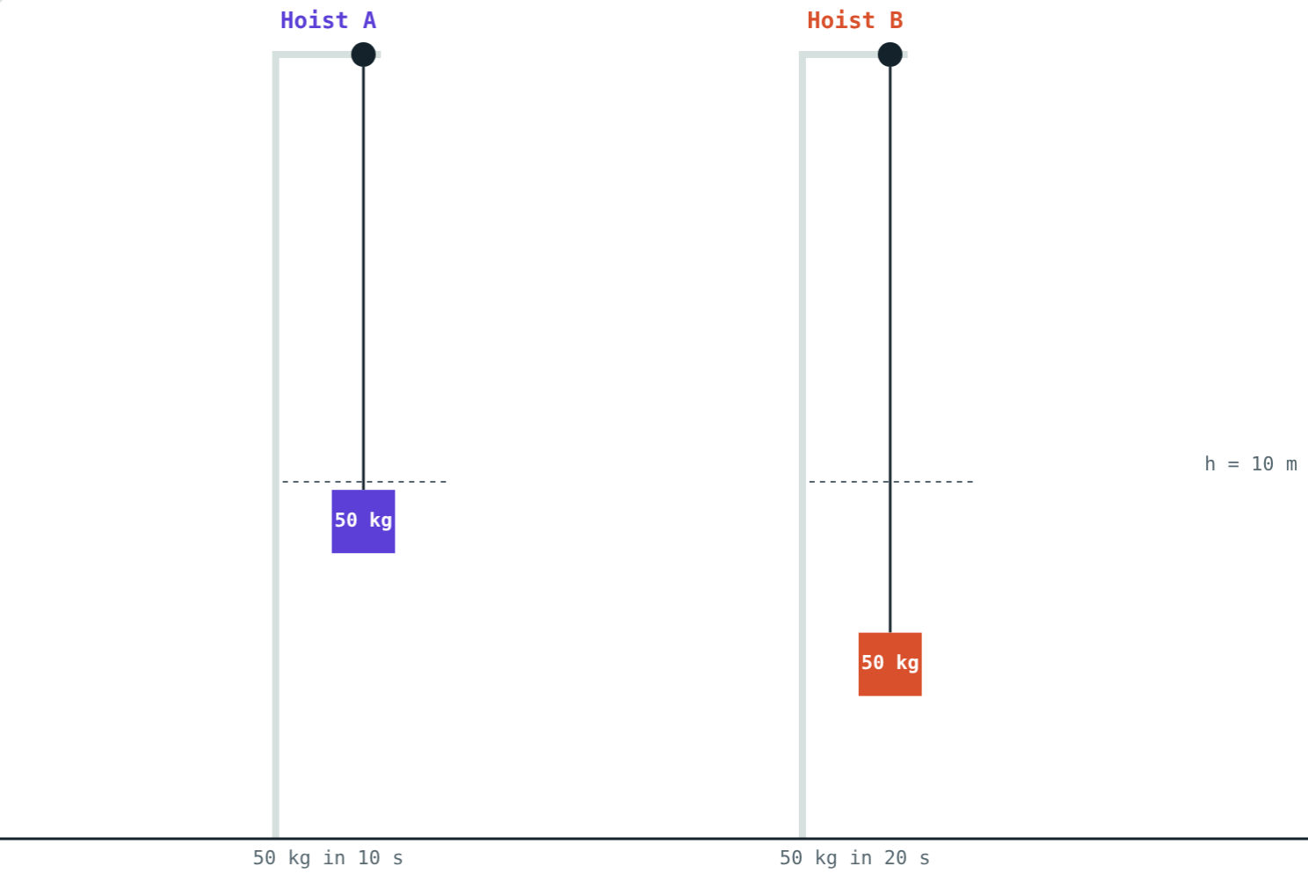
Power
STD 9 SCIENCE · CH. 2 WORK AND ENERGY
Lesson 4 · Visual Physics
Notes:
Goal: students can calculate power, use watts, kilowatts and horsepower, and work out electricity use in kWh.

Slide 2
Same work, different speed
Two students carry identical bags up the same staircase. One runs, one walks.
Who does more work? Who is more powerful?
Same load, same height: A takes 10 s, B takes 20 s
Notes:
They do the same work. The runner is more powerful because she does it faster.

Slide 3
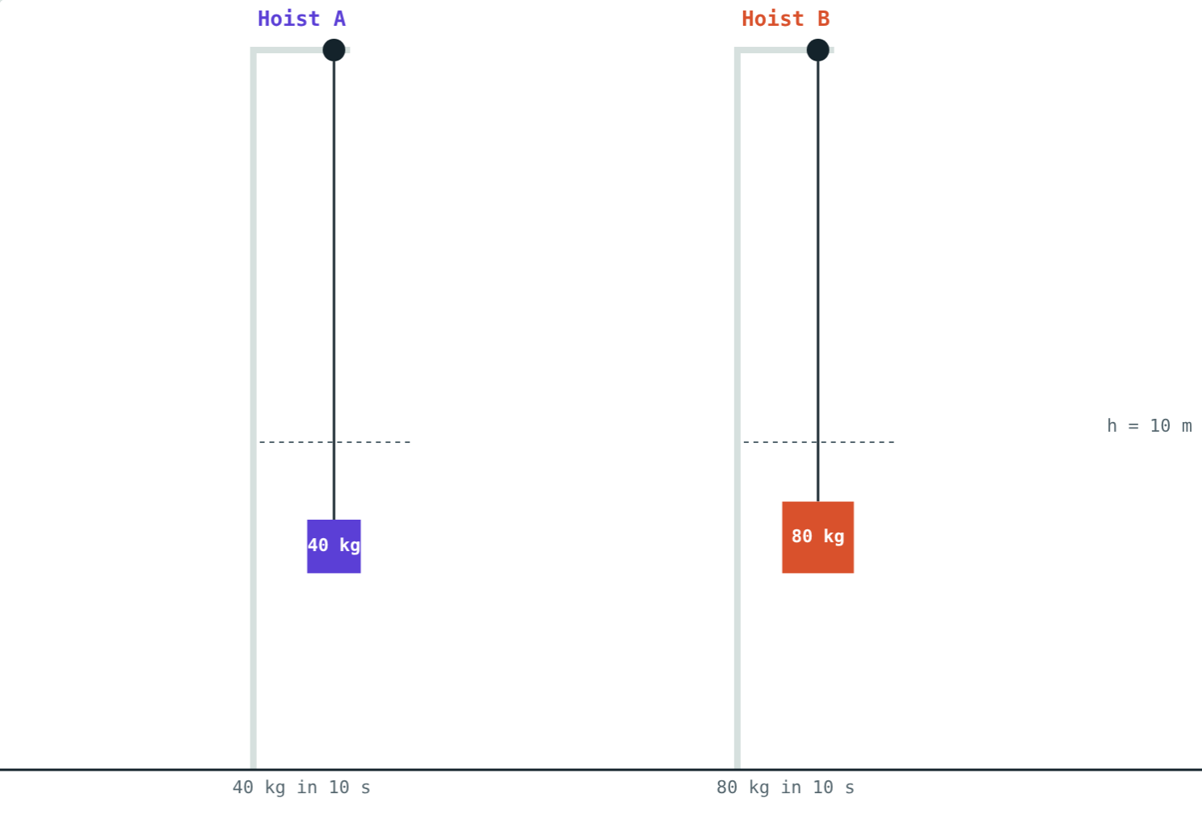
Power
P = W ÷ t
The rate of doing work
Unit: watt (W) = 1 J per second
1 kW = 1000 W
1 horsepower (hp) = 746 W
B lifts twice the load in the same time: twice the power
Notes:
Power is also the rate at which energy is transferred, for example by an electric heater.

Slide 4
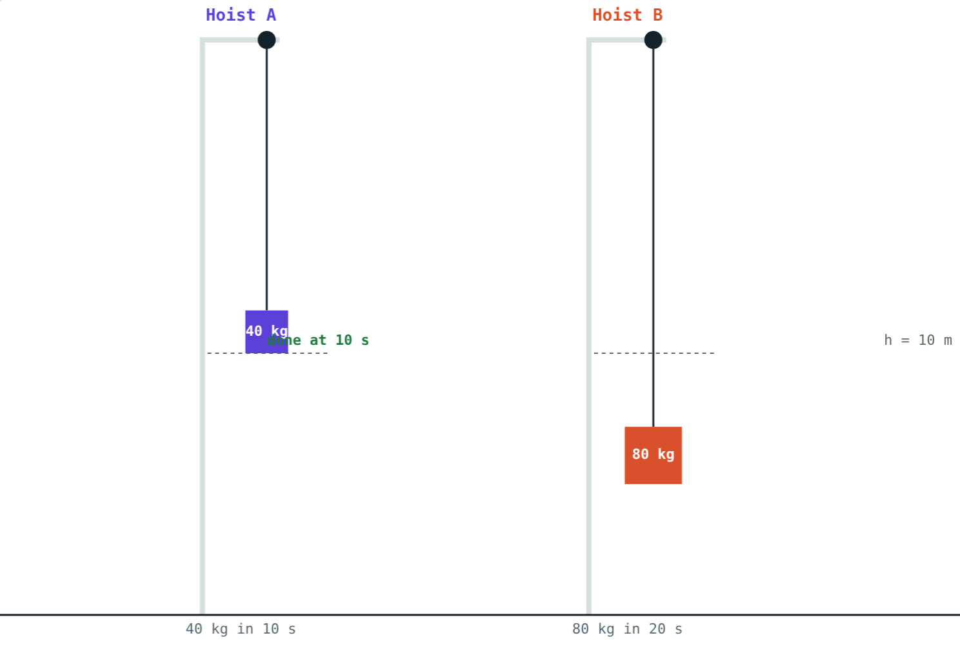
Comparing hoists
Same 4900 J of work: A 490 W, B 245 W.
Twice the work in twice the time: both 392 W.
Notes:
Power depends on both work and time.

Slide 5
Who is more powerful?
Same work, 4900 J each. A takes 10 s, B takes 20 s:
490 W
hoist A
245 W
hoist B
Doing the same work in half the time means twice the power.
Both lift 50 kg through 10 m
Notes:
P = 4900 ÷ 10 and 4900 ÷ 20.

Slide 6
The kilowatt hour
1 kWh
3.6 MJ
kW × h
The “unit” on your bill
In joules
How to calculate
Energy used by 1 kW for 1 hour.
1000 W × 3600 s = 3.6 × 10⁶ J.
Units = power in kW × time in hours.
Notes:
The kWh is a unit of energy, not power. Students often mix these up.

Slide 7
Worked examples
Climbing the stairs
A water pump
Raju (50 kg) runs up stairs 12 m high in 20 s. Find his work and power.
A pump lifts 200 kg of water 15 m in 60 s. Find its power in W and hp.
W = 50 × 9.8 × 12 = 5880 J
P = 5880 ÷ 20 = 294 W
W = 200 × 9.8 × 15 = 29 400 J
P = 29 400 ÷ 60 = 490 W
In hp: 490 ÷ 746 ≈ 0.66 hp
Notes:
Remind students to use seconds for watts.

Slide 8
Worked example: the geyser bill
A 1500 W geyser runs 40 minutes a day. Find the units used in 30 days and the cost at ₹8 per unit.
Per day: 1.5 kW × ⅔ h = 1 kWh
In 30 days: 30 kWh
Cost: 30 × 8 = ₹240
Power × time = energy
Notes:
Have students check a real electricity bill at home.

Slide 9
Household appliances
Appliance | Power | Units in 4 h a day for 30 days
LED bulb | 9 W | 1.1 kWh
Ceiling fan | 75 W | 9 kWh
Television | 100 W | 12 kWh
Iron | 1000 W | 120 kWh
Geyser | 2000 W | 240 kWh
Notes:
Units = kW × 4 × 30. The lesson page has a calculator for this.

Slide 10

Common mistakes
Work vs power
Minutes for watts
Work in J; power in J/s = W.
Use seconds for watts, hours for kWh.
Watts in kWh
“kWh is power”
Divide by 1000 first.
kWh is a unit of energy.
Notes:
Unit errors are the main source of wrong answers in this lesson.

Slide 11
Quick check
1
A motor does 6000 J of work in 30 s. Find its power.
2
How many joules are in 1 kWh?
3
How many watts make 1 horsepower?
4
Two equal-mass girls climb the same stairs in 10 s and 15 s. Who is more powerful?
Notes:
Answers: 1) 200 W. 2) 3.6 × 10⁶ J. 3) 746 W. 4) The one who takes 10 s.

Slide 12
Race the hoists yourself
Open the Power lesson on the Visual Physics website. Compare two hoists, then work out your home's electricity use.
Next lesson: Simple machines
Notes:
Homework idea: list the appliances at home, their power ratings and daily use, and estimate the monthly bill.

