Slide 1
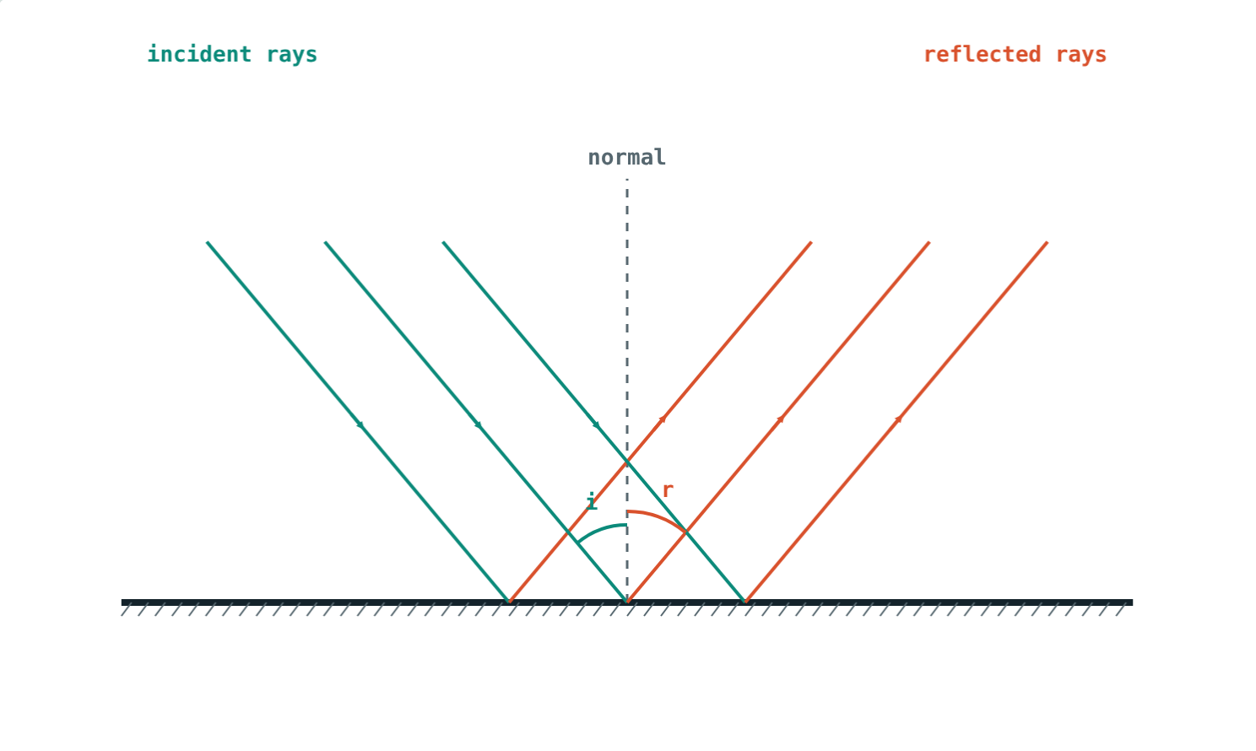
Reflection and Plane Mirrors
STD 9 SCIENCE · CH. 11 REFLECTION OF LIGHT
Lesson 1 · Visual Physics
Notes:
Goal: students can state the laws of reflection, tell regular from irregular reflection, and describe the image in a plane mirror.

Slide 2
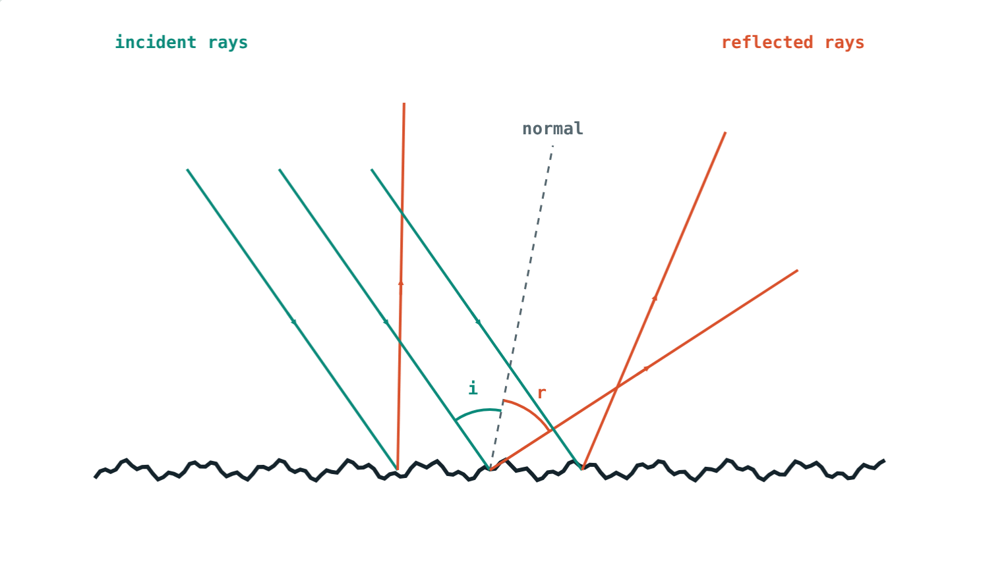
Mirror or paper?
A mirror shows your face. A sheet of white paper reflects light too, yet shows no image at all.
What makes the difference?
A rough surface scatters the light
Notes:
Let students guess before revealing: smoothness. Both surfaces obey the same laws.

Slide 3
The laws of reflection
∠i = ∠r
Angles are measured from the normal
Incident ray, normal and reflected ray lie in one plane
Incident and reflected rays are on opposite sides of the normal
i = 40°, so r = 40°
Notes:
The normal is the line at 90° to the mirror at the point where the ray strikes.

Slide 4
Regular and irregular reflection
Parallel rays stay parallel: a clear image.
Each ray obeys i = r, but the rays scatter.
Notes:
Diffuse reflection is why we can read a page or see a wall from any direction.

Slide 5
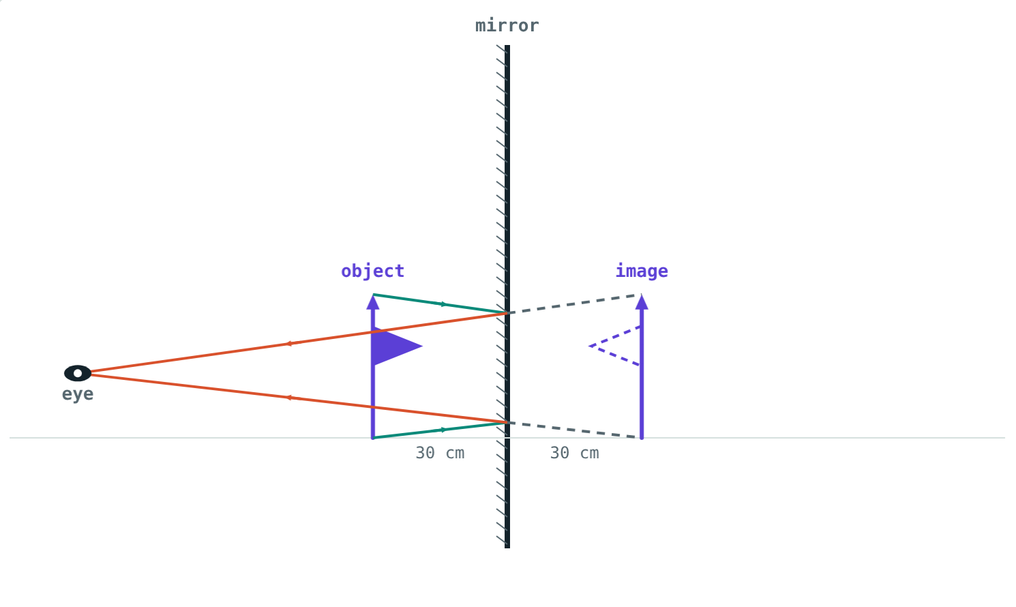
The image in a plane mirror
Virtual: cannot be caught on a screen
Erect and the same size as the object
As far behind the mirror as the object is in front
Laterally inverted: left and right swapped
Rays only seem to come from behind the mirror
Notes:
The eye traces the reflected rays back in straight lines to the image point.

Slide 6




Lateral inversion around you
Ambulance
Your hands
Clocks
Writing
The word is painted reversed so drivers read it in their mirrors.
Raise your right hand: your image raises its left.
A clock in a mirror seems to run backwards.
Words in a mirror read from right to left.
Notes:
Ask students to write their name so that it reads correctly in a mirror.

Slide 7
Worked examples
Walking towards a mirror
A candle
Asha stands 3 m from a mirror, then walks 1 m closer. How far is she from her image each time?
A candle is 15 cm in front of a plane mirror. How far apart are the candle and its image?
3 + 3 = 6 m
2 + 2 = 4 m
Image 15 cm behind the mirror
15 + 15 = 30 cm
Notes:
Moving 1 m towards the mirror brings you 2 m closer to your image.

Slide 8
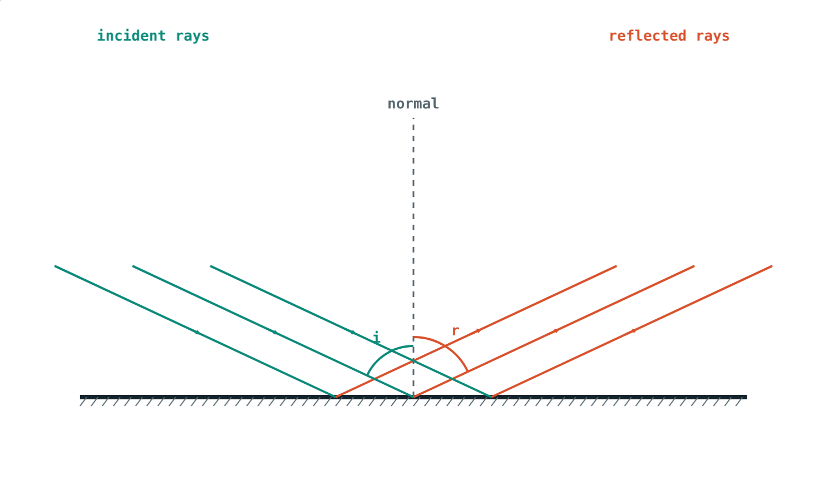
Worked example: angle from the surface
A ray makes 25° with the surface of a mirror. Find i, r and the angle between the incident and reflected rays.
i = 90° − 25° = 65°
r = i = 65°
Angle between rays = 65° + 65° = 130°
i = r = 65°
Notes:
The classic trap is to take i as 25°.

Slide 9
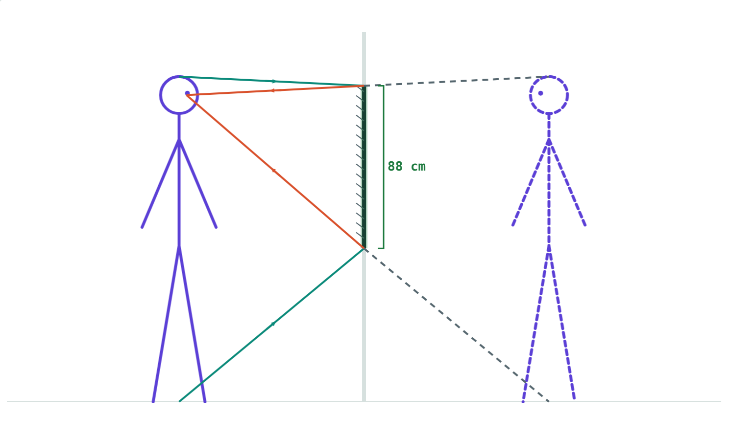
A mirror for the hall
To see himself head to toe:
88 cm
mirror length
83 cm
bottom edge above floor
Rohan: 176 cm tall, eyes at 166 cm
Half your height is enough, at any distance.
Notes:
Top edge: halfway between eyes and top of head, (166 + 176) ÷ 2 = 171 cm.

Slide 10

Common mistakes
Angle from the mirror
Image on the mirror
Measure i and r from the normal.
It is as far behind as the object is in front.
“Rough surfaces break the laws”
A full-height mirror
Each ray still obeys i = r.
Half your height is enough.
Notes:
Drawing the normal first avoids the first mistake.

Slide 11
Quick check
1
A ray hits a mirror with i = 40°. What is the angle of reflection?
2
Why can you read a book from almost any direction?
3
A candle is 15 cm in front of a plane mirror. Describe its image.
4
Why is AMBULANCE written reversed on the front of an ambulance?
Notes:
Answers: 1) 40°. 2) The rough page reflects light irregularly in all directions. 3) Virtual, erect, same size, 15 cm behind the mirror. 4) Lateral inversion: it reads correctly in a driver's rear-view mirror.

Slide 12
Bounce some light yourself
Open the Reflection and Plane Mirrors lesson on the Visual Physics website. Sweep the angle, roughen the surface and move the object.
Next lesson: Images in inclined mirrors
Notes:
Homework idea: measure the angles of incidence and reflection with a mirror strip, a protractor and pins.

