Slide 1
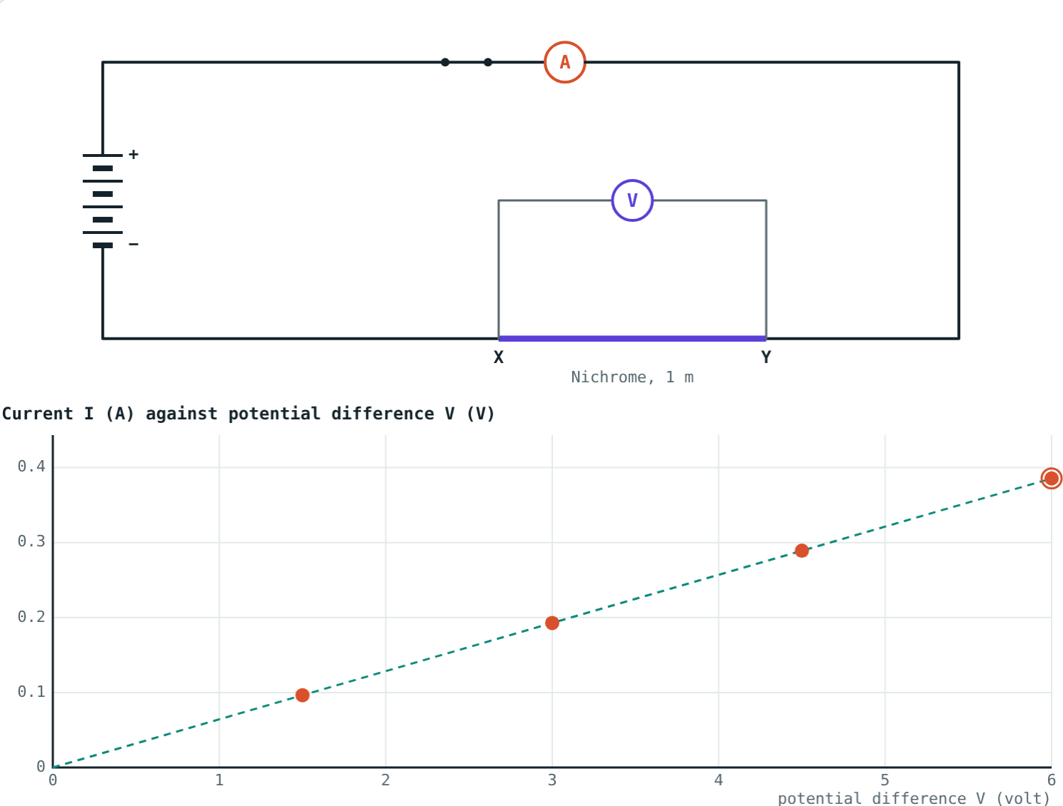
Resistance and Ohm's Law
STD 9 SCIENCE · CH. 3 CURRENT ELECTRICITY
Lesson 2 · Visual Physics
Notes:
Goal: students can state Ohm's law, use V = IR, describe the experiment, use R = ρL/A, and distinguish conductors from insulators.

Slide 2
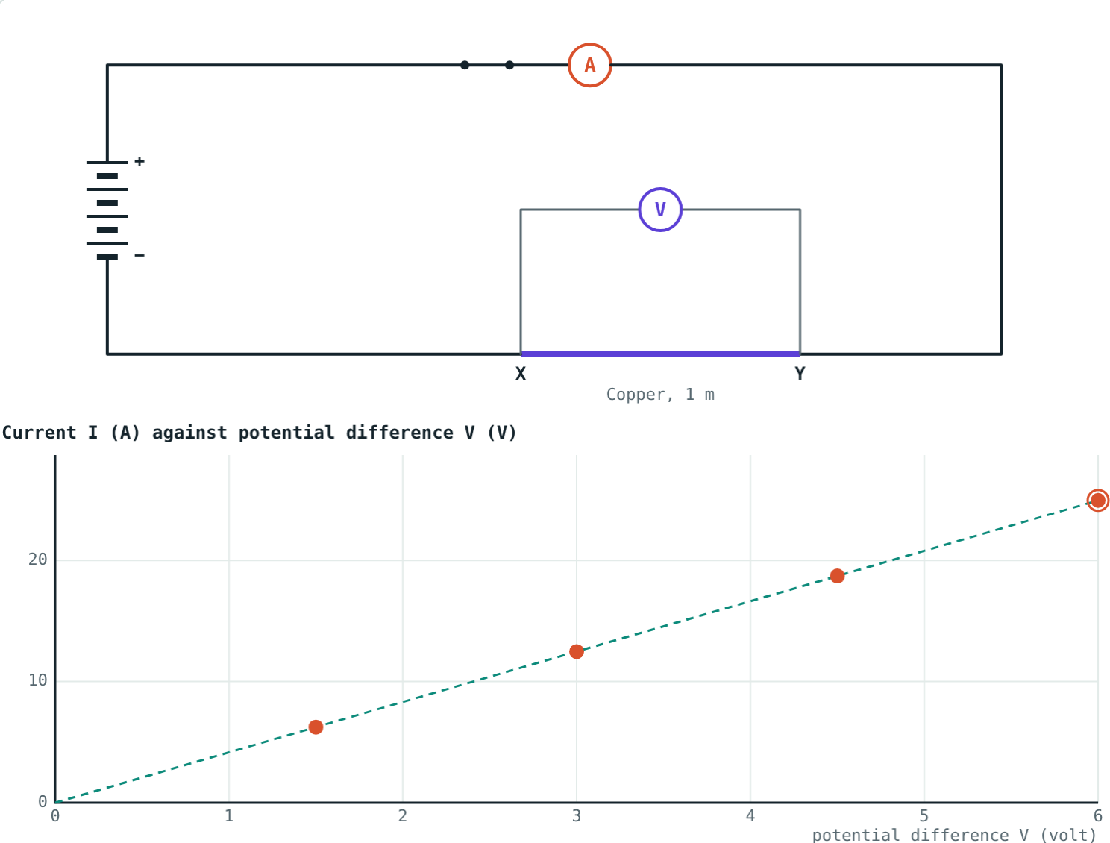
Same cell, very different currents
One cell drives a large current through copper, a small one through nichrome, and almost none through rubber.
What controls the size of the current?
Copper wire: about 25 A from four cells
Notes:
The answer is resistance, which depends on the material and the shape of the wire.

Slide 3
Ohm's law
V = I × R
If the physical state stays the same, current is proportional to potential difference.
Resistance R = V ÷ I, in ohms (Ω)
1 Ω: 1 V drives 1 A
Caused by electrons colliding with atoms
Readings for 1 to 4 cells lie on a straight line
Notes:
'Physical state' mainly means temperature.

Slide 4
The experiment
Cells | V (volt) | I (ampere) | V ÷ I (ohm)
1 | 1.5 | 0.096 | 15.6
2 | 3.0 | 0.193 | 15.6
3 | 4.5 | 0.289 | 15.6
4 | 6.0 | 0.386 | 15.6
Notes:
Readings for a nichrome wire 1 m long and 0.3 mm in diameter. V ÷ I stays the same: that constant is the resistance.

Slide 5
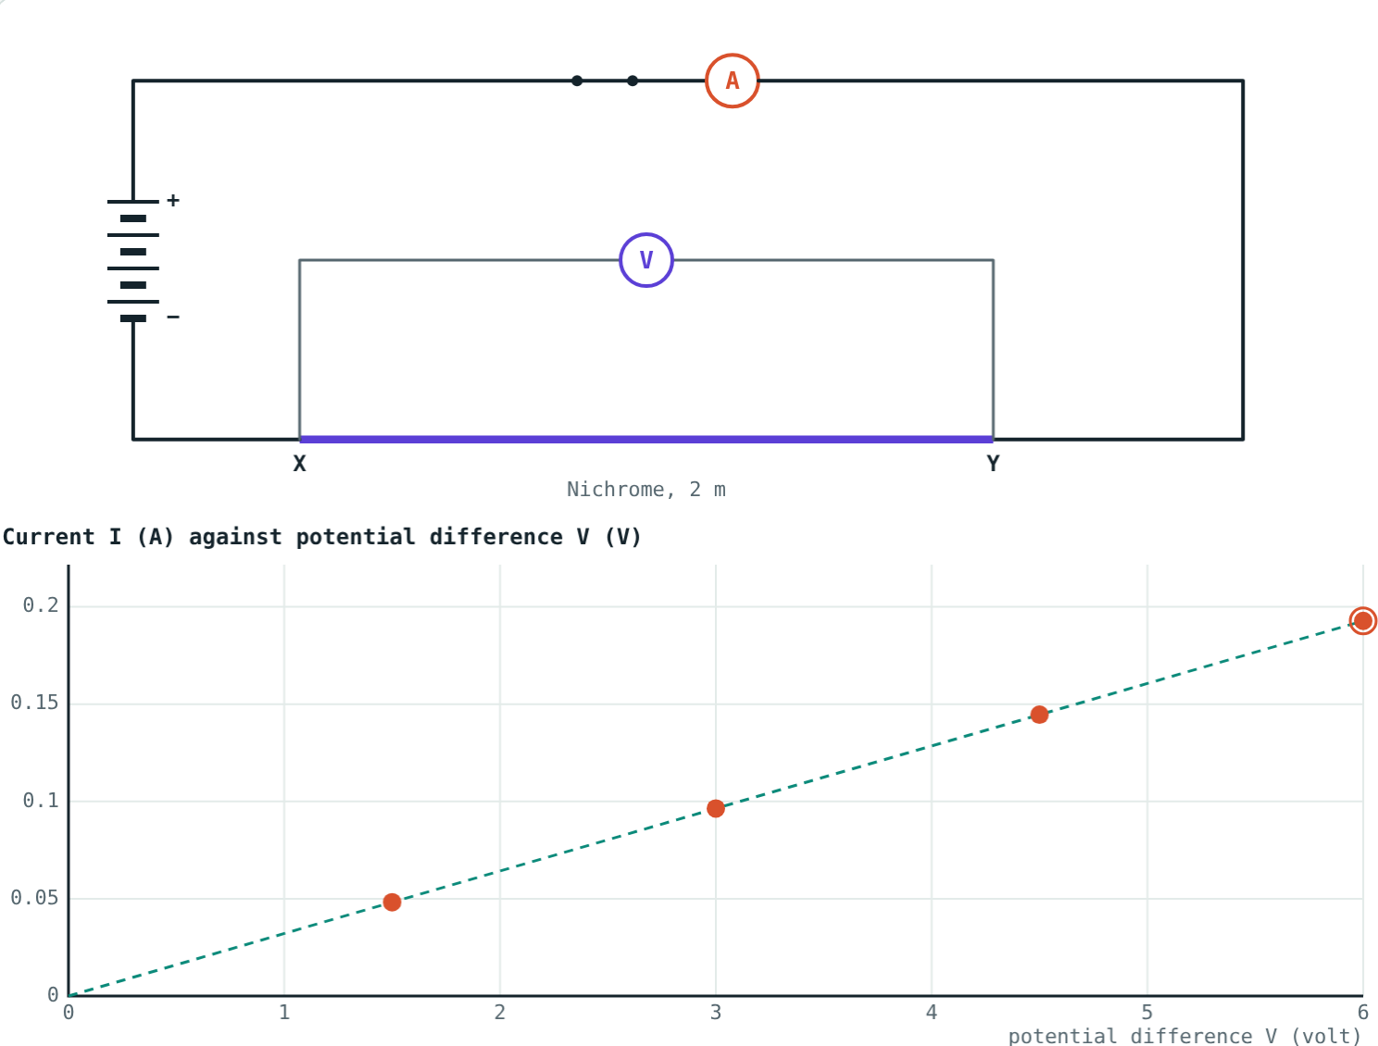
What decides resistance
R = ρ L ÷ A
Longer wire: more resistance
Thicker wire: less resistance
Material: resistivity ρ in Ω m
Hotter metal: more resistance
A 2 m wire: twice the resistance, half the slope
Notes:
Doubling the diameter makes the area four times larger.

Slide 6
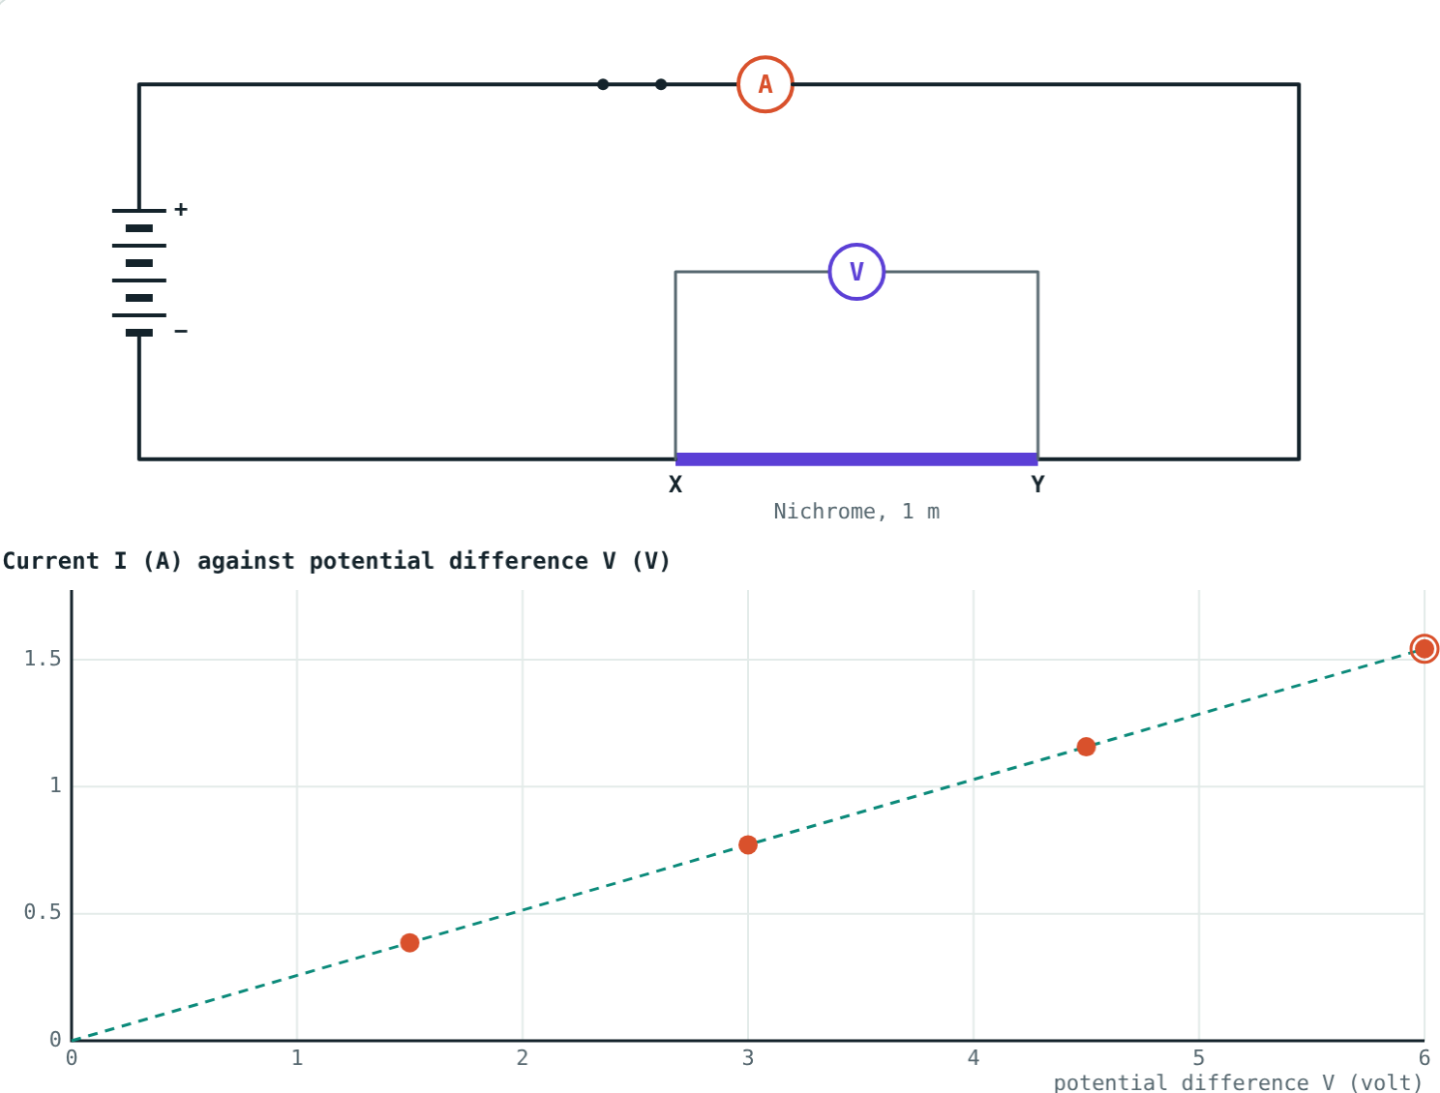
Length and thickness
Nichrome 2 m: R = 31.1 Ω.
Nichrome 0.6 mm: R = 3.9 Ω.
R ∝ L, and R ∝ 1/A.
Notes:
Compare the slopes of the two graphs: a steeper line means less resistance.

Slide 7
Conductors and insulators
Material | Resistivity (Ω m) | Type and use
Copper | 1.7 × 10⁻⁸ | Conductor: connecting wires
Aluminium | 2.7 × 10⁻⁸ | Conductor: power lines
Nichrome | 1.1 × 10⁻⁶ | High resistance: heater elements
Glass | about 10¹⁰ to 10¹⁴ | Insulator
Rubber | about 10¹³ | Insulator: gloves, cable covers
Notes:
Conductors have very low resistance; insulators have extremely high resistance.

Slide 8
Worked examples
An electric iron
A resistor and a cell
An iron draws 4 A from 230 V. Find its resistance.
A 5 Ω resistor is joined across a 1.5 V cell. Find the current.
R = 230 ÷ 4 = 57.5 Ω
I = 1.5 ÷ 5 = 0.3 A
Notes:
Rearrange V = IR as needed.

Slide 9
Worked example: R = ρL/A
Find the resistance of a nichrome wire 1 m long and 0.3 mm in diameter (ρ = 1.1 × 10⁻⁶ Ω m).
r = 1.5 × 10⁻⁴ m, A = πr² ≈ 7.07 × 10⁻⁸ m²
R = 1.1 × 10⁻⁶ × 1 ÷ 7.07 × 10⁻⁸ ≈ 15.6 Ω
The simulation gives the same 15.6 Ω
Notes:
Halve the diameter and convert mm to m before squaring.

Slide 10

Common mistakes
Diameter as radius
Ohm's law always holds
Halve it, and convert mm to m.
Only at constant temperature.
Double thickness, half R
Resistance vs resistivity
Double diameter gives a quarter of R.
Ω for a wire; Ω m for a material.
Notes:
The area mistake is the most common in R = ρL/A problems.

Slide 11
Quick check
1
12 V drives 0.5 A through a resistor. Find its resistance.
2
What shape is the I–V graph for a wire obeying Ohm's law?
3
A wire is replaced by one twice as long. What happens to R?
4
Which material is used in heater elements, and why?
Notes:
Answers: 1) 24 Ω. 2) A straight line through the origin. 3) It doubles. 4) Nichrome: high resistivity and it does not burn easily when hot.

Slide 12
Run the experiment yourself
Open the Resistance and Ohm's Law lesson on the Visual Physics website. Record readings, change the wire, and test insulators.
Next lesson: Resistors in series and parallel
Notes:
Homework idea: find the power rating and voltage on three appliances and work out each one's resistance.

