Slide 1
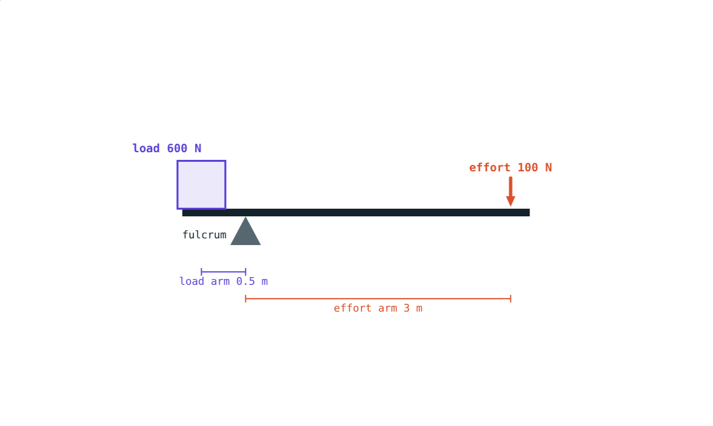
Simple Machines
STD 9 SCIENCE · CH. 2 WORK AND ENERGY
Lesson 5 · Visual Physics
Notes:
This lesson follows the new NCERT Class 9 book. Goal: students can calculate mechanical advantage, use the law of the lever, classify levers and analyse a ramp.

Slide 2
Lifting a rock with a bar
A 600 N rock is far too heavy to lift by hand. With a long crowbar, a 100 N push does it.
Where does the extra force come from?
Class I lever: effort arm 3 m, load arm 0.5 m
Notes:
The machine does not create energy. The effort moves six times farther than the load.

Slide 3
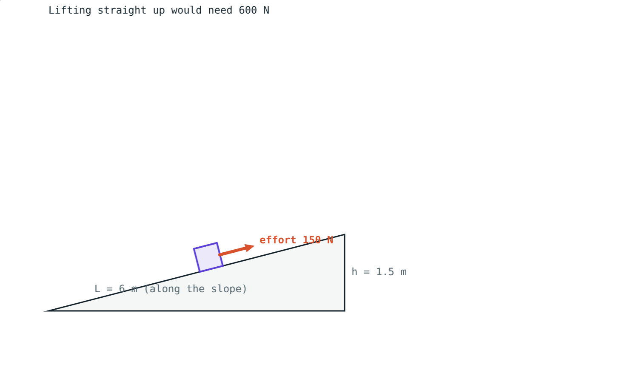
Mechanical advantage
MA = load ÷ effort
Effort: the force you apply
Load: the force you overcome
Work out is never more than work in
Less force means more distance
A ramp: 150 N over 6 m instead of 600 N over 1.5 m
Notes:
Both give 900 J of work. The machine only changes how that work is delivered.

Slide 4
The law of the lever
E × effort arm = L × load arm
Fulcrum: the fixed turning point
Arms are measured from the fulcrum
MA = effort arm ÷ load arm
A longer effort arm gives a bigger advantage
100 × 3 = 600 × 0.5
Notes:
Try it with a ruler balanced on a pencil and coins as weights.

Slide 5
Three classes of lever
I
II
III
Fulcrum in the middle
Load in the middle
Effort in the middle
Seesaw, crowbar, scissors.
Wheelbarrow, nutcracker, bottle opener. MA > 1.
Tongs, tweezers, forearm. MA < 1, but more speed.
Notes:
Memory aid: the class number tells you what is in the middle: 1 fulcrum, 2 load, 3 effort.

Slide 6
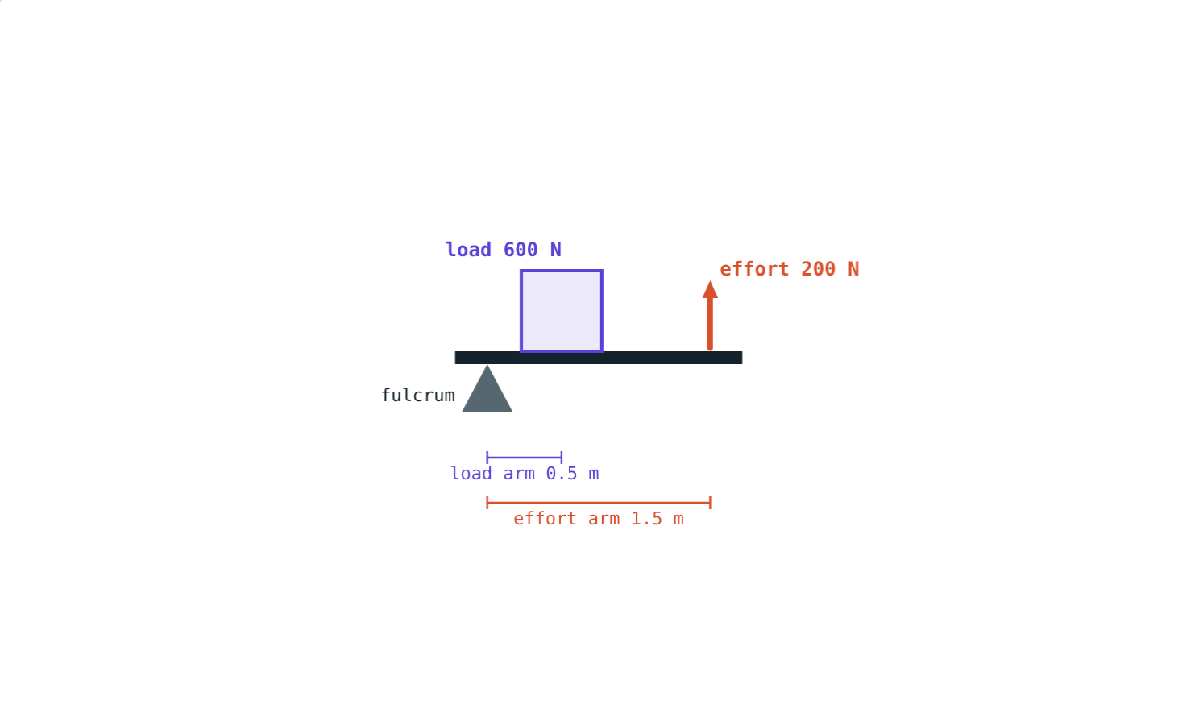
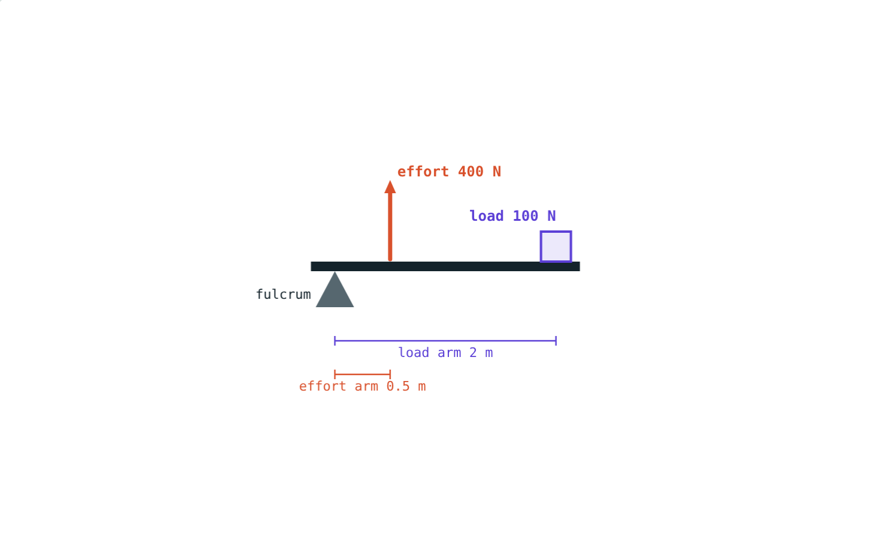
Class II and class III
Load 600 N, effort 200 N: MA 3.
Load 100 N, effort 400 N: MA 0.25.
A class III lever costs force but gains distance and speed at the load end.
Notes:
Ask why we use tongs at all: precision and reach, not force.

Slide 7
Ramps and pulleys
Ramp: MA = L ÷ h
Effort × L = load × h (no friction)
Longer, gentler ramp: less force needed
Fixed pulley: MA 1, changes direction
Movable pulley: ideal MA 2
L = 6 m, h = 1.5 m: MA = 4
Notes:
A well pulley does not reduce the force; it lets you pull down using your body weight.

Slide 8
Worked examples
A crowbar
A loading ramp
Load 600 N, load arm 0.2 m, effort arm 1.2 m. Find the effort and MA.
An 800 N sack is pushed up a smooth 4 m ramp to a 1 m platform. Find the effort and MA.
E × 1.2 = 600 × 0.2, E = 100 N
MA = 600 ÷ 100 = 6
E × 4 = 800 × 1, E = 200 N
MA = 4 ÷ 1 = 4
Notes:
In both cases, work in = work out.

Slide 9
Worked example: balancing a seesaw
A 20 kg child sits 1.5 m from the middle of a seesaw. Where must a 30 kg child sit to balance?
196 × 1.5 = 294 × d
d = 1 m from the middle
The heavier child sits closer to the fulcrum
Notes:
g cancels, so 20 × 1.5 = 30 × d also works.

Slide 10

Common mistakes
“Machines make energy”
Arms from the bar's end
They trade force for distance.
Measure from the fulcrum.
MA upside down
“Class III is useless”
MA = load ÷ effort.
It gives speed and reach.
Notes:
Energy conservation from Lesson 3 explains why machines cannot give out more work than they take in.

Slide 11
Quick check
1
A machine lifts 500 N with an effort of 125 N. Find its MA.
2
Which class of lever is a wheelbarrow?
3
What effort pushes a 400 N box up a smooth ramp 5 m long and 1 m high?
4
Can a simple machine reduce the work needed?
Notes:
Answers: 1) 4. 2) Class II. 3) 80 N. 4) No; it can reduce the force, but the work stays the same or more.

Slide 12
Balance a lever yourself
Open the Simple Machines lesson on the Visual Physics website. Try all three lever classes and a ramp.
That completes Chapter 2: Work and Energy
Notes:
Homework idea: find five levers at home and classify each one.

