Slide 1
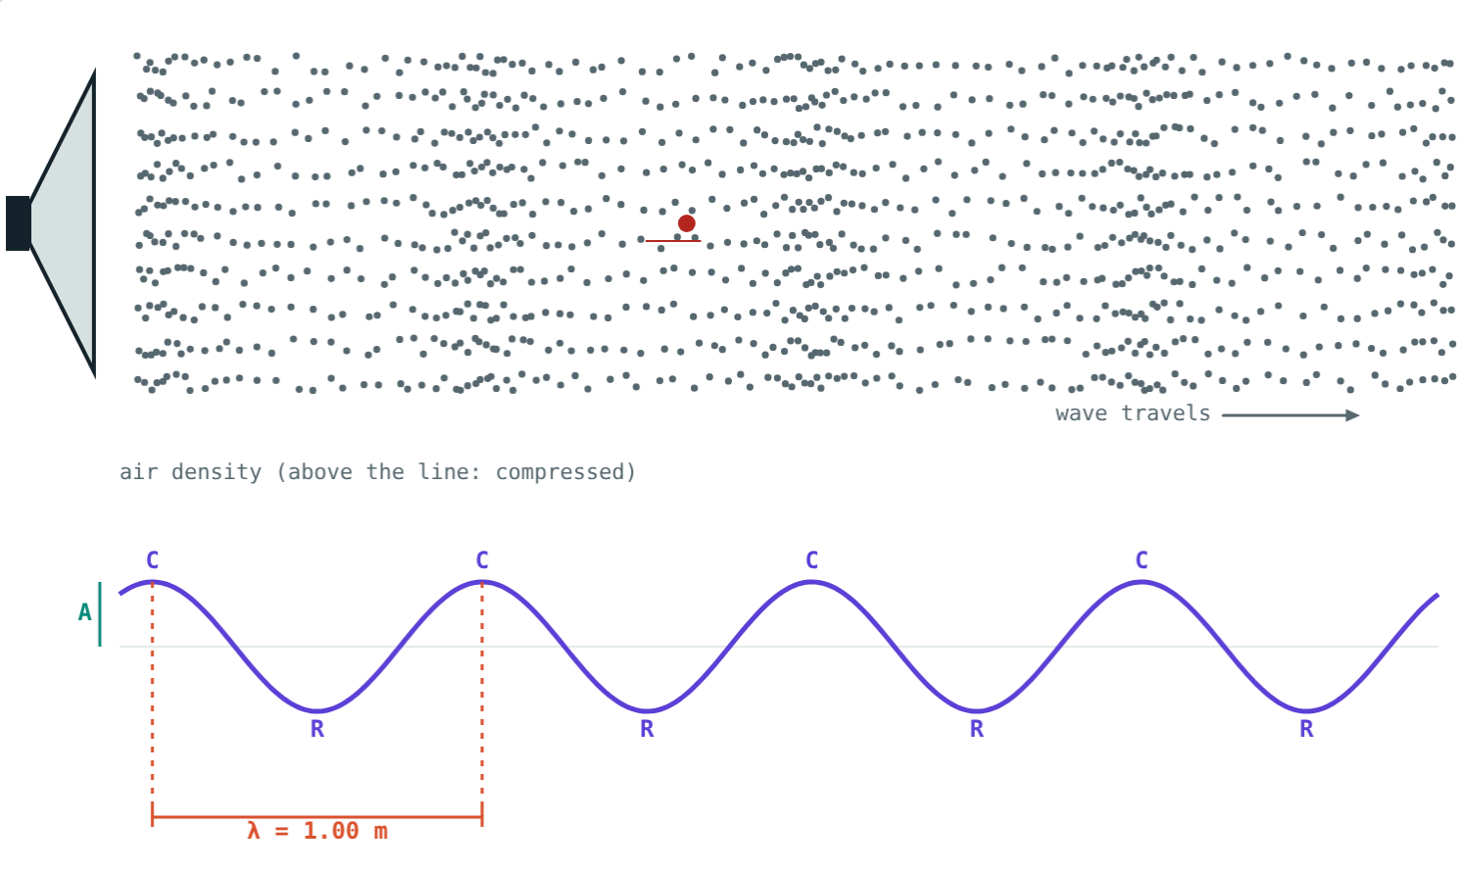
Sound Waves
STD 9 SCIENCE · CH. 12 STUDY OF SOUND
Lesson 1 · Visual Physics
Notes:
Goal: students can explain how sound is produced and travels, describe compressions and rarefactions, and use v = νλ.

Slide 2
Feel the buzz
Touch your throat while you hum. Strike a tuning fork and dip it in water: it splashes.
What do all sounds have in common?
A speaker pushing on the air
Notes:
Every sound starts with a vibration.

Slide 3
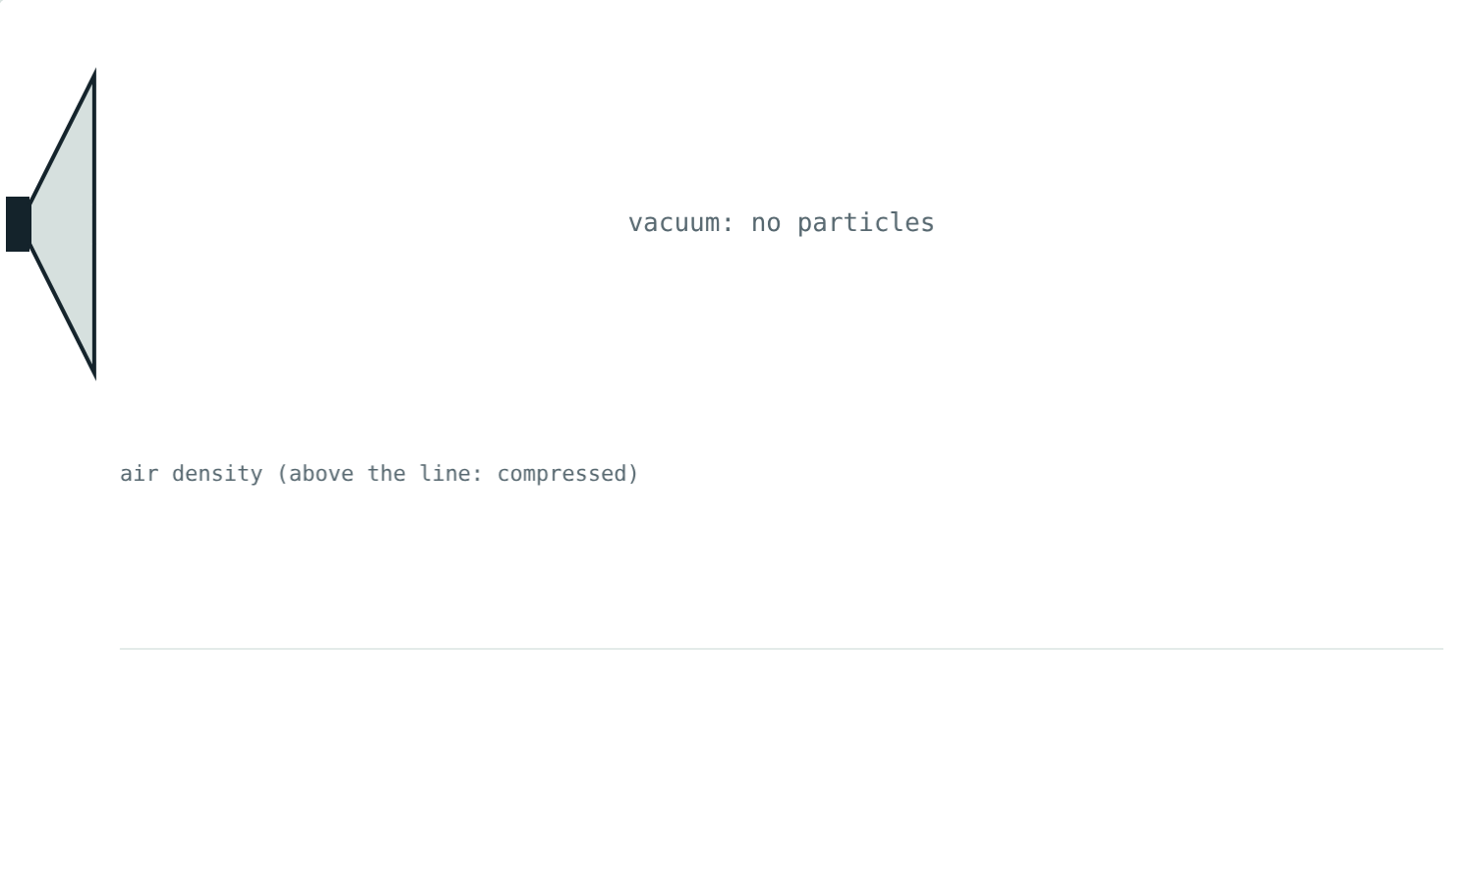
Sound needs a medium
A vibrating object pushes the particles next to it
Each particle pushes its neighbours
Solids, liquids and gases can carry sound
No particles, no sound: a vacuum is silent
With the air removed, nothing carries the vibration
Notes:
Describe the bell-jar experiment: the bell fades as air is pumped out.

Slide 4
Longitudinal waves
Particles vibrate along the direction of travel
Compression (C): particles crowded together
Rarefaction (R): particles spread apart
Particles stay in place; the pattern travels
Watch the red particle: it only shakes in place
Notes:
A slinky pushed back and forth shows the same pattern.

Slide 5
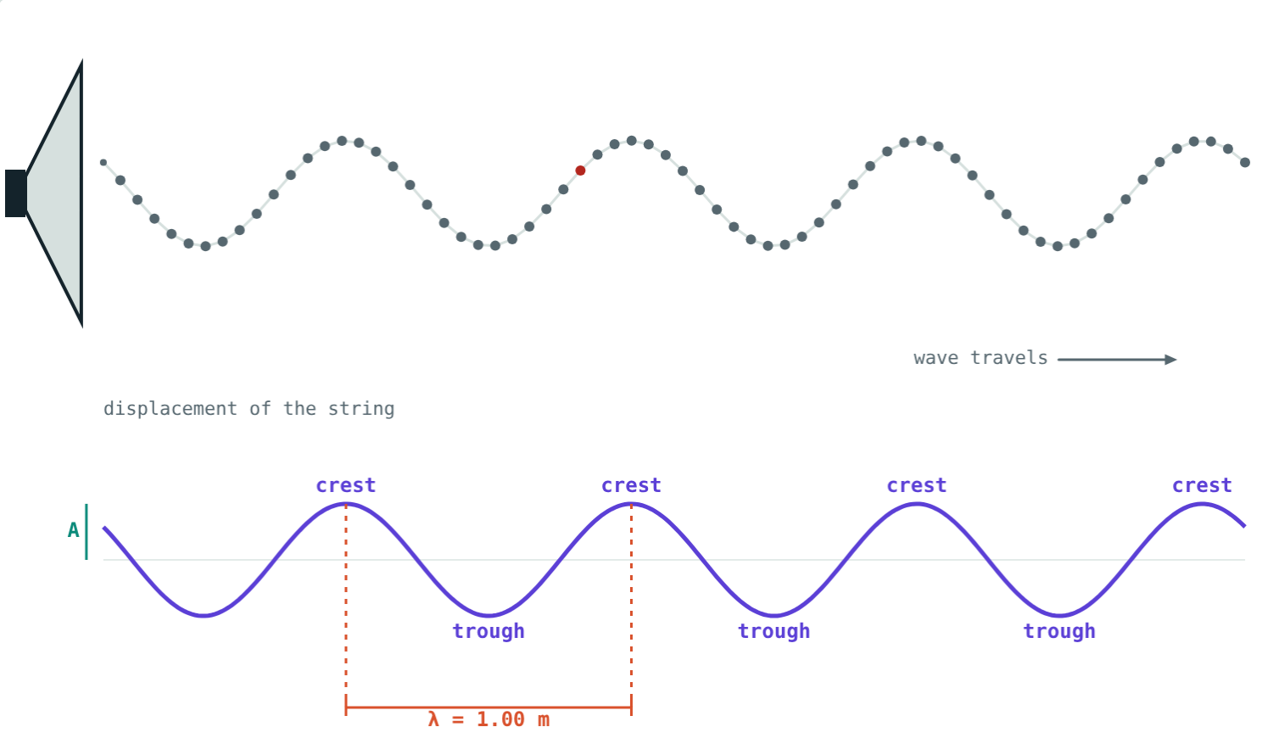
Longitudinal and transverse
Particles move along the wave: compressions and rarefactions.
Particles move across the wave: crests and troughs.
Notes:
Sound in air is always longitudinal.

Slide 6
Describing a wave
λ
ν
T
A
Wavelength
Frequency
Time period
Amplitude
Distance between two neighbouring compressions. Unit: m.
Vibrations per second. Unit: hertz (Hz).
Time for one vibration. T = 1/ν.
Largest change from the undisturbed state.
Notes:
In one period the wave moves one wavelength: v = λ/T = νλ.

Slide 7
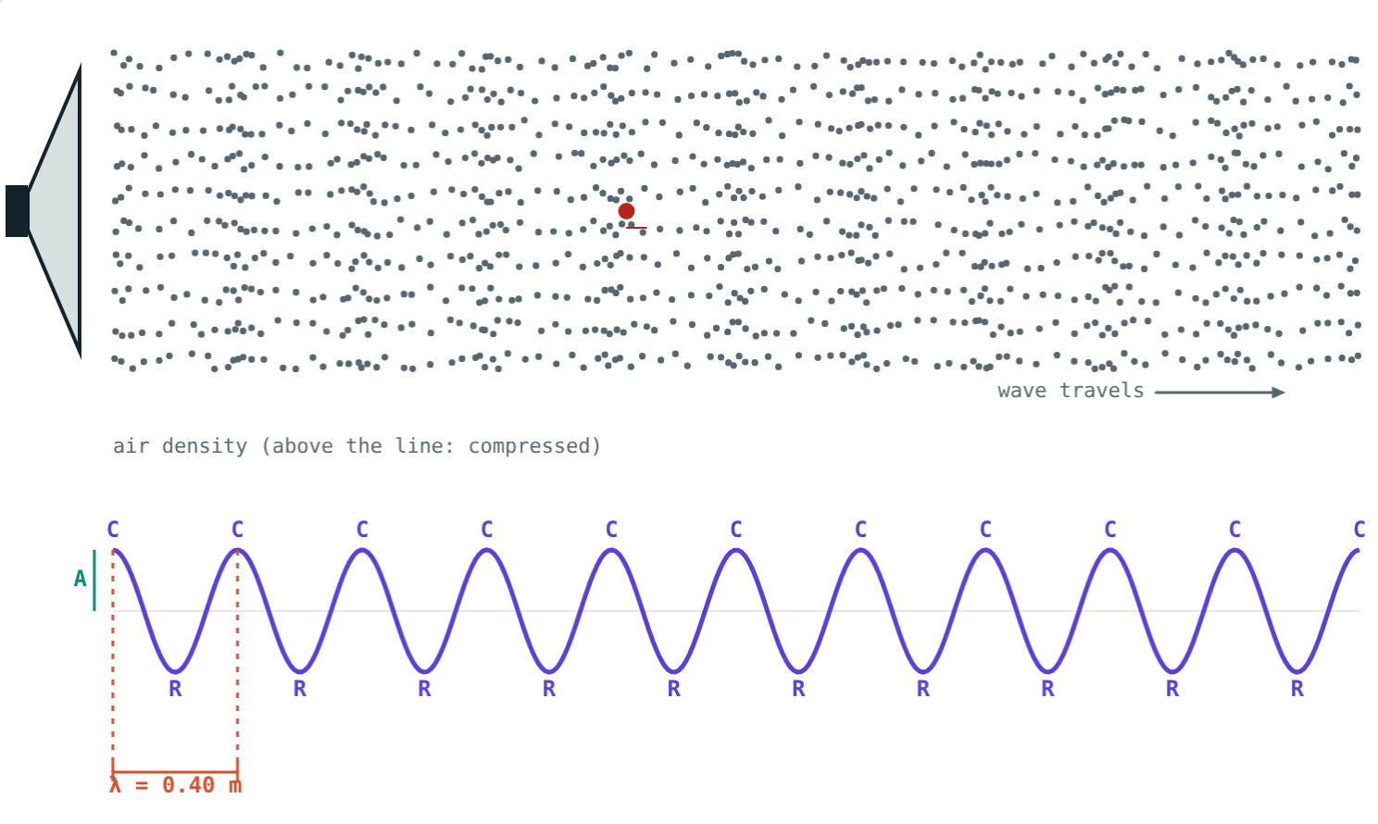
Speed of a wave
v = ν × λ
Higher frequency: shorter wavelength
In one medium, speed stays the same
Air: about 340 m/s
850 Hz: λ = 0.40 m
Notes:
Compare with 340 Hz on the earlier slide: λ = 1 m.

Slide 8
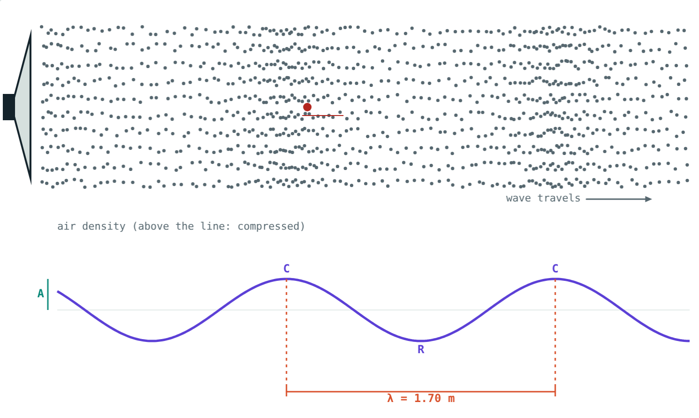
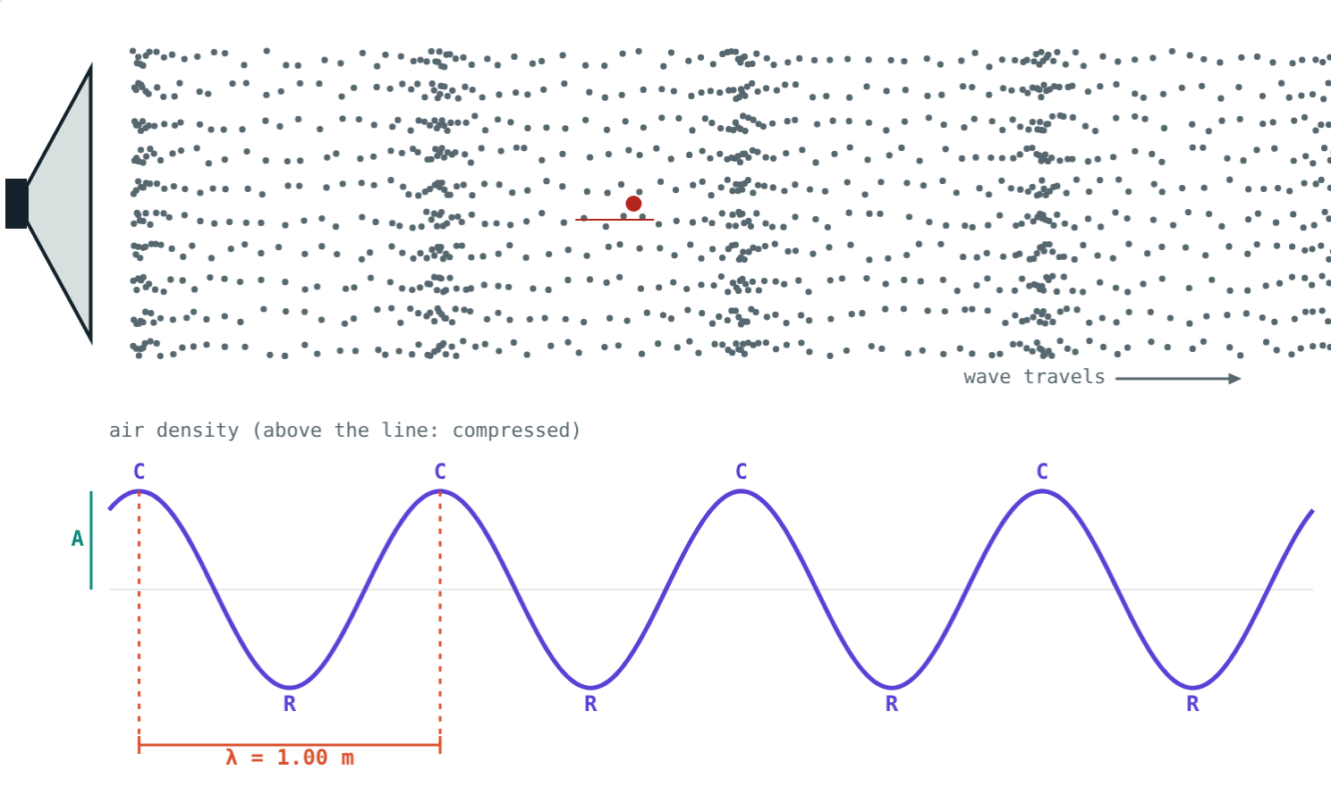
Pitch and loudness
200 Hz: long wavelength, deep note.
Large amplitude: more energy, louder sound.
Notes:
Pitch goes with frequency; loudness goes with amplitude.

Slide 9
Worked examples
A tuning fork
How far in 3 s?
ν = 500 Hz, v = 340 m/s. Find λ and T.
ν = 850 Hz, λ = 0.4 m. How far does the sound travel in 3 s?
λ = 340 ÷ 500 = 0.68 m
T = 1 ÷ 500 = 0.002 s
v = 850 × 0.4 = 340 m/s
340 × 3 = 1020 m
Notes:
Write the formula first, then substitute.

Slide 10

Common mistakes
“The air travels to your ear”
“High notes travel faster”
Only the disturbance travels.
Same medium, same speed.
Pitch vs loudness
“Sound crosses space”
Pitch: frequency. Loudness: amplitude.
Sound needs a medium.
Notes:
Ask students to explain why we see the Sun's explosions but never hear them.

Slide 11
Quick check
1
How do air particles move in a sound wave?
2
A sound of 680 Hz travels at 340 m/s. Find its wavelength.
3
Which property of a sound decides its loudness?
4
Why can't astronauts hear each other directly on the Moon?
Notes:
Answers: 1) Back and forth along the direction of travel. 2) 0.5 m. 3) Amplitude. 4) There is no air on the Moon to carry sound.

Slide 12
Make waves yourself
Open the Sound Waves lesson on the Visual Physics website. Change the frequency and amplitude and watch the particles.
Next lesson: The speed of sound
Notes:
Homework idea: a string telephone made from two cups shows sound travelling through a solid.

