Slide 1
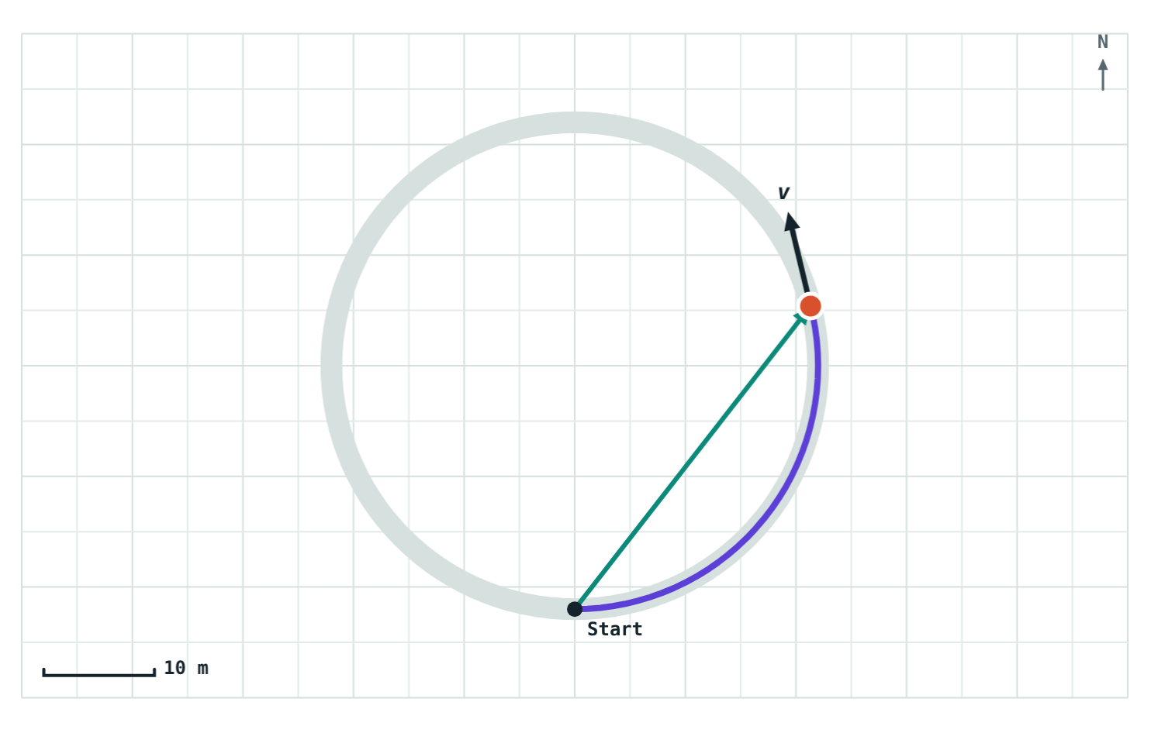
Speed and Velocity
STD 9 SCIENCE · CH. 1 LAWS OF MOTION
Lesson 2 · Visual Physics
Notes:
Lesson 2 of Chapter 1. Goal: students can calculate speed and velocity, convert between km/h and m/s, and explain why velocity can change while speed stays the same.

Slide 2

Same speed, different velocity
Two cyclists leave the same crossroads at 5 m/s. One heads north, the other heads east.
5 m/s north
Are they moving at the same speed?
Do they have the same velocity?
5 m/s east
Notes:
Take a show of hands for each question. Most will say the speeds are equal; some will hesitate on velocity. Today's lesson explains why the velocities differ.

Slide 3
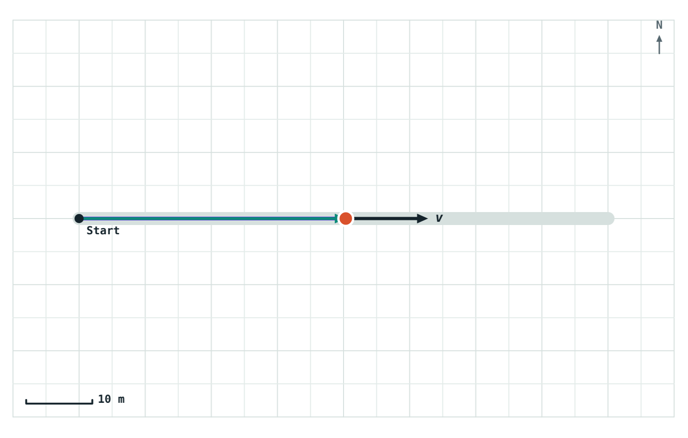
Speed: how fast
speed = distance ÷ time
The distance travelled in unit time
Size only, no direction: a scalar
SI unit: metres per second (m/s)
Average speed = total distance ÷ total time
40 m along a straight road in 5 s: speed = 8 m/s
Notes:
Stress the word 'distance': speed uses the whole path, not the straight-line displacement.

Slide 4
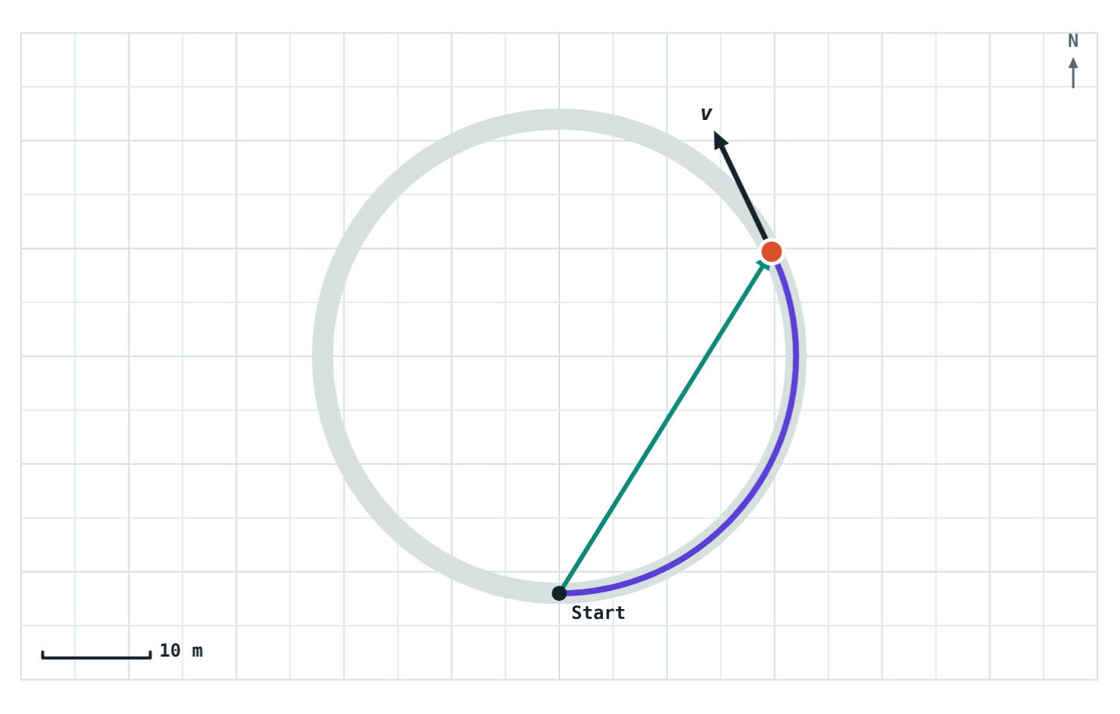
Velocity: how fast, and which way
velocity = displacement ÷ time
The displacement in unit time
Size and direction: a vector
Unit m/s, always with a direction: “5 m/s north”
Without a direction it is only a speed
The arrow v is the velocity: its length is the speed, it points the way the cyclist moves
Notes:
Link back to the hook: both cyclists had a speed of 5 m/s, but velocities of 5 m/s north and 5 m/s east. Different directions mean different velocities.

Slide 5



Three ways velocity can change
The speed changes
The direction changes
Both change
An auto-rickshaw speeds up along a straight road.
A cyclist rides round a circular track at a steady speed.
A car slows down as it turns a corner.
Notes:
Ask for an everyday example of each. The middle card surprises most students: constant speed, yet changing velocity.

Slide 6
Changing km/h into m/s
1 km = 1000 m and 1 h = 3600 s, so
km/h | m/s
18 | 5
36 | 10
54 | 15
72 | 20
90 | 25
1 km/h = 5/18 m/s
km/h to m/s: multiply by 5/18
m/s to km/h: multiply by 18/5 (= 3.6)
Notes:
A quick check: every 18 km/h is 5 m/s. Have students fill in 108 km/h (30 m/s) themselves.

Slide 7
Speed or velocity?
 | Speed | Velocity
Defined as | Distance ÷ time | Displacement ÷ time
Direction | Not included (scalar) | Included (vector)
Unit | m/s | m/s, with a direction
Average over a round trip | More than zero | Zero
Changes when | Speeding up or slowing down | Speed or direction changes
Notes:
Pairs with the distance/displacement table from Lesson 1: speed goes with distance, velocity goes with displacement.

Slide 8
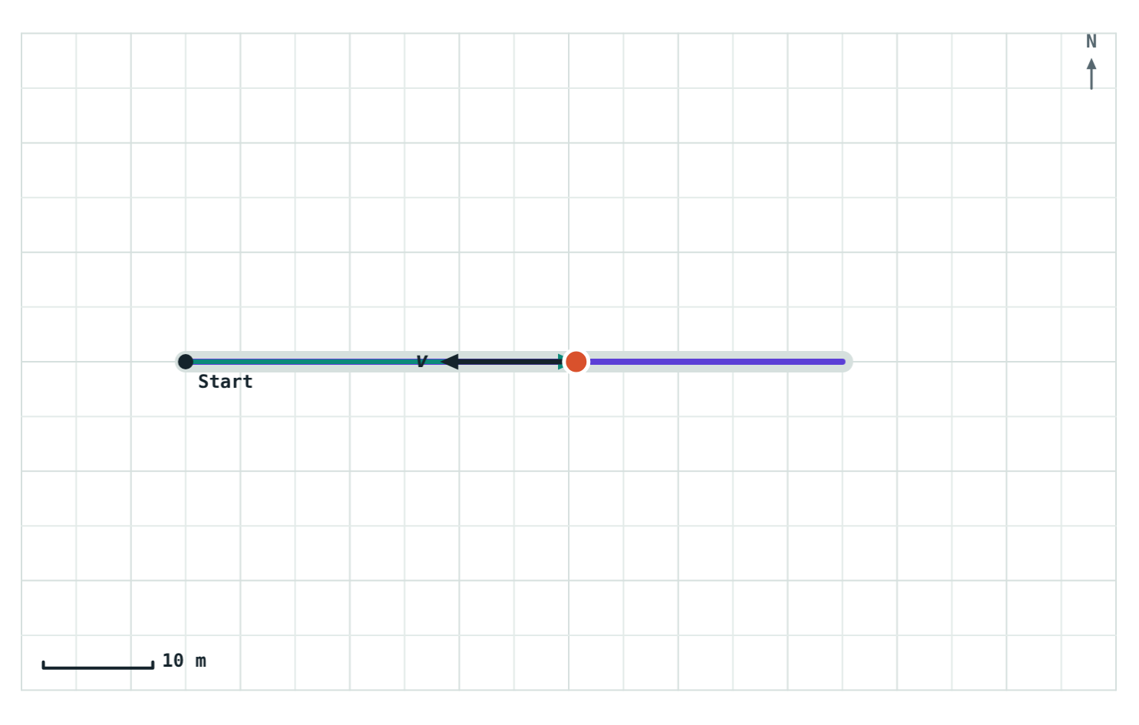
A round trip: speed yes, velocity no
At the finish: 120 m in 15 s, back at the start.
8 m/s
average speed
0 m/s
average velocity
Displacement is zero, so the average velocity is zero, even though the rider never stopped.
Riding 60 m east and back at 8 m/s, shown on the way back
Notes:
Average speed = 120 m ÷ 15 s = 8 m/s. Average velocity = 0 m ÷ 15 s = 0. Ask: what is the size of the velocity at any moment during the ride? Still 8 m/s; only the average is zero.

Slide 9
Worked examples
A bus journey
Back to Riya's walk
A bus covers 90 km in 1.5 hours. Find its average speed in km/h and m/s.
Riya walked 40 m east, then 30 m north, in 50 s. Find her average speed and velocity.
Average speed = 90 ÷ 1.5 = 60 km/h
In m/s: 60 × 5/18 = 16.7 m/s
Average speed = 70 ÷ 50 = 1.4 m/s
Average velocity = 50 ÷ 50 = 1 m/s, 37° N of E
Notes:
Riya's walk reuses the Lesson 1 example. Average velocity (1 m/s) is less than average speed (1.4 m/s) because the displacement cuts the corner.

Slide 10
Worked example: one lap
A cyclist rides once around a circular track 200 m long in 40 s. Find her average speed and average velocity.
Average speed = 200 ÷ 40 = 5 m/s
She ends where she started, so displacement = 0 and average velocity = 0 m/s
Follow-up: what is her average velocity after half a lap (20 s)? The diameter is 200 ÷ π ≈ 63.7 m.
Notes:
Follow-up answer: 63.7 m ÷ 20 s ≈ 3.2 m/s, in the direction straight across the track.

Slide 11

Common mistakes
Mixing units
Using displacement for speed
Don't divide metres by hours. Convert first: 1 km/h = 5/18 m/s.
Speed uses the whole path (distance). Velocity uses displacement.
Steady speed = steady velocity
No direction
Only in a straight line. Turning changes the velocity.
A velocity without a direction is just a speed.
Notes:
Unit mixing is the most common error in numerical problems on this topic.

Slide 12
Quick check
1
An auto-rickshaw circles a roundabout at a steady 20 km/h. Is its velocity constant?
2
A train moves at 54 km/h. What is that in m/s?
3
A runner finishes one lap of a 400 m track in 100 s. Average speed? Average velocity?
4
Can average velocity ever be larger than average speed?
Notes:
Answers: 1) No; its direction keeps changing, so its velocity changes. 2) 54 × 5/18 = 15 m/s. 3) Average speed 4 m/s; average velocity 0. 4) No; displacement is never more than distance, and both are divided by the same time.

Slide 13
Ride it yourself
Open the Speed and Velocity lesson on the Visual Physics website. Change the speed, pick a route, and watch the velocity arrow.
Next lesson: Uniform and non-uniform motion
Notes:
Homework idea: time yourself walking a measured distance at school and work out your average speed in m/s and km/h.

