Slide 1
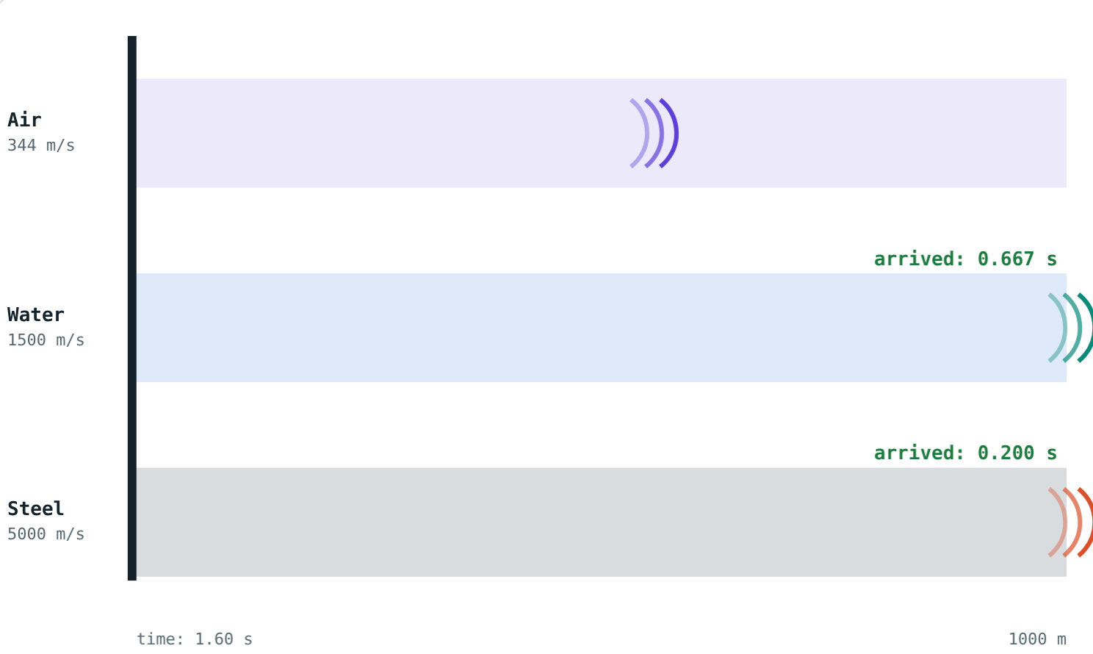
The Speed of Sound
STD 9 SCIENCE · CH. 12 STUDY OF SOUND
Lesson 2 · Visual Physics
Notes:
Goal: students can compare the speed of sound in different media, use v ≈ 332 + 0.6t, and find distances from the lightning-thunder gap.

Slide 2
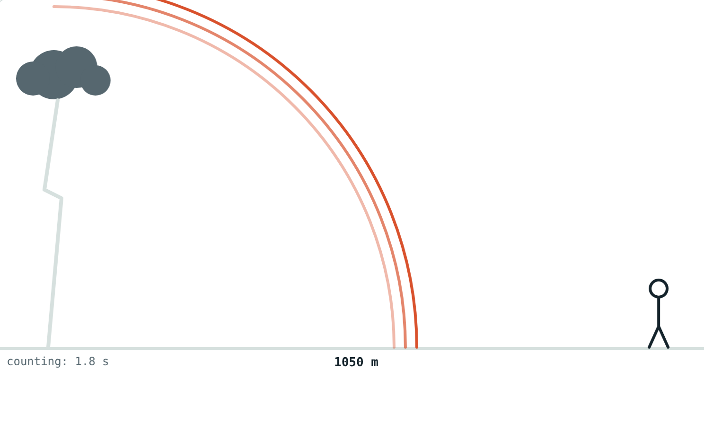
See first, hear later
At a cricket match you see the bat hit the ball before you hear the crack. In a storm, the flash comes before the thunder.
Why does the sound arrive late?
The thunder still on its way
Notes:
Light is almost a million times faster than sound in air.

Slide 3
Speed depends on the medium
Medium | Approximate speed
Air at 0 °C | 332 m/s
Air at 20 °C | 344 m/s
Water | about 1500 m/s
Steel | about 5000 m/s
Notes:
Fastest in solids, slower in liquids, slowest in gases.

Slide 4
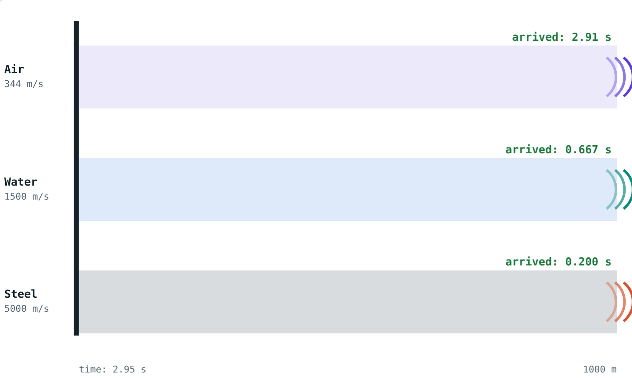
The race
Steel and water have arrived; air is halfway.
Air finally arrives over 1000 m.
Notes:
Tightly linked particles pass the push on faster.

Slide 5
Temperature matters
v ≈ 332 + 0.6 t
t is the air temperature in °C
About 0.6 m/s faster per degree
Faster in a lighter gas: hydrogen beats oxygen
Frequency and loudness do not matter
Air at 20 °C: 344 m/s
Notes:
Warmer gas particles move faster and pass the disturbance more quickly.

Slide 6
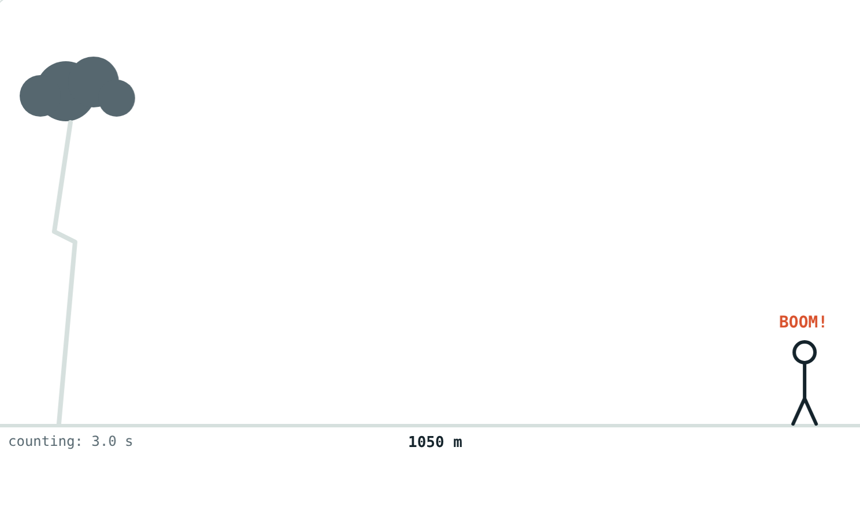
Lightning and thunder
distance = v × t
Light: 3 × 10⁸ m/s, arrives almost at once
Thunder: a few hundred m/s
Count seconds from flash to thunder
3 s at 350 m/s: 1050 m away
Notes:
A rough rule: every 3 seconds is about 1 km.

Slide 7
Worked examples
Warm and cold air
The storm
Find v at 20 °C. At what temperature is v = 350 m/s?
Thunder is heard 3 s after the flash at 30 °C. How far away?
332 + 0.6 × 20 = 344 m/s
(350 − 332) ÷ 0.6 = 30 °C
v = 332 + 18 = 350 m/s
350 × 3 = 1050 m
Notes:
Always find v for the temperature first.

Slide 8
An ear to the rail
Through steel and through air (20 °C):
0.2 s
through steel
2.9 s
through air
A tap 1000 m away
You hear the same tap twice, about 2.7 s apart.
Notes:
This is why people once put an ear to the rail to hear an approaching train.

Slide 9




Where it matters
Storms
Races
Railways
Concerts
Time the thunder to judge how far away the lightning is.
Timekeepers start their watches at the smoke, not the bang.
A train is heard through the rail before through the air.
All notes arrive together: speed does not depend on frequency.
Notes:
Over 100 m, the starting gun's sound arrives about 0.3 s late.

Slide 10

Common mistakes
“Fastest in air”
“High notes travel faster”
Slowest in gases, fastest in solids.
All frequencies travel together.
Ignoring temperature
“Thunder comes later”
About 0.6 m/s more per °C.
It happens with the flash; it arrives later.
Notes:
Point out that students hear the same mistakes in everyday speech; ask for a counter-example to each.

Slide 11
Quick check
1
In which medium does sound travel fastest: air, water or steel?
2
Find the speed of sound in air at 25 °C.
3
Thunder comes 5 s after the flash (v = 340 m/s). How far away is the storm?
4
Is sound faster in hydrogen or oxygen at the same temperature?
Notes:
Answers: 1) Steel. 2) 347 m/s. 3) 1700 m. 4) Hydrogen.

Slide 12
Race some sound yourself
Open the Speed of Sound lesson on the Visual Physics website. Change the temperature and the distance, then press Play.
Next lesson: Echo and reverberation
Notes:
Homework idea: time the thunder in the next storm and estimate the distance.

