Slide 1
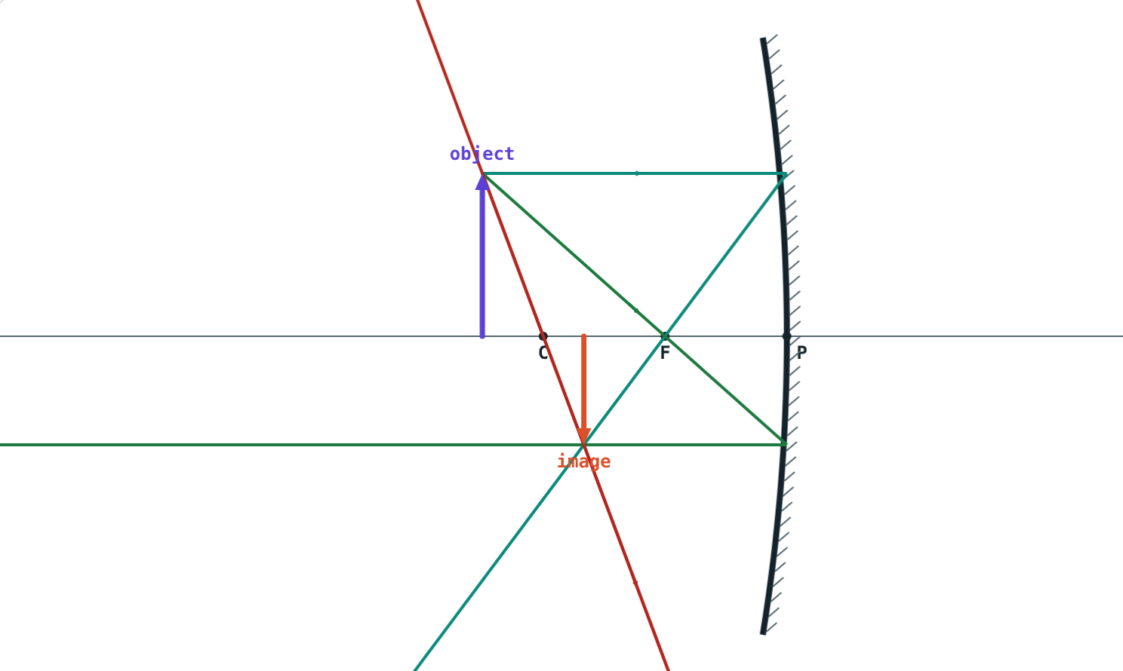
Spherical Mirrors and Ray Diagrams
STD 9 SCIENCE · CH. 11 REFLECTION OF LIGHT
Lesson 3 · Visual Physics
Notes:
Goal: students can name the parts of a spherical mirror, draw ray diagrams with the three rules, and describe the images for each object position.

Slide 2
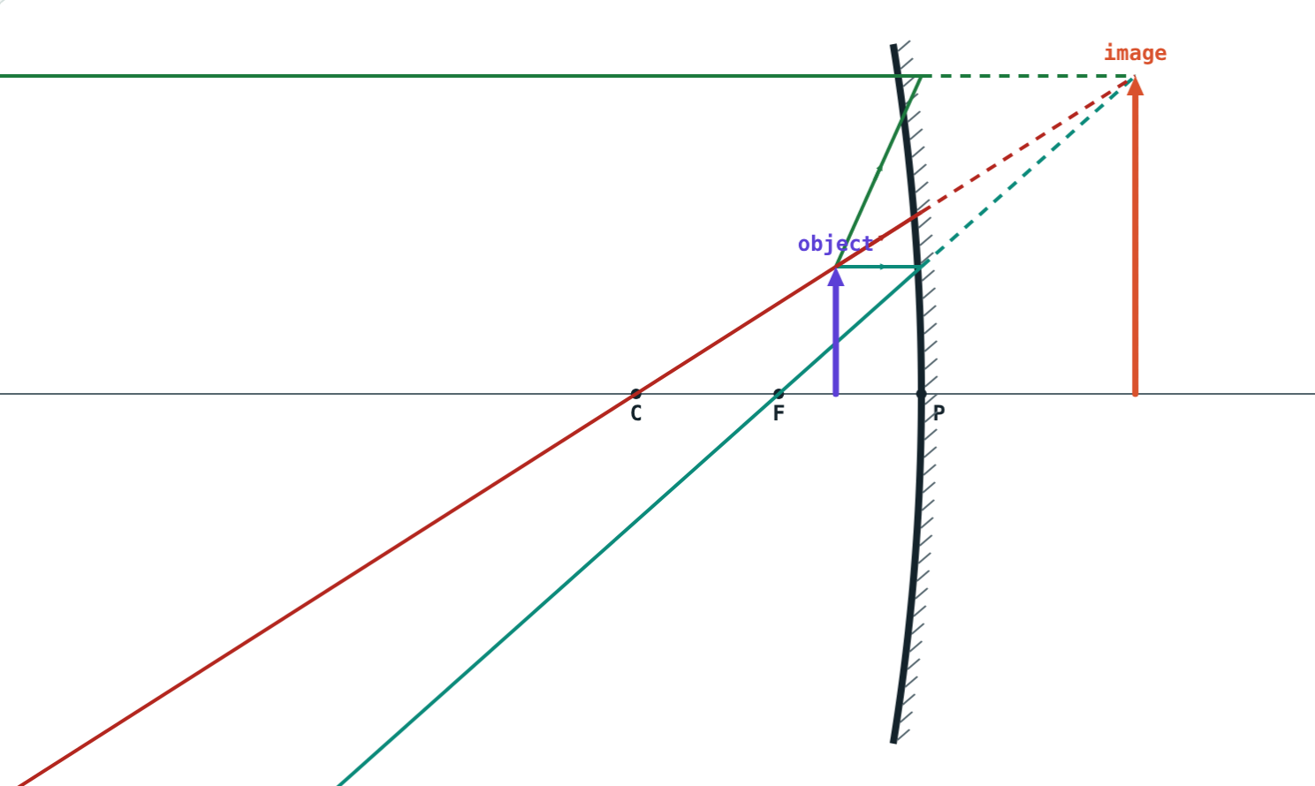
The spoon test
Look into the hollow of a steel spoon: you are upside down. Bring it very close: you are huge and upright. Turn it over: you are small and upright.
How can one spoon do all three?
Object inside F: large and upright
Notes:
Let students try with real spoons before the explanation.

Slide 3
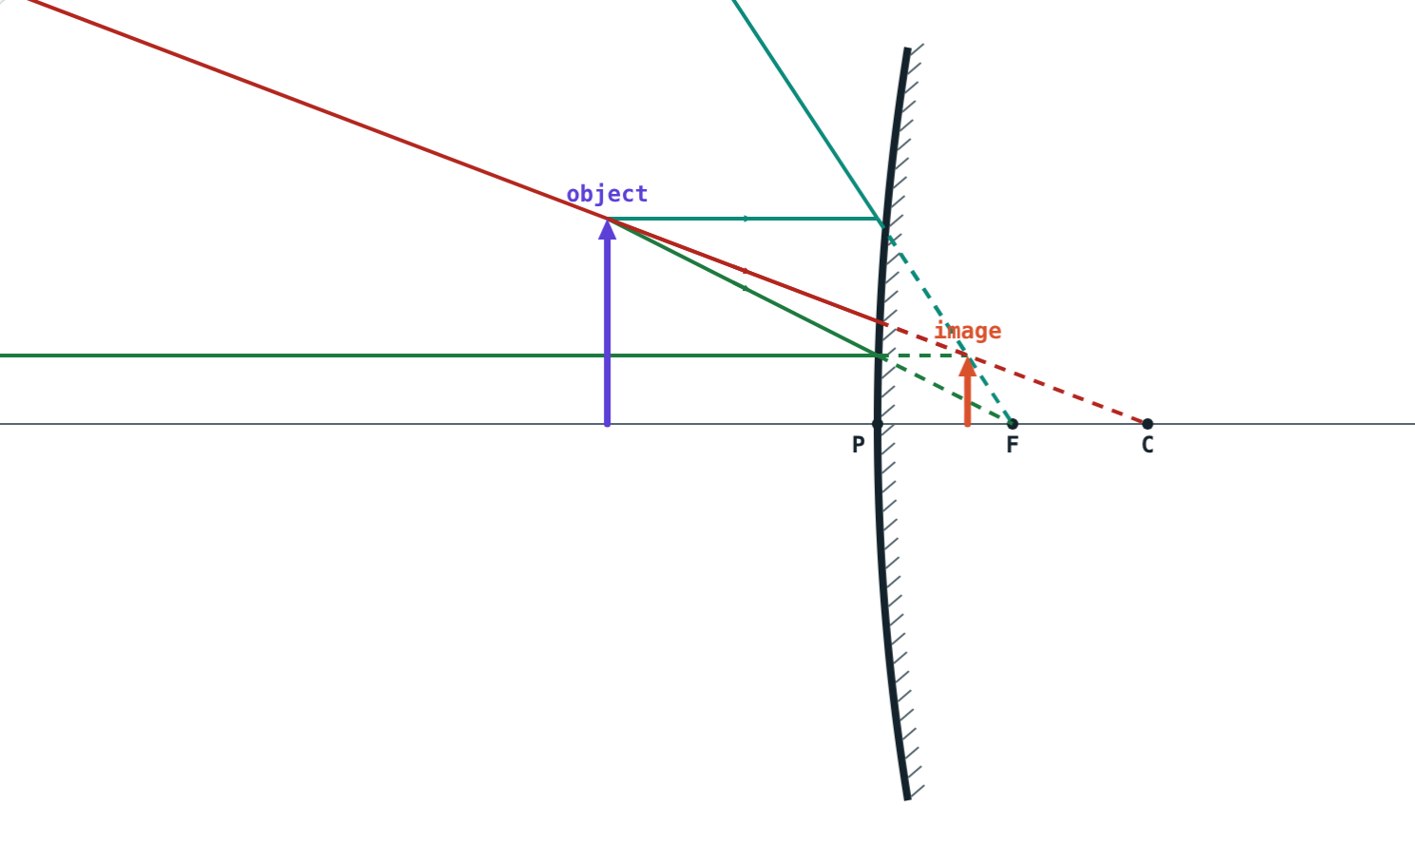
Concave and convex
Concave: the hollow side reflects
Concave mirrors converge parallel rays
Convex: the bulging side reflects
Convex mirrors make parallel rays diverge
Convex mirror: rays spread out
Notes:
Both are pieces of a hollow sphere; which side is silvered decides the type.

Slide 4
Words you need
Term | Meaning
Pole P | Centre of the mirror's surface
Centre of curvature C | Centre of the sphere the mirror is part of
Radius of curvature R | Radius of that sphere, PC
Principal axis | Line through P and C
Principal focus F | Where parallel rays meet (or seem to come from)
Focal length f | PF; f = R ÷ 2
Notes:
F is halfway between P and C.

Slide 5
Three rays to find an image
Ray 1
Ray 2
Ray 3
Parallel to the axis
Through F
Through C
Reflects through F (or seems to come from F).
Reflects parallel to the axis.
Hits at right angles and comes straight back.
Notes:
Any two rays are enough; the third is a check.

Slide 6
Images formed by a concave mirror
Object | Image | Size | Nature
At infinity | At F | Point-sized | Real, inverted
Beyond C | Between F and C | Diminished | Real, inverted
At C | At C | Same size | Real, inverted
Between C and F | Beyond C | Magnified | Real, inverted
At F | At infinity | Highly magnified | Real, inverted
Between F and P | Behind the mirror | Magnified | Virtual, erect
Notes:
Walk the object in with the simulation's Play button and tick off each row.

Slide 7
Far and near
Small, real and inverted, between F and C.
Large, virtual and erect, behind the mirror.
Notes:
Real images form where rays really meet; virtual ones where they only seem to.

Slide 8
Convex mirrors
Image always virtual, erect and diminished
Always behind the mirror, between P and F
Shows a wide area in a small space
Rays seem to come from behind the mirror
Notes:
This is why the image in a car's side mirror looks further away than it is.

Slide 9




Uses of spherical mirrors
Dentist and shaving
Torches and headlamps
Solar cookers
Rear-view mirrors
Concave, object inside F: large, upright image.
Concave, bulb at F: a parallel beam.
Concave: sunlight concentrated at F.
Convex: a wide view, upright image.
Notes:
Also: convex mirrors at sharp bends in hill roads and in shops.

Slide 10
Worked examples
From R to f
Predicting an image
A concave mirror has R = 36 cm. Where is its principal focus?
An object is 25 cm from a concave mirror with f = 10 cm. Describe the image.
f = R ÷ 2 = 36 ÷ 2 = 18 cm
C is at 2f = 20 cm: object beyond C
Image: between F and C, real, inverted, diminished
Notes:
Locate C first, then use the table.

Slide 11

Common mistakes
“F is at C”
“Concave always inverts”
F is halfway: f = R ÷ 2.
Inside F the image is virtual and erect.
Virtual for every case
“Convex can magnify”
Only when the object is inside F.
Its image is always smaller.
Notes:
Ask students to sketch the diagram rather than memorise the table.

Slide 12
Quick check
1
Where do rays parallel to the axis of a concave mirror meet after reflection?
2
Where should a torch bulb be placed to give a parallel beam?
3
Describe the image of an object at C of a concave mirror.
4
Why are convex mirrors used as rear-view mirrors?
Notes:
Answers: 1) At the principal focus F. 2) At F. 3) At C, same size, real and inverted. 4) They give a wide field of view with an erect image.

Slide 13
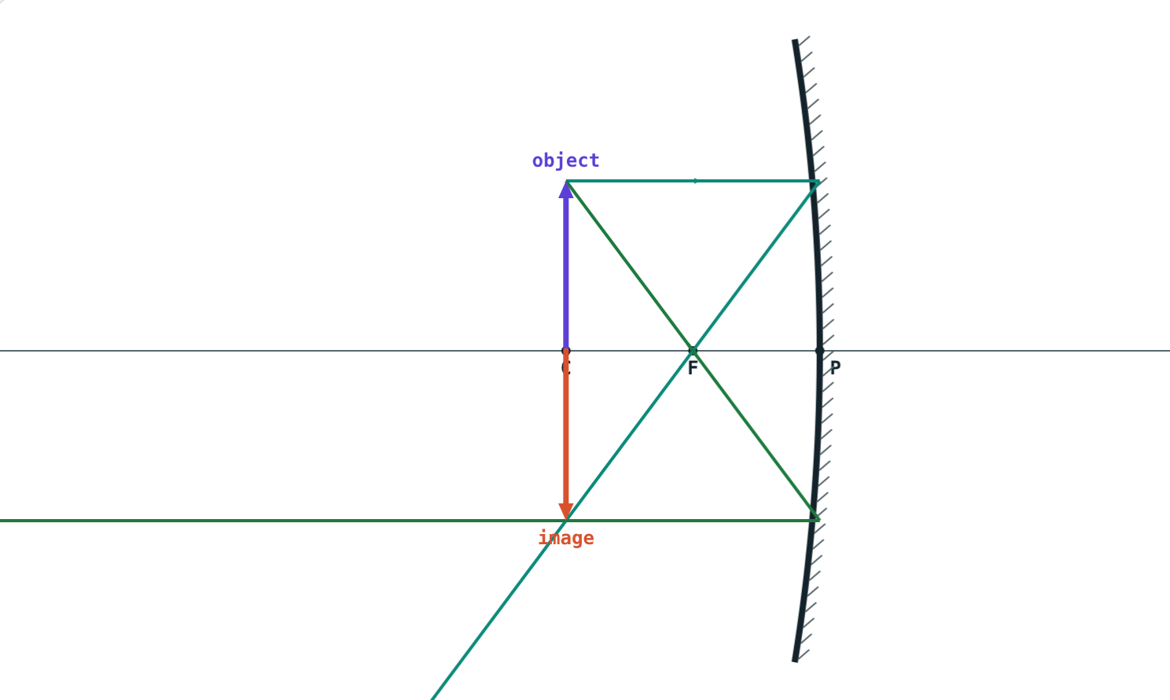
Draw ray diagrams live
Open the Spherical Mirrors lesson on the Visual Physics website. Walk the object towards the mirror and watch the image change.
Next lesson: The mirror formula and magnification
Notes:
Homework: draw all six concave-mirror ray diagrams on graph paper.

