Slide 1
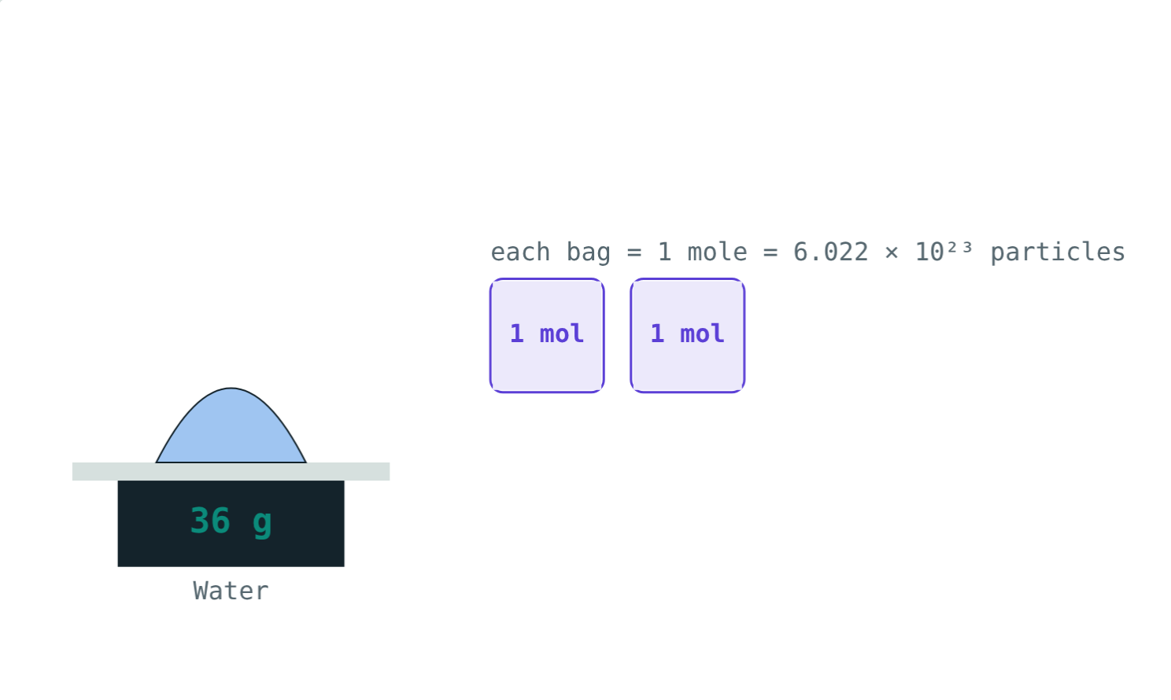
The Mole
STD 9 SCIENCE · CH. 4 MEASUREMENT OF MATTER
Lesson 3 · Visual Physics
Notes:
Goal: students can use Avogadro's number, molar mass, n = m/M and N = n × Nₐ.

Slide 2
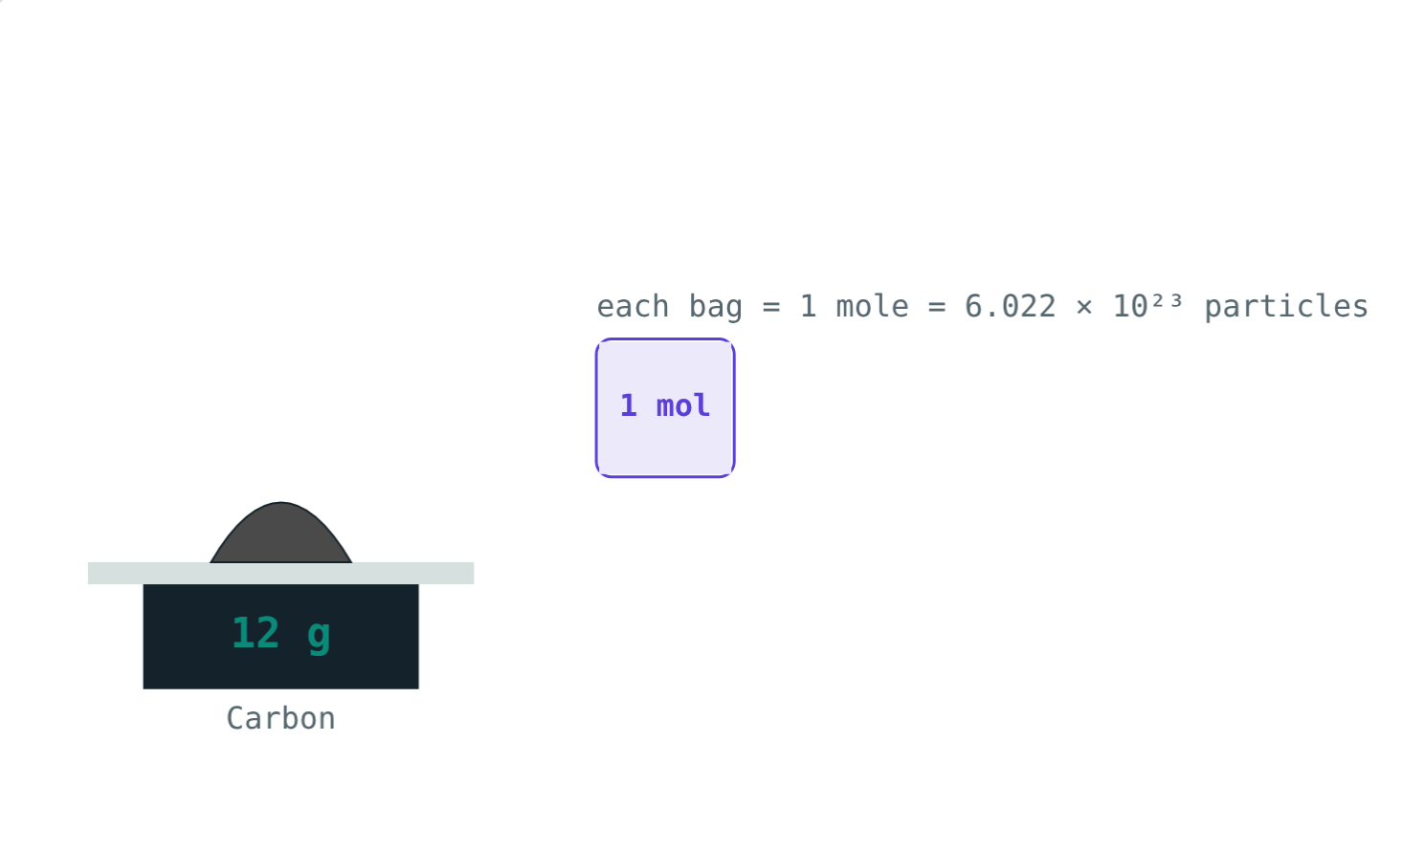
Counting by weighing
A shopkeeper counts eggs in dozens and paper in reams. Atoms are far too many to count one by one.
What counting unit do chemists use?
12 g of carbon: exactly one mole of atoms
Notes:
The mole is the chemist's dozen, just a much bigger number.

Slide 3
The mole
Nₐ = 6.022 × 10²³
1 mole = as many particles as atoms in 12 g of C-12
That number is Avogadro's number
Particles can be atoms, molecules or ions
Each bag holds one mole
Notes:
6.022 × 10²³ is about 600 000 billion billion.

Slide 4
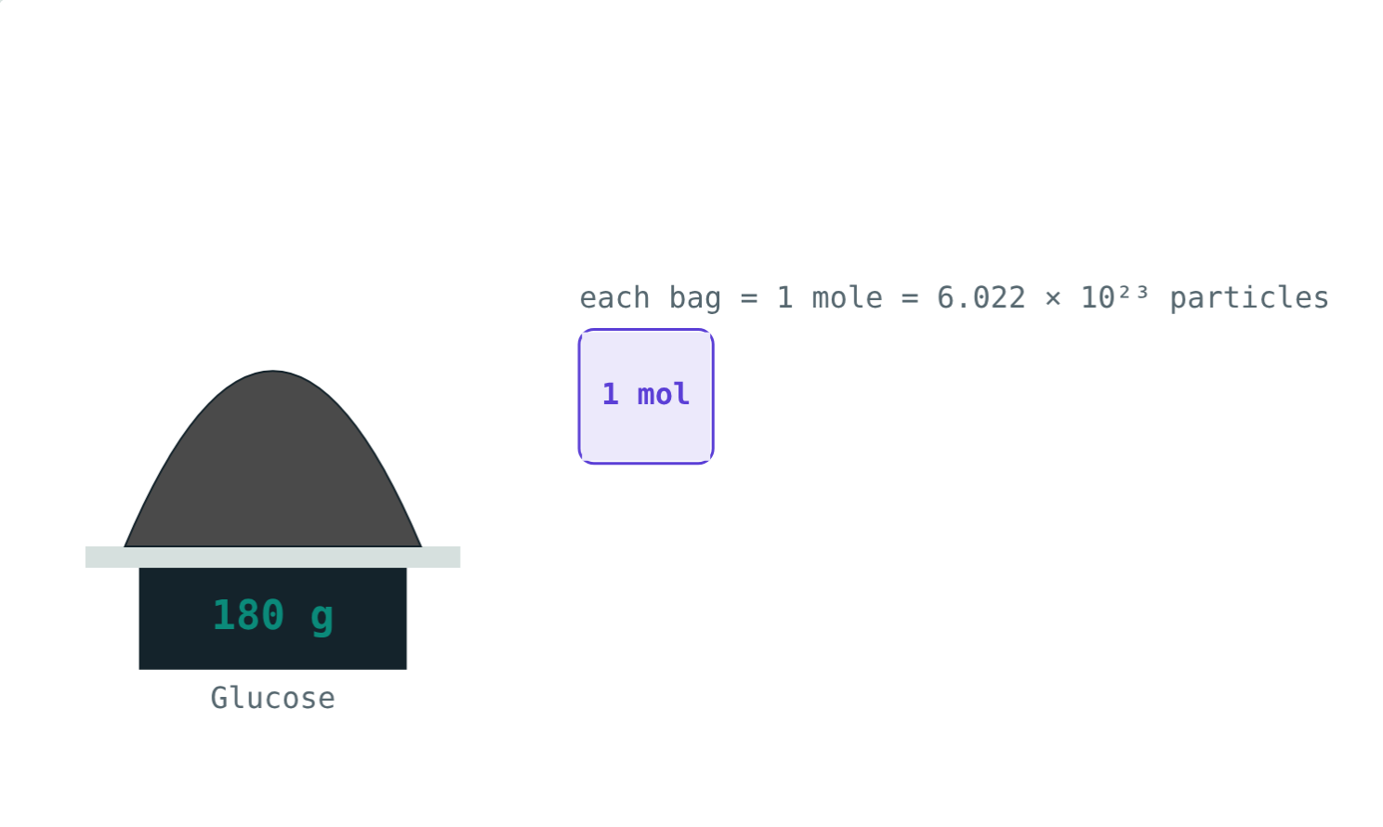
Molar mass
M in g/mol
Mass of one mole of a substance
Same number as molecular mass in u
Water: 18 u → 18 g/mol
Glucose: 180 u → 180 g/mol
180 g of glucose: still just one mole
Notes:
One mole of every substance has the same number of particles but a different mass.

Slide 5
Two formulae
n = m ÷ M
N = n × Nₐ
× atoms
Mass to moles
Moles to particles
Particles to atoms
Divide the mass in grams by the molar mass.
Multiply moles by Avogadro's number.
Multiply by the number of atoms in each molecule.
Notes:
Run these in either direction: particles → moles → mass works too.

Slide 6
Same moles, different masses
12 g = 1 mol of carbon atoms.
180 g = 1 mol of glucose molecules.
Notes:
Each glucose molecule is 15 times heavier than a carbon atom.

Slide 7
Worked example: water
How many moles and molecules are in 36 g of water?
n = 36 ÷ 18 = 2 mol
N = 2 × 6.022 × 10²³ = 1.204 × 10²⁴
36 g of water: two bags
Notes:
Each molecule has 3 atoms, so there are 3.61 × 10²⁴ atoms.

Slide 8
Worked examples
Atoms in CO₂
Particles to mass
How many molecules and atoms are in 4.4 g of CO₂?
Find the mass of 3.011 × 10²³ sodium atoms (Na = 23).
n = 4.4 ÷ 44 = 0.1 mol
Molecules = 6.022 × 10²²
Atoms = 3 × that = 1.807 × 10²³
n = 3.011 ÷ 6.022 = 0.5 mol
m = 0.5 × 23 = 11.5 g
Notes:
Keep the powers of ten in every line.

Slide 9
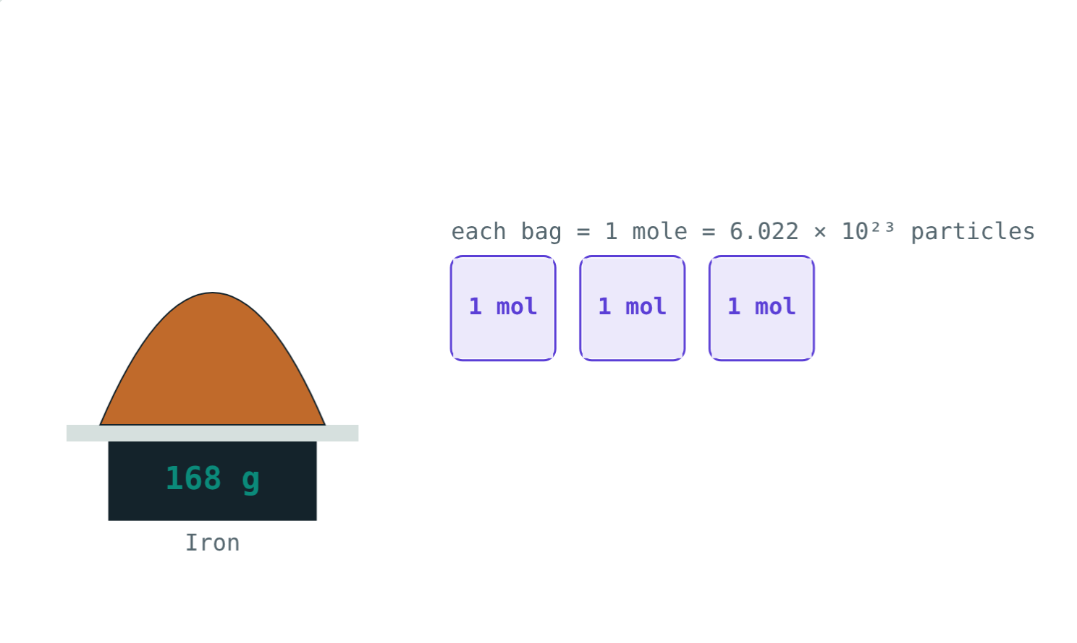
Three moles of iron
n = 168 ÷ 56:
3 mol
of iron
1.81 × 10²⁴
iron atoms
168 g of iron (Fe = 56)
3 × 6.022 × 10²³ = 1.807 × 10²⁴ atoms.
Notes:
Iron exists as single atoms, so particles and atoms are the same here.

Slide 10

Common mistakes
Multiplying by M
Molecules as atoms
Moles = mass ÷ molar mass.
Multiply by atoms per molecule.
u vs g/mol
Losing 10²³
Same number: 18 u, 18 g/mol.
Write Nₐ = 6.022 × 10²³ in full.
Notes:
Unit tracking prevents most of these.

Slide 11
Quick check
1
How many moles are in 88 g of CO₂?
2
How many particles are in one mole of any substance?
3
What is the mass of 0.5 mol of water?
4
Which has more atoms: 1 mol of water or 1 mol of carbon?
Notes:
Answers: 1) 2 mol. 2) 6.022 × 10²³. 3) 9 g. 4) 1 mol of water (3 atoms per molecule).

Slide 12
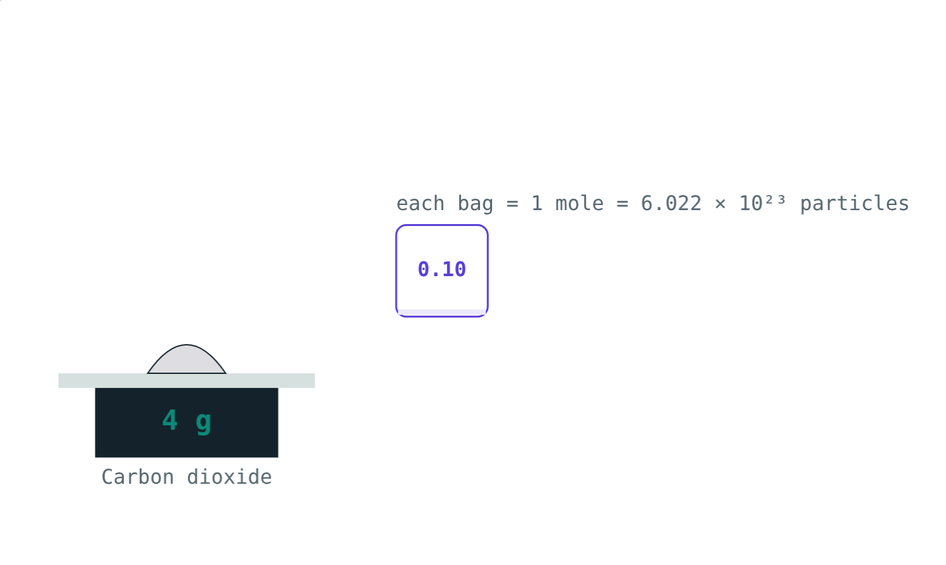
Count particles yourself
Open the Mole lesson on the Visual Physics website. Weigh out different substances and count the moles.
Next lesson: Valency and chemical formulae
Notes:
Homework idea: how many moles of sugar are in a 1 kg packet (sucrose, C₁₂H₂₂O₁₁ = 342 g/mol)? About 2.9 mol.

