Slide 1
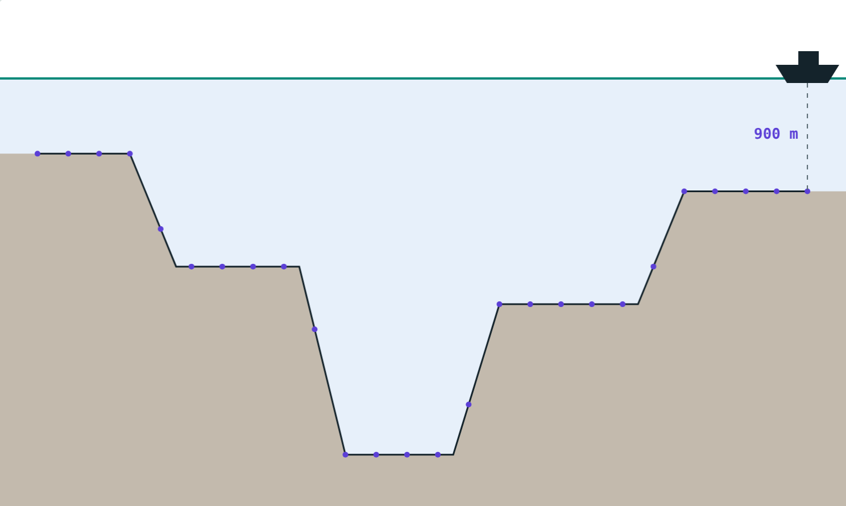
Ultrasound and SONAR
STD 9 SCIENCE · CH. 12 STUDY OF SOUND
Lesson 4 · Visual Physics
Notes:
Goal: students know the audible range, infrasound and ultrasound, and can calculate depths with SONAR.

Slide 2
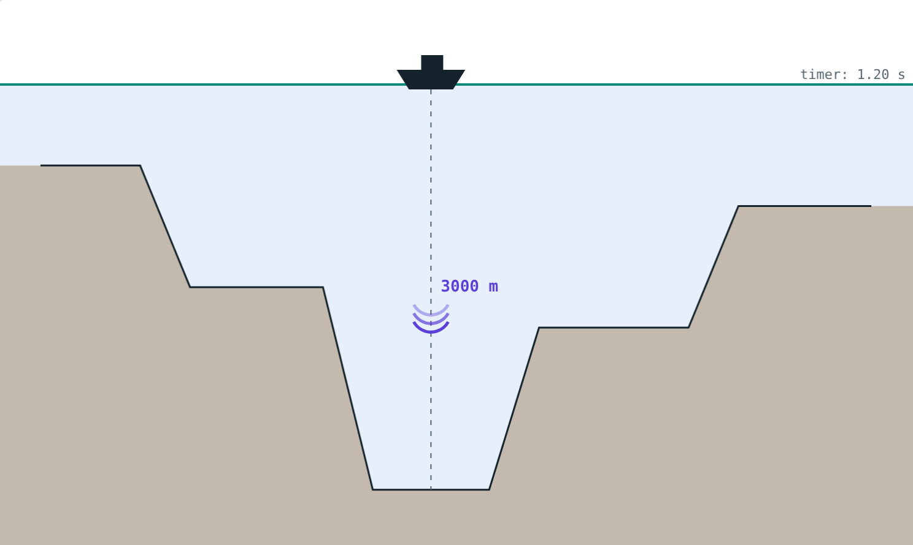
Seeing with sound
Bats hunt moths in the dark. Ships measure oceans thousands of metres deep.
How can sound show where things are?
A pulse heading for the sea bed
Notes:
Both rely on timing echoes of sounds too high for us to hear.

Slide 3
Three ranges of sound
Range | Frequency | Examples
Infrasound | below 20 Hz | Earthquakes, whales, elephants
Audible | 20 Hz to 20 kHz | Speech, music
Ultrasound | above 20 kHz | Bats, dolphins, dog whistles
Notes:
Our upper limit falls as we grow older.

Slide 4
Why ultrasound?
Very short wavelength
Travels in a narrow beam
Reflects well even from small objects
Echoes reveal position and shape
About 50 kHz pulses
Notes:
Audible sound spreads out too much to locate small objects.

Slide 5
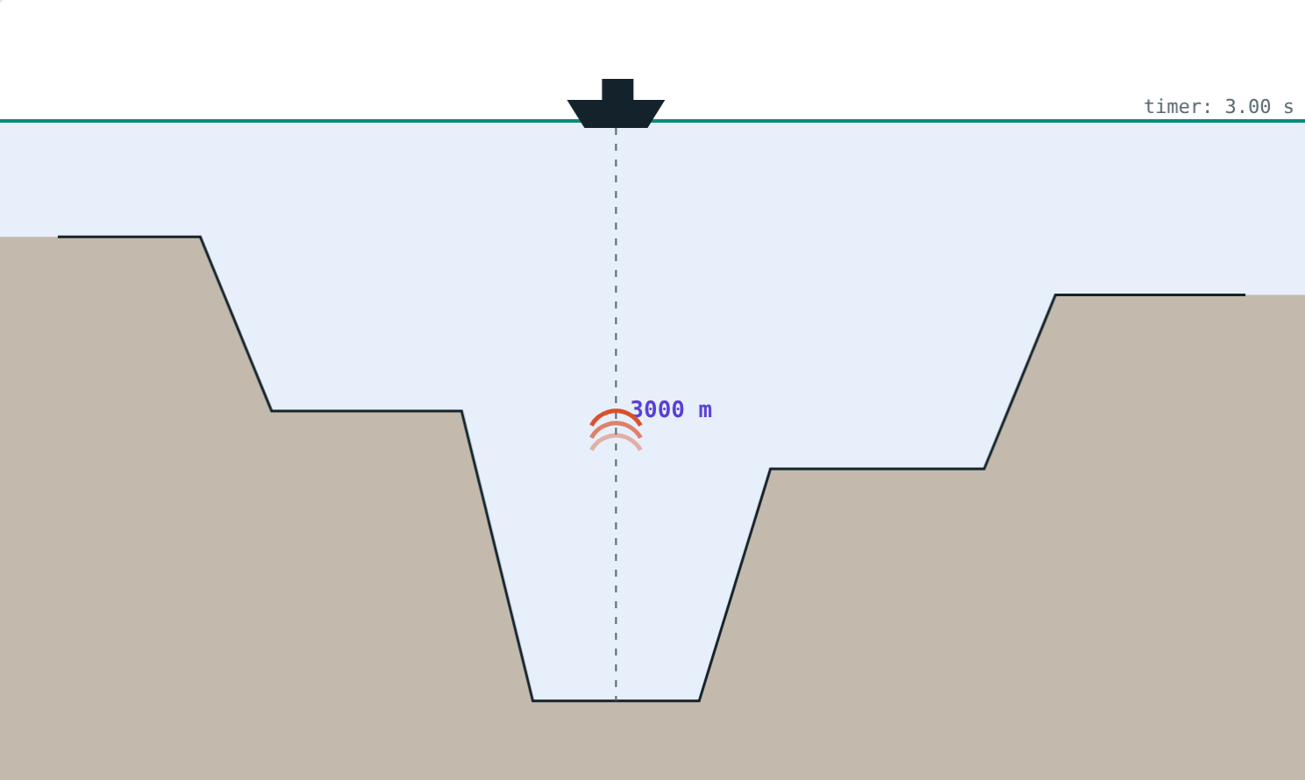
SONAR
depth = v × t ÷ 2
SOund Navigation And Ranging
Transmitter sends a pulse; receiver catches the echo
Sound in sea water: about 1500 m/s
Echo from 3000 m returns after 4 s
Notes:
Again divide by 2: down and back.

Slide 6
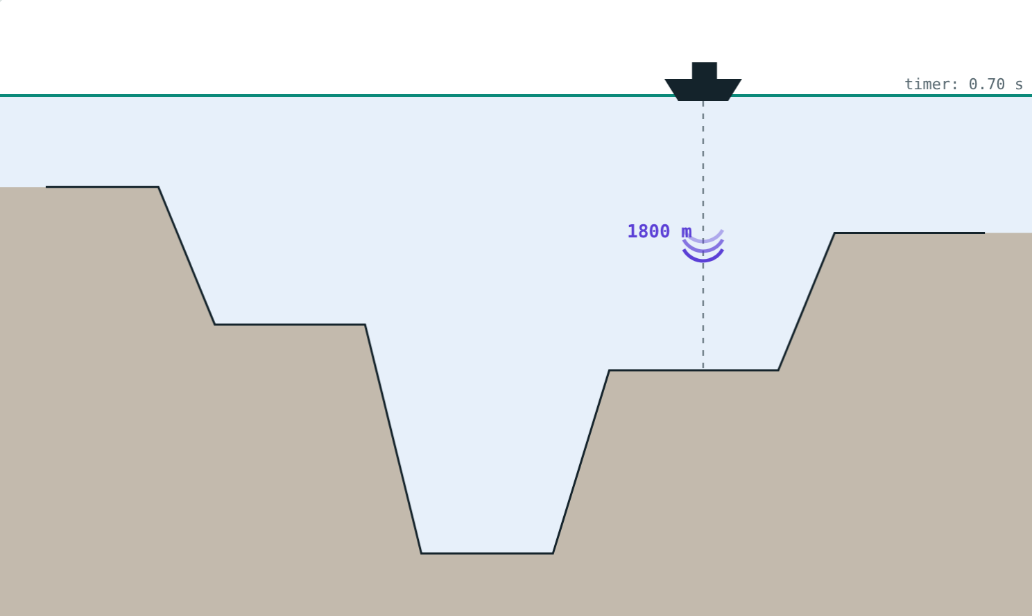
Mapping the sea bed
1800 m: echo after 2.4 s.
A dot for each echo traces the sea bed.
Notes:
Modern ships send fans of beams to map a strip at a time.

Slide 7




Uses of ultrasound
SONAR
Sonography
Heart scans
Industry
Sea depth, wrecks, submarines, shoals of fish.
Pictures of organs and unborn babies, no radiation.
Echocardiography shows the heart beating.
Finds cracks in metal; cleans small parts.
Notes:
Bats and dolphins use the same principle, called echolocation.

Slide 8
Worked example: how deep?
A SONAR echo returns after 4 s. Sound travels at 1500 m/s in sea water. Find the depth.
Total distance = 1500 × 4 = 6000 m
Depth = 6000 ÷ 2 = 3000 m
Echo after 4 s
Notes:
Remind students that the speed in sea water depends on temperature and saltiness.

Slide 9
Worked examples
Predicting the echo
A bat's squeak
The sea is 1800 m deep (v = 1500 m/s). When does the echo return?
A bat squeaks at 50 000 Hz in air (340 m/s). Find λ. Can we hear it?
t = 2 × 1800 ÷ 1500 = 2.4 s
λ = 340 ÷ 50 000 = 6.8 mm
Above 20 kHz: ultrasound
Notes:
A wavelength of a few millimetres lets the bat detect a moth.

Slide 10

Common mistakes
Depth = v × t
“Ultrasound is loud”
Divide by 2: down and back.
It means high frequency, not loudness.
340 m/s under water
Infra vs ultra
Use about 1500 m/s in the sea.
Infra: below 20 Hz. Ultra: above 20 kHz.
Notes:
Ask which of these uses students have seen.

Slide 11
Quick check
1
What is the audible range of a healthy young person?
2
A SONAR echo returns after 2 s (v = 1500 m/s). How deep is the sea?
3
Name an animal that produces infrasound.
4
Why is ultrasound used to look inside the body?
Notes:
Answers: 1) About 20 Hz to 20 000 Hz. 2) 1500 m. 3) Elephant (or whale). 4) Its short wavelength gives detailed echoes, and it uses no harmful radiation.

Slide 12
Map the ocean yourself
Open the Ultrasound and SONAR lesson on the Visual Physics website. Move the ship and time the echoes.
That completes Chapter 12: Study of Sound
Notes:
Research idea: how do bats avoid confusing their echoes with those of other bats?

