Slide 1
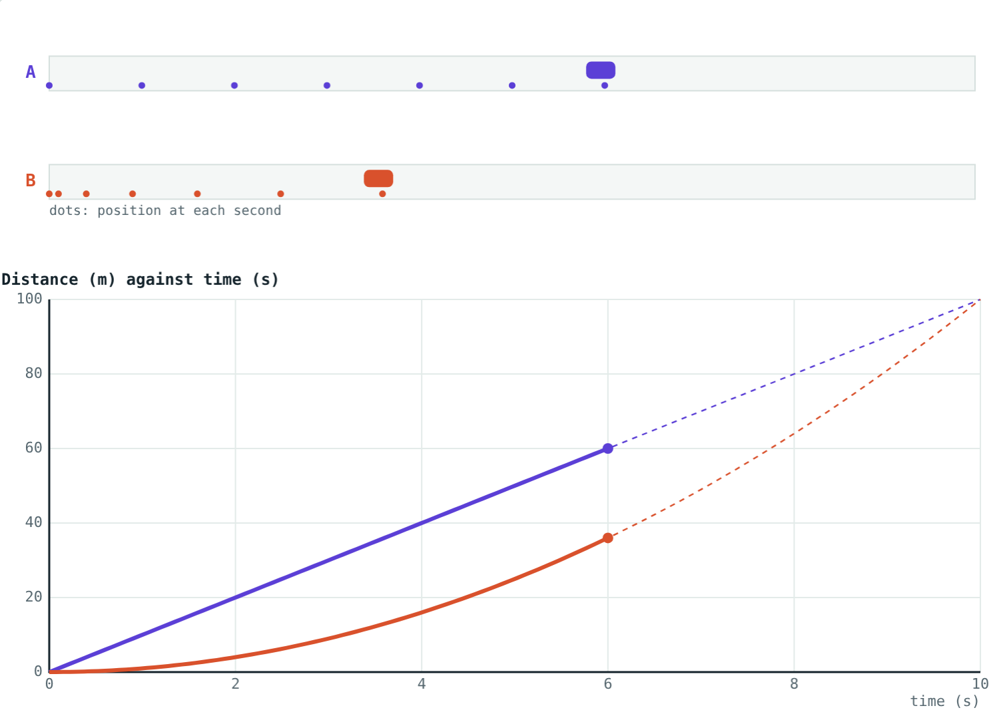
Uniform and Non-uniform Motion
STD 9 SCIENCE · CH. 1 LAWS OF MOTION
Lesson 3 · Visual Physics
Notes:
Goal: students can tell uniform from non-uniform motion using equal time intervals, and recognise each on a distance–time graph.

Slide 2
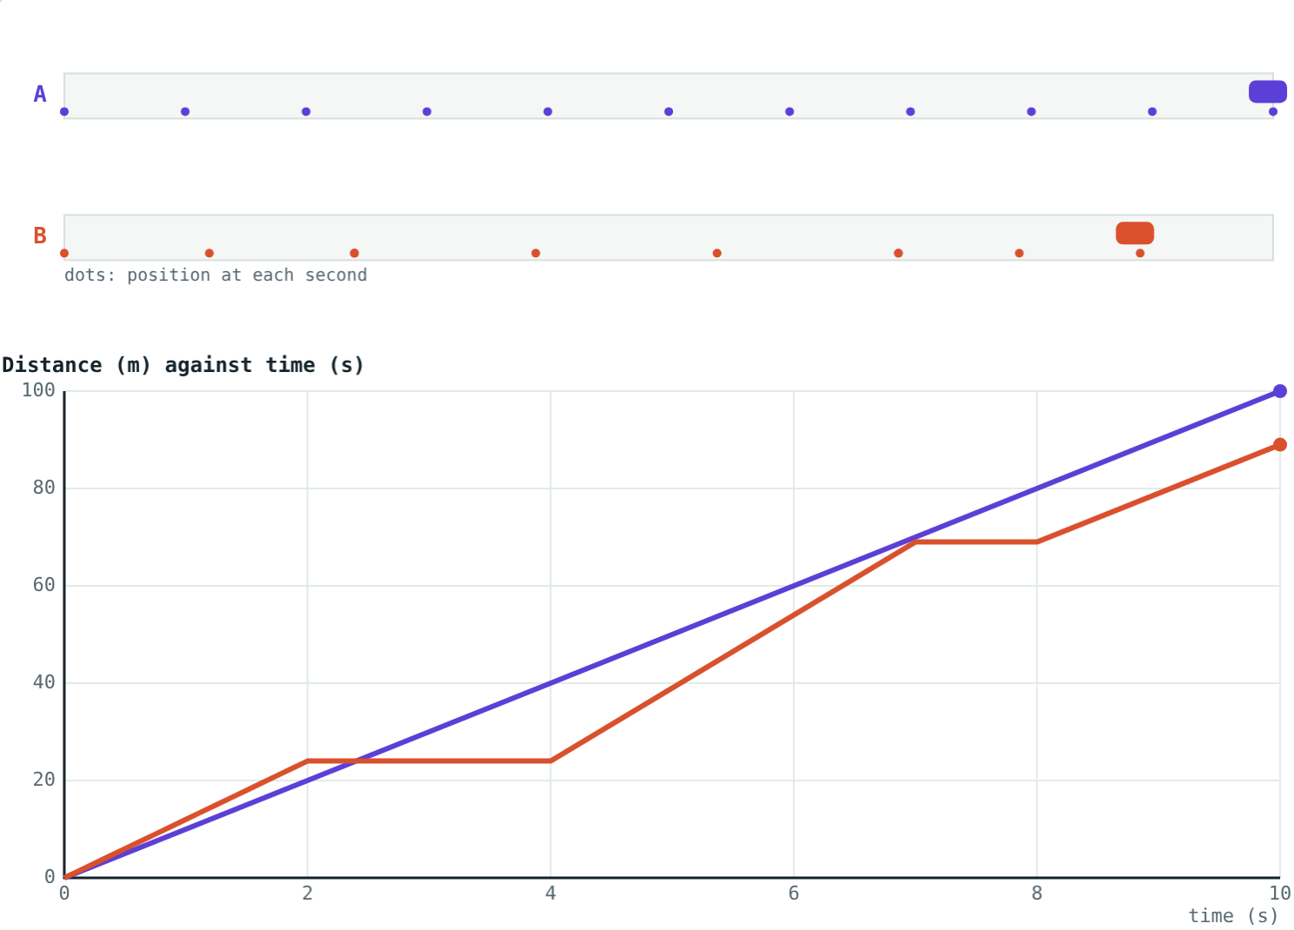
Highway or traffic?
Car A cruises along an empty highway. Car B is stuck in city traffic: it moves, stops, then moves again.
Which car covers the same distance every second?
Dots show each car's position at every second
Notes:
Let students describe the dots before naming anything. Car A's dots are evenly spaced; car B's are not, and two of them sit on top of each other where B stopped.

Slide 3
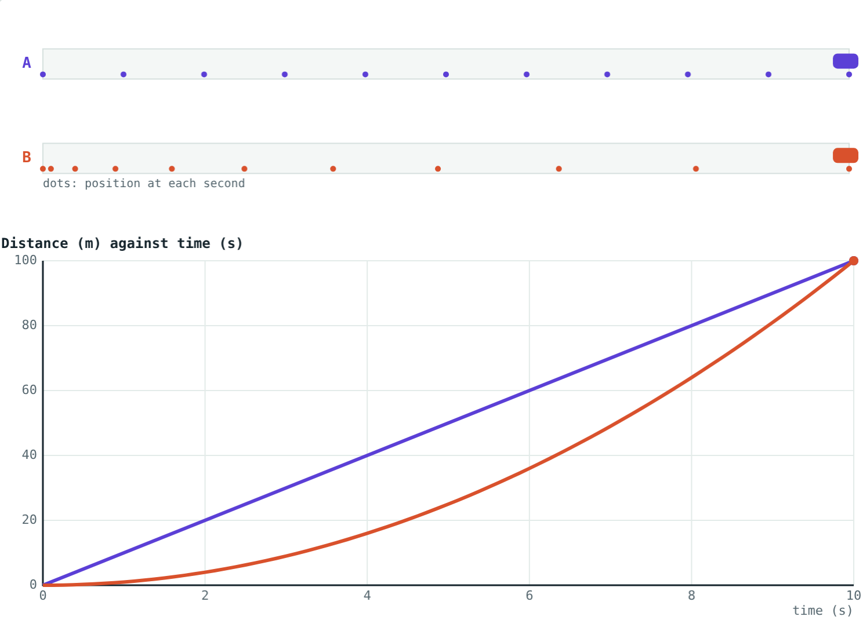
Uniform motion
Equal distances in equal intervals of time.
The speed does not change
Dots at each second are evenly spaced
Along a straight line: uniform linear motion
Distance–time graph: a straight line
Car A (violet) adds 10 m every second
Notes:
Stress 'equal intervals of time, however small'. A car that covers 60 m in each minute but varies within the minute is not strictly uniform.

Slide 4
Non-uniform motion
Unequal distances in equal intervals of time.
The speed keeps changing
Gaps between the dots change
Speeding up, slowing down or stopping
Distance–time graph: a curve or a bent line
In traffic, car B (coral) moves, stops and moves again
Notes:
Ask for everyday examples: an auto-rickshaw in traffic, a train leaving a station, a ball rolling to a stop.

Slide 5



How to spot it
Equal gaps
Changing gaps
Graph shape
Same distance in every second: uniform motion.
Different distances in equal times: non-uniform motion.
A straight distance–time line means uniform. A curve means non-uniform.
Notes:
Three quick tests students can apply to any table, picture or graph.

Slide 6
Read the table
Time (s) | 0 | 1 | 2 | 3 | 4 | 5
Car P (m) | 0 | 15 | 30 | 45 | 60 | 75
Car Q (m) | 0 | 5 | 15 | 30 | 50 | 75
Notes:
Ask students to find the distance covered in each second for both cars. P: 15, 15, 15, 15, 15 (uniform). Q: 5, 10, 15, 20, 25 (non-uniform). Both reach 75 m in 5 s.

Slide 7
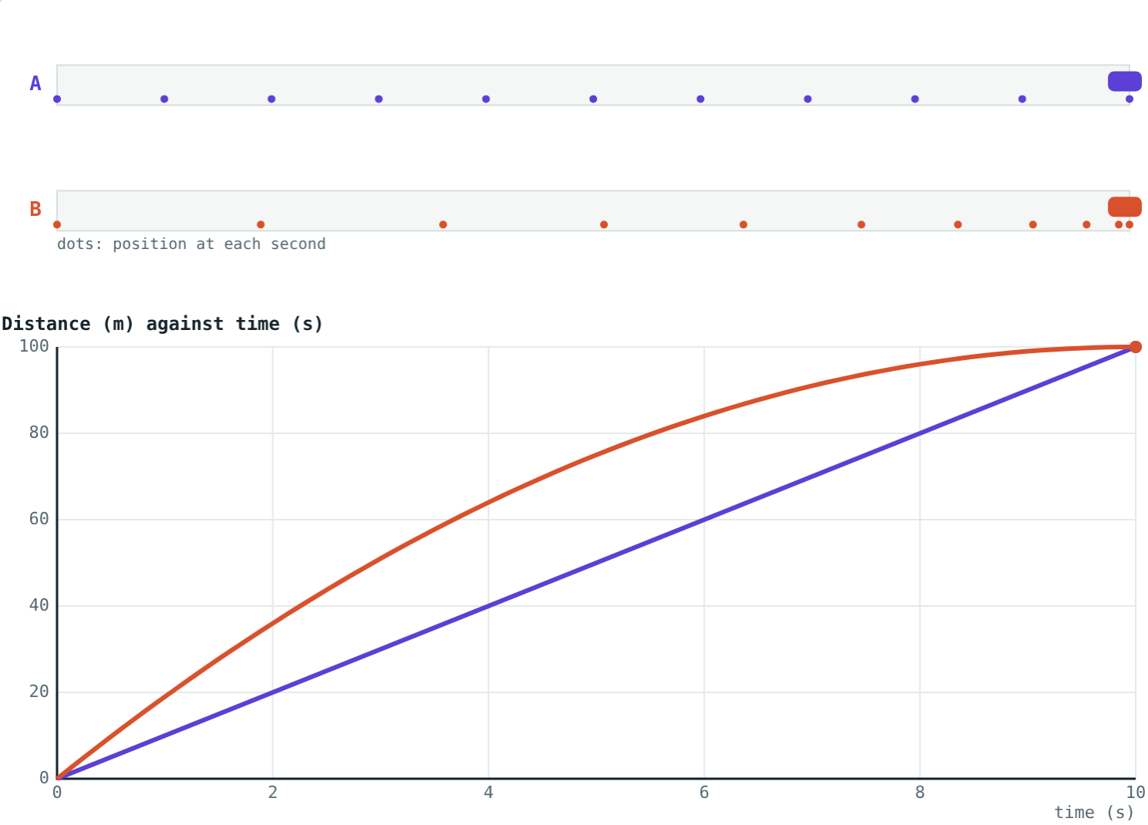
Same distance, different motion
Car B speeds up and also reaches 100 m at 10 s.
Car B starts fast and brakes, again reaching 100 m at 10 s.
Car A (violet) and car B end in the same place at the same time, but only car A moved uniformly.
Notes:
The totals match in both pictures, yet the dot patterns and graph shapes are completely different. Totals alone cannot tell you whether motion was uniform.

Slide 8
Worked examples
An express train
Car Q from the table
A train covers 25 m in every second for 2 minutes. Is its motion uniform? Find its speed and the distance travelled.
Find car Q's average speed over 5 s, and the distance it covers in its first and last seconds.
Equal distances in equal times: uniform
Speed = 25 m ÷ 1 s = 25 m/s
Distance = 25 × 120 = 3000 m
Average speed = 75 ÷ 5 = 15 m/s
First second: 5 − 0 = 5 m
Last second: 75 − 50 = 25 m
Notes:
Example 2 shows why an average speed can hide non-uniform motion: Q's speed went from about 5 m/s to about 25 m/s.

Slide 9
An average can hide the detail
Car B covers 89 m in 10 s, but not steadily:
8.9 m/s
average speed
0 m
in seconds 3 and 4
Two seconds standing still and seconds of 15 m each average out to 8.9 m/s.
Car B in heavy traffic
Notes:
Car B's speeds second by second: 12, 12, 0, 0, 15, 15, 15, 0, 10, 10 m/s. Total 89 m.

Slide 10

Common mistakes
Judging by the total only
“Uniform means fast”
Two cars can cover the same total in the same time. Check each equal interval.
A tortoise at a steady 0.1 m/s is in uniform motion. Uniform means unchanging.
Ignoring stops
A stop is part of the motion. Stopping at a signal makes the motion non-uniform.
Notes:
Most errors come from looking only at the final distance and time.

Slide 11
Quick check
1
A cyclist covers 4 m in each of four seconds. Is her motion uniform?
2
Give one example of non-uniform motion from your journey to school.
3
What shape is the distance–time graph for uniform motion?
4
Two runners each finish 100 m in 20 s. Must both have run uniformly?
Notes:
Answers: 1) Yes, equal distances in equal times. 2) Any stop-start example: bus, traffic, walking up stairs. 3) A straight line. 4) No; equal average speeds say nothing about how the speed changed.

Slide 12
Race the cars yourself
Open the Uniform and Non-uniform Motion lesson on the Visual Physics website. Change car B's motion and watch the dots and the graph.
Next lesson: Acceleration
Notes:
Homework idea: record the distance a friend walks every 5 seconds, once walking steadily and once speeding up. Plot both.

