Slide 1
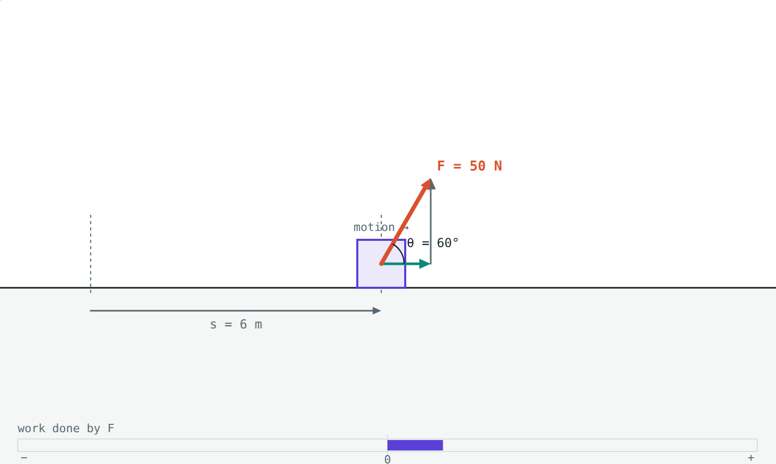
Work
STD 9 SCIENCE · CH. 2 WORK AND ENERGY
Lesson 1 · Visual Physics
Notes:
Goal: students know when work is done, calculate W = Fs and W = Fs cos θ, use the joule, and classify positive, negative and zero work.

Slide 2
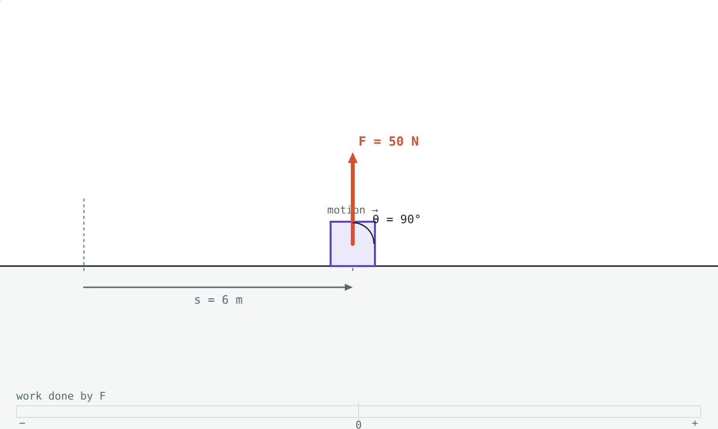
Did you do any work?
You hold a heavy bag still for an hour. Your arms ache and you feel tired.
Did you do any work on the bag?
A force at right angles to the motion does no work
Notes:
Let students argue. The physics answer is no: the bag did not move, so no work was done on it. Everyday 'work' and scientific work are different.

Slide 3
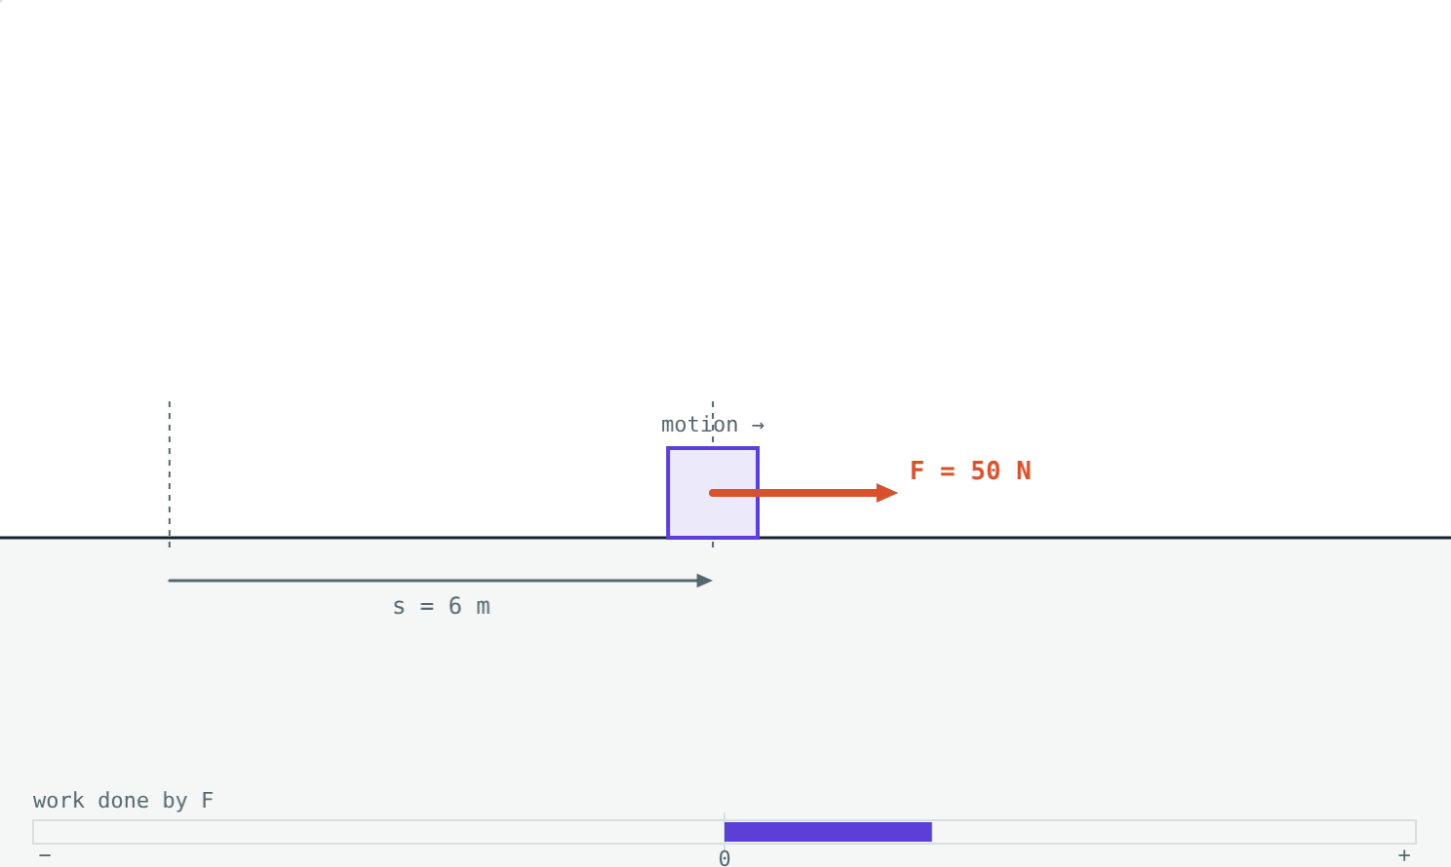
What counts as work
W = F × s
Work is done when a force causes displacement.
Needs a force and movement caused by it
Unit: joule (J) = 1 N × 1 m
Pushing a wall that does not move: zero work
50 N along the motion for 6 m: W = 300 J
Notes:
1 joule: a force of 1 N moving an object 1 m in the direction of the force. Lifting an apple (about 1 N) by 1 m takes about 1 J.

Slide 4
A force at an angle
W = F s cos θ
Only F cos θ, the part along the motion, does work
cos 0° = 1, cos 60° = 0.5
cos 90° = 0, cos 180° = −1
At 60°, only 25 N of the 50 N force moves the box
Notes:
The dashed teal arrow in the picture is F cos θ. The grey dashed arrow is the part at right angles, which does no work.

Slide 5
Positive, negative and zero work
+
−
0
Positive (θ = 0°)
Negative (θ = 180°)
Zero (θ = 90°)
Force along the motion: pulling a trolley, gravity on a falling ball.
Force against the motion: friction, brakes, gravity on a ball thrown up.
Force at right angles to the motion, or no motion at all.
Notes:
Ask for more examples of each. Carrying a bag on level ground is the classic zero-work example.

Slide 6
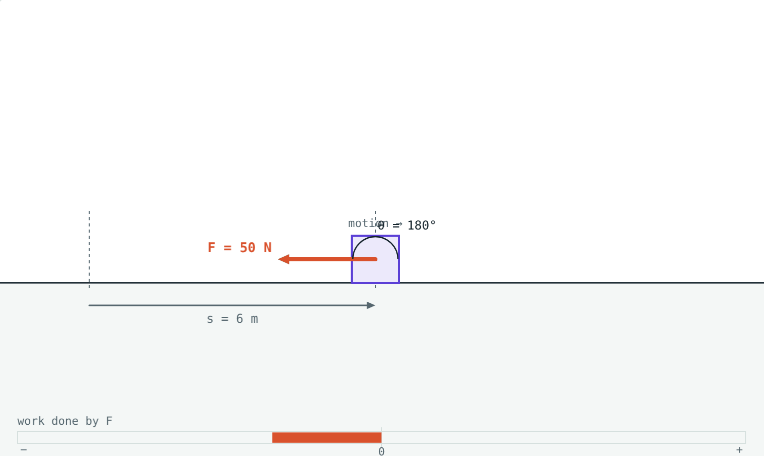
Same force, opposite work
50 N along the motion over 6 m: +300 J.
50 N against the motion over 6 m: −300 J.
The sign tells you whether the force helps or opposes the motion.
Notes:
Negative work removes energy from the moving object, which is why brakes slow a bicycle.

Slide 7
Worked examples
Pushing a handcart
Pulling a suitcase
A vendor pushes a handcart with 60 N, moving it 5 m in the direction of the push. Find the work done.
A 100 N pull along a handle at 60° to the floor moves a suitcase 10 m. Find the work done.
W = 60 × 5 = 300 J
W = 100 × 10 × cos 60°
= 100 × 10 × 0.5 = 500 J
Notes:
In the second example, half of the force is wasted pulling upward.

Slide 8
Worked example: lifting a bag
A student lifts a 5 kg bag onto a table 0.8 m high at a steady speed. Find the work done by the student and by gravity. (g = 9.8 m/s²)
Force = mg = 5 × 9.8 = 49 N
Work by student = 49 × 0.8 = 39.2 J
Work by gravity = −39.2 J
Gravity acts down while the bag moves up: negative work
Notes:
The two works add to zero because the bag's speed did not change.

Slide 9
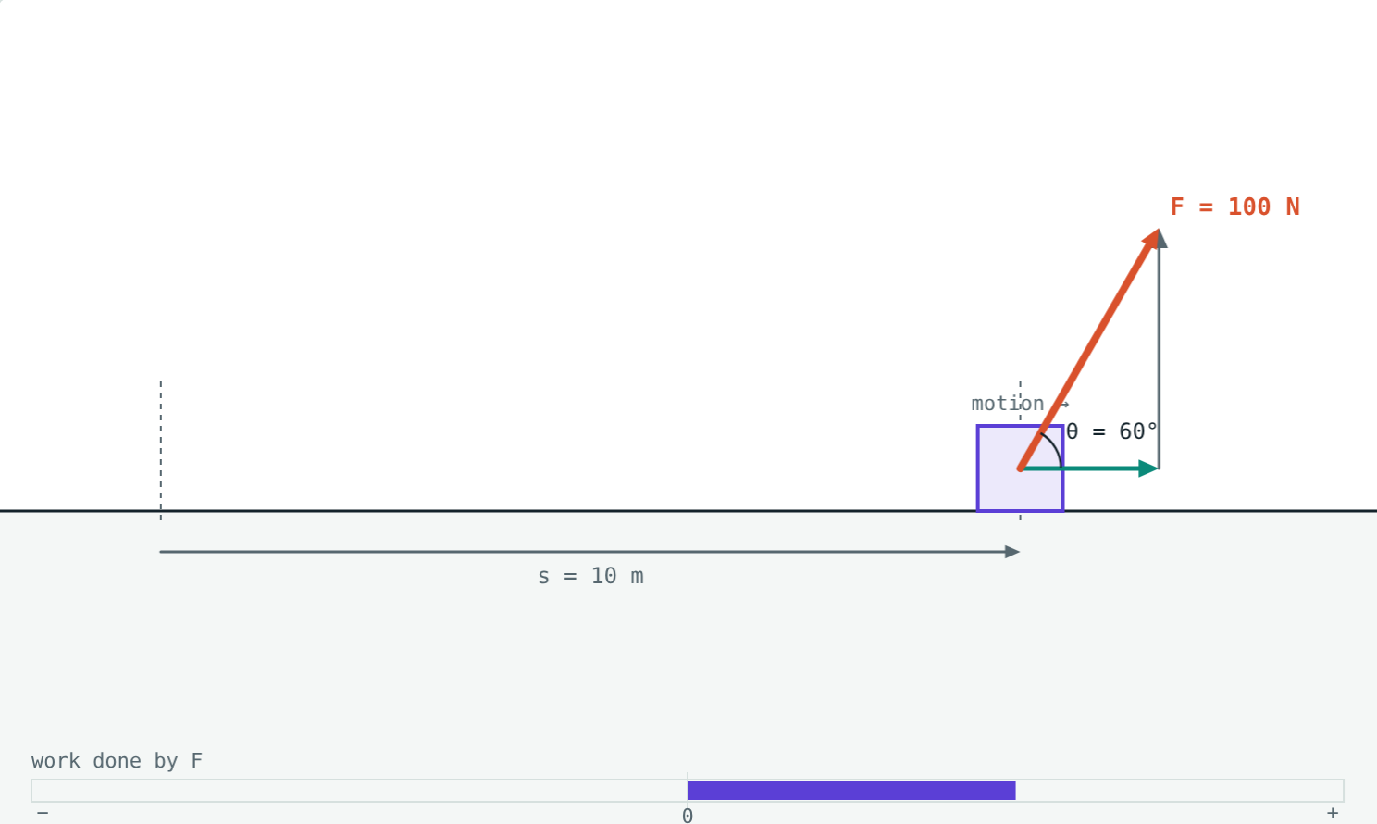
Pulling at an angle
Of the 100 N pull:
50 N
along the motion
500 J
work done
100 N at 60° over 10 m
Pulling closer to the direction of motion wastes less of your force.
Notes:
The other 86.6 N acts at right angles and only lifts the suitcase slightly off the floor.

Slide 10

Common mistakes
“Tired means work”
Whole force at an angle
No displacement, no work, however tiring it feels.
Only F cos θ does work.
Dropping the sign
Mass instead of weight
Forces against the motion do negative work.
Lifting needs a force of mg newtons.
Notes:
The weight mistake is common: students multiply kg by metres and call it joules.

Slide 11
Quick check
1
Is any work done when you push hard on a wall that does not move?
2
A force of 20 N moves a crate 3 m in its own direction. Find the work done.
3
A coolie walks 50 m on level ground with a load on his head. What work does his upward force do?
4
What kind of work does friction do on a sliding box?
Notes:
Answers: 1) No; there is no displacement. 2) 60 J. 3) Zero; the force is at 90° to the motion. 4) Negative work.

Slide 12
Move the box yourself
Open the Work lesson on the Visual Physics website. Change the force, the angle and the distance, and watch the work bar.
Next lesson: Kinetic and potential energy
Notes:
Homework idea: list five everyday actions and decide whether each involves positive, negative or zero work.

