Slide 1
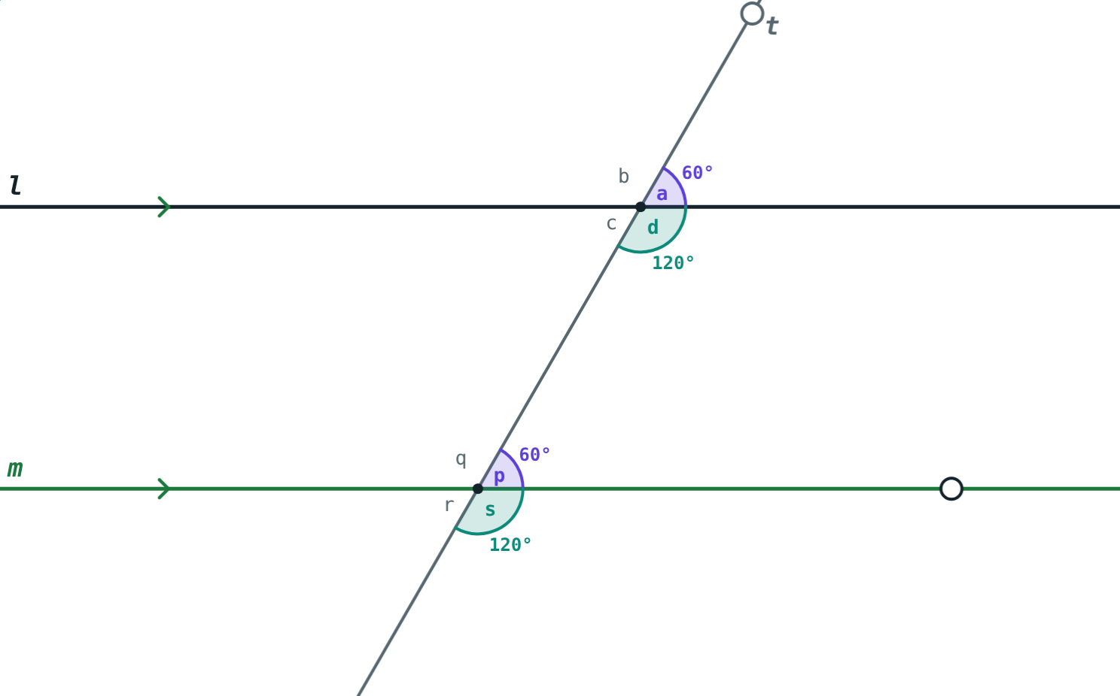
Angles Made by a Transversal
STD 9 MATHEMATICS PART II · CH. 2 PARALLEL LINES
Lesson 1 · Visual Science & Maths
Notes:
Goal: students can name the pairs of angles made by a transversal and use the properties of parallel lines to find angles.

Slide 2
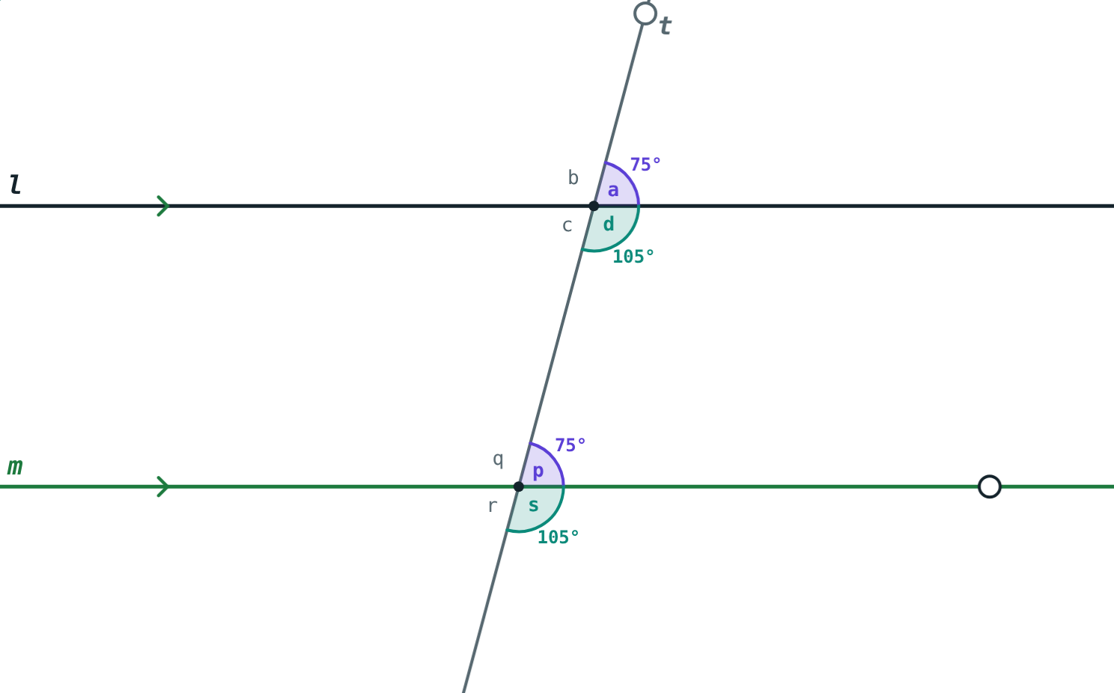
Rails and a crossing road
A straight road crosses two railway lines. It makes four angles at each rail.
If we know one angle, how many of the eight can we find?
One angle gives all eight
Notes:
Answer: all eight, if the rails are parallel.

Slide 3
A transversal
Cuts two lines in two distinct points
Four angles at each point: eight in all
∠c, ∠d, ∠p, ∠q lie between the lines: interior angles
Transversal t cuts l and m
Notes:
Parallel lines: lines in one plane that do not intersect.

Slide 4
Pairs of angles
Pair | Where | Examples
Corresponding | Same position at the two points | ∠a, ∠p · ∠d, ∠s
Alternate interior | Between the lines, opposite sides of t | ∠c, ∠p · ∠d, ∠q
Alternate exterior | Outside the lines, opposite sides of t | ∠a, ∠r · ∠b, ∠s
Interior, same side | Between the lines, same side of t | ∠d, ∠p · ∠c, ∠q
Notes:
Use the letters of the simulation figure: a b c d at l, p q r s at m.

Slide 5
Properties of parallel lines
180°
=
=
Interior angles
Corresponding
Alternate
Interior angles on the same side are supplementary.
Corresponding angles are of equal measure.
Alternate angles are of equal measure.
Notes:
Proof idea: ∠a + ∠d = 180° (linear pair) and ∠d + ∠p = 180° (interior angles), so ∠a = ∠p. Then ∠c = ∠a (vertically opposite), so ∠c = ∠p.

Slide 6
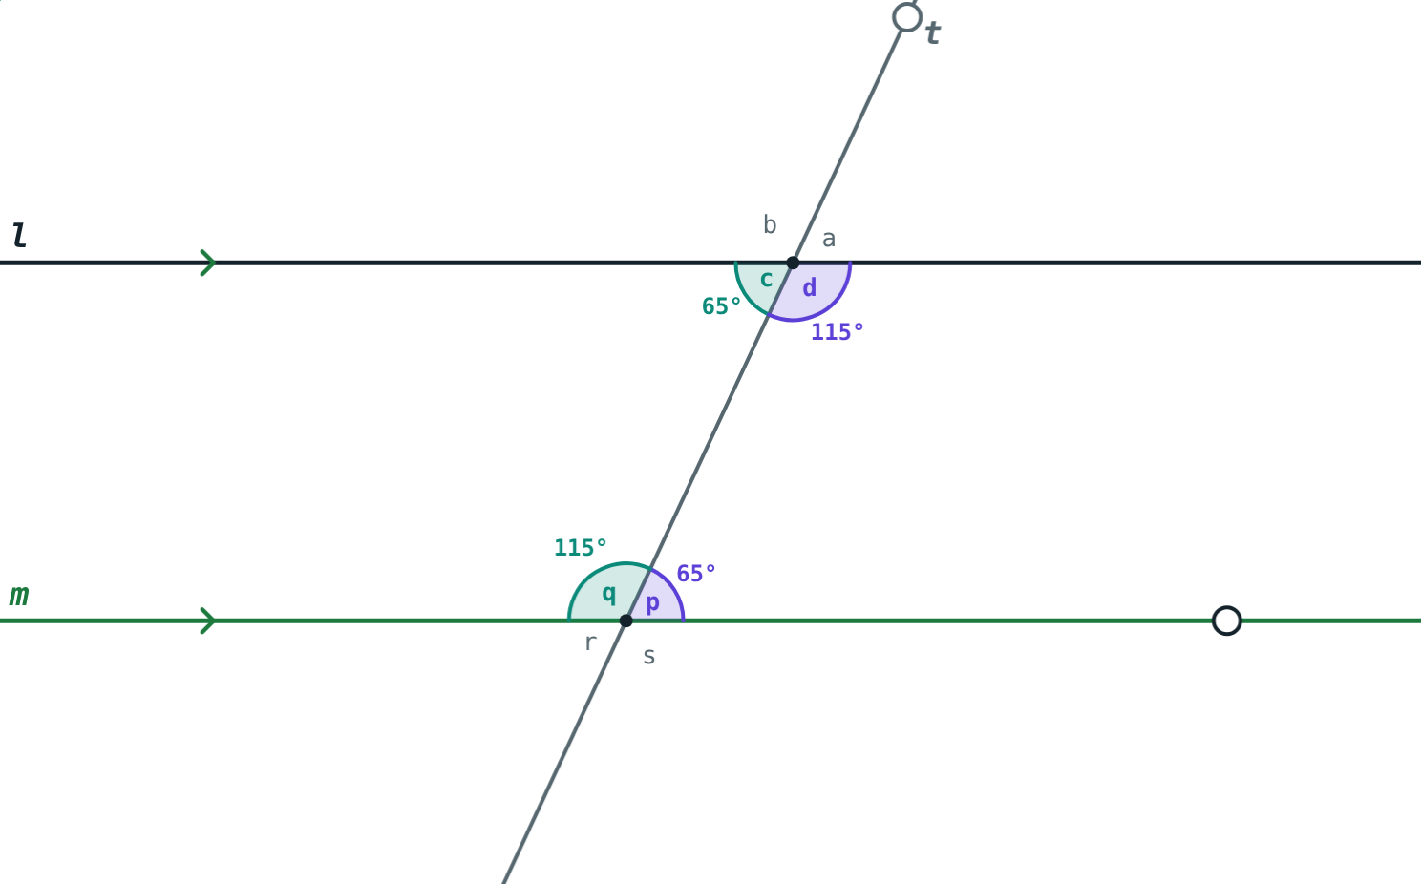
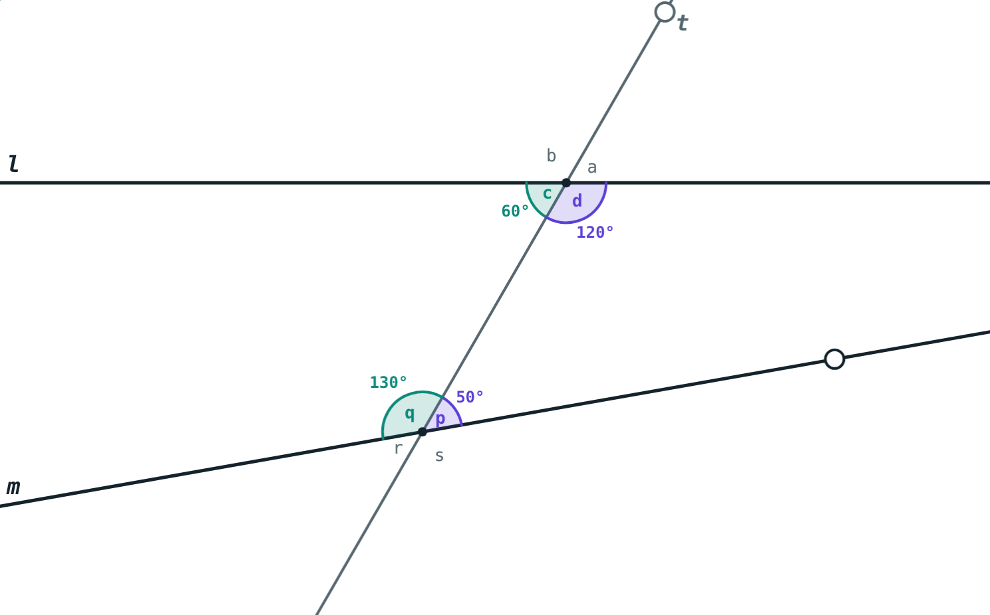
Only when l ∥ m
l ∥ m: interior angles 115° + 65° = 180°.
m turned 10°: 120° + 50° = 170°, lines meet.
Notes:
If interior angles on one side add up to less than 180°, the lines meet on that side (Euclid’s postulate).

Slide 7
Worked examples
All from one
Interior with x
l ∥ m and ∠a = 75°. Find the other angles.
∠d = (3x + 10)°, ∠p = (2x + 20)°, l ∥ m.
∠b = 180° − 75° = 105°
∠c = ∠p = ∠r = 75°
∠d = ∠q = ∠s = 105°
5x + 30 = 180, x = 30
∠d = 100°, ∠p = 80°
Notes:
Name the property used for each angle.

Slide 8
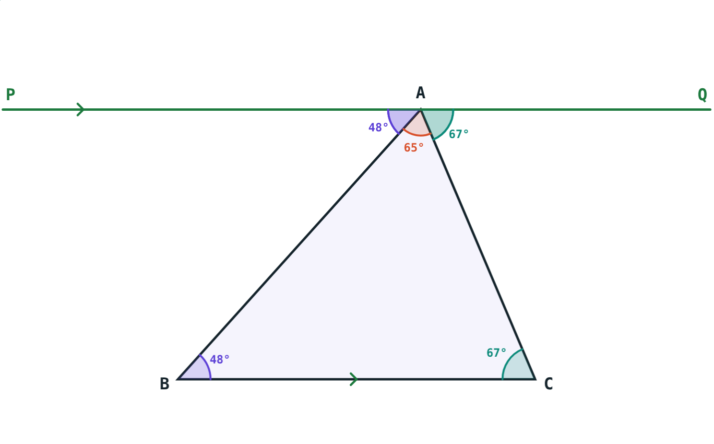
Worked example: the angle sum
In △ABC, ∠B = 48° and ∠C = 67°. PQ through A is parallel to BC. Find ∠PAB, ∠QAC and ∠BAC.
∠PAB = 48°, ∠QAC = 67° (alternate)
∠BAC = 180° − 48° − 67° = 65°
PQ ∥ BC through A
Notes:
The three angles at A make a straight angle, so ∠A + ∠B + ∠C = 180°.

Slide 9
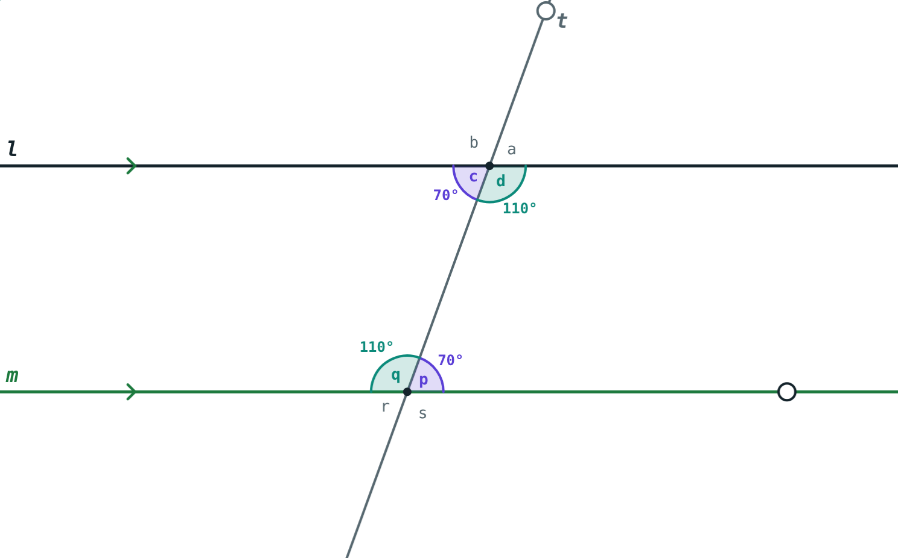
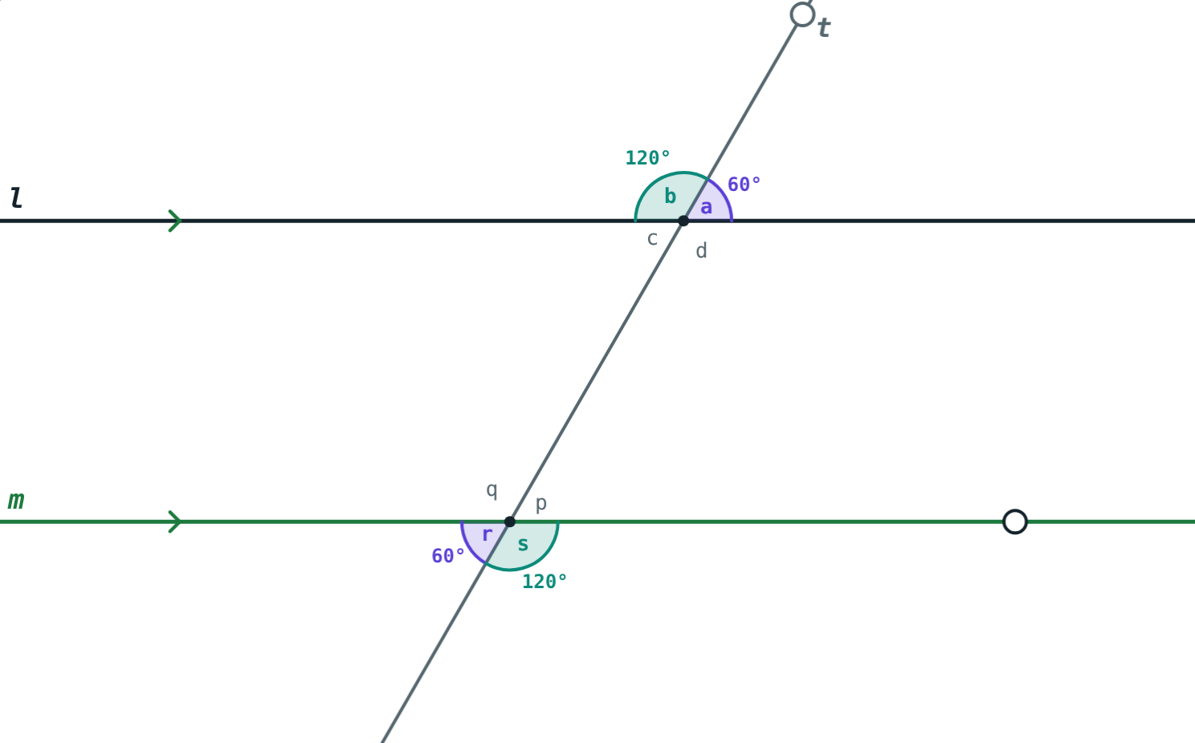
Alternate pairs
Alternate interior: ∠c = ∠p = 70°.
Alternate exterior: ∠a = ∠r = 60°.
Notes:
A line perpendicular to one of two parallel lines is perpendicular to the other too.

Slide 10

Common mistakes
Any two lines
“Interior angles are equal”
The properties hold only when l ∥ m.
They add up to 180°.
Mixing up pairs
Wrong angle
Corresponding: same position; alternate: opposite sides.
Name each angle before using a property.
Notes:
Draw a non-parallel pair on the board to show the properties failing.

Slide 11
Quick check
1
l ∥ m. One corresponding angle is 112°. Find the other.
2
l ∥ m. One interior angle is 75°. Find the interior angle on the same side.
3
In the figure, which pair is alternate interior: ∠a, ∠p or ∠c, ∠p?
4
In △ABC, ∠C = 75° and PQ through A is parallel to BC. Find ∠QAC.
Notes:
Answers: 1) 112°. 2) 105°. 3) ∠c and ∠p. 4) 75° (alternate angles).

Slide 12
Turn the lines yourself
Open the Angles Made by a Transversal lesson on the Visual Science & Maths website. Drag the transversal and turn line m to see when the properties hold.
Next lesson: Tests for parallel lines
Notes:
Homework: l ∥ m and ∠b = 128°. Find all eight angles.

