Slide 1
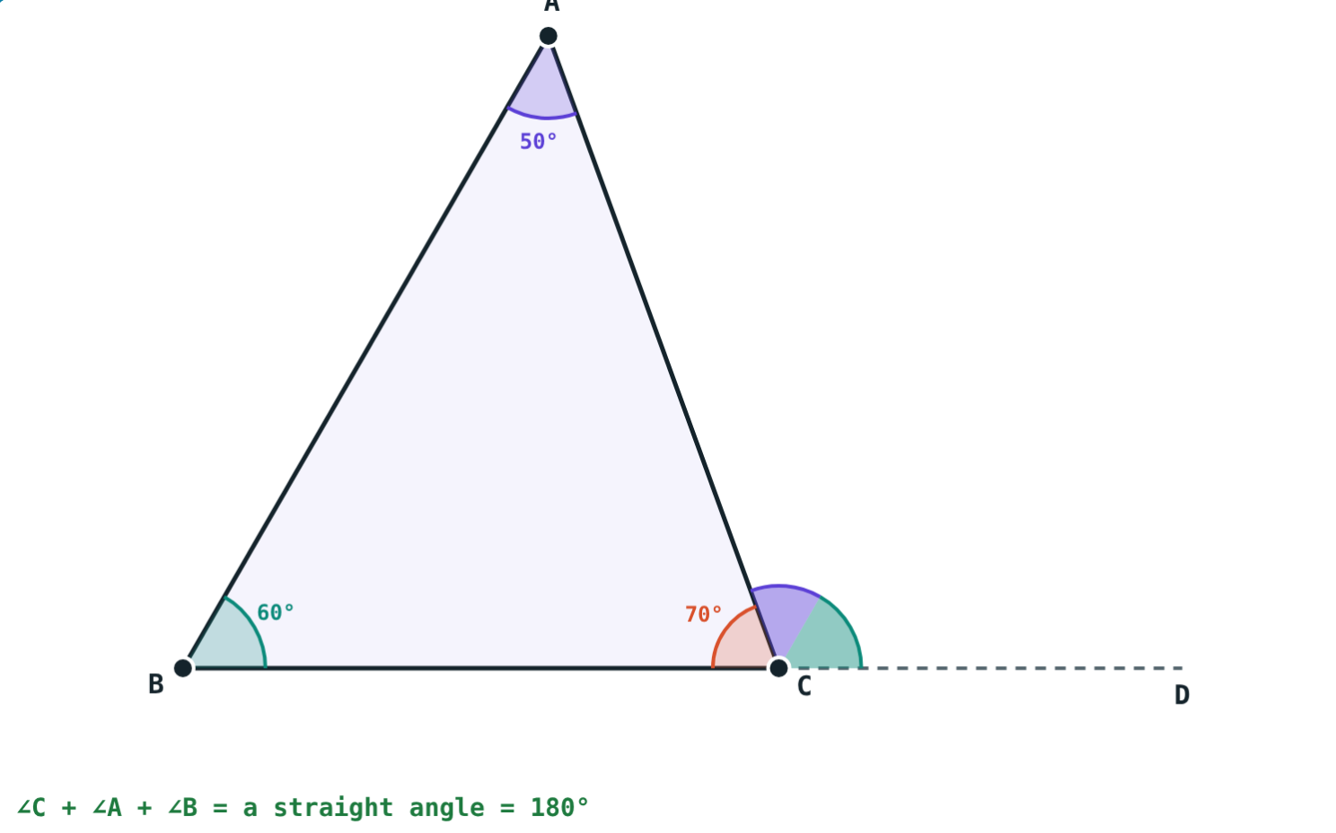
Angles of a Triangle
STD 9 MATHEMATICS PART II · CH. 3 TRIANGLES
Lesson 1 · Visual Science & Maths
Notes:
Goal: students can use the angle sum property and the theorem of remote interior angles.

Slide 2
Tear off the corners
Cut out any triangle, tear off its three corners and place them side by side.
What shape do the corners always make?
A straight line: 180°
Notes:
Do this with paper triangles of different shapes before showing the slide.

Slide 3
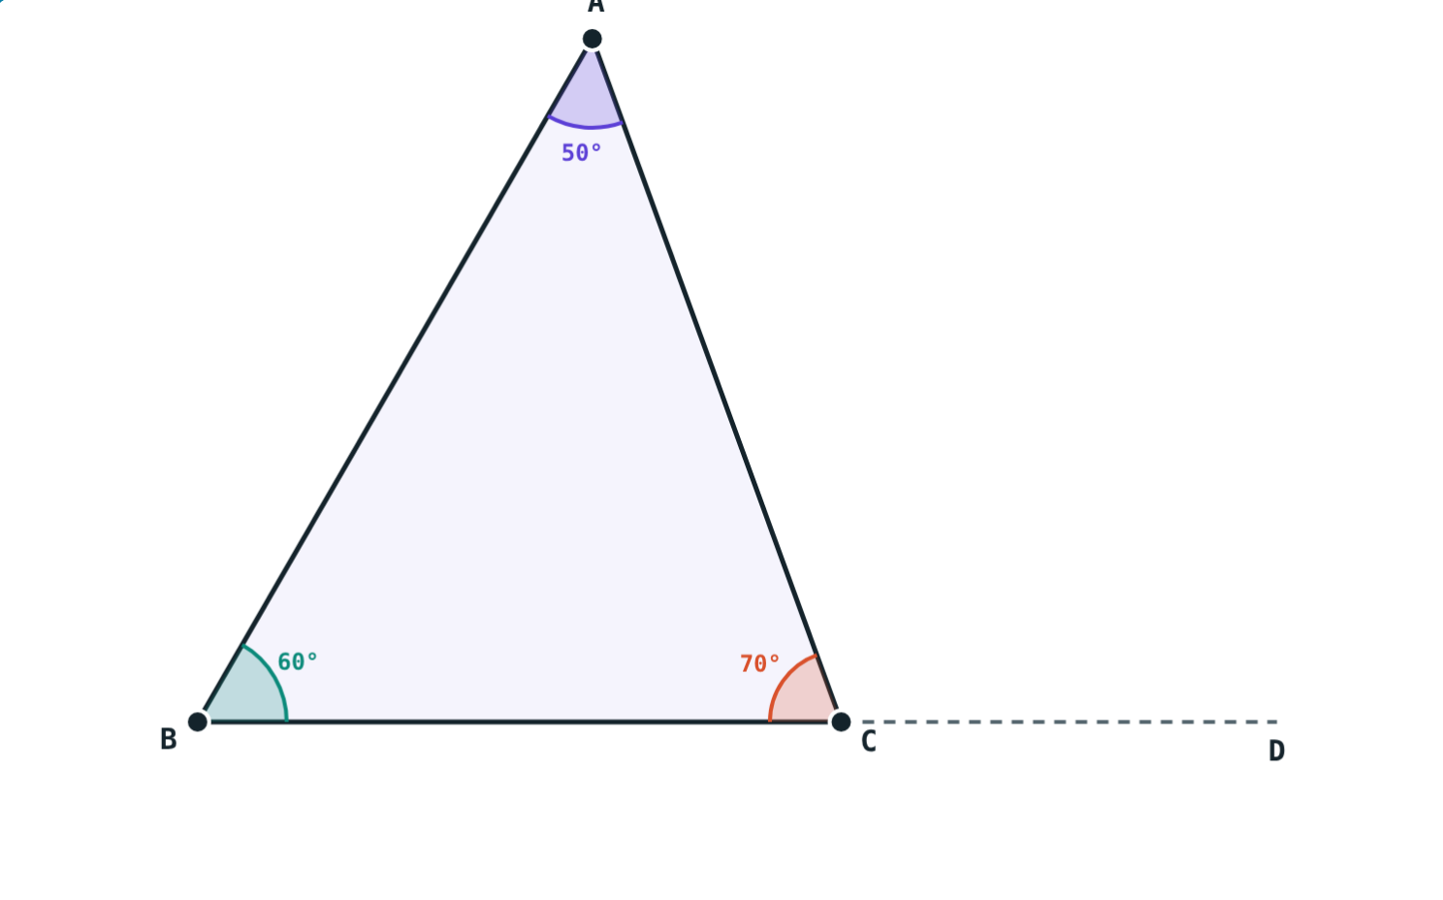
Angle sum
∠A + ∠B + ∠C = 180°
True for every triangle
Drag the corners: the sum never changes
At most one obtuse or right angle
50° + 60° + 70° = 180°
Notes:
Two obtuse angles would already exceed 180°.

Slide 4
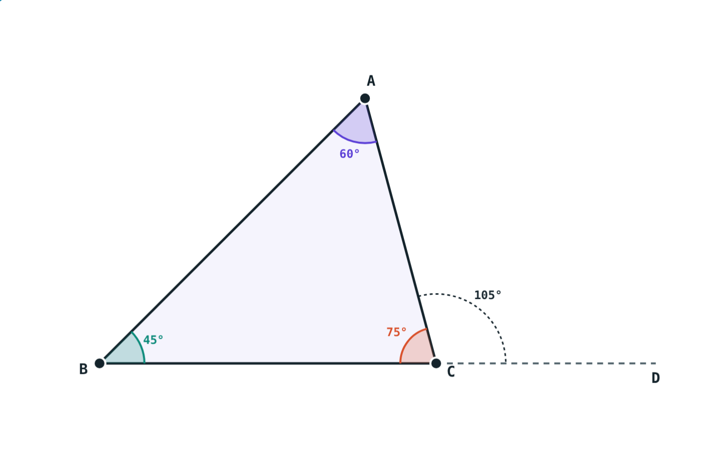
Exterior angle
Extend BC to D
∠ACD is an exterior angle
∠A and ∠B are its remote interior angles
Exterior ∠ACD = 120°
Notes:
The interior angle next to it, ∠ACB, is not a remote angle.

Slide 5
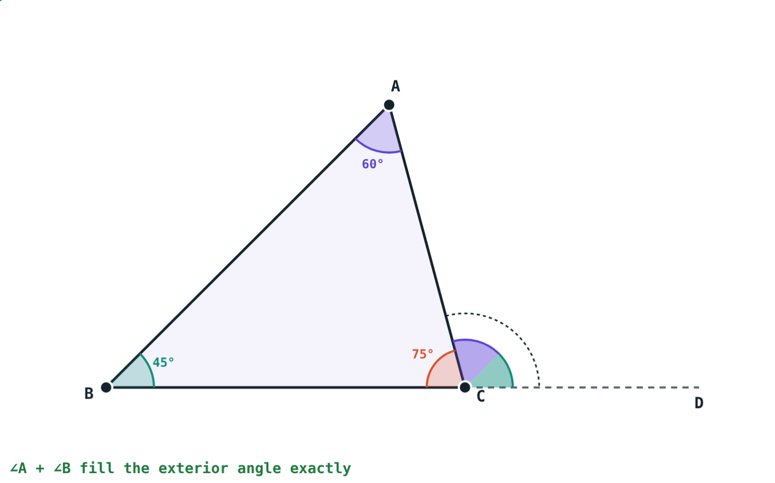
Remote interior angles theorem
∠ACD = ∠A + ∠B
∠ACB + ∠ACD = 180° (linear pair)
∠A + ∠B + ∠ACB = 180° (angle sum)
So ∠ACD = ∠A + ∠B
∠A and ∠B fill the exterior angle
Notes:
Consequence: an exterior angle is greater than each remote interior angle.

Slide 6
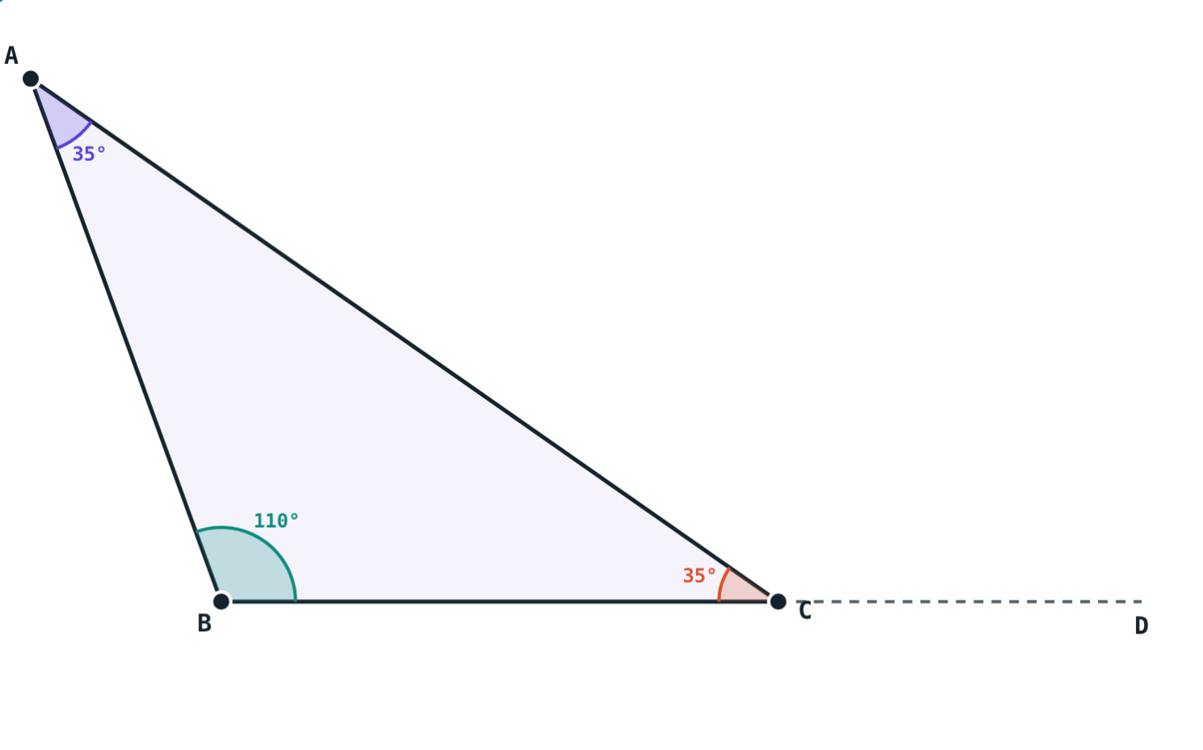
Any shape works
50° + 60° + 70° = 180°
35° + 110° + 35° = 180°
Notes:
Let students try extreme shapes in the simulation.

Slide 7
Worked examples
Angles in a ratio
Exterior angle
Angles in the ratio 5 : 6 : 7. Find them.
∠P = 55°, ∠Q = 65°, QR extended to S. Find ∠PRS and ∠PRQ.
18x = 180°, x = 10°
50°, 60°, 70°
∠PRS = 55° + 65° = 120°
∠PRQ = 180° − 120° = 60°
Notes:
For ratios, divide 180° by the sum of the ratio terms.

Slide 8
Exterior angles all round
Each exterior angle = 180° − its interior angle:
540° − 180°
3 × 180° minus the angle sum
360°
total of the exterior angles
Walking round a triangle, you turn through one full turn.
One exterior angle at each corner
Notes:
This links to the exterior angle sum of any polygon later.

Slide 9
From sum to exterior
∠C + ∠A + ∠B make a straight angle.
∠A + ∠B fill the exterior angle.
Notes:
The same picture proves both results.

Slide 10

Common mistakes
Adding the wrong angles
Exterior = interior
Use the two angles not touching the exterior angle.
They add to 180°.
Two obtuse angles
Ratio total
Impossible: they would exceed 180°.
Divide 180° by the sum of the ratio.
Notes:
Draw each mistake on the board and ask what is wrong.

Slide 11
Quick check
1
Two angles are 48° and 75°. Find the third.
2
An exterior angle is 110° and one remote interior angle is 40°. Find the other.
3
Is an exterior angle bigger or smaller than each remote interior angle?
4
Can a triangle have angles of 100°, 50° and 40°?
Notes:
Answers: 1) 57°. 2) 70°. 3) Bigger. 4) No, they add to 190°.

Slide 12
Move the corners yourself
Open the Angles of a Triangle lesson on the Visual Science & Maths website. Drag the vertices and press “Move the corners”.
Next lesson: Congruence of triangles
Notes:
Homework: textbook practice set 3.1.

