Slide 1
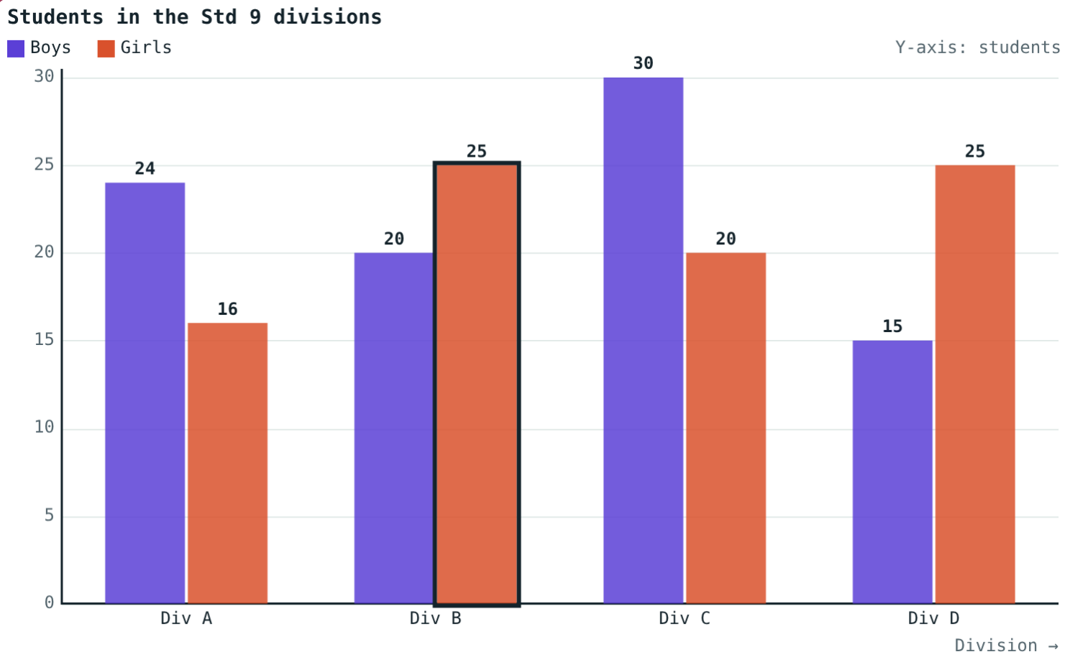
Bar Graphs
STD 9 MATHEMATICS PART I · CH. 7 STATISTICS
Lesson 1 · Visual Science & Maths
Notes:
Goal: students can choose a scale and draw and read double, subdivided and percentage bar graphs.

Slide 2
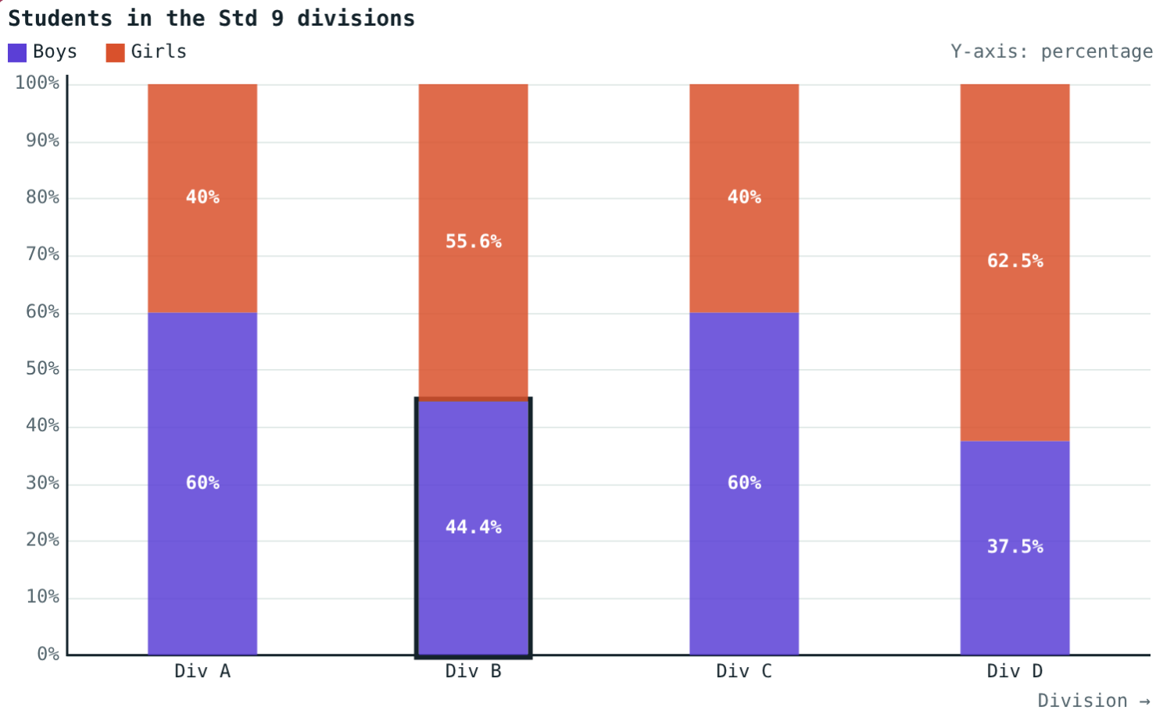
Which division has more girls?
Div A: 24 boys, 16 girls. Div B: 20 boys, 25 girls. Div C: 30 and 20. Div D: 15 and 25.
Which division has the largest share of girls?
Div D: 62.5% girls
Notes:
Div B and Div D both have 25 girls, but D has a larger share. Raw numbers can mislead.

Slide 3
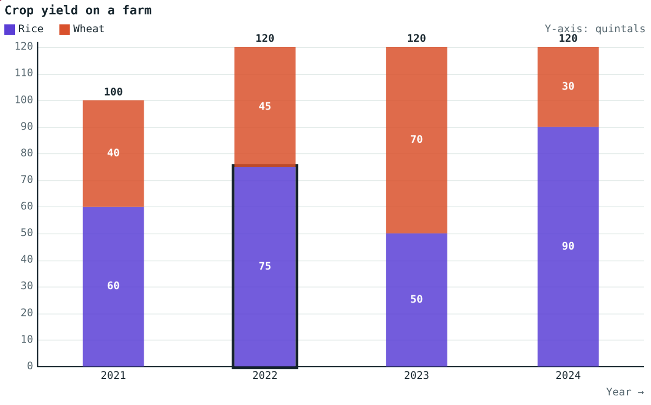
Axes and scale
Groups on the X-axis, quantities on the Y-axis
Scale: e.g. 1 division = 10 students
Start at 0, equal steps
Equal bar widths and equal gaps
1 division = 10 quintals
Notes:
Choose the scale so the tallest bar fits the paper.

Slide 4
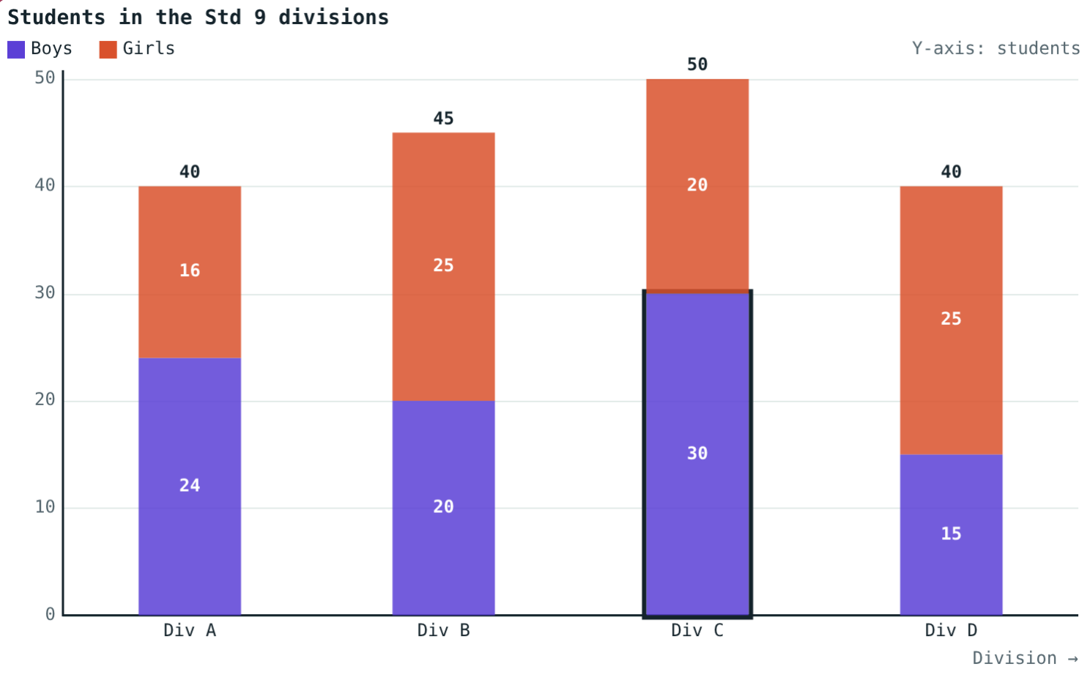
Double and subdivided
Two bars side by side: compare within a group.
One bar = the total, divided into parts.
Notes:
In a subdivided bar the second part sits on top of the first.

Slide 5
Percentage bar graph
part ÷ total × 100
Every bar is 100 units tall
Each part is a percentage of its own group
Compares groups of different sizes fairly
Div B: 44.4% boys, 55.6% girls
Notes:
Div A: 24 ÷ 40 × 100 = 60% boys.

Slide 6



Which graph when?
Double
Subdivided
Percentage
Compare two quantities in each group.
Show the total and its parts.
Compare shares when totals differ.
Notes:
Ask students which graph answers the hook question best (percentage).

Slide 7
Worked examples
Choosing a scale
Percentages
Crop totals: 100, 120, 120, 120 quintals.
Div B: 20 boys, 25 girls.
Tallest bar 120
1 division = 20: 6 divisions; = 10: 12 divisions
20 ÷ 45 × 100 ≈ 44.4%
25 ÷ 45 × 100 ≈ 55.6%
Notes:
Check that the two percentages add up to 100.

Slide 8
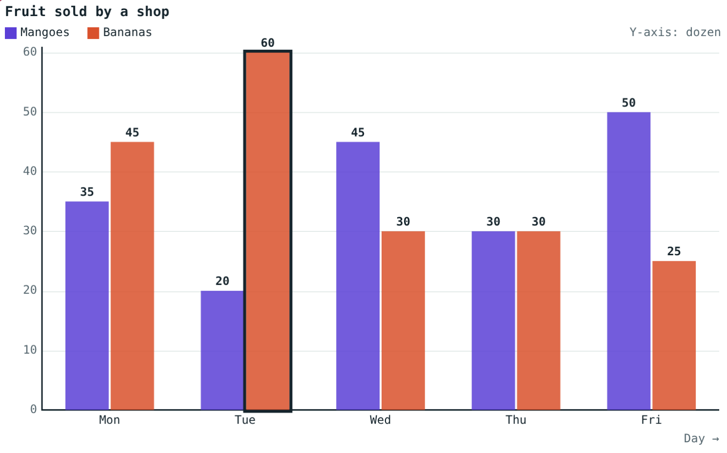
Worked example: reading a graph
On Tuesday the mango bar reaches 20 and the banana bar 60. How many more bananas, and how many in all?
60 − 20 = 40 dozen more
60 + 20 = 80 dozen in all
Mangoes and bananas sold (dozen)
Notes:
Read values by drawing a line from the bar top across to the Y-axis.

Slide 9
Same data, fair comparison
Div B and Div D both have 25 girls:
55.6%
girls in Div B (25 of 45)
62.5%
girls in Div D (25 of 40)
Equal numbers, different shares: the percentage graph shows it.
Percentage bar graph
Notes:
25 ÷ 45 × 100 ≈ 55.6%; 25 ÷ 40 × 100 = 62.5%.

Slide 10

Common mistakes
Uneven scale
Second part from 0
Start at 0 and rise in equal steps.
In a subdivided bar it sits on the first.
Grand total for %
Unequal widths or gaps
Divide by the group's own total.
Only the height changes.
Notes:
Show a badly drawn graph and let students find the errors.

Slide 11
Quick check
1
In a percentage bar graph, how tall is every bar?
2
18 boys and 27 girls: girls' percentage?
3
Which graph shows the total and its parts in one bar?
4
Largest value 84, 1 division = 10: how many divisions at least?
Notes:
Answers: 1) 100. 2) 60%. 3) Subdivided bar graph. 4) 9.

Slide 12
Draw it three ways
Open the Bar Graphs lesson on the Visual Science & Maths website. Switch the same data between double, subdivided and percentage graphs.
Next lesson: Frequency tables
Notes:
Homework: collect boys/girls counts for three classes and draw all three graphs.

