Slide 1
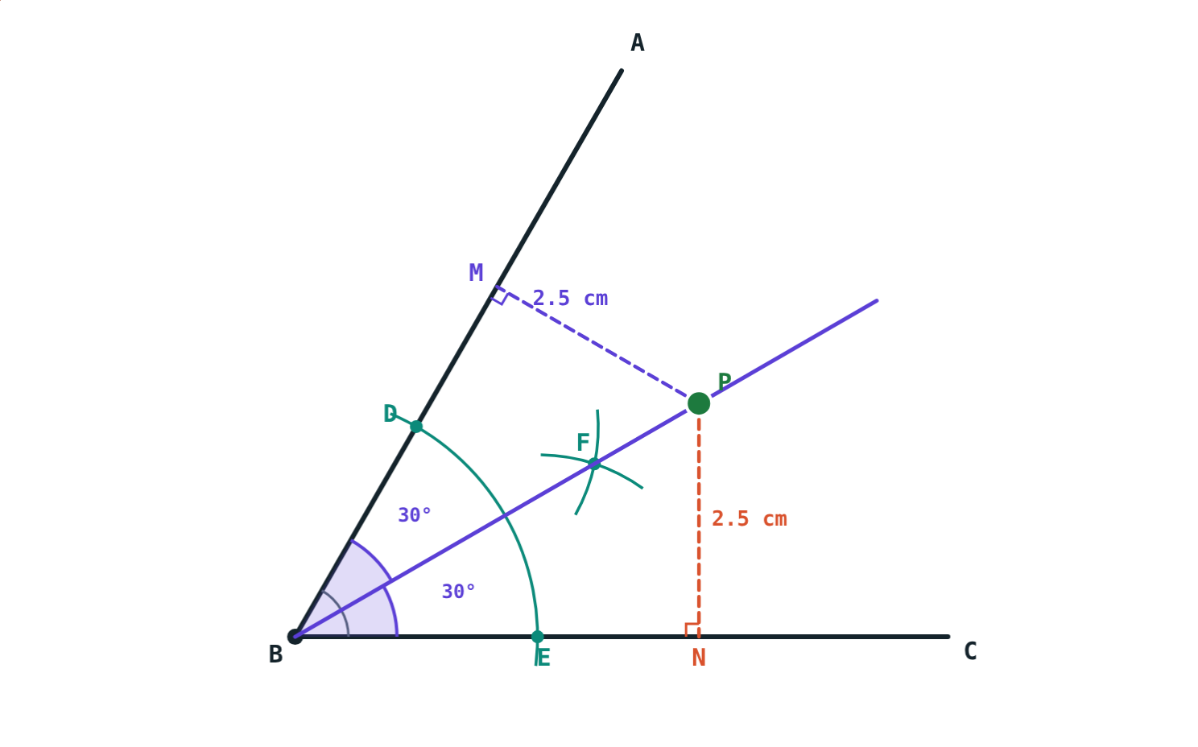
Perpendicular and Angle Bisectors
STD 9 MATHEMATICS PART II · CH. 4 CONSTRUCTIONS OF TRIANGLES
Lesson 1 · Visual Science & Maths
Notes:
Goal: students can state the perpendicular bisector theorem and the angle bisector theorem with their converses, and construct both bisectors with a compass.

Slide 2
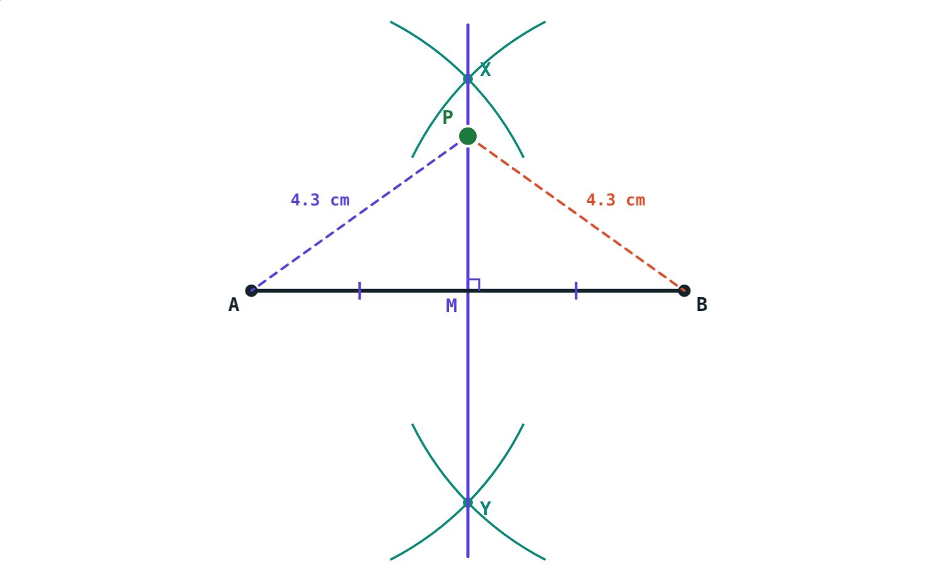
A fair place for a well
Two farms are 7 km apart. The village wants a well exactly as far from one farm as from the other.
Where can the well go? Is there only one place?
P is 4.3 cm from A and from B
Notes:
Let students mark a few possible spots on the board. They will find the spots line up on one straight line.

Slide 3
Perpendicular bisector theorem
P on the bisector ⇔ PA = PB
The perpendicular bisector passes through the midpoint M and is perpendicular to AB
Every point on it is equidistant from A and B
Converse: a point with PA = PB lies on it
Proof: △PMA ≅ △PMB by S-A-S
AB = 7 cm: PA = PB = 4.3 cm
Notes:
Draw the two triangles PMA and PMB and ask which three parts match: AM = BM, the right angles, and PM common.

Slide 4
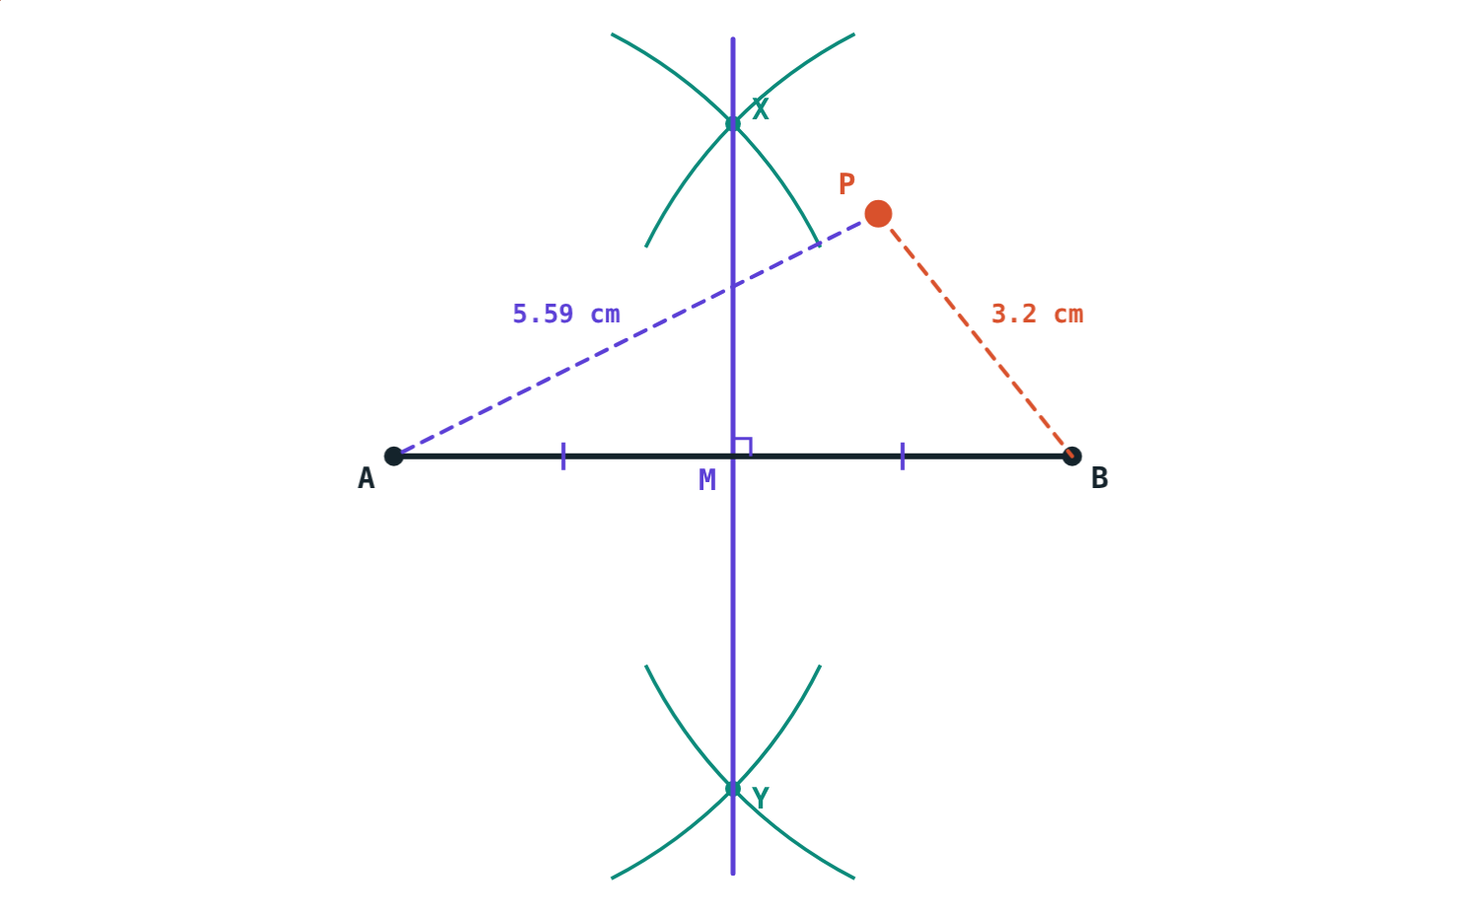
On the line, or off it?
On the bisector: PA = PB = 4.3 cm.
Off it: PA = 5.59 cm, PB = 3.2 cm.
Notes:
This is the converse at work: if PA and PB are not equal, P cannot be on the perpendicular bisector.

Slide 5
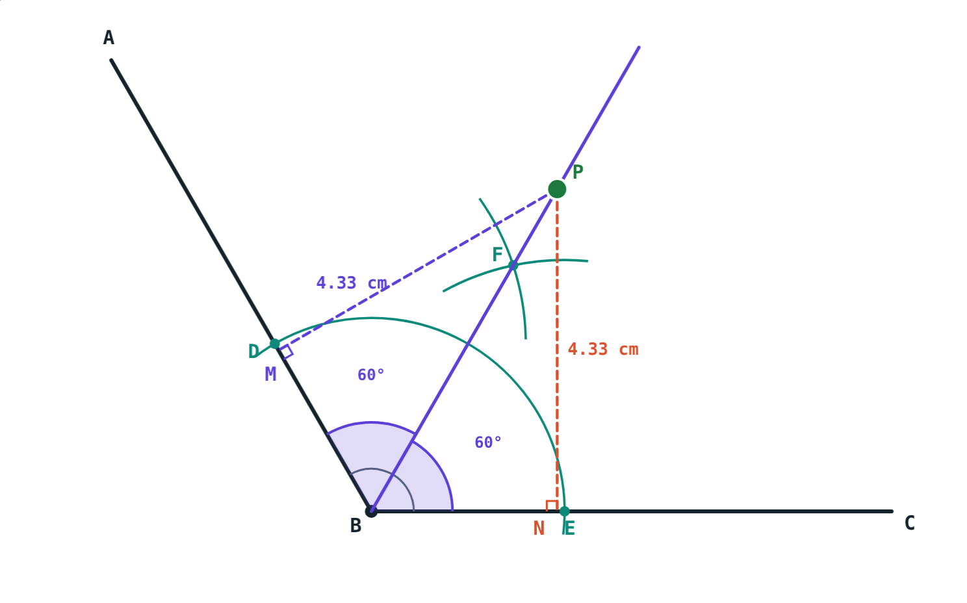
Angle bisector theorem
P on the bisector ⇔ PM = PN
The bisector divides the angle into two congruent angles
Distance from a line = length of the perpendicular
Every point on the bisector is equidistant from the arms
Converse: a point equidistant from the arms is on the bisector
∠ABC = 120°: P is 4.33 cm from both arms
Notes:
Proof: △PMB ≅ △PNB by A-A-S (equal halves of the angle, right angles, PB common).

Slide 6



Compass constructions
Perpendicular bisector
Angle bisector
Why they work
Radius more than half of AB. Arcs from A and from B meet at X and Y. Draw XY.
Arc from B cuts the arms at D and E. Equal arcs from D and E meet at F. Draw ray BF.
XA = XB and YA = YB, so X and Y are on the bisector. △BDF ≅ △BEF by S-S-S.
Notes:
Demonstrate both constructions on the board, then let students press “Play construction” to watch the arcs drawn step by step.

Slide 7
Worked examples
Perpendicular bisector
Angle bisector
AB = 8 cm. P is on its perpendicular bisector and PM = 3 cm. Find PA and PB.
BF bisects ∠ABC = 60°. P is on BF with BP = 5 cm. How far is P from each arm?
AM = 4 cm, ∠PMA = 90°
PA = √(16 + 9) = 5 cm
PA = PB = 5 cm
∠PBC = 30°
30°–60°–90° triangle: PN = ½ × 5
P is 2.5 cm from each arm
Notes:
Example 1 uses Pythagoras; example 2 uses the 30°–60°–90° triangle from the last chapter.

Slide 8
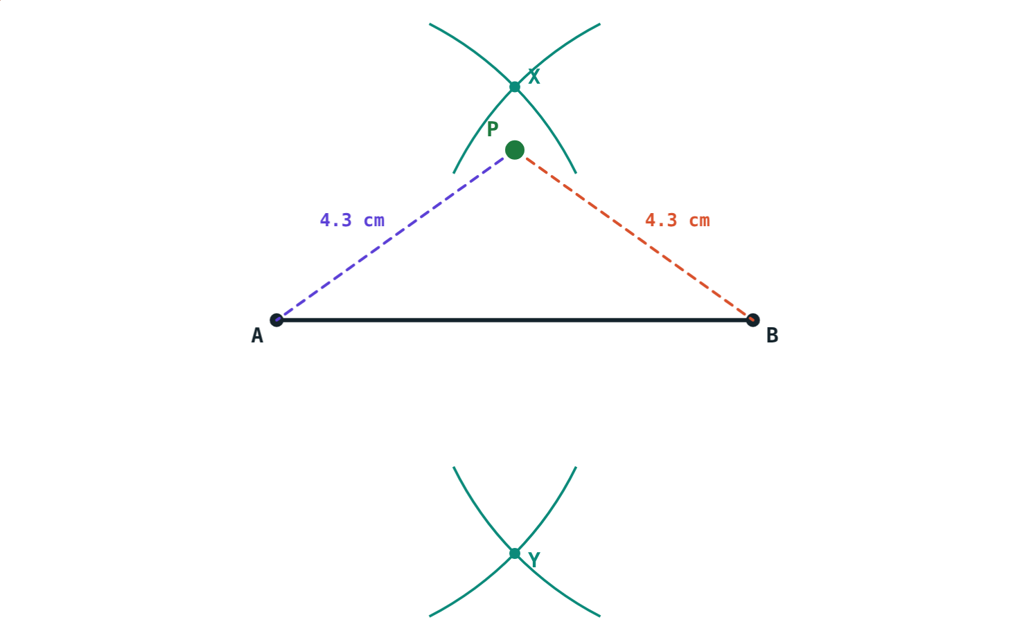
Worked example: using the converse
Villages A and B are 6 km apart. A tank T must be 4 km from each. Where can it go?
TA = TB, so T is on the perpendicular bisector
TM = √(4² − 3²) = √7 ≈ 2.65 km
Two places, 2.65 km either side of AB
Arcs from A and B meet at X and Y
Notes:
Scale 1 cm for 1 km. Students can check with the simulation: PA = PB = 4 cm when P is 2.65 cm above M.

Slide 9
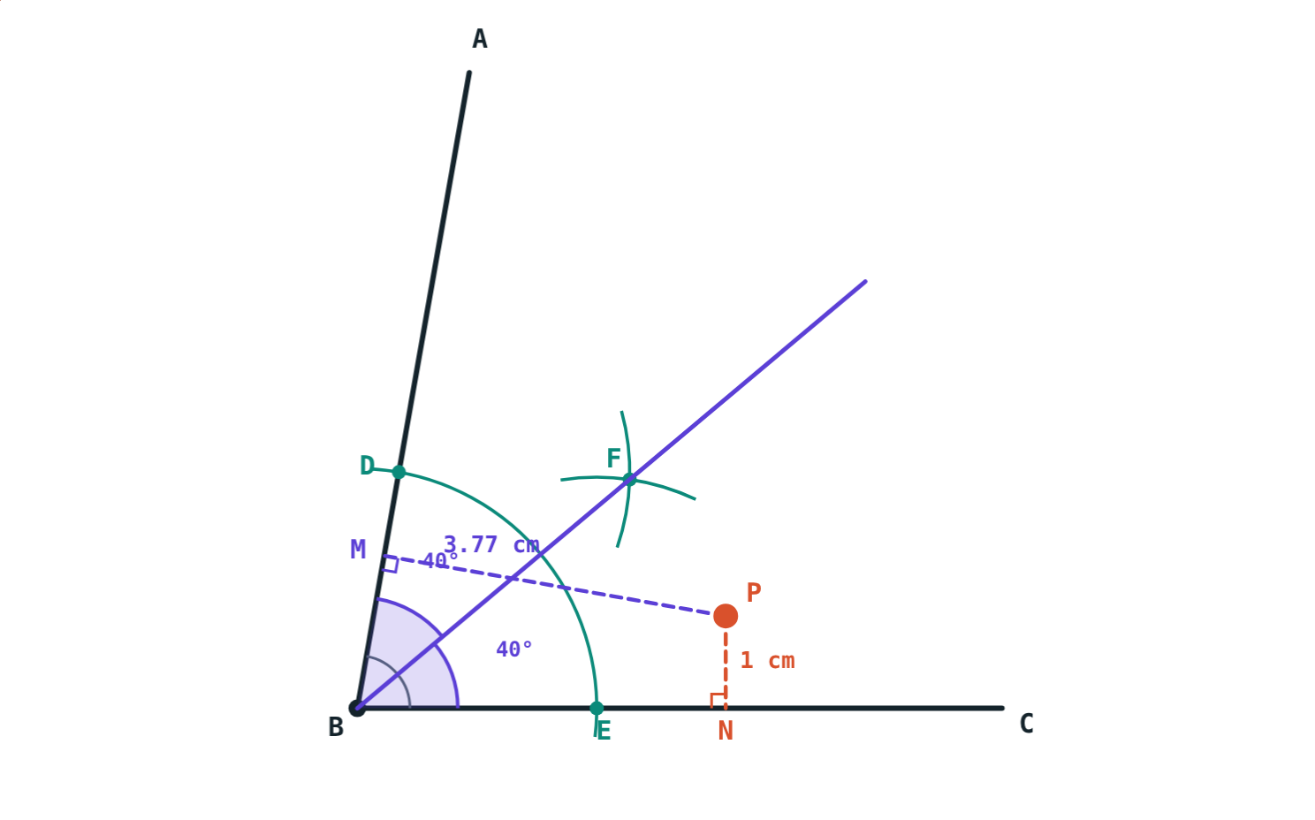
Off the bisector
Measure the perpendicular distances of P from the two arms:
3.77 cm
from arm BA
1 cm
from arm BC
Different distances, so P is not on the bisector (converse).
∠ABC = 80°, P not on BF
Notes:
Ask: where would P have to move to make the two distances equal?

Slide 10

Common mistakes
Compass too small
Changing the opening
The radius must be more than half of AB, or the arcs never meet.
Arcs from A and B (or D and E) need the same radius.
Slanting distance
Forgetting the converse
Distance from an arm is along the perpendicular.
PA = PB already tells you P is on the bisector.
Notes:
Have students try the first mistake deliberately: open the compass to less than half of AB and see what happens.

Slide 11
Quick check
1
P is on the perpendicular bisector of XY and PX = 7 cm. Find PY.
2
QA = QB = 5 cm and AB = 8 cm. How far is Q from AB?
3
Ray BD bisects ∠ABC = 84°. Find ∠ABD.
4
A point is 3 cm from both arms of ∠ABC. Where does it lie?
Notes:
Answers: 1) 7 cm. 2) 3 cm (half of AB is 4, √(25 − 16) = 3). 3) 42°. 4) On the bisector of ∠ABC (converse of the angle bisector theorem).

Slide 12
Draw the arcs yourself
Open the Perpendicular and Angle Bisectors lesson on the Visual Science & Maths website. Drag P and press “Play construction”.
Next lesson: Constructing triangles
Notes:
Homework: construct the perpendicular bisector of a 6.4 cm segment and the bisector of a 110° angle; measure to check.

