Slide 1
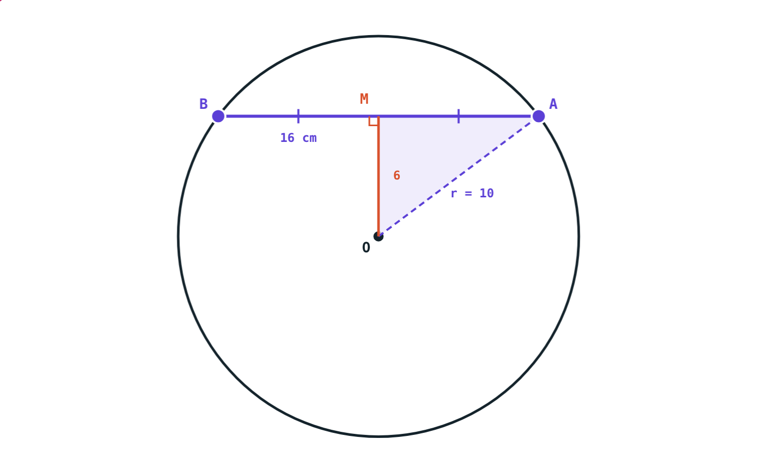
Chords of a Circle
STD 9 MATHEMATICS PART II · CH. 6 CIRCLE
Lesson 1 · Visual Science & Maths
Notes:
Goal: students can use the perpendicular-from-the-centre theorem and Pythagoras to find a chord or its distance from the centre, and know that congruent chords are equidistant from the centre.

Slide 2
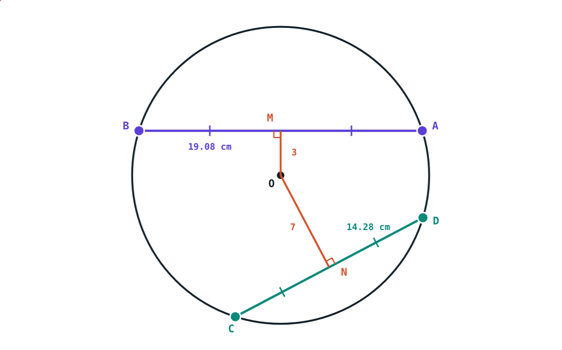
Cutting a round cake
Cut a round cake straight across. The cut is a chord. Some cuts are long, some are short.
What decides how long the cut is?
3 cm from the centre: 19.08 cm. 7 cm from it: 14.28 cm.
Notes:
Let students guess before revealing: only the distance of the cut from the centre matters.

Slide 3
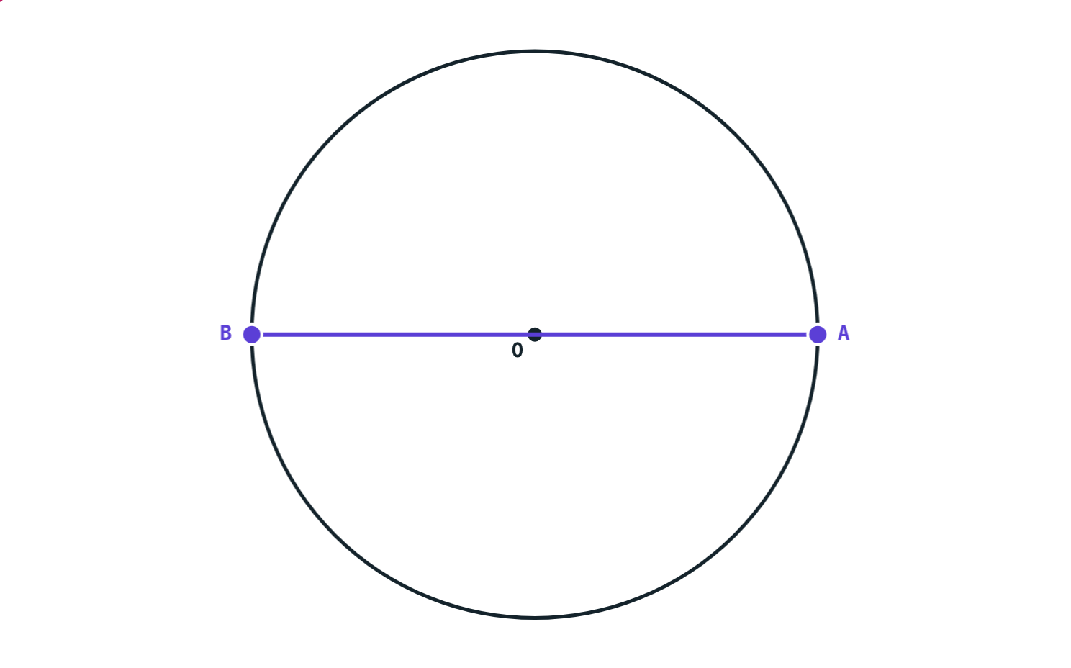
Words to know
Circle: all points in a plane at the same distance from a fixed point, the centre
Radius: that distance
Chord: a segment with both end points on the circle
Diameter: a chord through the centre; it is the longest chord, 2 × radius
Radius 5 cm: diameter AB = 10 cm
Notes:
Ask: is a radius a chord? (No, only one end point is on the circle.)

Slide 4
The perpendicular from the centre
OM ⊥ AB ⇒ AM = MB
Join OA and OB: both are radii
△OMA and △OMB are congruent (hypotenuse–side test)
Converse: the centre joined to the midpoint of a chord is perpendicular to it
Radius 10 cm, OM = 6 cm, AM = MB = 8 cm
Notes:
The theorem and its converse are both in the textbook; students should be able to write the proof of the theorem.

Slide 5
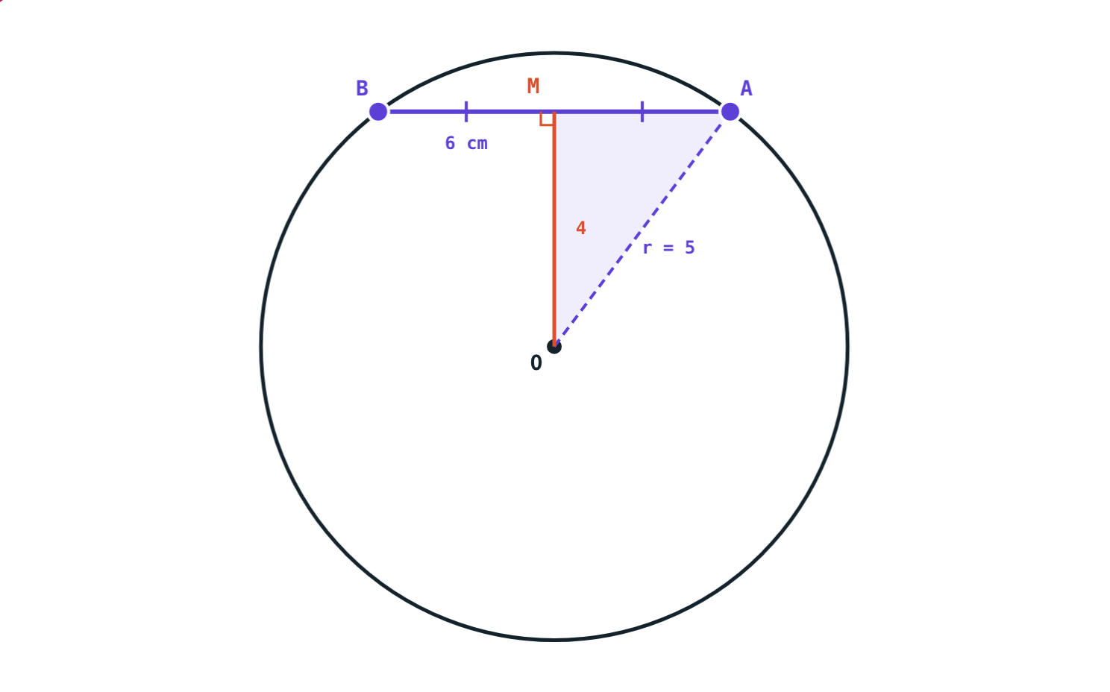
Radius, distance and half-chord
OA² = OM² + AM²
△OMA has a right angle at M
(radius)² = (distance)² + (half the chord)²
Know any two, find the third
Double AM to get the chord
5² = 4² + 3²: chord AB = 6 cm
Notes:
The distance of a chord from the centre always means the perpendicular distance OM.

Slide 6
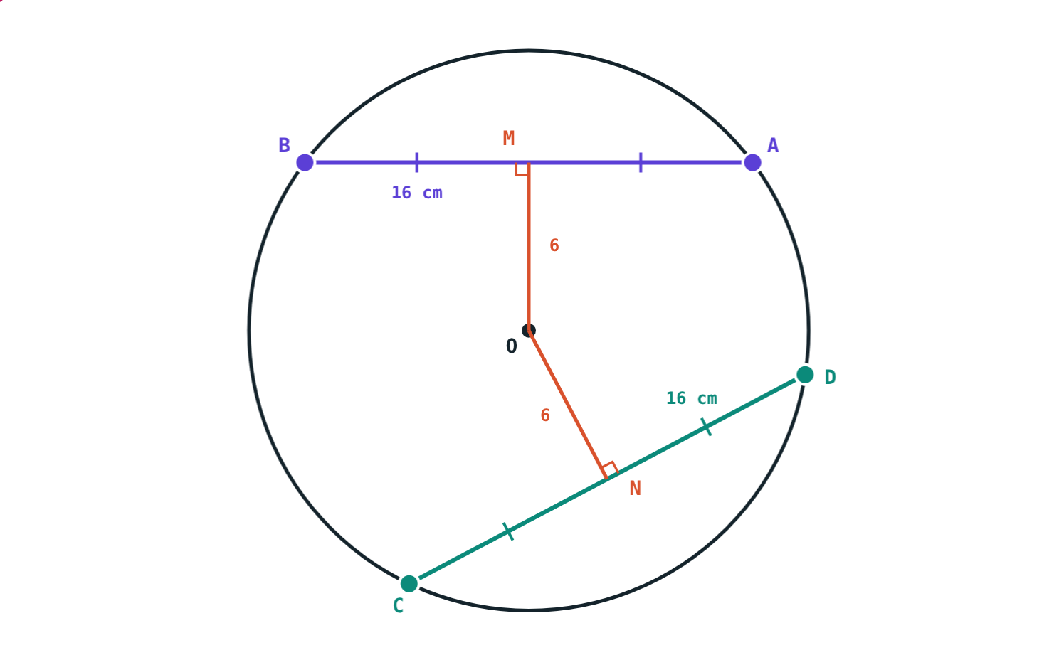
Congruent chords
Both 6 cm from O: AB = CD = 16 cm.
3 cm from O: 19.08 cm. 7 cm from O: 14.28 cm.
Congruent chords are equidistant from the centre, and chords equidistant from the centre are congruent.
Notes:
Both theorems follow from OA² = OM² + AM²: the radius is fixed, so equal distances give equal half-chords.

Slide 7
Worked examples
Distance of a chord
Length of a chord
Radius 15 cm, chord AB = 24 cm. How far is AB from the centre?
Radius 8.5 cm, chord 4 cm from the centre. Find the chord.
AM = 12 cm
OM² = 225 − 144 = 81
OM = 9 cm
AM² = 72.25 − 16 = 56.25
AM = 7.5 cm
AB = 2 × 7.5 = 15 cm
Notes:
Draw OM and OA first every time; the right triangle does the work.

Slide 8
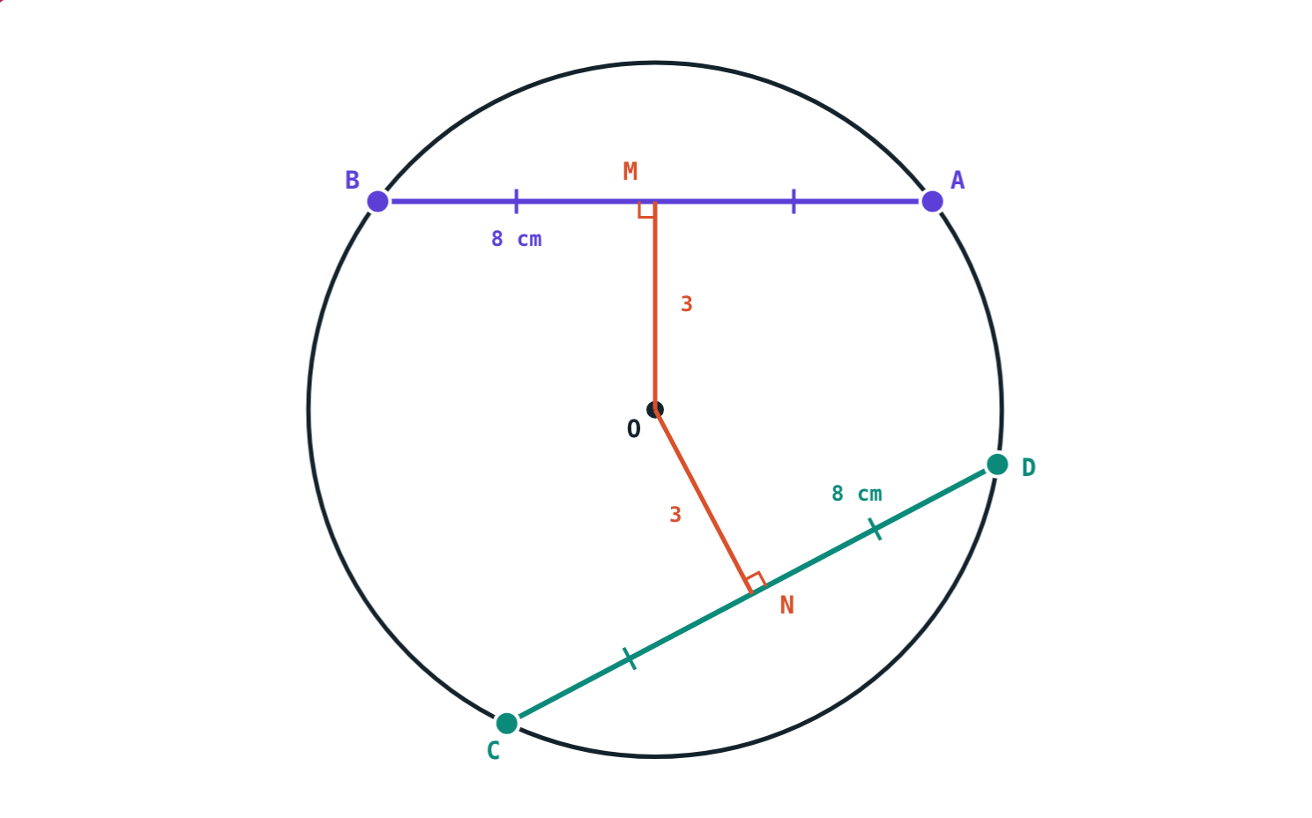
Worked example: two chords
In a circle of radius 5 cm, chords AB and CD are each 8 cm long. How far is each from the centre?
Half of each chord = 4 cm
Distance = √(25 − 16) = 3 cm
OM = ON = 3 cm
Radius 5 cm, AB = CD = 8 cm
Notes:
This is the theorem in numbers: congruent chords, equal distances.

Slide 9
Nearer means longer
Same circle, two chords:
19.08 cm
chord 3 cm from O
14.28 cm
chord 7 cm from O
The nearer a chord is to the centre, the longer it is. At distance 0 it is the diameter, 20 cm.
Radius 10 cm
Notes:
19.08 = 2√(100 − 9) and 14.28 = 2√(100 − 49), both rounded to two decimals.

Slide 10

Common mistakes
The whole chord in Pythagoras
Slanted distance
The right triangle OMA has AM, half the chord.
Distance from the centre is the perpendicular OM.
Forgetting to double
“Far chords are longer”
After finding AM, the chord is 2 × AM.
Nearer the centre means longer; the diameter is longest.
Notes:
Ask students which mistake gives an answer bigger than the diameter.

Slide 11
Quick check
1
Radius 17 cm, chord 30 cm. How far is the chord from the centre?
2
Radius 10 cm, chord 6 cm from the centre. How long is the chord?
3
Two chords are each 4 cm from the centre. One is 10 cm. The other?
4
M is the midpoint of chord PQ and O the centre. Find ∠OMP.
Notes:
Answers: 1) 8 cm (√(289 − 225) = √64). 2) 16 cm (half chord √(100 − 36) = 8). 3) 10 cm: equidistant chords are congruent. 4) 90°.

Slide 12
Drag the chords yourself
Open the Chords of a Circle lesson on the Visual Science & Maths website. Drag A and B round the circle and watch OM bisect the chord.
Next lesson: Incircle and circumcircle
Notes:
Homework: textbook practice set 6.1, checked with the simulation.

