Slide 1
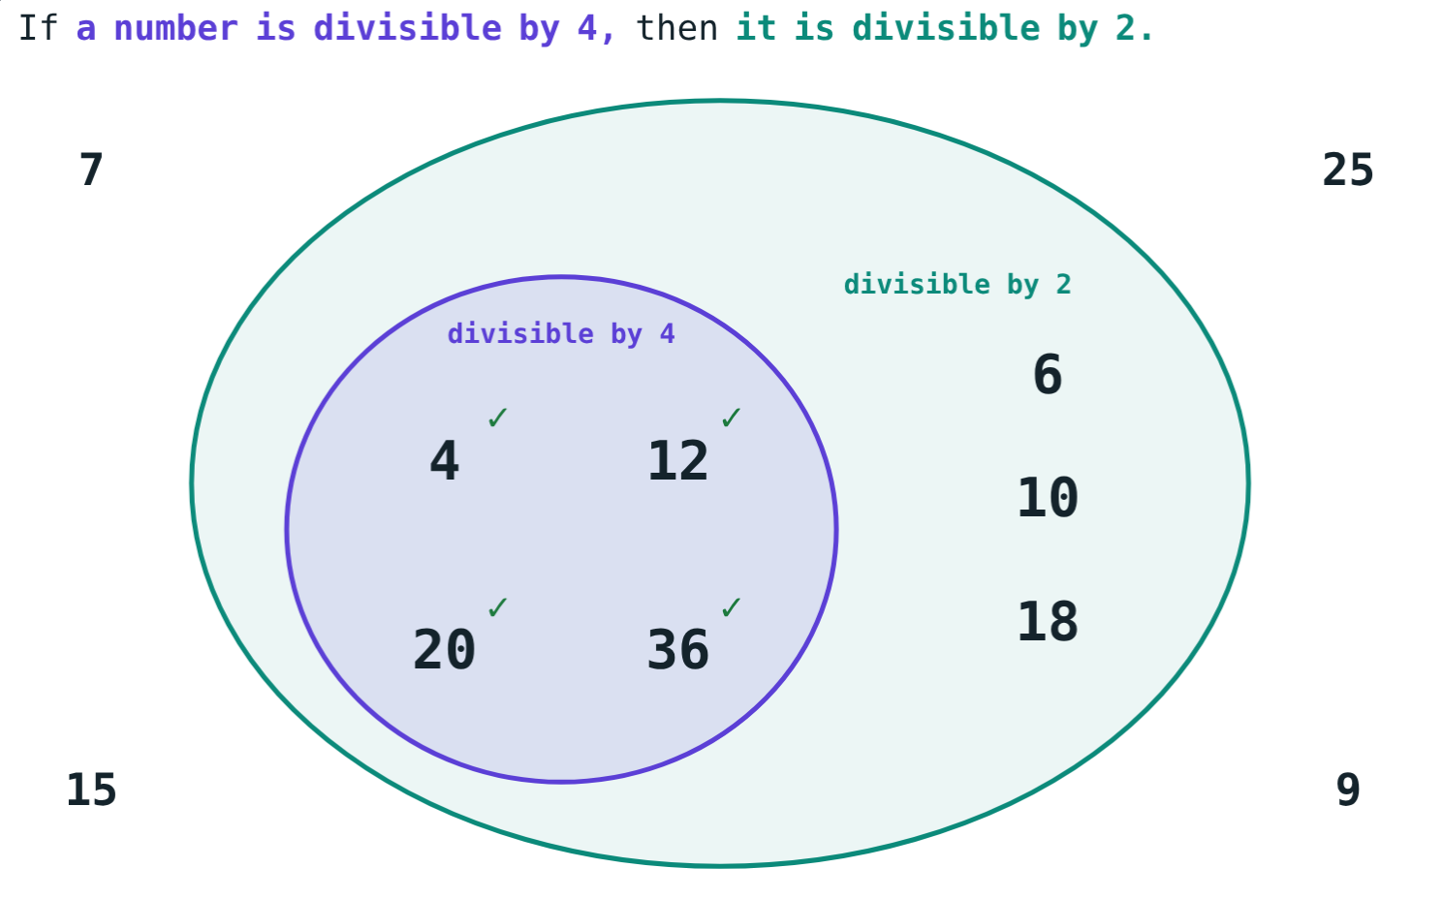
Conditional Statements and Proofs
STD 9 MATHEMATICS PART II · CH. 1 BASIC CONCEPTS IN GEOMETRY
Lesson 2 · Visual Science & Maths
Notes:
Goal: students can write a statement in if-then form, name its antecedent and consequent, write the converse, and follow a direct and an indirect proof.

Slide 2
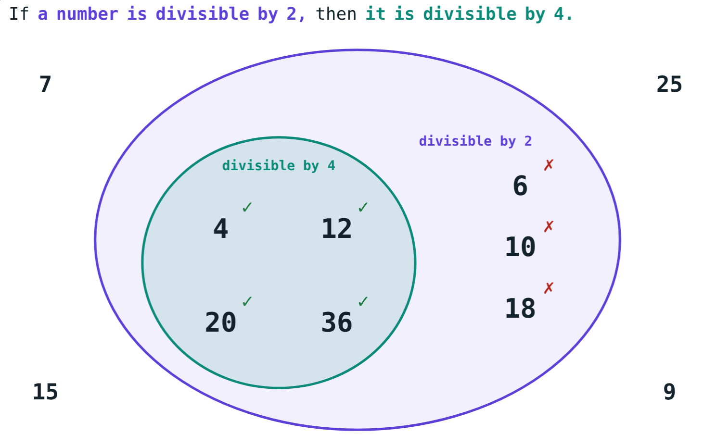
Turn it round
Every number divisible by 4 is divisible by 2. Is every number divisible by 2 also divisible by 4?
Does a true statement stay true when we turn it round?
6, 10 and 18 say no
Notes:
Let students test a few even numbers before showing the picture.

Slide 3
Conditional statements
If (antecedent), then (consequent)
Antecedent: the given part
Consequent: the part to be proved
True when the first set lies inside the second
Divisible by 4 sits inside divisible by 2
Notes:
“If a number is divisible by 4, then it is divisible by 2.”

Slide 4
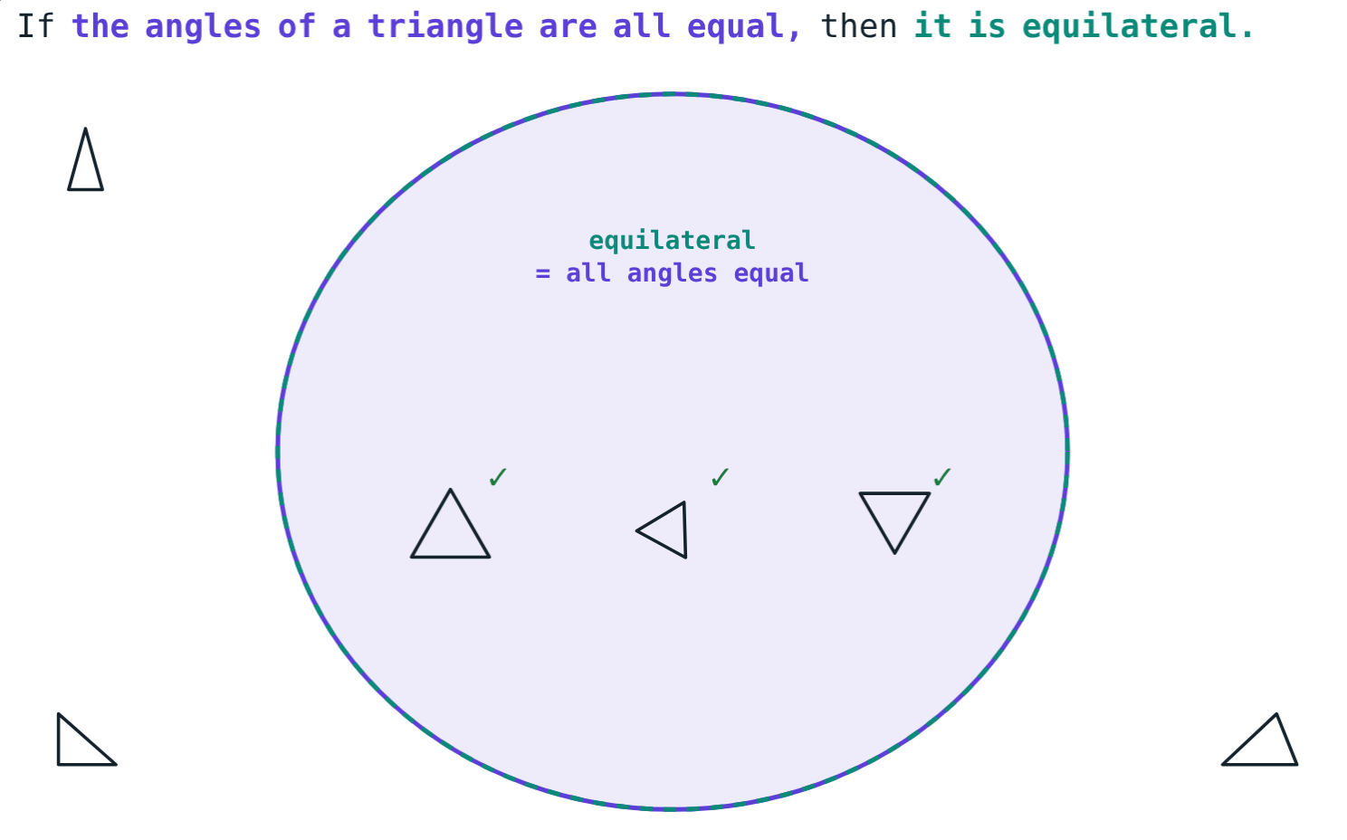
The converse
False converse: 6 is divisible by 2, not by 4.
True converse: equal angles ↔ equilateral.
Notes:
The converse interchanges the antecedent and the consequent. One counterexample shows a statement is false.

Slide 5



Two kinds of proof
Direct proof
Indirect proof
Counterexample
Start from the given facts and move step by step to the conclusion.
Suppose the conclusion is false; reach a contradiction.
One example where the statement fails proves it false.
Notes:
Examples, however many, never prove a general statement.

Slide 6
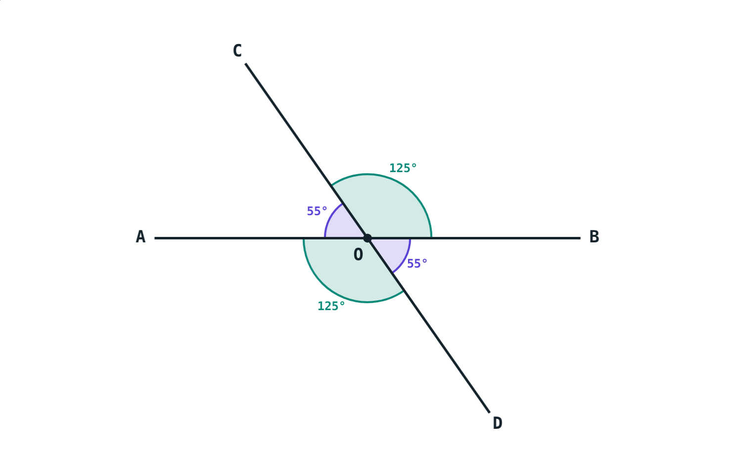
A direct proof
∠AOC + ∠BOC = 180° (linear pair)
∠BOC + ∠BOD = 180° (linear pair)
So ∠AOC = ∠BOD
Vertically opposite angles are equal
Lines AB and CD meet at O
Notes:
Each step follows from a known fact. In the same way ∠BOC = ∠AOD.

Slide 7
Worked examples
If-then form
Converse
“A number ending in 0 is divisible by 5.”
If two angles form a linear pair, then they are supplementary.
If a number ends in 0, then it is divisible by 5
Converse false: 15
Converse: supplementary → linear pair
130° and 50° apart: false
Notes:
Always test the converse separately.

Slide 8
Worked example: using the proof
Lines AB and CD meet at O and ∠AOC = 55°. Find ∠BOC, ∠BOD and ∠AOD.
∠BOC = 180° − 55° = 125°
∠BOD = ∠AOC = 55°
∠AOD = ∠BOC = 125°
∠AOC = 55°
Notes:
Name the reason for each step: linear pair, vertically opposite angles.

Slide 9
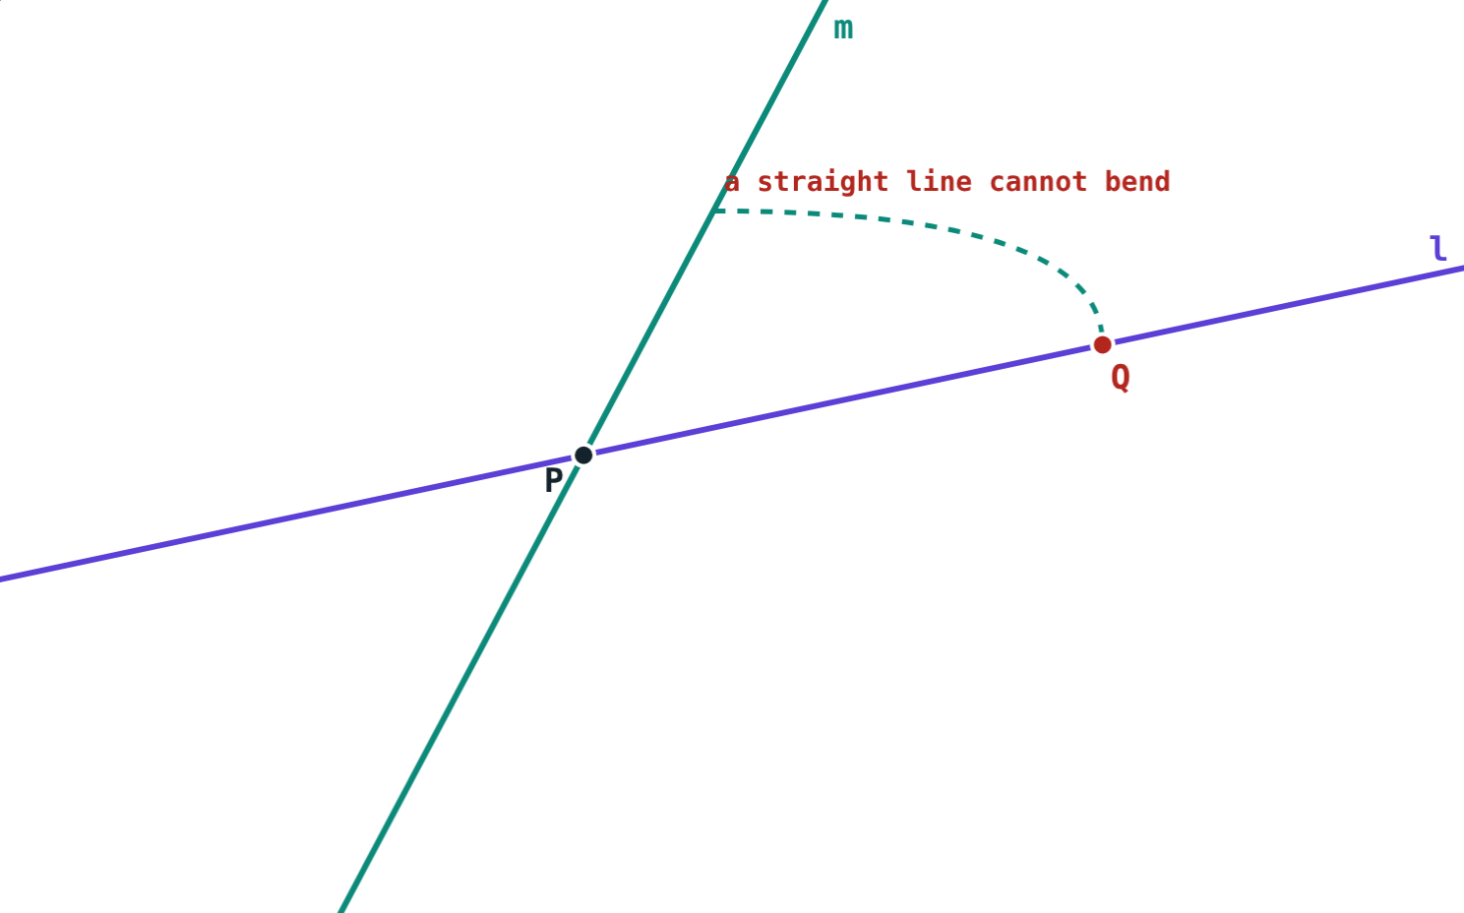
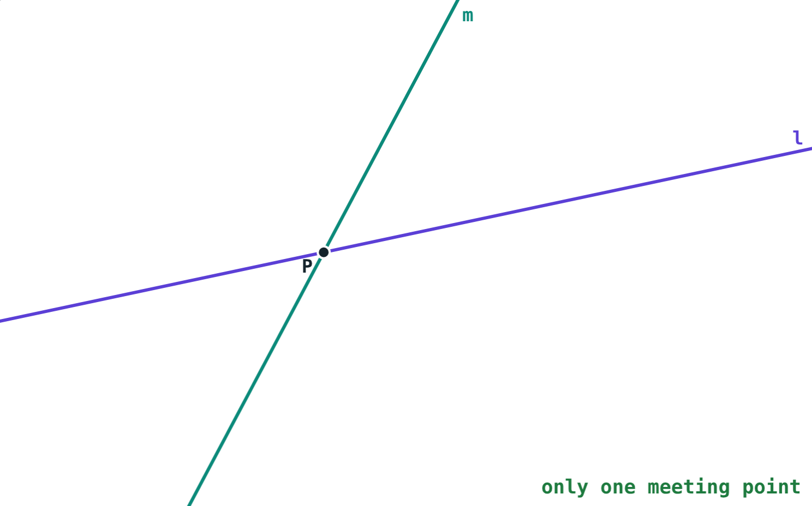
An indirect proof
Suppose l and m also meet at a point Q.
One line through P and Q: contradiction.
Notes:
Two distinct lines meet in at most one point: supposing a second point Q makes l and m the same line, which contradicts “distinct”.

Slide 10
Common mistakes
“The converse is true too”
Proving with examples
Not always; test it separately.
A few examples do not prove a general statement.
Swapping the parts
Supposing the wrong thing
Antecedent after “if”, consequent after “then”.
Suppose the conclusion is false, not the given part.
Notes:
Ask students to write one statement whose converse is true and one whose converse is false.

Slide 11
Quick check
1
Name the antecedent: “If a triangle is equilateral, then it is isosceles.”
2
Write the converse of “If x = 4, then x² = 16.” Is it true?
3
Is the converse of “If two angles are right angles, then they are congruent” true?
4
How does an indirect proof begin?
Notes:
Answers: 1) A triangle is equilateral. 2) If x² = 16, then x = 4; false, x could be −4. 3) No: two 40° angles are congruent. 4) Suppose the conclusion is false.

Slide 12
Turn statements round yourself
Open the Conditional Statements and Proofs lesson on the Visual Science & Maths website. Switch each statement to its converse and step through the proofs.
Next chapter: Parallel Lines
Notes:
Homework: write three statements in if-then form and their converses; mark each true or false.

