Slide 1
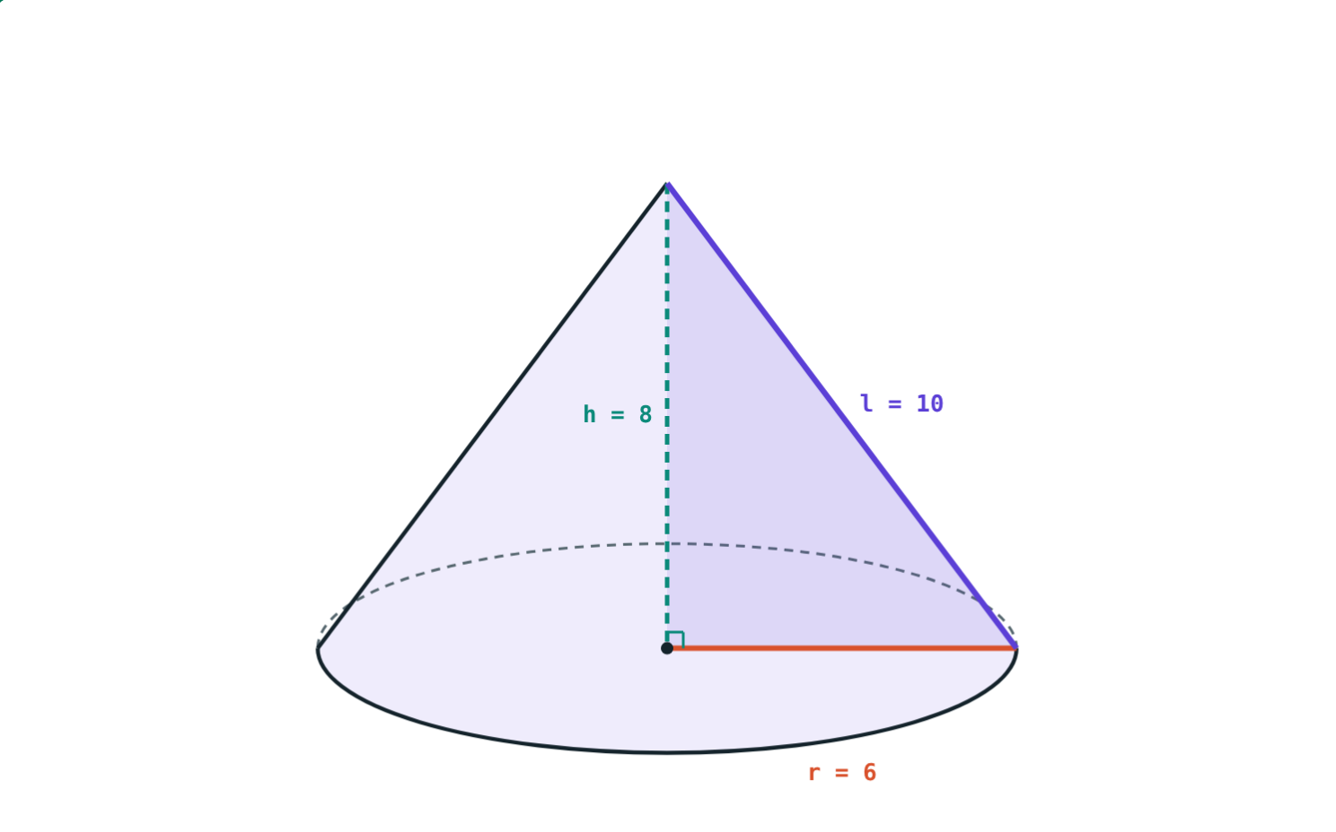
Cones
STD 9 MATHEMATICS PART II · CH. 9 SURFACE AREA AND VOLUME
Lesson 2 · Visual Science & Maths
Notes:
Goal: students can find the slant height, curved and total surface area, and volume of a right circular cone.

Slide 2
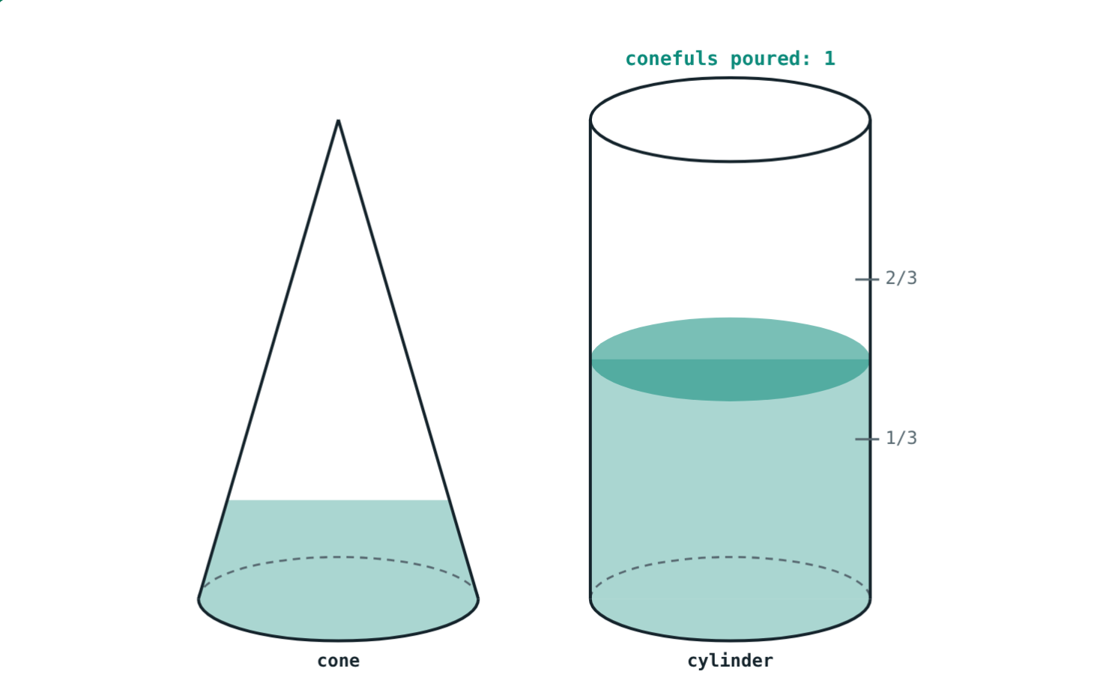
Three conefuls
A cone and a cylinder have the same base and the same height. Fill the cone with sand and pour it into the cylinder.
How many conefuls fill the cylinder?
After one and a half conefuls
Notes:
Let students guess (2? 3? 4?) before showing the answer. If possible, do it with paper models and sand or rice.

Slide 3
Slant height
l² = r² + h²
h: perpendicular height, vertex to centre of base
l: slant height, vertex to the edge of the base
r, h and l make a right triangle
r = 6, h = 8, so l = 10
Notes:
This is Pythagoras' theorem with l as the hypotenuse. 36 + 64 = 100.

Slide 4
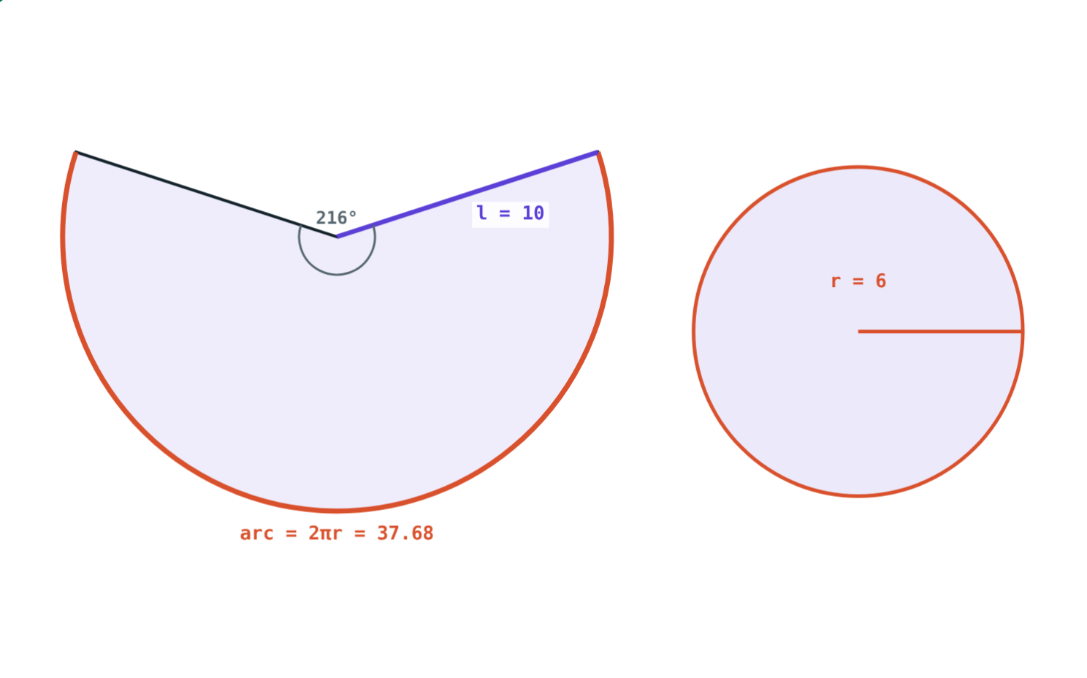
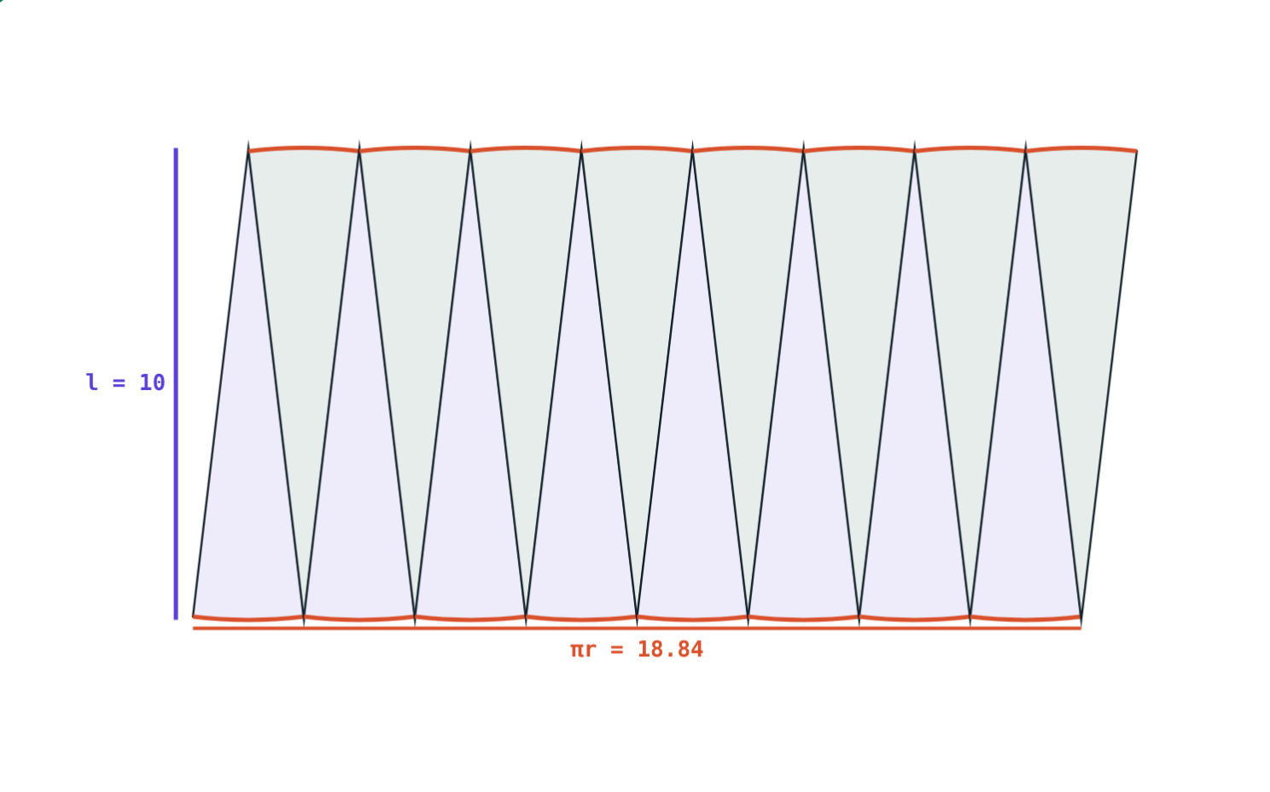
Open the curved surface
A sector of radius l = 10 cm; its arc is 2πr.
Pieces make a near-rectangle πr by l: area πrl = 188.4 cm².
Notes:
The more pieces, the closer to a rectangle. Length is half the arc (πr) because half the pieces point each way.

Slide 5
Cone formulae
Measure | Formula | r = 7, h = 24 (π = 22/7)
Slant height | l² = r² + h² | l = 25 cm
Curved surface area | πrl | 550 cm²
Total surface area | πr(l + r) | 704 cm²
Volume | ⅓πr²h | 1232 cm³
Notes:
Surface uses l; volume uses h. 22/7 × 7 × 25 = 550; 22/7 × 7 × 32 = 704; ⅓ × 22/7 × 49 × 24 = 1232.

Slide 6
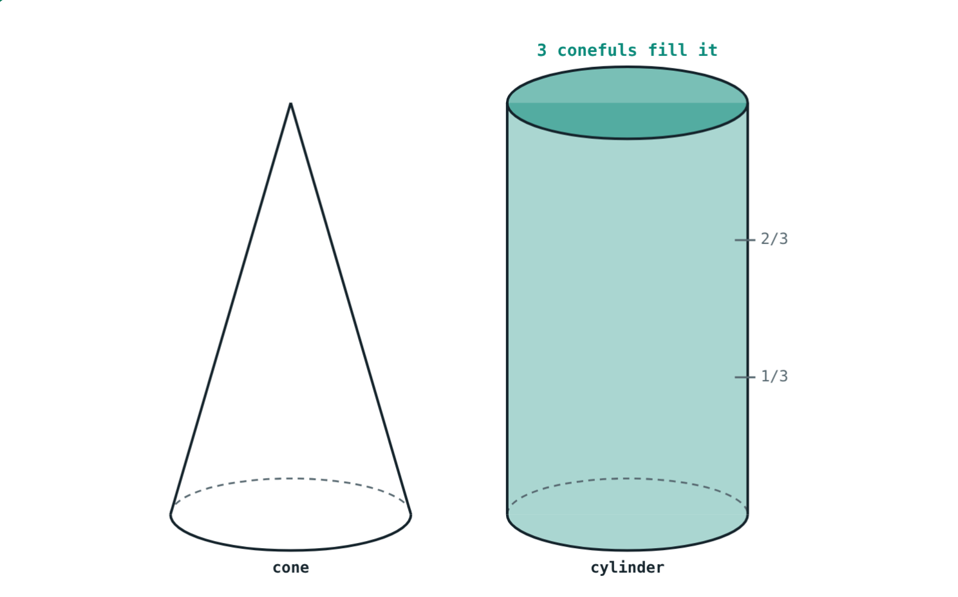
Why one third?
Same base (r = 7 cm) and same height (h = 24 cm):
3696 cm³
cylinder πr²h
1232 cm³
cone ⅓πr²h
Volume of a cone = ⅓ × volume of the cylinder with the same base and height.
Three conefuls fill the cylinder
Notes:
3 × 1232 = 3696.

Slide 7
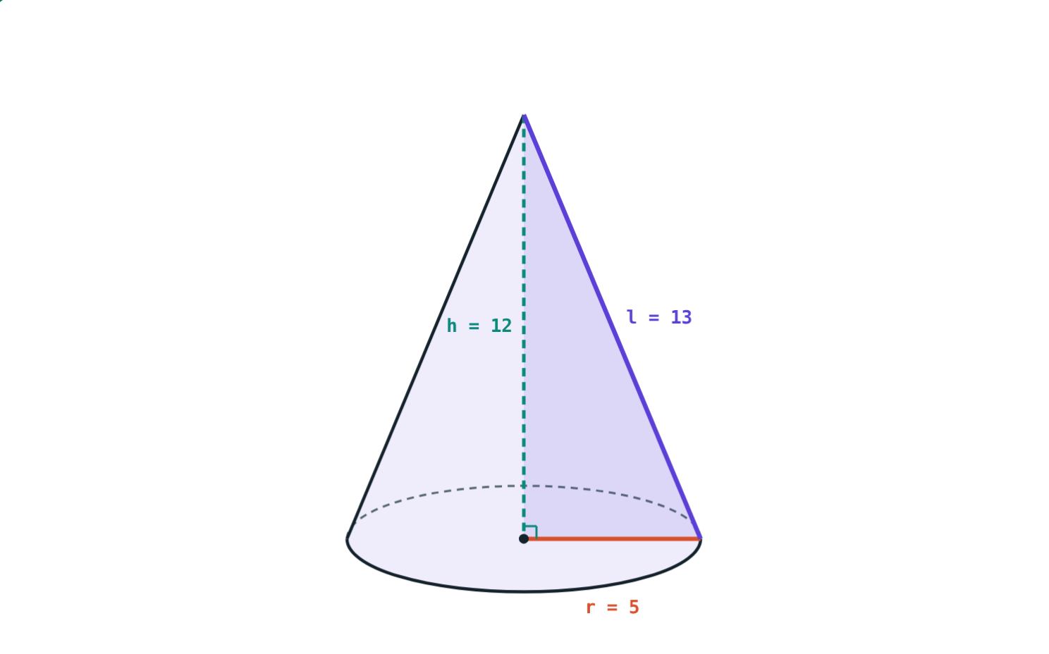
Worked example: a birthday cap
A conical cap has r = 5 cm and h = 12 cm. Find l, the curved surface area and the total surface area of a closed cone of this size.
l² = 25 + 144 = 169, l = 13 cm
3.14 × 5 × 13 = 204.1 cm²
3.14 × 5 × 18 = 282.6 cm²
r = 5 cm, h = 12 cm, π = 3.14
Notes:
A cap is open at the bottom, so the card needed is only the curved surface.

Slide 8
Worked examples
A heap of grain
Finding the height
r = 7 m, h = 24 m (π = 22/7). Find the volume and slant height.
Volume 1570 cm³, r = 10 cm (π = 3.14). Find h.
⅓ × 22/7 × 49 × 24 = 1232 m³
l² = 49 + 576 = 625, l = 25 m
⅓ × 3.14 × 100 × h = 1570
314h = 4710, h = 15 cm
Notes:
In the second example, multiply both sides by 3 first to remove the fraction.

Slide 9
How wide is the net?
The arc of the sector is the base circumference 2πr:
6 : 10
r : l
216°
angle of the sector
Sector angle = 360° × r ÷ l = 360° × 6 ÷ 10 = 216°.
r = 6 cm, l = 10 cm
Notes:
Extension, not in the textbook formulae: the sector is r/l of a full circle of radius l. Its area is (r/l) × πl² = πrl, which matches the curved surface area.

Slide 10

Common mistakes
h in the surface
l in the volume
Curved surface is πrl: find l first.
Volume is ⅓πr²h with the height h.
Forgetting ⅓
Base on an open cone
A cone is a third of the cylinder.
A cap or funnel: πrl only.
Notes:
The first two mistakes are the most common in exams.

Slide 11
Quick check
1
A cone has r = 8 cm and h = 6 cm. Find its slant height.
2
r = 7 cm, l = 10 cm. Find the curved surface area (π = 22/7).
3
A cylinder holds 900 cm³. How much does a cone with the same base and height hold?
4
Write the formula for the total surface area of a cone.
Notes:
Answers: 1) l² = 64 + 36 = 100, l = 10 cm. 2) 22/7 × 7 × 10 = 220 cm². 3) 300 cm³. 4) πr(l + r).

Slide 12
Cut and pour the cone yourself
Open the Cones lesson on the Visual Science & Maths website. Unroll the cone, rearrange the pieces and pour three conefuls.
Next lesson: Spheres and hemispheres
Notes:
Homework: make a paper cone of radius 7 cm and slant height 25 cm; find its curved surface area and check it against the paper sector.

