Slide 1
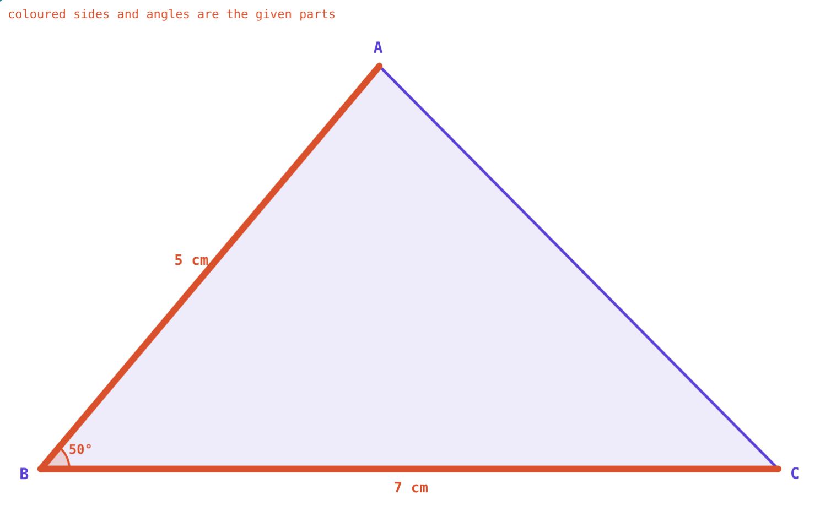
Congruence of Triangles
STD 9 MATHEMATICS PART II · CH. 3 TRIANGLES
Lesson 2 · Visual Science & Maths
Notes:
Goal: students know the five tests of congruence, can name the test in a given situation, and know why SSA and AAA fail.

Slide 2
Do we need all six?
A triangle has three sides and three angles. To show two triangles are identical, must we check all six?
Which three parts are enough?
Two sides and the angle between: one triangle
Notes:
Answer: some sets of three are enough; some are not.

Slide 3
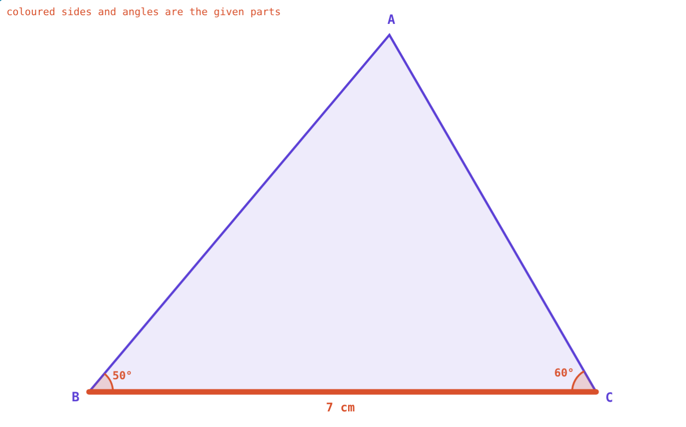
Congruent triangles
Corresponding sides and angles equal
One fits exactly on the other
△ABC ≅ △PQR: A↔P, B↔Q, C↔R
A-S-A fixes the triangle
Notes:
The order of letters records the matching.

Slide 4
Tests of congruence
Test | Equal parts
S-S-S | All three sides
S-A-S | Two sides and the angle between them
A-S-A | Two angles and the side between them
A-A-S | Two angles and a side not between them
Hypotenuse–side | Right triangles: hypotenuse and one side
Notes:
Each of these fixes exactly one triangle.

Slide 5
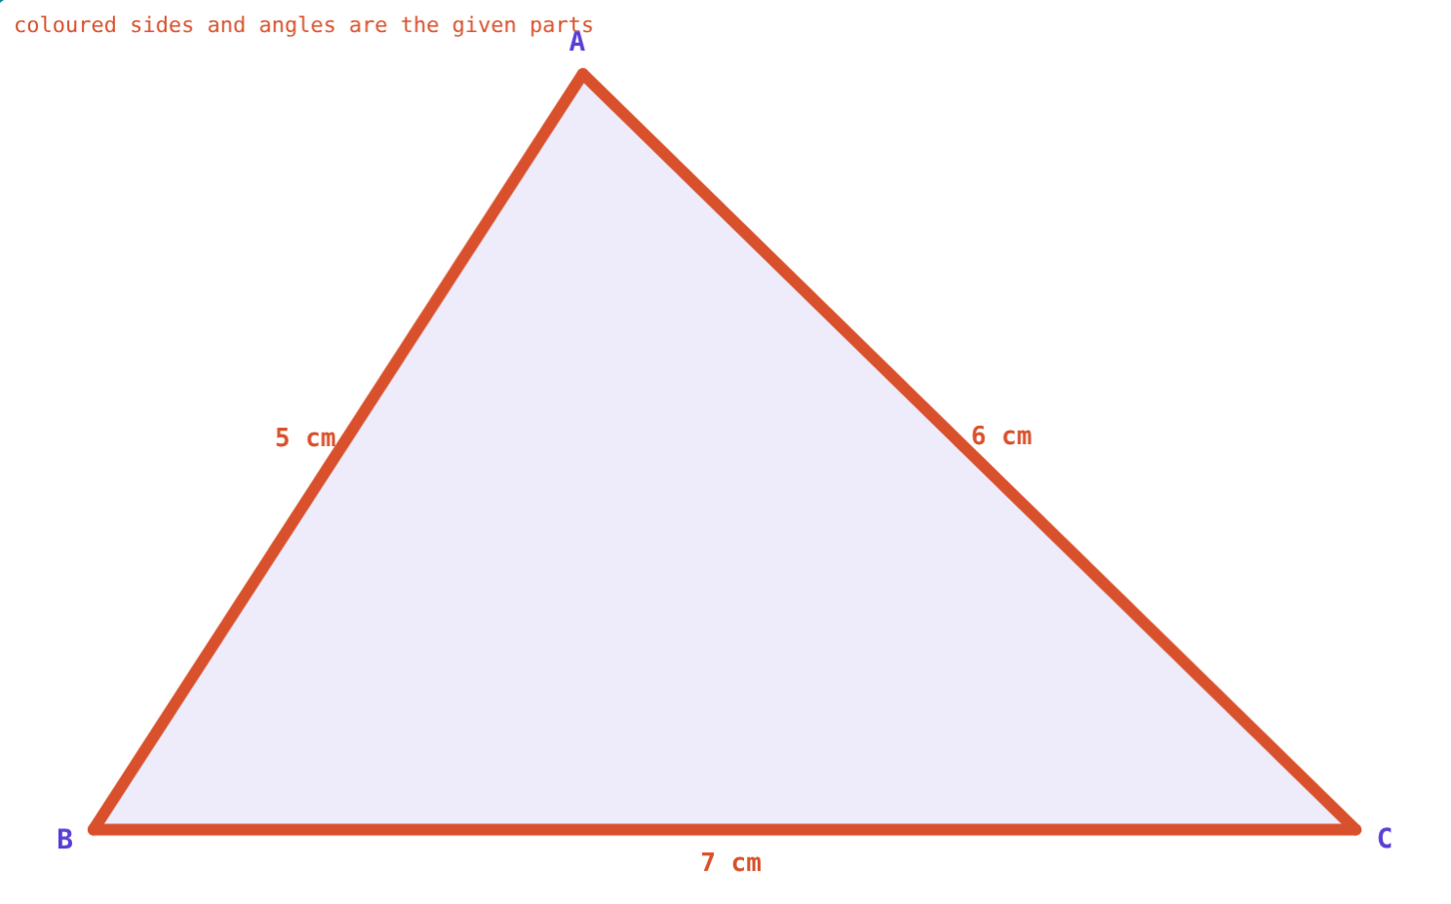
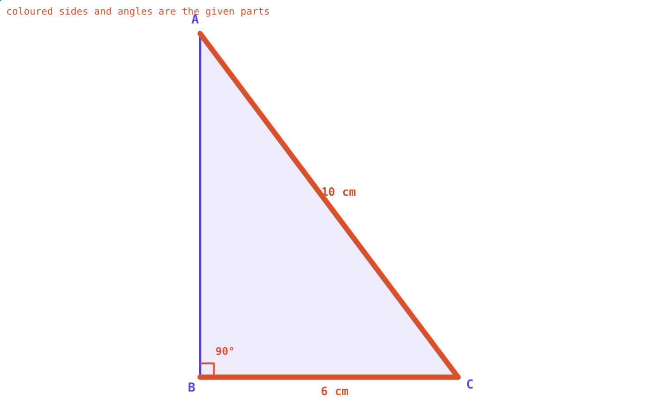
Parts that fix a triangle
5, 7 and 6 cm: only one triangle.
10 cm and 6 cm: the third side must be 8 cm.
Notes:
The simulation draws every triangle that fits; here there is only ever one.

Slide 6
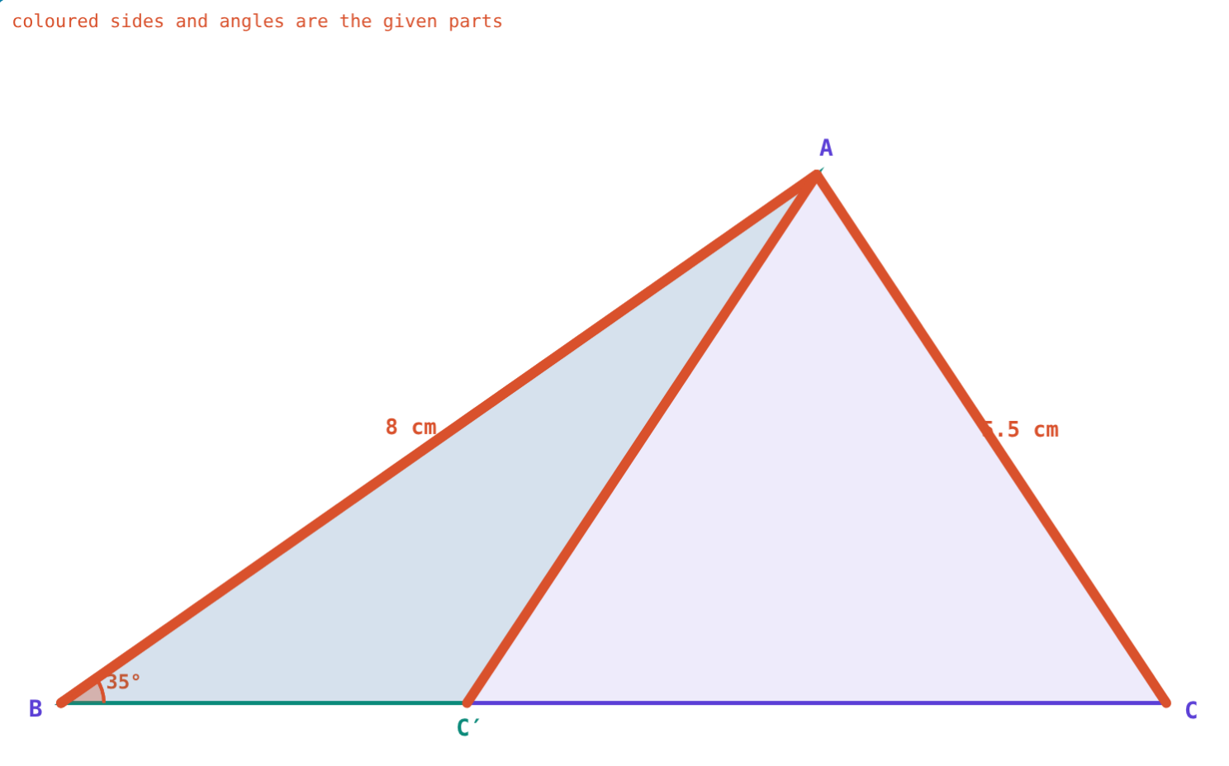
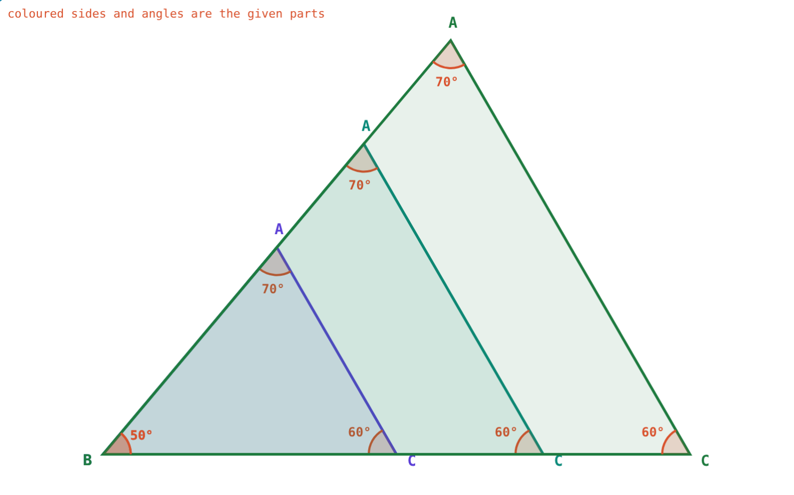
Parts that do not
Same two sides and angle, two different triangles.
Same angles, any size: similar, not congruent.
Notes:
This is the key visual of the lesson: let students find their own two-triangle S-S-A case.

Slide 7
Worked examples
Name the test
Use c.s.c.t.
AB = PQ = 5 cm, ∠B = ∠Q = 50°, BC = QR = 7 cm.
PS = RS, ∠PSQ = ∠RSQ, SQ common. Show PQ = RQ.
The angle is between the sides
Congruent by S-A-S
△PSQ ≅ △RSQ by S-A-S
So PQ = RQ (c.s.c.t.)
Notes:
c.s.c.t.: corresponding sides of congruent triangles.

Slide 8
Right triangles
Hypotenuse–side test, then Pythagoras:
Congruent
by hypotenuse–side
8 cm
third side √(100 − 36)
Two right triangles with the same hypotenuse and one side are identical.
Hypotenuse 10 cm, side 6 cm
Notes:
The right angle is the third given part.

Slide 9



Where congruence is used
Proofs
Manufacturing
Constructions
Show sides or angles equal through congruent triangles.
Identical parts are congruent shapes.
The tests tell you which measurements fix a triangle.
Notes:
Constructions of triangles is the next textbook chapter and relies on these tests.

Slide 10

Common mistakes
S-S-A as a test
A-A-A as a test
It can fit two triangles.
Same shape, not the same size.
Mismatched order
Wrong angle in S-A-S
Keep A↔P, B↔Q, C↔R.
The angle must be between the two sides.
Notes:
Show the S-S-A slide again when discussing the first mistake.

Slide 11
Quick check
1
Which does not prove congruence: S-S-S, A-S-A, A-A-A or S-A-S?
2
AB = DE, BC = EF and ∠B = ∠E. Which test applies?
3
If △PQR ≅ △XYZ, which side equals QR?
4
Right triangles with hypotenuse 13 cm and one side 5 cm: find the third side.
Notes:
Answers: 1) A-A-A. 2) S-A-S. 3) YZ. 4) 12 cm.

Slide 12
Test the tests yourself
Open the Congruence lesson on the Visual Science & Maths website. Try to build two different triangles from the same parts.
Next lesson: Isosceles and right triangles
Notes:
Homework: textbook practice set 3.2.

