Slide 1
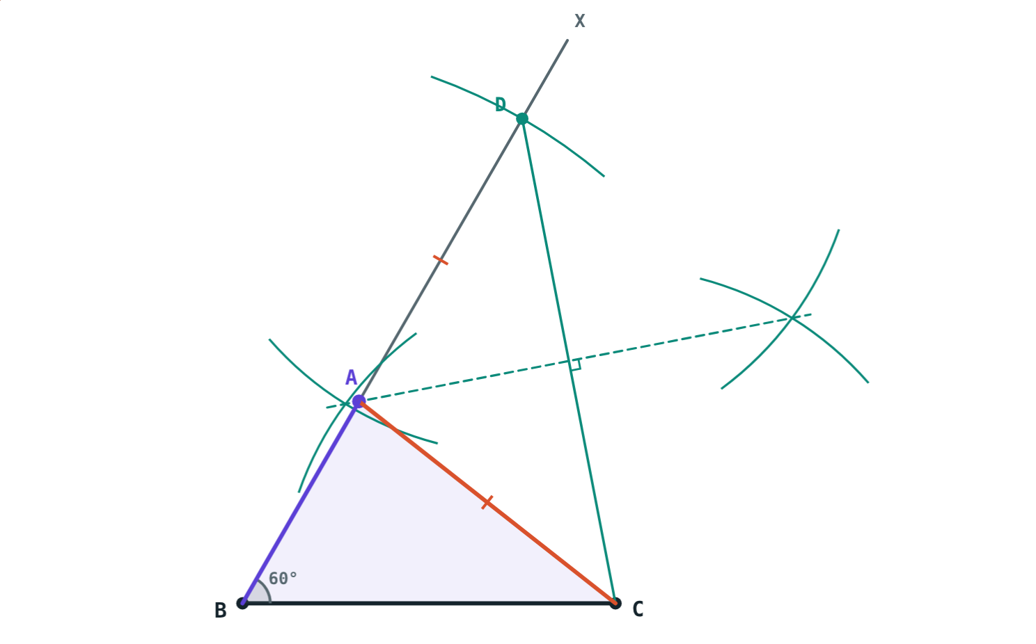
Constructing Triangles
STD 9 MATHEMATICS PART II · CH. 4 CONSTRUCTIONS OF TRIANGLES
Lesson 2 · Visual Science & Maths
Notes:
Goal: students can construct a triangle given (1) base, base angle and sum of the other sides, (2) base, base angle and difference of the other sides, (3) perimeter and base angles, and explain why each works.

Slide 2
Only the total is known
A triangle has base 8 cm and ∠B = 60°. We do not know AB or AC, only that AB + AC = 12 cm.
Can we still draw it exactly?
Yes: AB = 5 cm and AC = 7 cm
Notes:
Let students try with a ruler first. Trial and error is slow; the construction finds A in one go.

Slide 3
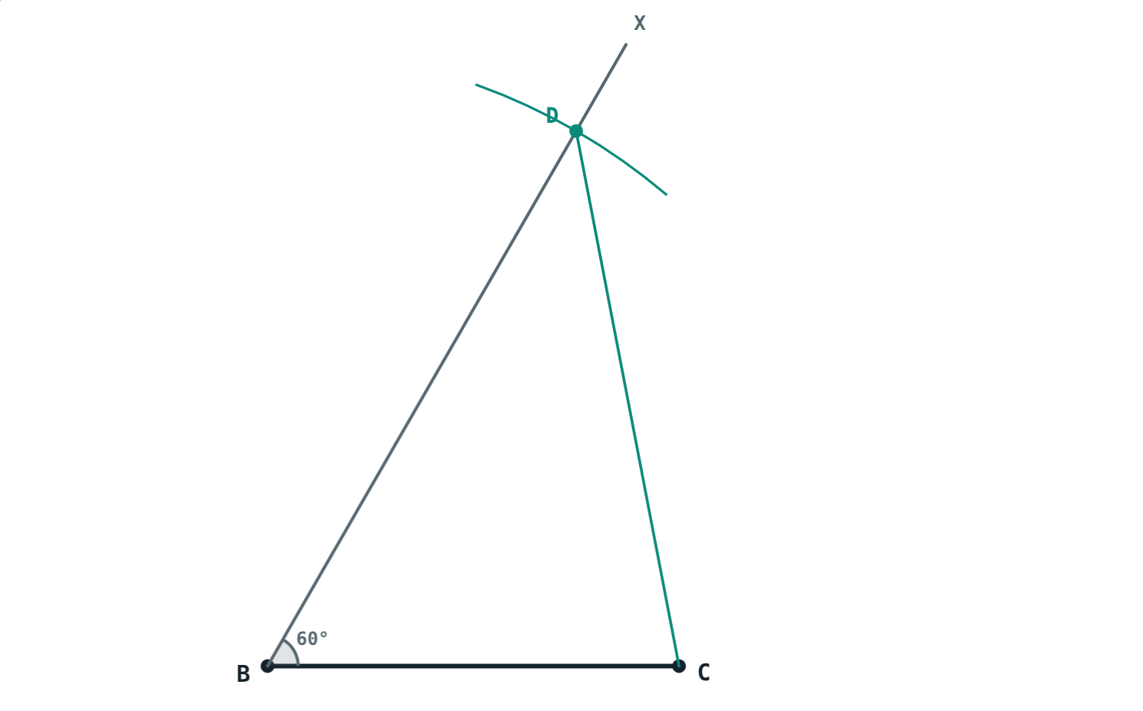
Given BC, ∠B and AB + AC
Draw BC and ray BX at the given ∠B
Mark D on BX with BD = AB + AC; join DC
Perpendicular bisector of DC meets BX at A
Why: AD = AC, so AB + AC = AB + AD = BD
Step 4: join DC
Notes:
Check first: AB + AC must be more than BC, or no triangle exists.

Slide 4
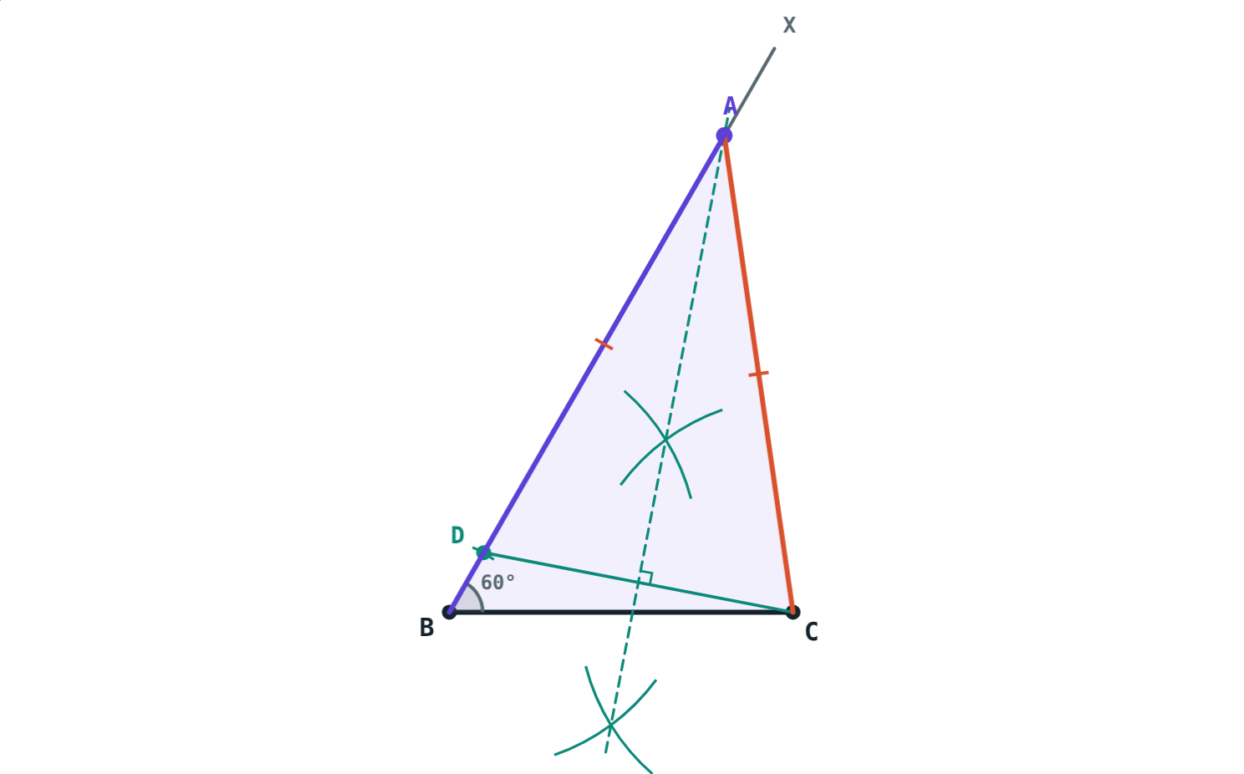
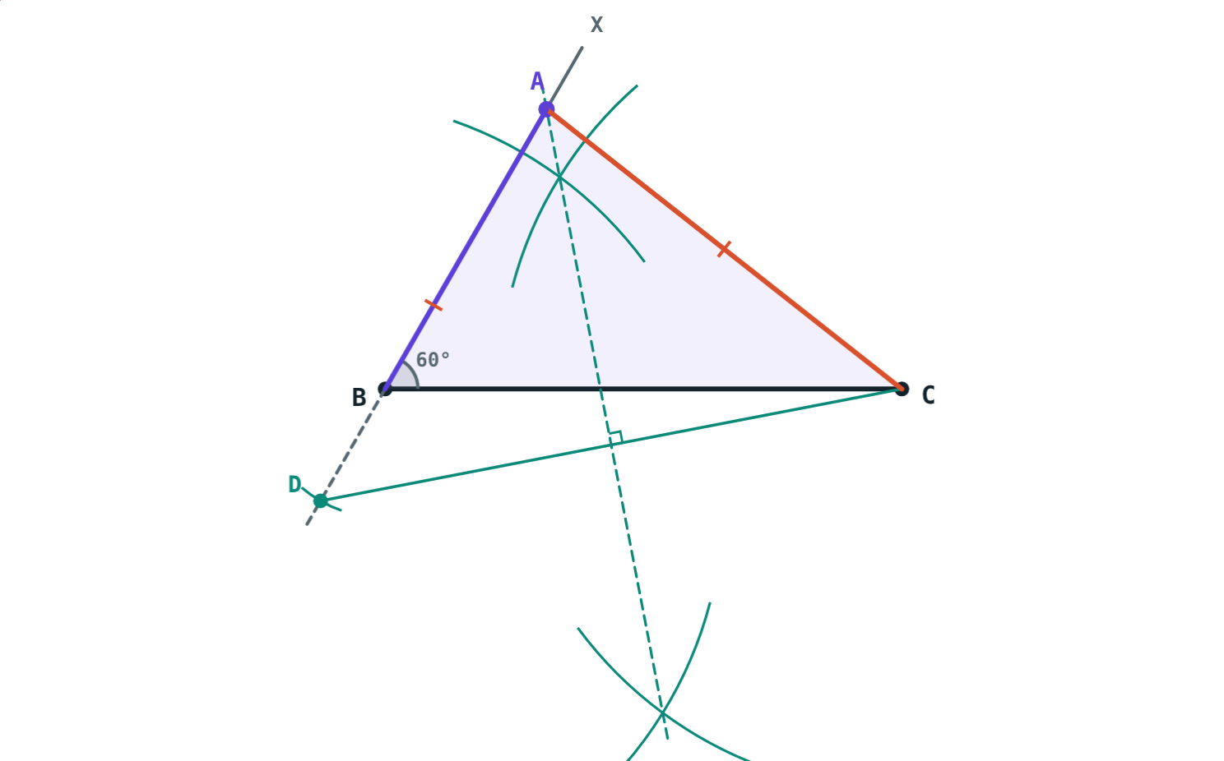
Given BC, ∠B and a difference
AB − AC: D on ray BX, BD = 1 cm. AB = 8, AC = 7.
AC − AB: D on the opposite ray, BD = 2 cm. AB = 5, AC = 7.
Notes:
In both cases A is on the perpendicular bisector of DC, so AD = AC. The difference must be less than BC.

Slide 5
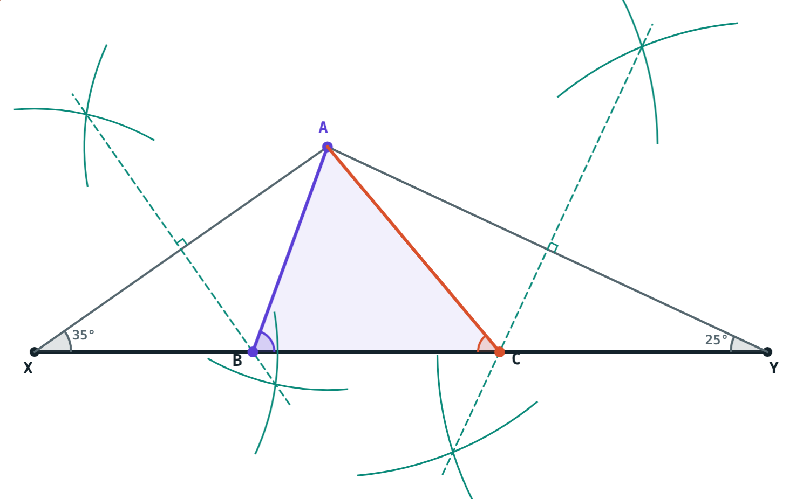
Given the perimeter and ∠B, ∠C
Draw XY = AB + BC + CA
At X draw ½∠B, at Y draw ½∠C; the rays meet at A
Perpendicular bisectors of AX and AY give B and C
BX = BA and CY = CA, so XY is the perimeter
∠B = 70°, ∠C = 50°, perimeter 12 cm
Notes:
Why ∠ABC is the full angle: △ABX is isosceles with base angles ½∠B, and ∠ABC is its exterior angle, so it equals ½∠B + ½∠B.

Slide 6



Before you draw
Rough figure
Check it exists
Find A
Sketch the triangle and mark the given measures.
Sum of two sides > third side. Difference < third side.
Every method finds the last vertex with a perpendicular bisector.
Notes:
The textbook always starts with a rough figure; insist on it.

Slide 7
Worked examples
Sum
Difference
BC = 8 cm, ∠B = 60°, AB + AC = 12 cm.
BC = 5 cm, ∠B = 60°, AB − AC = 1 cm.
BD = 12 cm on ray BX; join DC
Perpendicular bisector of DC gives A
Measure: AB = 5 cm, AC = 7 cm
BD = 1 cm on ray BX; join DC
Perpendicular bisector of DC gives A
Measure: AB = 8 cm, AC = 7 cm
Notes:
Check each answer: 5 + 7 = 12 and 8 − 7 = 1.

Slide 8
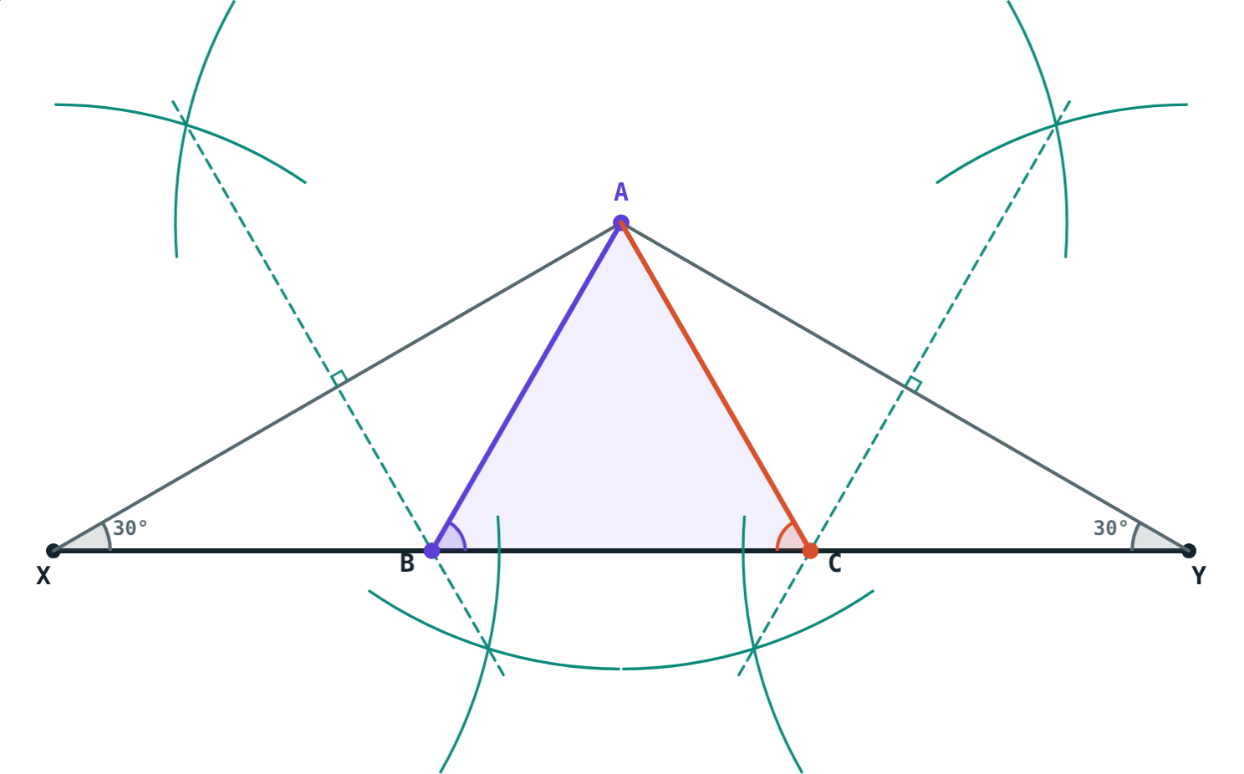
Worked example: perimeter
Construct △ABC with ∠B = ∠C = 60° and perimeter 15 cm. What kind of triangle is it?
XY = 15 cm; draw 30° at X and at Y
Perpendicular bisectors of AX, AY give B, C
∠A = 60°: equilateral, sides 5 cm
Perimeter 15 cm, ∠B = ∠C = 60°
Notes:
Half of 60° is 30°. Students often draw the full 60° at X and Y; the simulation shows the half angles.

Slide 9
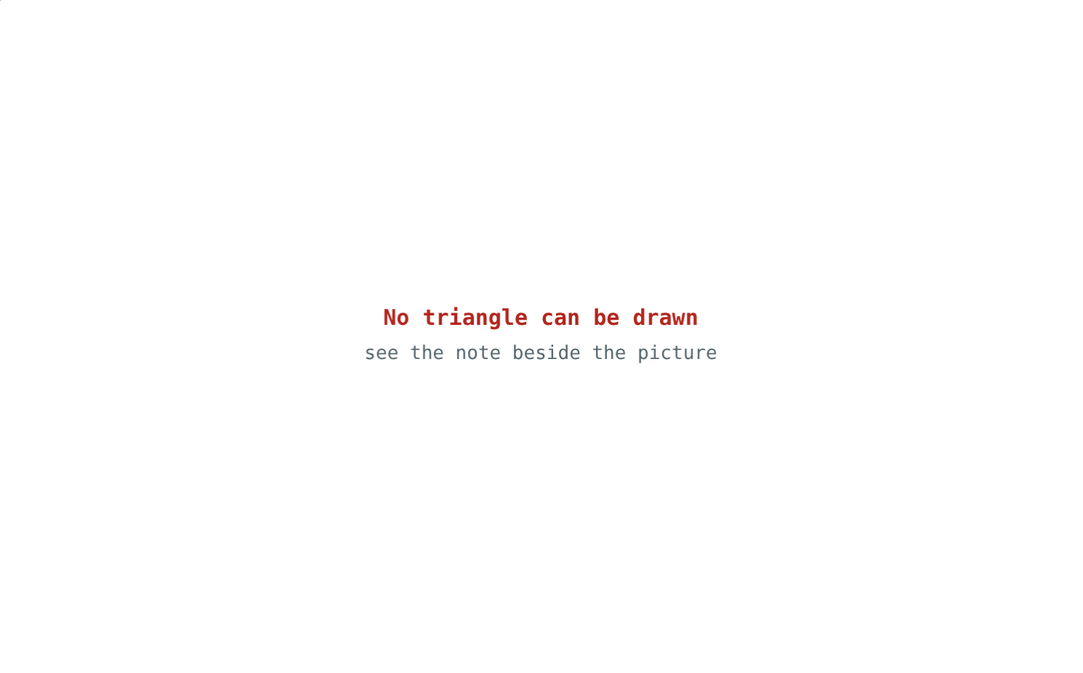
When no triangle exists
Compare the given sum with the base:
6 cm
AB + AC
7 cm
BC
6 is less than 7: the sum of two sides must be greater than the third.
BC = 7 cm, ∠B = 50°, AB + AC = 6 cm
Notes:
Ask for the smallest sum that would work with BC = 7 cm (anything more than 7 cm).

Slide 10

Common mistakes
Sum on the base
Wrong ray for AC − AB
BD = AB + AC goes on the ray at ∠B, not along BC.
When AC is longer, D goes on the opposite ray.
Full angles at X and Y
No check
Draw half of ∠B and half of ∠C.
Sum > BC and difference < BC, or no triangle.
Notes:
Use the simulation's “Next step” button to show where each mistake would happen.

Slide 11
Quick check
1
Given QR, ∠Q and PQ + PR: what length is QD?
2
In that construction, why is PD = PR?
3
∠B = 80°, ∠C = 50°: which angles are drawn at X and Y?
4
BC = 6 cm, ∠B = 45°, AB + AC = 5 cm. Can you draw it?
Notes:
Answers: 1) QD = PQ + PR. 2) P is on the perpendicular bisector of DR. 3) 40° and 25°. 4) No: AB + AC must be greater than BC.

Slide 12
Construct them yourself
Open the Constructing Triangles lesson on the Visual Science & Maths website. Choose what is given and press “Next step”.
Next chapter: Quadrilaterals
Notes:
Homework: construct △PQR with QR = 6.5 cm, ∠Q = 60° and PQ − PR = 2.5 cm, then check with the simulation.

